Slide 1
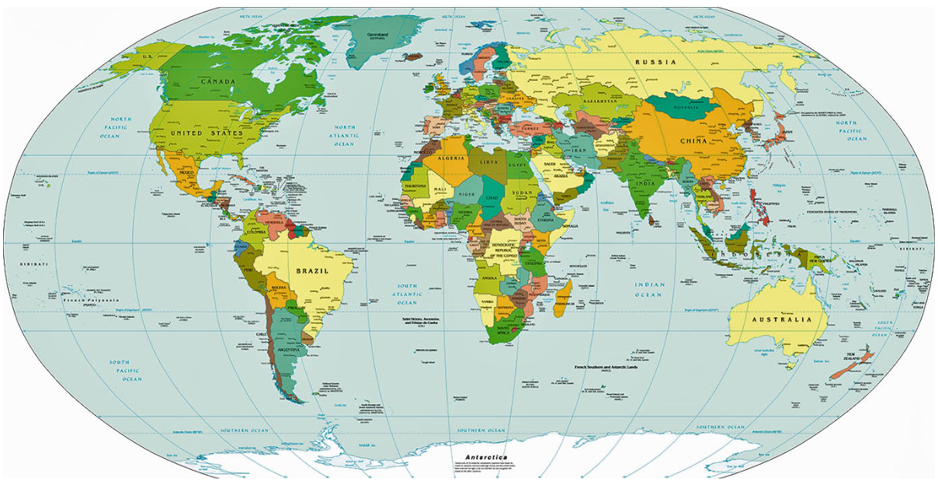
Distribution of mental health treatment sought
Click on a country to access distribution

Slide 2


Data description
Distribution of mental health treatment sought
Sought help
Age
Yes
No
Personal vs Professional
Note: Actual graphs may not look like this.

