Slide 1
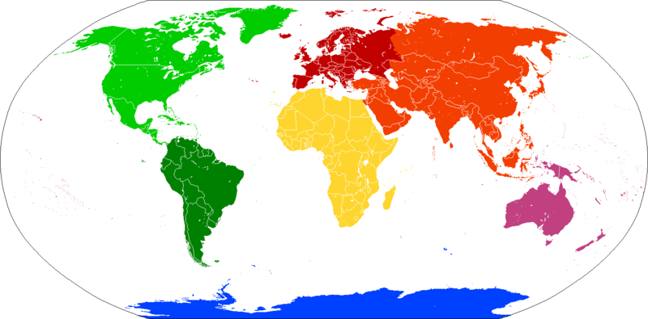

World Distribution based on Mental Health Treatment Consideration
Filter by
Country
Personal vs Professional
0
100
Note: Actual graphs may not look like this.

Slide 2


Plots of Different Variables Given Filters
Filter by
Country
Personal vs Professional
Gender
Note: Actual graphs may not look like this.

