Slide 1
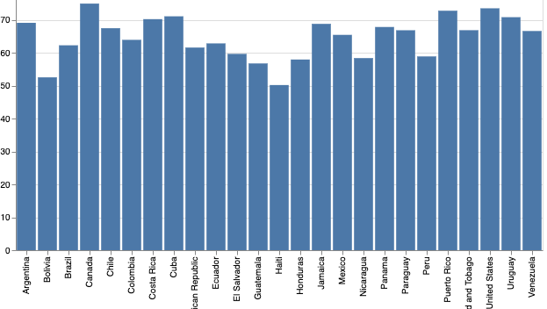
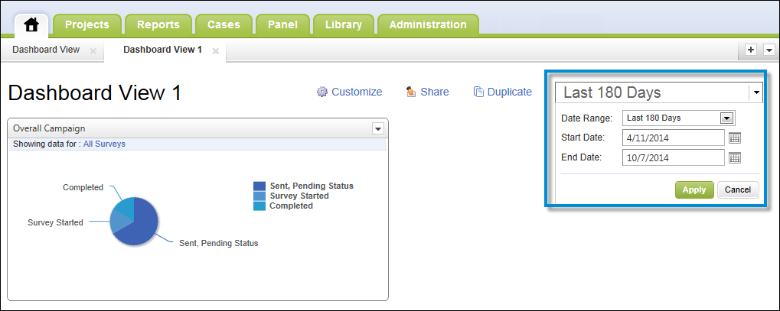
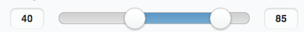
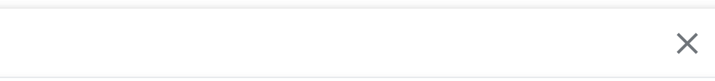
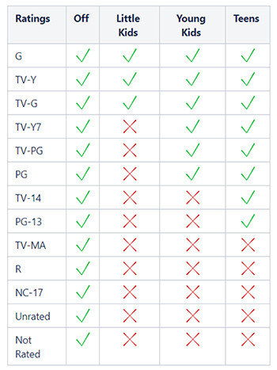
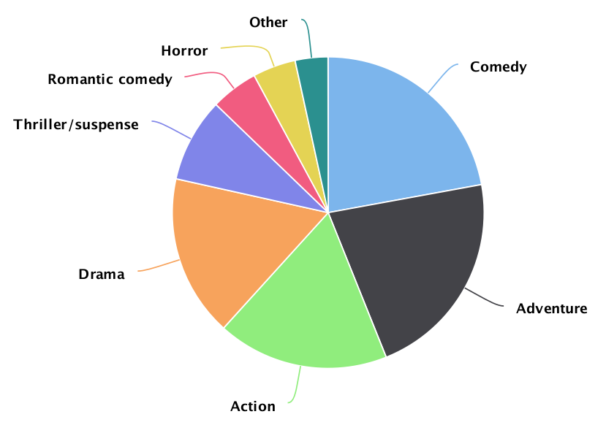
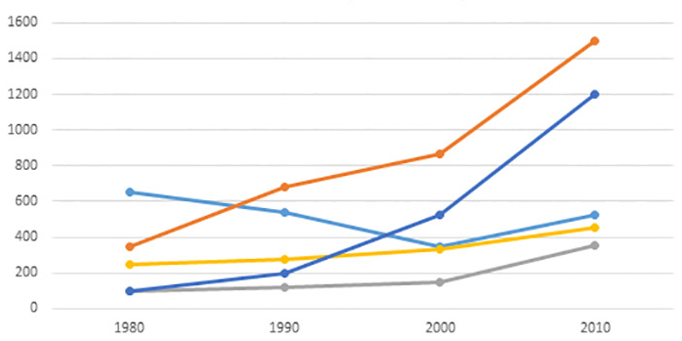
Netflix Movie Trend
Which Countries make the most movies?
calendar
Date Range
Number of movies produced
Slider
Duration of the movies
Drop down
Country
Which Genres was Most Popular?
Movie Rating Comparison
Drop down
Number of movies produced
Selected Duration

