Slide 1
Data Science: HoW dO YOU DO IT?
MIKE GELBART, PH.D. & TIFFANY TIMBERS, PH.D.

Slide 2
Outline
The data science software stack
Choosing the "best" software tool or language for the job
What is the (statistical) question?
A vignette: Asking and answering a predictive question
Where can I learn more data science?
Where can I access compute resources?

Slide 3







The data science software stack
Type of tools needed:
Programming language
Code editor
Version control software
Examples:

Slide 4
Choosing the "best" tool for the job
As long as the tools allow you to meet the following criteria for your analysis,
they will be suitable for data science:
Reproducible and auditable
Accurate
Collaborative
Parker, H. (2017), Opinionated Analysis Development. PeerJ, doi: 10.7287/peerj.preprints.3210v1

Slide 5
Reproducible and auditable
Data science requires reproducible and auditable analyses.
This means that you should be able to hand over your analysis and the raw data and they should be able to generate the exact same results as you. And see how this was done!
Performing analysis with code and version tracking can make your analysis reproducible and auditable!
Parker, H. (2017), Opinionated Analysis Development. PeerJ, doi: 10.7287/peerj.preprints.3210v1

Slide 6
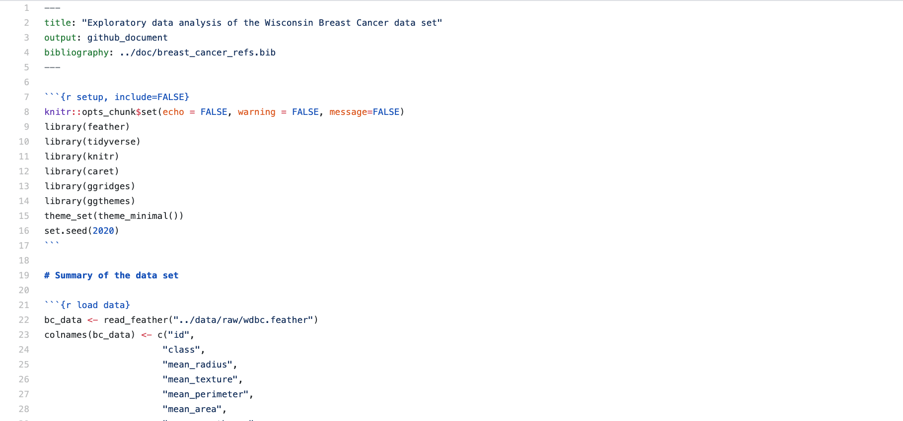
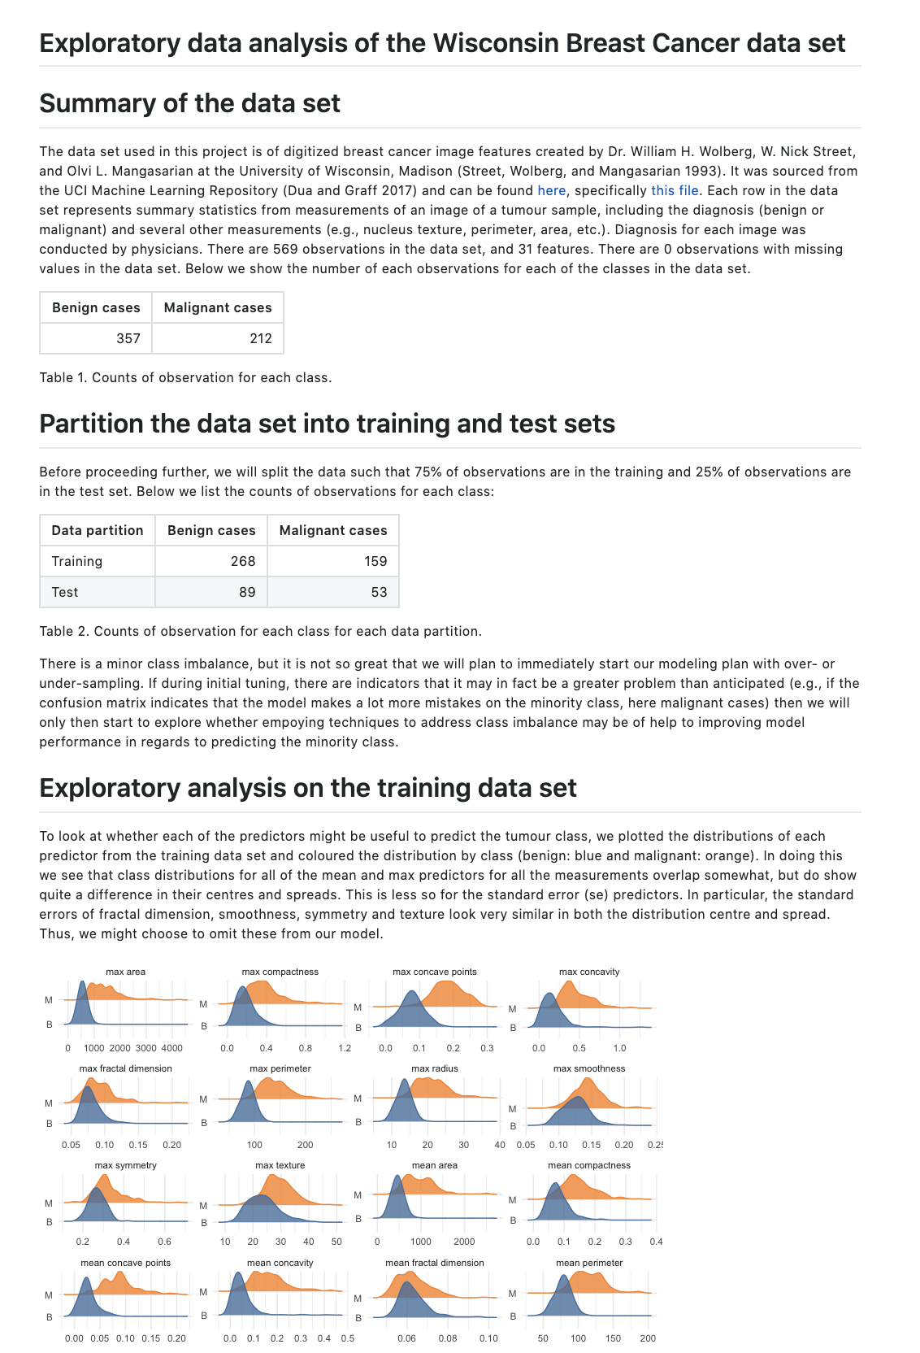
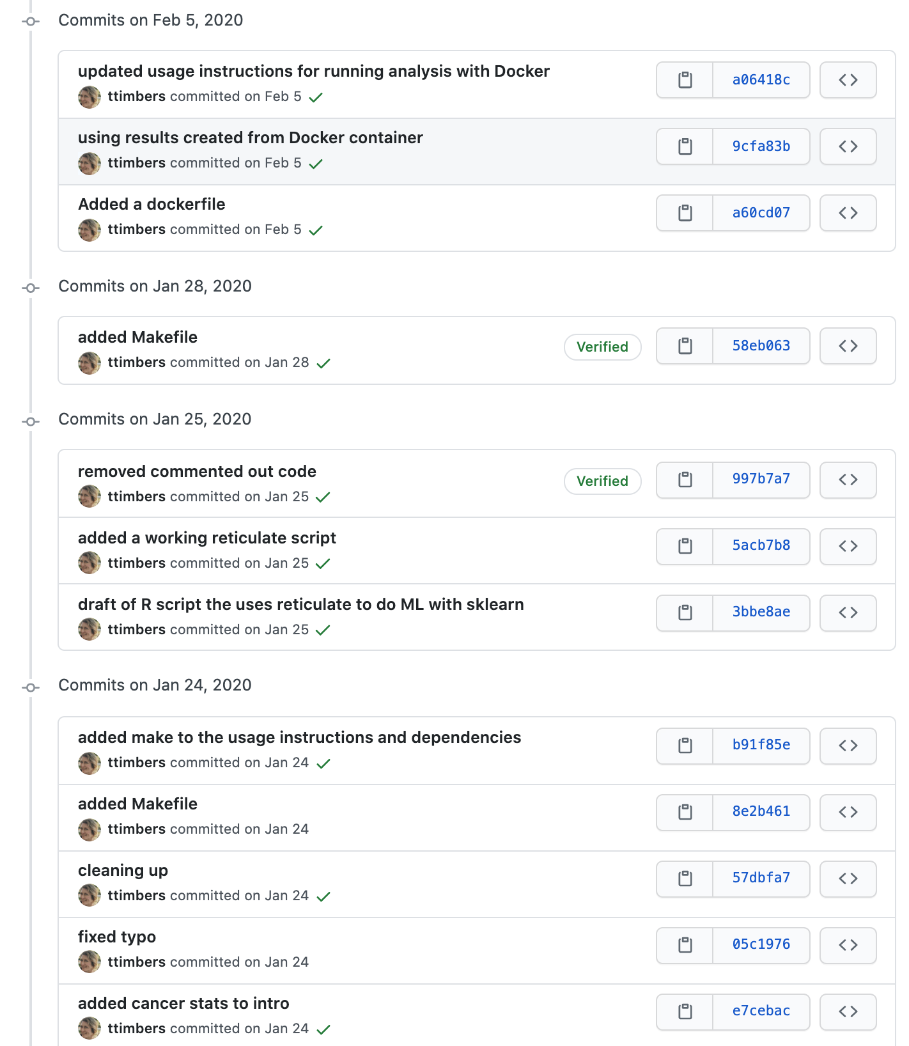
Reproducible and auditable
https://github.com/ttimbers/breast_cancer_predictor

Slide 7
Accurate
For analysis to be trustworthy, it also has to be accurate.
Writing your analysis with modular and testable code helps make your analysis accurate.
As does having your analysis code reviewed by others.
Parker, H. (2017), Opinionated Analysis Development. PeerJ, doi: 10.7287/peerj.preprints.3210v1

Slide 8
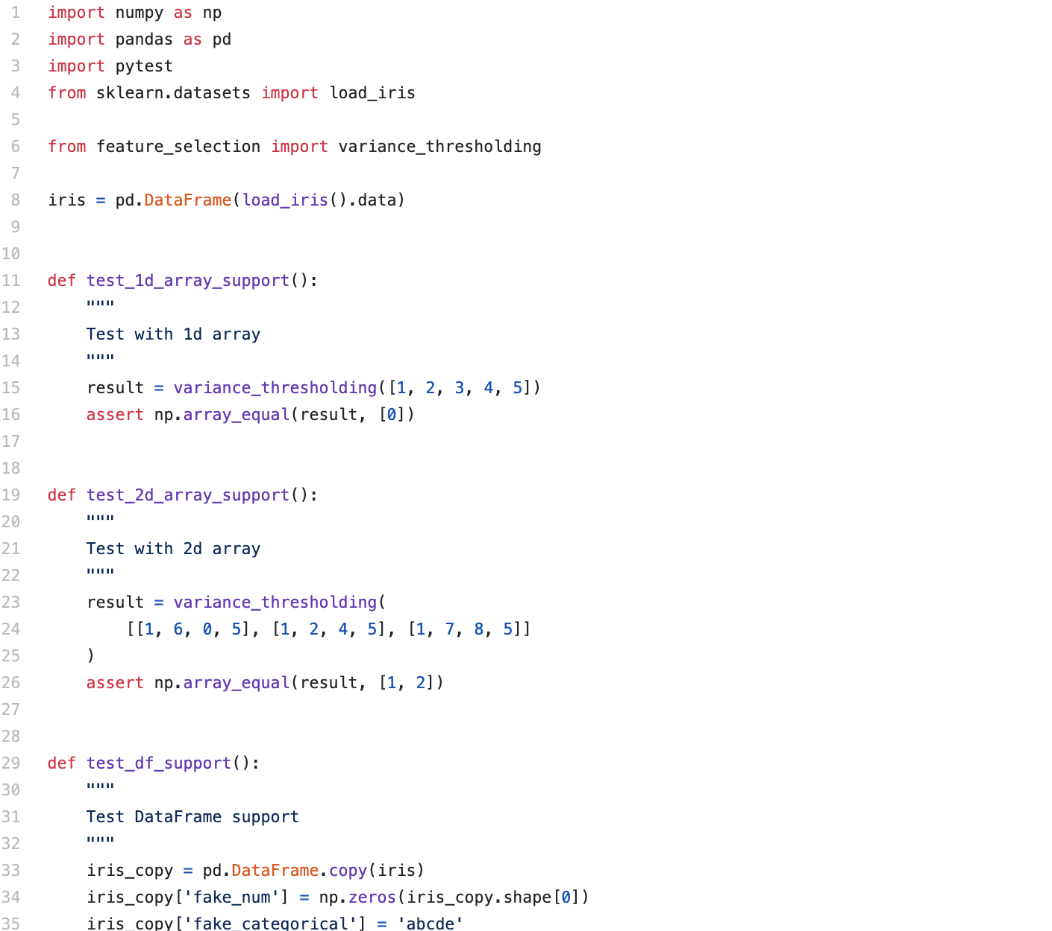
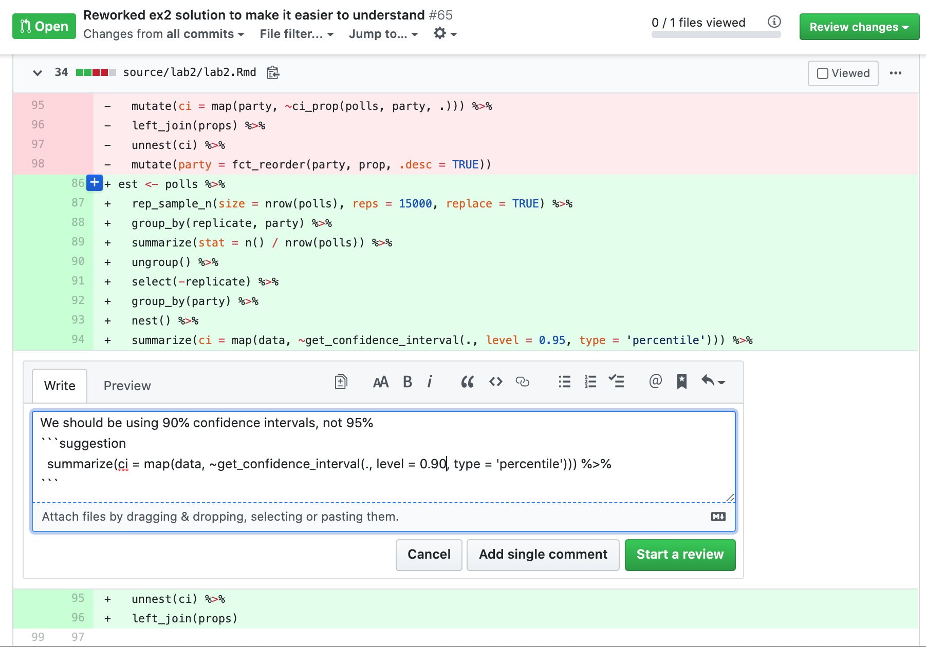
Accurate

Slide 9
Collaborative
An analysis is not useful unless it is used/viewed by others.
Most analysis for solving real-world problems are quite complex and sophisticated. Thus multiple experts are often required to complete such an analysis.
Collaborating on writing and code can be challenging if care is not taken, and versions are not managed.
Parker, H. (2017), Opinionated Analysis Development. PeerJ, doi: 10.7287/peerj.preprints.3210v1

Slide 10
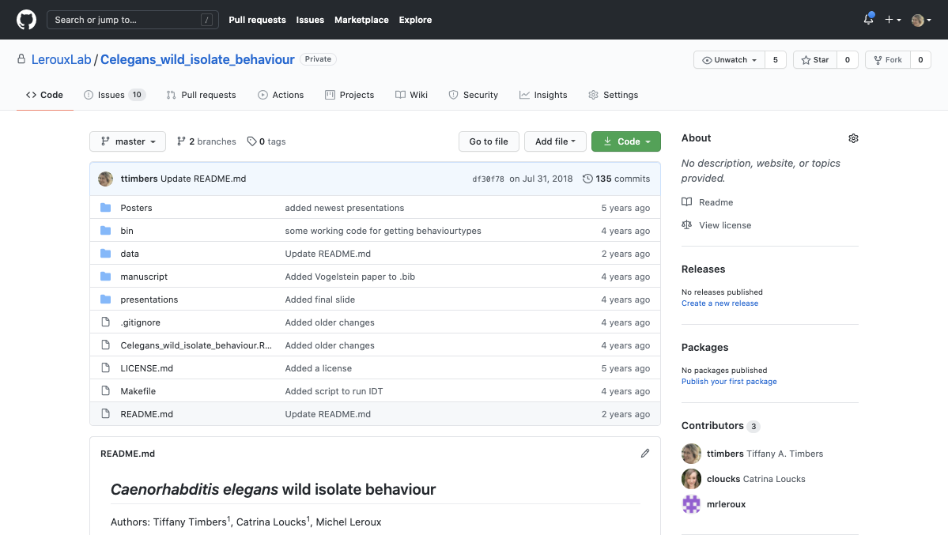
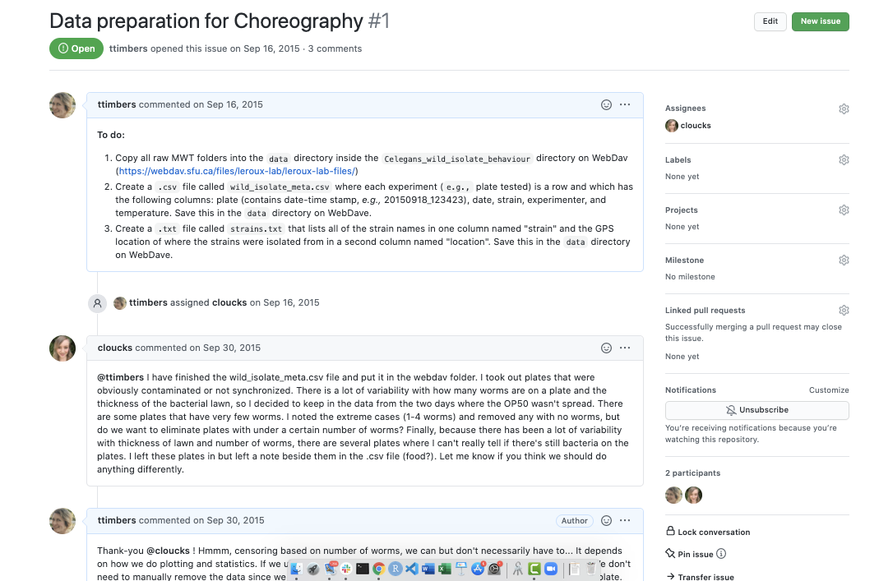
Collaborative

Slide 11
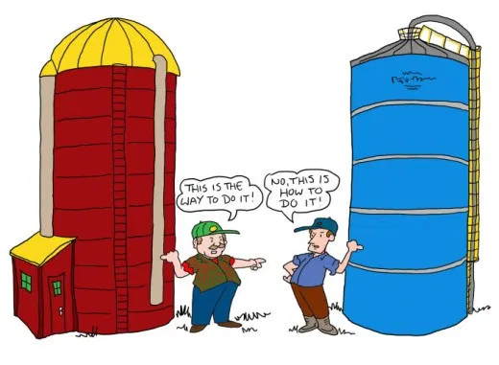
Choosing the "best" tool for the job
Source: http://thecontextofthings.com/2015/11/11/work-and-certain-skills-belonging-to-a-few-people/
Avoid the language wars... silos are worse than not choosing the "perfect" tool.

Slide 12

Choosing the "best" tool for the job
Source: https://chatsworthconsulting.com/2015/01/29/why-it-is-imperative-to-break-down-silos-now-and-five-ways-to-do-it/
Sharing of tools and workflows connect silos and leads to collaboration and success

Slide 13
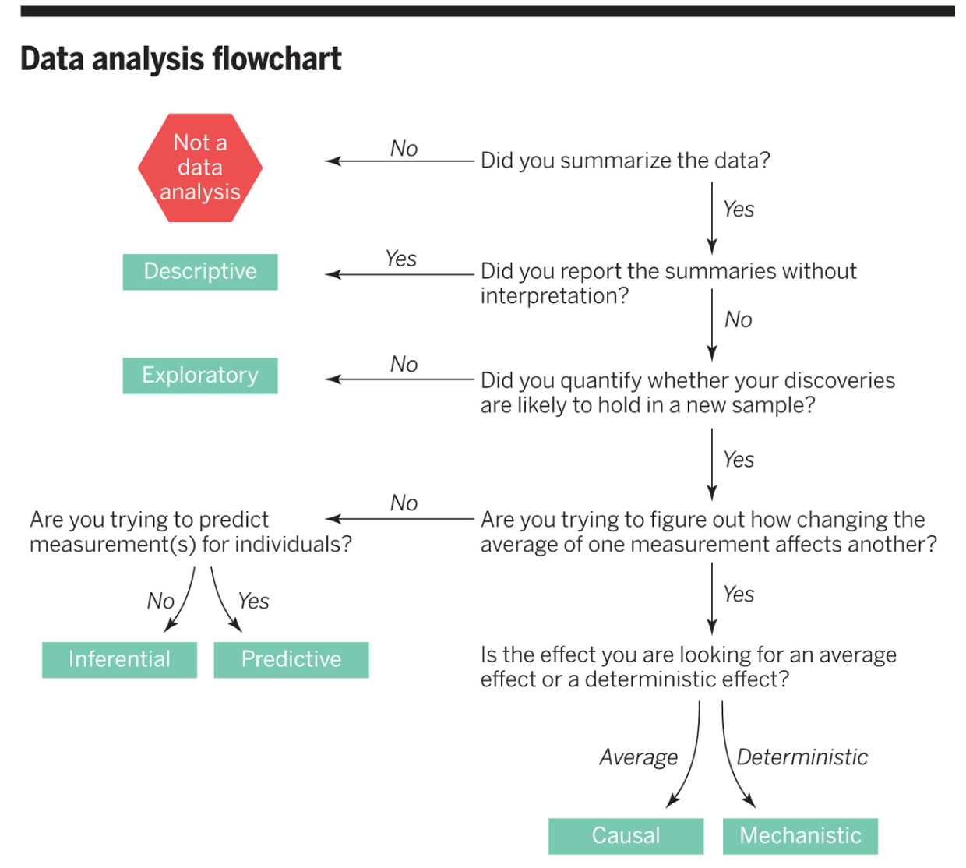
What is the (statistical) question?
Peng, R. & Leek, J. (2015), What is the question? Science, doi: 10.1126/science.aaa6146

Slide 14
Descriptive question
One that seeks to summarize a characteristic of a set of data. No interpretation of the result itself as the result is a fact, an attribute of the data set you are working with.
What is the frequency of viral illnesses in a set of data collected from a group of individuals?
How many people live in BC?

Slide 15
Exploratory question
One in which you analyze the data to see if there are patterns, trends, or relationships between variables looking for patterns that would support proposing a hypothesis to test in a future study.
What is the frequency of viral illnesses in a set of data collected from a group of individuals?
Does air pollution correlate with life expectancy in a set of data collected from groups of individuals from several regions in the United States?

Slide 16
Inferential question
One in which you analyze the data to see if there are patterns, trends, or relationships between variables in a representative sample. We want to quantify how much the patterns, trends, or relationships between variables is applicable to all individuals units in the population.
Is eating at least 5 servings a day of fresh fruit and vegetables is associated with fewer viral illnesses per year?
Is the gestational length of first born babies different from that of non-first borns?

Slide 17
Predictive question
One where you are trying to predict measurements or labels for individuals (people or things). Less interested in what causes the predicted outcome, just what predicts it.
How many viral illnesses will someone have next year?
What political party will someone vote for in the next US election?

Slide 18
Causal question
Asks about whether changing one factor will change another factor, on average, in a population. Sometimes the underlying design of the data collection, by default, allows for the question that you ask to be causal (e.g., randomized experiment or trial).
Does eating at least 5 servings a day of fresh fruit and vegetables cause fewer viral illnesses per year?
Does smoking lead to cancer?

Slide 19
Mechanistic question
One that tries to explain the underlying mechanism of the observed patterns, trends, or relationship (how does it happen?)
How do changes in diet lead to a reduction in the number of viral illnesses?
How does how airplane wing design change air flow over a wing, leading to decreased drag?

Slide 20
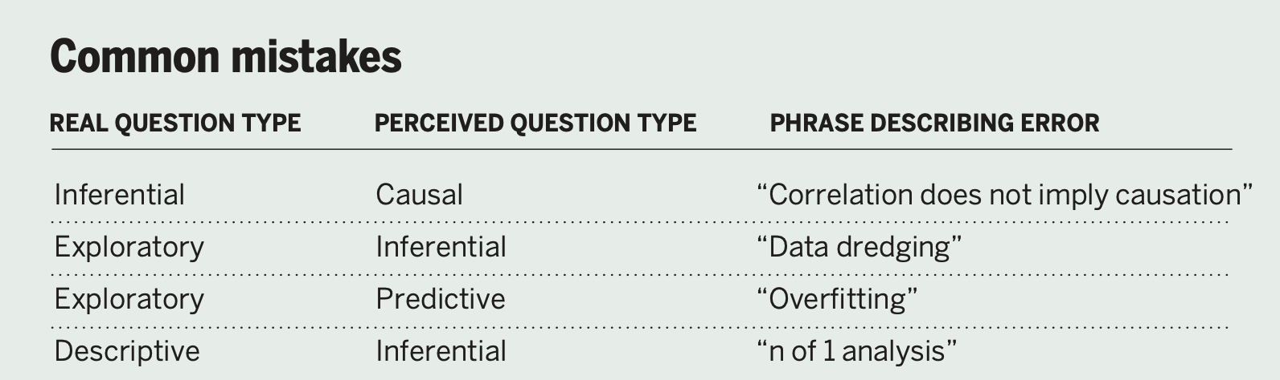
What is the (statistical) question?
Peng, R. & Leek, J. (2015), What is the question? Science, doi: 10.1126/science.aaa6146

Slide 21
A vignette: asking a predictive question
Will a patient develop heart disease?

Slide 22
Where can I access compute resources?
Install the data science software stack on your local desktop or laptop:
Mac OSX
Linux (Ubuntu)
Window 10

Slide 23
Where can I access compute resources?
Or take advantage of a University-run JupyterHub:
For UBC: https://ubc.syzygy.ca Login with your UBC cwl credentials. (see here for additional information, and for other institutions)

Slide 24
Where can I access compute resources?
If you need more compute power:
UBC has an Advanced Research Computing (ARC) unit: https://arc.ubc.ca/
ARC provices support to access Compute Canada's high-performance computing resources, as well as training on using their resources.

Slide 25
Where can I access compute resources?
If you need people and compute resources to help you get started on a project:
Submit a proposal to UBC's Amazon Cloud Innovation Centre: https://cic.ubc.ca/
Submit a proposal to be a partner for UBC's Master of Data Science capstone project: https://ubc-mds.github.io/capstone/about/
Get support from the Applied Statistics and Data Science Group (ASDa): https://asda.stat.ubc.ca/

Slide 26
Thank-you.
MIKE GELBART, PH.D. & TIFFANY TIMBERS, PH.D.

