Slide 1

DSCI 572 Supervised Learning II Dr. Muhammad Abdul Mageed Assistants: Peter Sullivan Ganesh Jawahar
DSCI 572
Ganesh Jawahar
sd
January 13, 2020

Slide 2
Goal of this tutorial
Introduce PyTorch
Why PyTorch?
Learn the basic PyTorch concepts
Learn to train a linear regression model purely in PyTorch

Slide 3
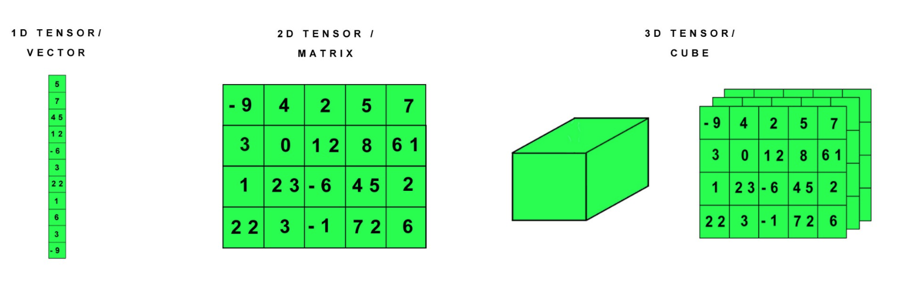

Introduction to PyTorch
Tool for scientific computing (e.g., machine learning)
Python language
3 main features:
n-dimensional Tensor, which is similar to NumPy but can run on GPUs
https://isoriver.com/safe-normal-gpu-temp-while-gaming/

Slide 4
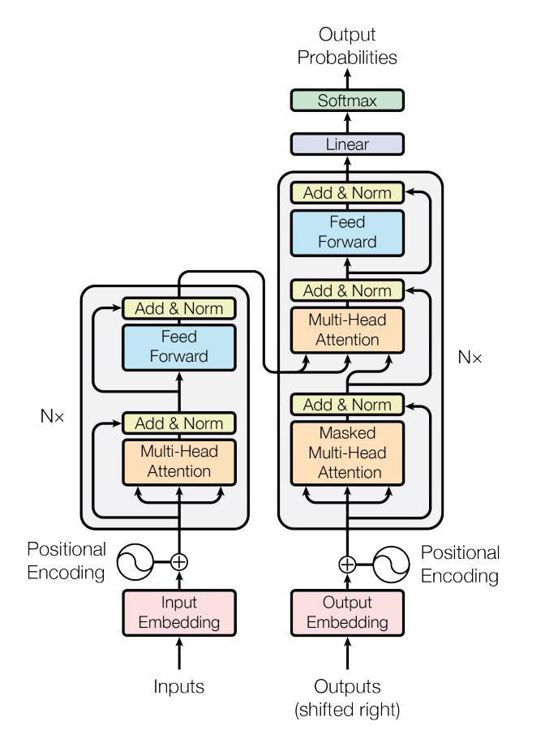
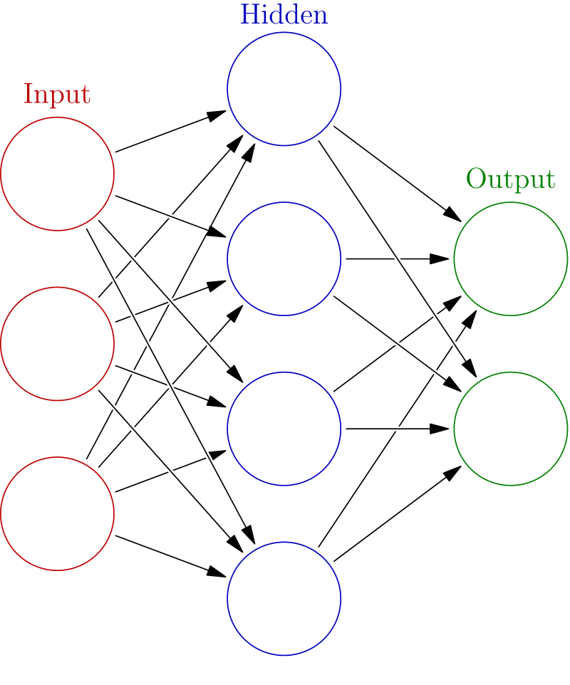
Introduction to PyTorch
Easily build big computational graphs
for deep learning
Automatic differentiation for computing
gradients for neural networks
https://pytorch.org/tutorials/_images/transformer_architecture.jpg

Slide 5
Why PyTorch?
Flexible to build machine learning models for a wide range of tasks:
Text Classification
Named Entity Recognition
Machine Translation
Question Answering
Play strategy games and so on.
Easy to learn, use, extend and debug
PyTorch’s core class Tensor is much like NumPy arrays

Slide 6
Why PyTorch?
Rich Ecosystem of Tools
AllenNLP: Designing and evaluating deep learning models for NLP
ParlAI: Sharing, training and evaluating dialog models across many tasks
Translate: Machine translation model from Facebook
Fastai: Training fast and accurate neural networks using modern best practices
ELF: Platform for game research
torchtext: Data processing utilities and popular datasets for natural language
torchaudio: I/O, popular datasets and common audio transformations
and so on.

Slide 7

Why PyTorch?

Slide 8
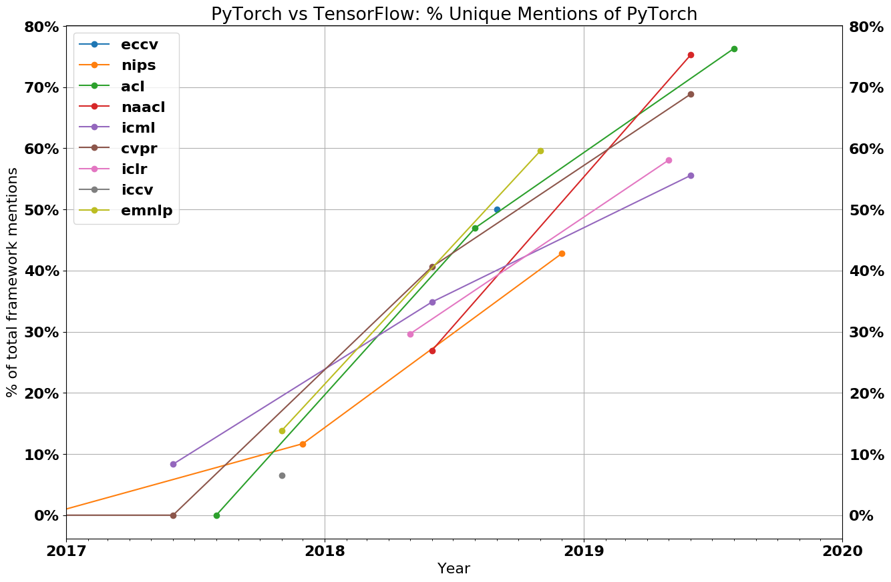
Why PyTorch?
Implementations of research papers are increasingly in PyTorch

Slide 9
Why PyTorch?
These courses will be using almost only PyTorch:
Supervised Learning II (Block 4) (current course)
Machine Translation (Block 5)
Trends in Computational Linguistics (Block 6)

Slide 10
PyTorch’s concepts
Tensors
Computational graph
Automatic differentiation
Affine transformation
Nonlinearity
Loss function
Optimizer
Data loader

Slide 11
Tensor
n-dimensional array
generalization of a matrix that can be indexed in more than 2 dimensions
Similar to NumPy as it shares most operations
Benefits from GPU acceleration while NumPy does not
All computations in deep learning are performed on tensors
Store optional information such as gradient and bookkeeping for computational graph.

Slide 12
[notebook]

Slide 13
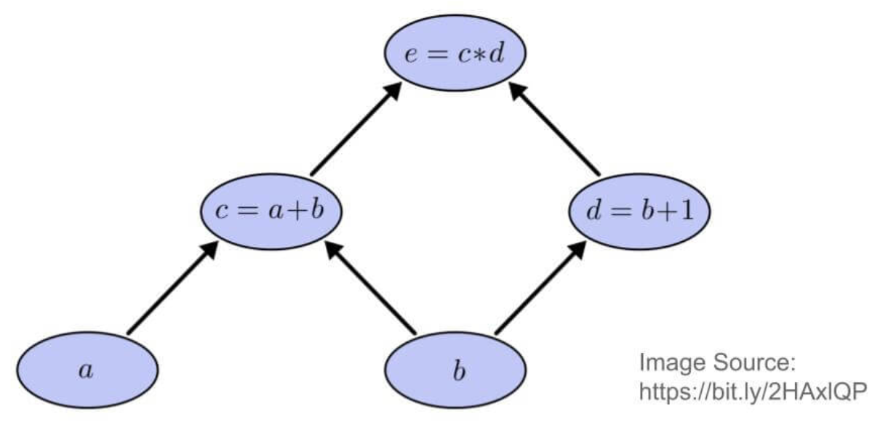
Computational Graph and Automatic Differentiation
A specification of how your data is combined to give you the output.
This graph contains enough info. to compute derivatives.
Autograd package provides automatic differentiation for all operations on Tensors.
If your tensor needs gradients, set its .requires_grad attribute to True.

Slide 14
[notebook]

Slide 15
Linearities, Nonlinearities and Loss functions
A deep learning model is typically composed of linearities (affine transformation) and nonlinearities in a clever way.
The nonlinearities makes the deep learning models powerful.
The last node of the computational graph is typically a loss function (or objective function),
which measure how far away the model prediction is from the actual target.
PyTorch has most of the commonly used linearities, nonlinearities and loss functions already inbuilt into the library.

Slide 16
[notebook]

Slide 17
Current Status
how to define an arbitrary computation graph (model) with linearities, nonlinearities
how to add loss function to our model to measure the quality of models' predictions
how to use backward function to compute the gradients
remaining piece:
how to update (or learn) the weights (e.g., parameters A,b of the linear layer)

Slide 18
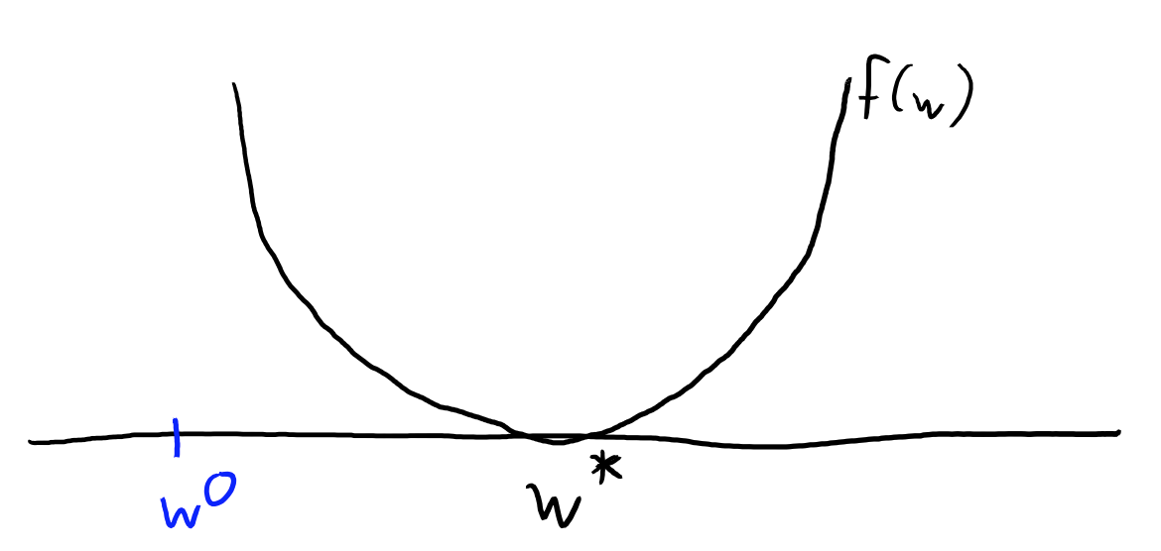


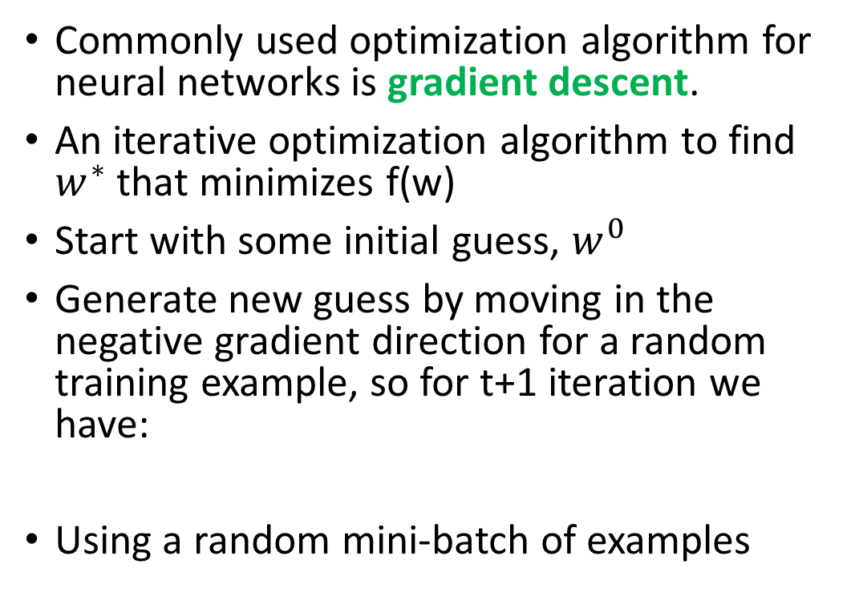
Optimization
Commonly used optimization algorithm for neural networks is gradient descent.
An iterative optimization algorithm to find $w^{∗}$ that minimizes f(w)
Start with some initial guess, $w^{0}$
Generate new guess by moving in the negative gradient direction for a random training example, so for t+1 iteration we have:
Using a random mini-batch of examples

Slide 19
[notebook]

