Slide 1

Python Programming
Muhammad Abdul-Mageed University of British Columbia muhammad.mageed@ubc.ca
Copyright © 2020 Muhammad Abdul-Mageed. All rights reserved.
No part of the materials including graphics or logos, available in this material may be copied, photocopied, reproduced, translated or reduced to any electronic medium or machine-readable form, in whole or in part, without specific permission (to request permission to use materials, email: muhammad.mageed@ubc.ca).

Slide 2
Agenda
Introductions & Course Overview: 2:00-3:30
Break: 3:30-3:45
Unix Intro: 3:45-5:50

Slide 3
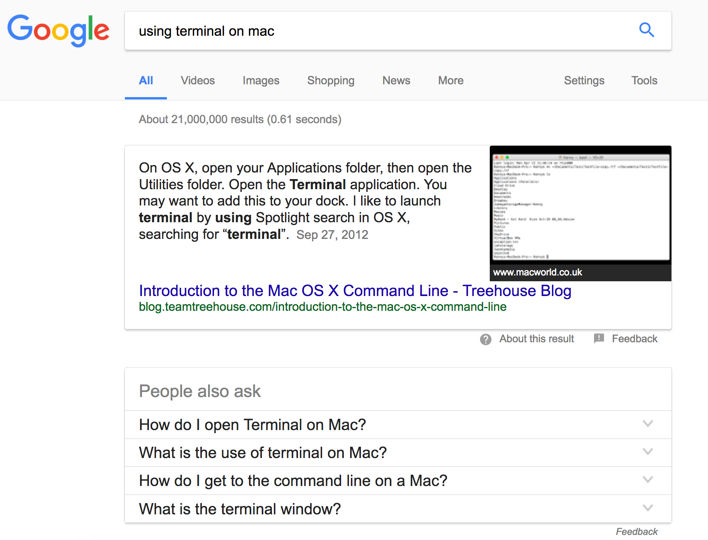
Using Terminal
Google will help you.
Try searching “using terminal on Mac OS X/Windows”?

Slide 4
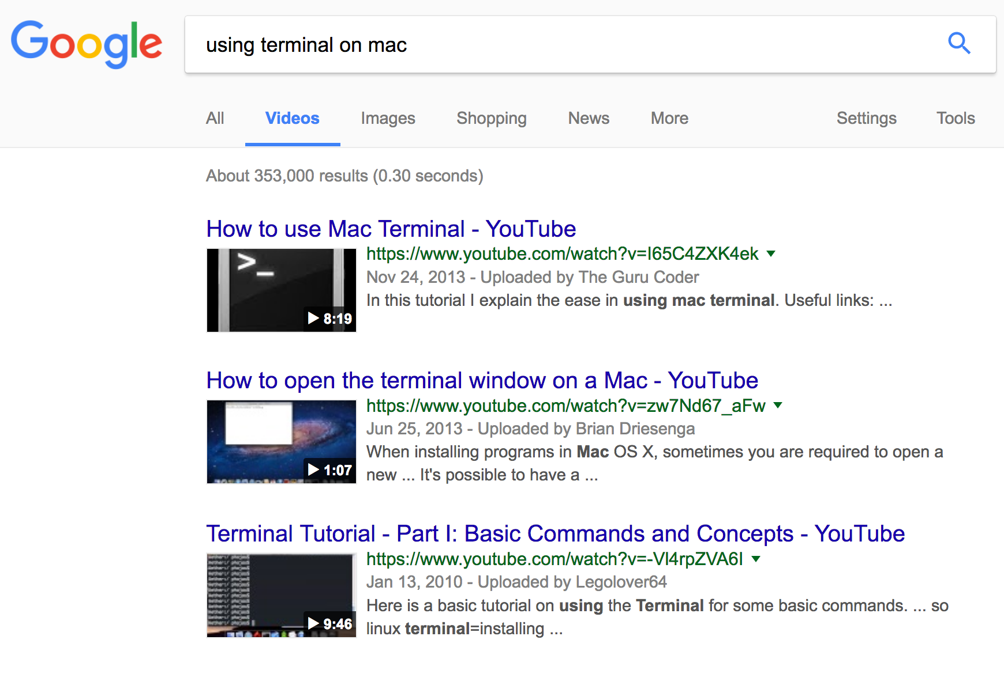
Using Terminal on Mac
Video search!

Slide 5
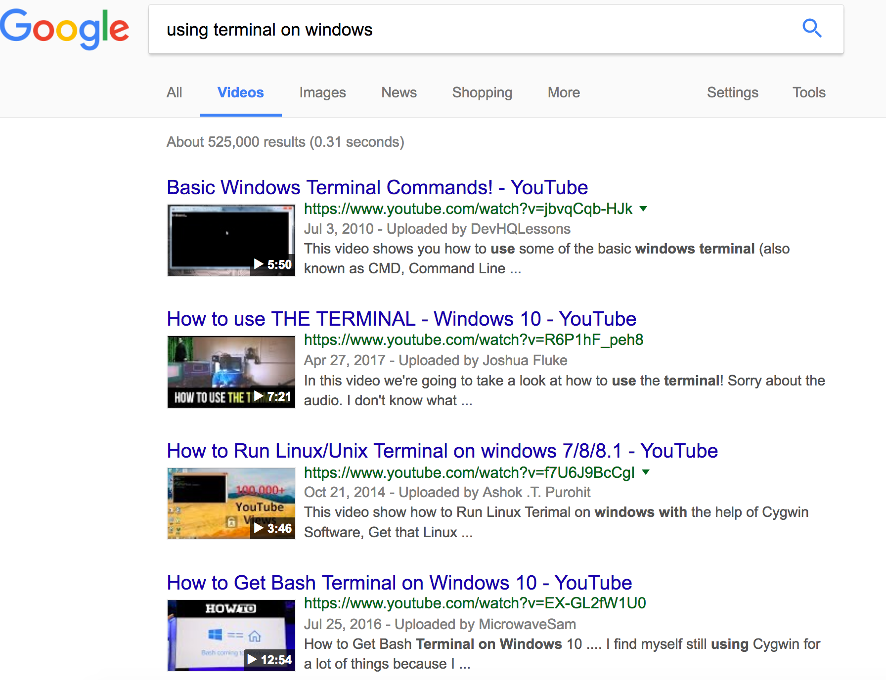
Using Terminal on Windows
Video search!

Slide 6
Exercise
Take 10 mins to research how to open the Terminal on your machine.
What can you do with the Terminal? (Can you identify 1 or 2 example tasks?)
You should get comfortable researching problems online. You’ll find this very useful.

Slide 7
Unix Simple Navigation
command | function
cd [directory] | change directory
mkdir [options] directory | make a directory
pwd | print working (i.e., current) directory
rmdir [options] directory | remove directory (won’t work if dir not empty)
rm –r directory | remove directory
Notes:
Further resources:
1. This book: - http://www.cibiv.at/teaching/documents/00-General_Documents/fiamingo1998_unix_book.pdf
2. This cheat sheet: - https://files.fosswire.com/2007/08/fwunixref.pdf.
3. Use Unix “man” command (e.g., “man cd” to check what the “cd” command means/does).

Slide 8
File Commands
command | function
ls [options] [directory or file] | list directory contents or file permissions
ls -a | lists all files, including those beginning with a dot (.)
ls -l | long listing: lists the mode, link information, owner, size, last modification (time)
cp file1 file2 | Copy file1 to file2
cp -r dir1 dir2 | Copy dir1 to dir2 (creates dir2 if it doesn’t exist)

Slide 9
More File Commands
command | function
touch file | - create file if it doesn’t exist; - change file access and modification times;
mv file1 file2 | Move file1 to file2 (if file2 doesn’t exit, it gets created. If file2 is the name of an existing dir, file1 gets moved to it)
cat file1 file2 file3 | concatenate and print files file1 file2 file3 to standard output
cat file1 file2 file3 > bigger_file | concatenate and print files file1 file2 file3 to the file bigger_file

Slide 10
More File Commands
command | function
more (or less or pg) file | page through the text file file
head [-number] file | display the first 10 (or number) of lines of file
tail [options] file | display the last few lines (or parts) of a file
tail [text string] | echo the text string to stdout (standard output)

Slide 11
Exercises
Open a new Terminal.
Close the Terminal.
Open it again.
Navigate to the Desktop (change directory).
Create a new directory under Desktop, call it “TEST”.
Go to “TEST” directory.

Slide 12
Exercises
Create a new directory “TEMP1” under “TEST”.
Download the file “shakespeare.txt” in “TEMP1”
Copy the “TEMP1” directory to “TEMP2”.
Remove “TEMP1” directory.
Go to “TEMP2”.
Print to screen the last 10 lines from “shakespeare.txt”.

Slide 13
Shakespeare Words!
command | function
cat shakespeare.txt | tr '[:space:]' '[\n*]' | tr -d '[:punct:]' |tr '[A-Z]' '[a-z]' | grep -v "^\s*$" | sort | uniq -c | sort -bnr > words.shak | - Can you tell what this command does? Take a look at Unix for Poets.

Slide 14
Bonus Exercises
Count the number of lines in “shakespeare.txt”. (hint: You can look this up online).
Replace the word “queen” in “shakespeare.txt” with “princess”.
Can you think of two interesting tasks you can use Unix to articulate?

