Slide 1
Real-time Anomaly Detection for Building Sensors Urban Data Lab Capstone Project EWS Meeting
Data 599 Mitch Harris, Ryan Koenig, Nathan Smith June 4, 2021

Slide 2
Outline
Introduction
Project Approach
Current Results
Future Study and Discussion

Slide 3
Introduction
Master of Data Science Program
General Capstone Project Goal

Slide 4
Master of Data Science Program Introduction
10-month accelerated Masters program
8 months classes
2 months capstone
Blend of:
Computer science
Statistics
Machine learning
Data presentation

Slide 5
Capstone Project Objective Introduction
Goal: Apply skills using real-world a dataset in an end-to-end project
Example: Last year an MDS group completed a project with UDL on classifying sensor end use
Duration: 7 weeks, proposal to final report

Slide 6
Project Approach
Project Description
Real-time Framework
Anomaly Detection Model

Slide 7
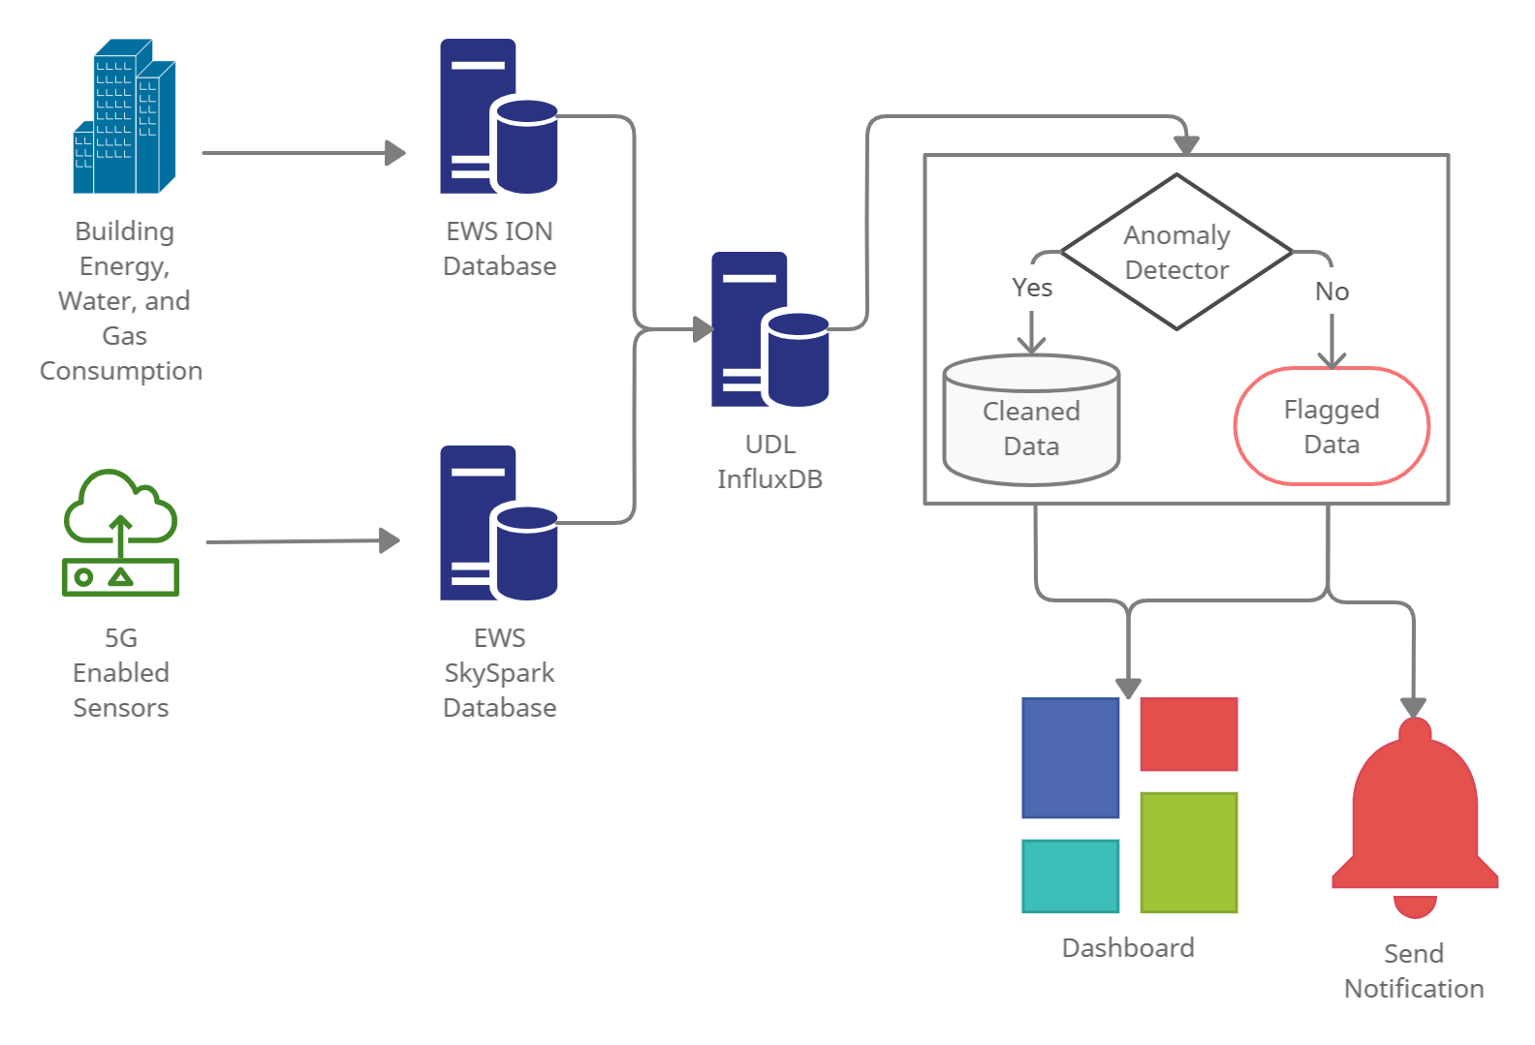
Description Project Approach
UDL have noticed inconsistent/erroneous data – no system in place to identify this
UDL are interested in deployment of an anomaly detection system capable of notifying users of unusual behavior

Slide 8
Approach Project Approach
Select a subset of data to use for the study (CEC)
Select a real-time detection framework
Research anomaly detection models
Build a pipeline for the anomaly detection model
Model evaluation and tuning
Implement the model/framework
Build a dashboard/notification system

Slide 9
Schedule Project Approach
Week | Goal
1 | Project Definitional and Proposal
2 | Data and System Understanding
3 | Anomaly Detection Model
4 | Implement Streaming Pipeline
5 | Value Week
6 | Dashboard
7 | Reporting

Slide 10





Real-time Detection Framework Project Approach
Anomaly detection model are trained and parameters stored
Anomaly detector only reads latest points and uses stored parameters
Run Weekly/Monthly to Update Model
Raw
Model Parameters Stored
Parsed
Detected
Train Parameters
Continuous Read/Detect/Write

Slide 11
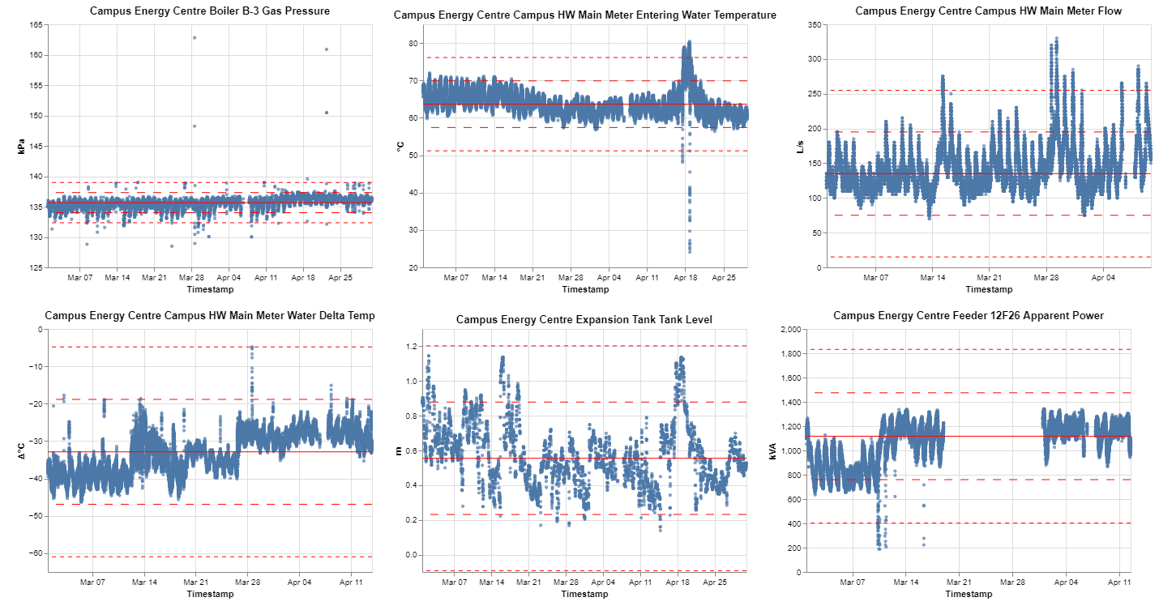
Subset of Data Project Approach
High variation in sensor patterns and anomalies types

Slide 12
Anomaly Detection Model Project Approach
LSTM Encoder-Decoder Model Selected
Identified as a successful model on IoT sensors
Able to run in an unsupervised approach
Flexible model to handle different sensor types
Has tunable parameters

Slide 13
Anomaly Detection Model Project Approach
Two Model Setups Considered
X-2
X-1
X0
X-2
X-1
X0
X1’
X-2’
X-1’
X0’
Next Point Prediction
(Many-to-One)
Sequence Reconstruction
(Many-to-Many, Seq2Seq)

Slide 14
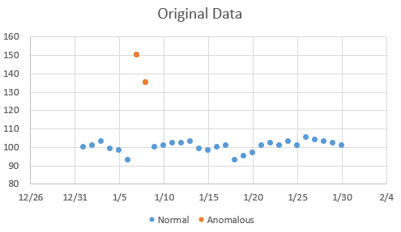
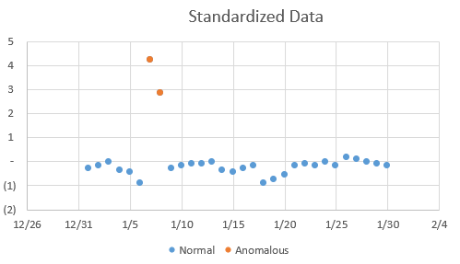
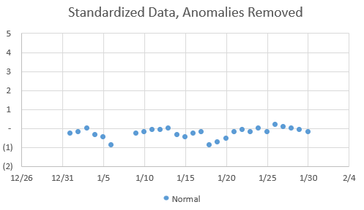
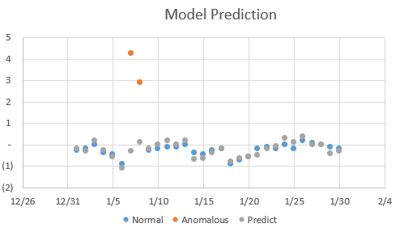
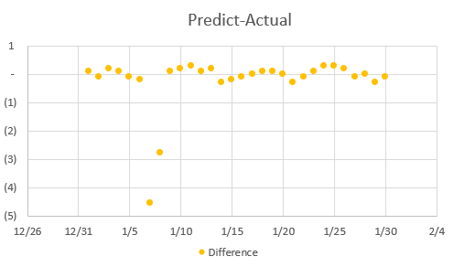
Anomaly Detection Model Example Project Approach
Train Model Here
Notes:
Training completed weekly/monthly
Predict on ongoing basis
Trains on normal data
Allows operational adjustment
Allows new sensor to use a similar sensor trained model to start detection

Slide 15
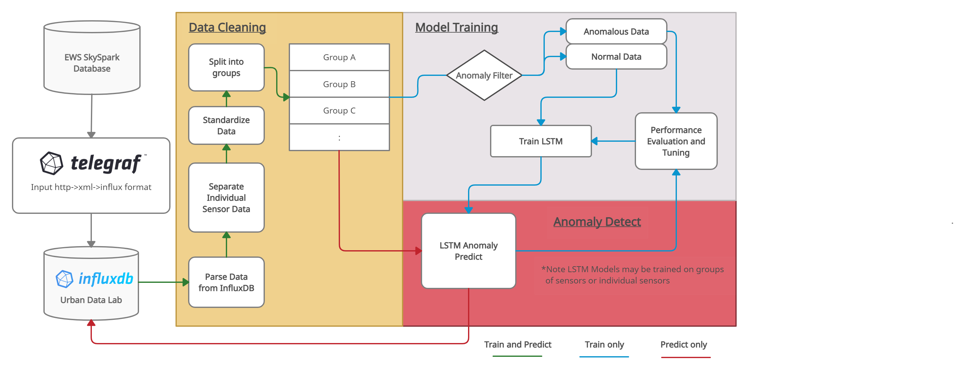
Anomaly Detection Model Pipeline Project Approach
Notes:
Training completed weekly/monthly
Predict on ongoing basis
Trains on normal data
Allows operational adjustment
Allows new sensor to use a similar sensor trained model to start detection

Slide 16
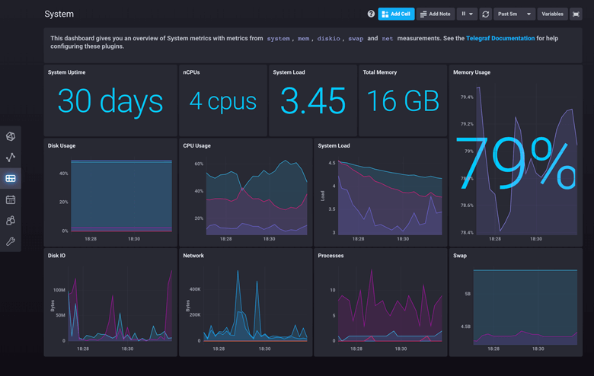
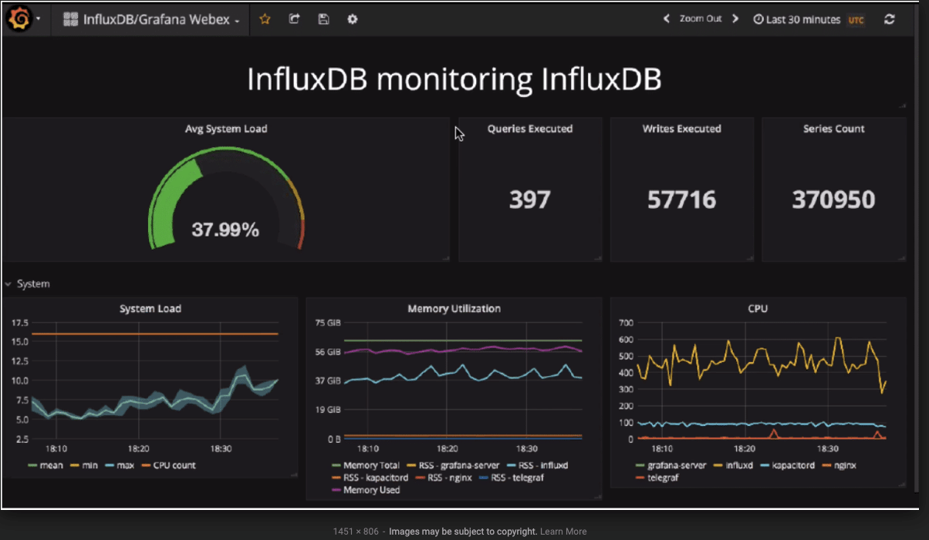
Dashboard/Notification System Project Approach
Likely built directly into InfluxDB, move to Grafana if required

Slide 17
Additional Comments Project Approach
The model framework is not tailored specifically to the boiler dataset (there are potentially approaches that would work better specifically to boiler data) but the hope is that it provides an approach allowing models to be trained on groups of similar sensors.
This could provide a good initial anomaly detection framework applied to different buildings/sensor types and then customized algorithms/rules could be integrated as necessary.
It is recognized that ideally we would have time in the project to consider various approaches but given the timeline we feel this is a reasonable approach to use.

Slide 18
Current Results

Slide 19
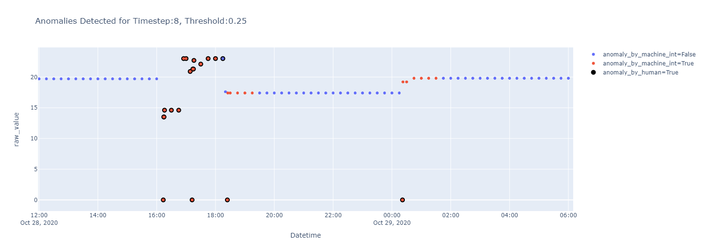
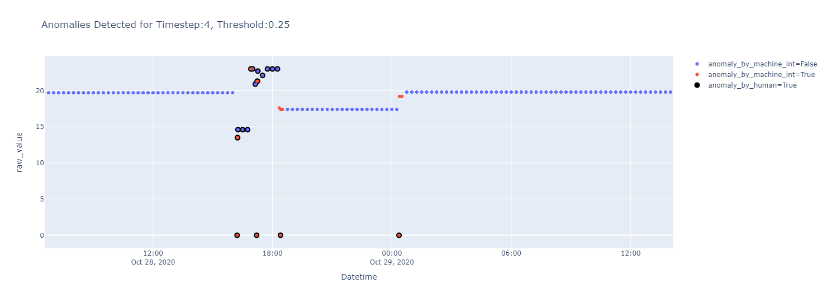
Current Model Results Current Results
Sequence Reconstruction
Predicting Next Point
Notes:
Training completed weekly/monthly
Predict on ongoing basis
Trains on normal data
Allows operational adjustment
Allows new sensor to use a similar sensor trained model to start detection

Slide 20
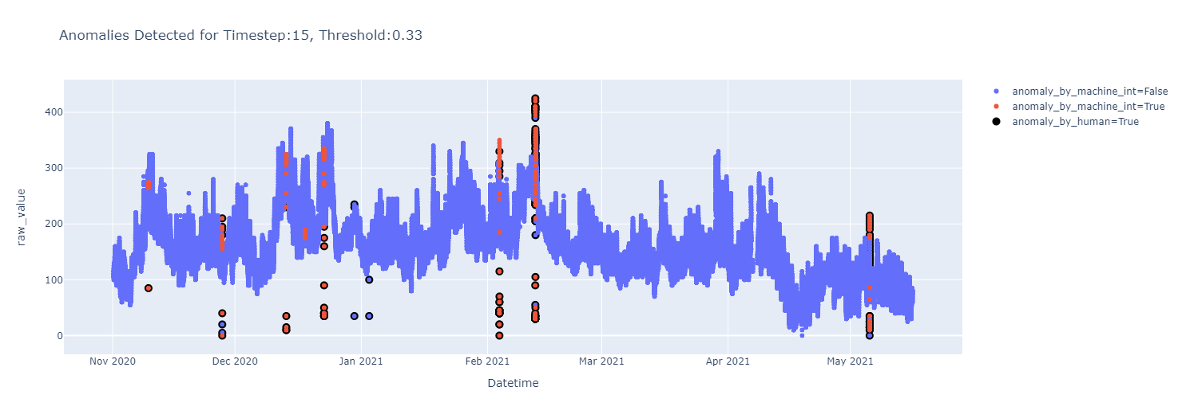
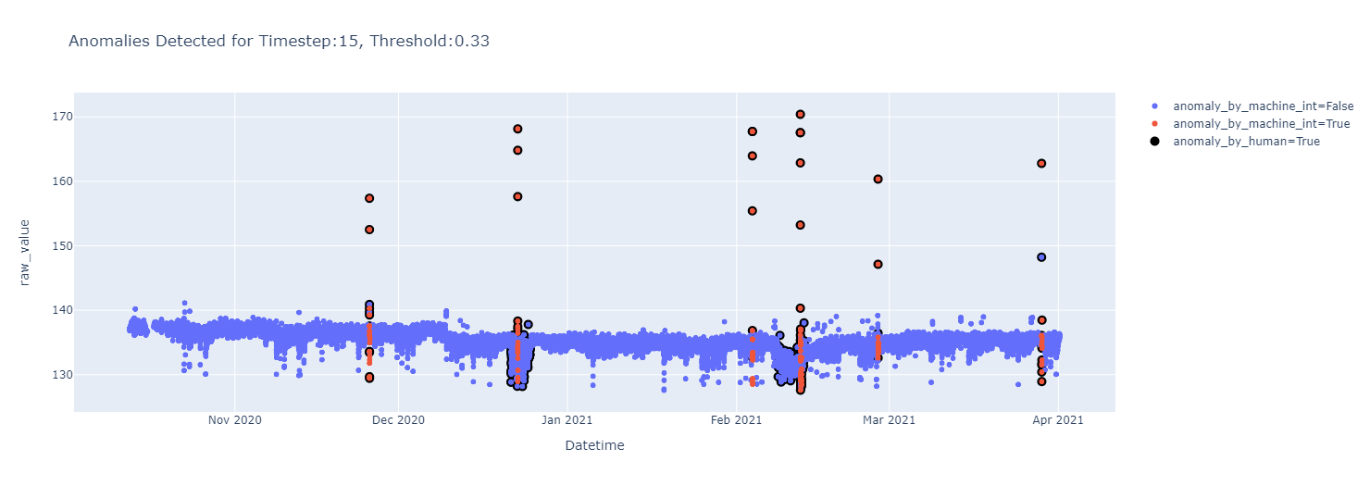
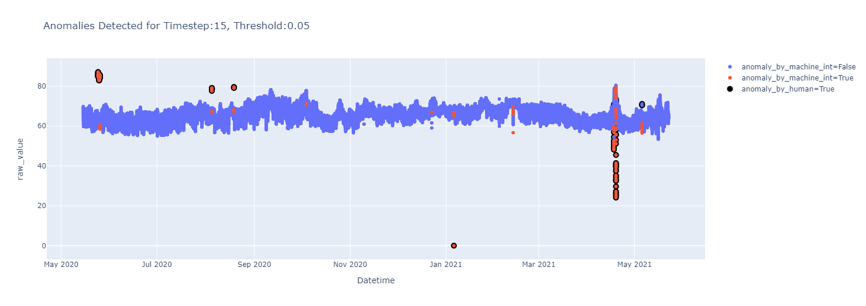
Current Model Results Current Results
CEC HW Main Meter Flow Rate
CEC Boiler B-1 Gas Pressure
CEC HW Main Meter Entering Water Temperature
Notes:
Training completed weekly/monthly
Predict on ongoing basis
Trains on normal data
Allows operational adjustment
Allows new sensor to use a similar sensor trained model to start detection

Slide 21
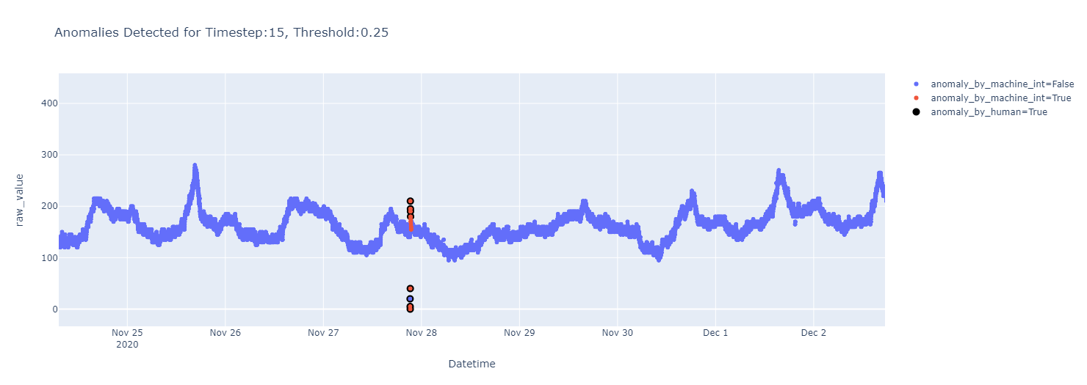
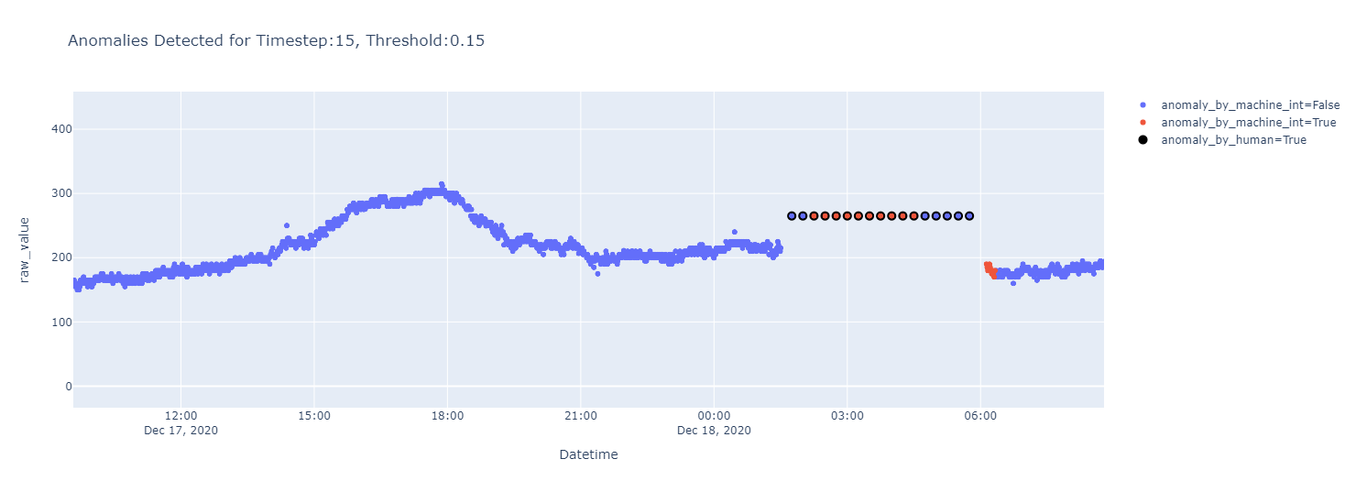
Current Model Results Current Results
Notes:
Training completed weekly/monthly
Predict on ongoing basis
Trains on normal data
Allows operational adjustment
Allows new sensor to use a similar sensor trained model to start detection

Slide 22
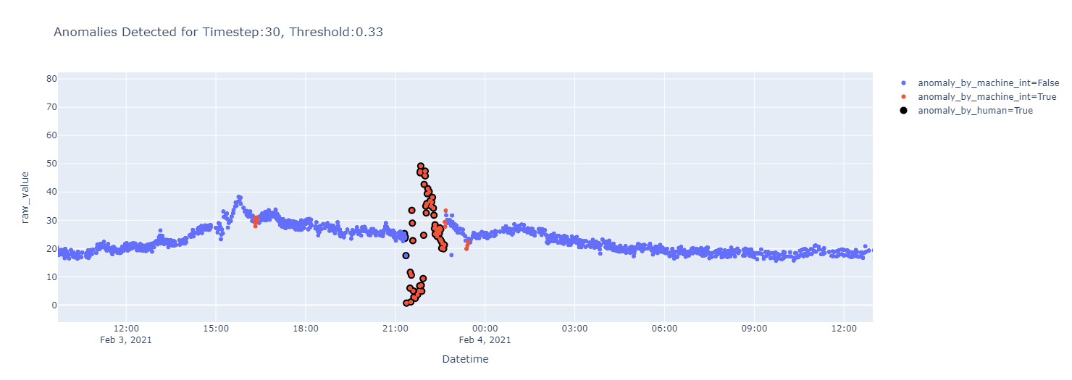
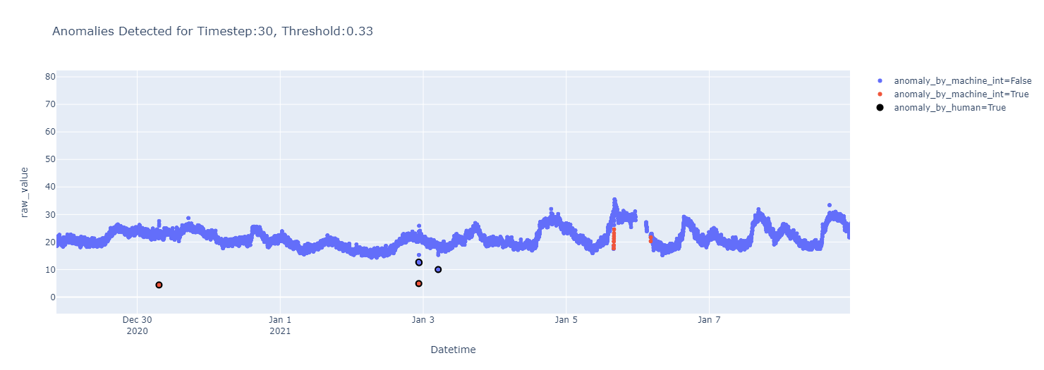
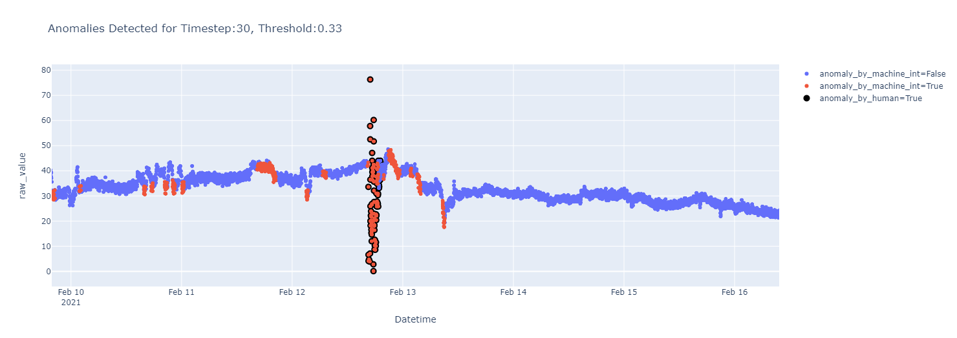
Current Model Results Current Results
Identifies manually labelled anomalous events quite well
Needs tuning to avoid incorrect flagging
Notes:
Training completed weekly/monthly
Predict on ongoing basis
Trains on normal data
Allows operational adjustment
Allows new sensor to use a similar sensor trained model to start detection

Slide 23
Future Study
Anomaly Detection Framework
Anomaly Detection Model
Model Performance
Dashboard and Notification System

Slide 24
Anomaly Detection Framework Future Study
Anomaly detection inline with Telegraf to provide better real-time detection
Improve current implementation to avoid re-querying the same data from InfluxDB

Slide 25
Anomaly Detection Model Future Study
The LSTM-ED represents a complex model that is capable of being very flexible/general for univariate sensor data
However, the study did not have time to assess simpler models that may perform well and the study did not assess model that use multiple sensors to predict if data are anomalous
The study also did not assess putting sensor/system specific anomaly detection model/rules inline with the more general approach

Slide 26
Model Performance Future Study
This study only looked at qualitative anomaly detection performance, using records or applying simple anomaly detection methods on sensors with known model/rules would allow quantitative performance evaluation
Additional sensors should be assessed
Additional system should be assessed to determine the generalizability of the approach

Slide 27
Dashboard and Notification System Future Study
Only a simple dashboard and notification system using built-in InfluxDB functionality will be looked at in this study and the system will just be set to send a notification system on any anomaly detection data
More sophisticated notifications systems are likely required that could include only providing notifications if multiple sensors detected anomalous data or turning off notifications if equipment is not operational

Slide 28

Discussion
Mitch Harris
Ryan Koenig
Nathan Smith

