Slide 1
Realtime Anomaly Detection for Building Sensors Urban Data Lab Capstone Project Week 7 Status
Data 599 Mitch Harris, Ryan Koenig, Nathan Smith June 15, 2021

Slide 2
Outline
Previous Week Summary (June 7 – 13)
Next/Final Week Planning (June 14 – 22)
Timeline Reflection

Slide 3
Previous Week Summary
Week 6 Goals: Dashboard
Final Model Testing
Work on Report
Dashboard
Wrap-up Model Implementation

Slide 4
Week 6 Tasks Previous Week (June 7 - 13)
Final Model Testing
Selected threshold rule and default window length
Downloaded an additional 5 sensors (had to do this manually)
Summarized results
Evaluating 5 additional sensors Monday but now complete

Slide 5
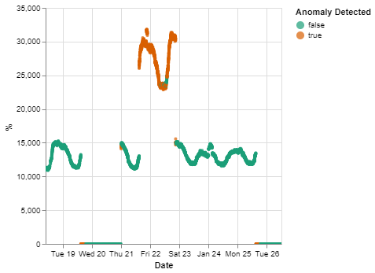
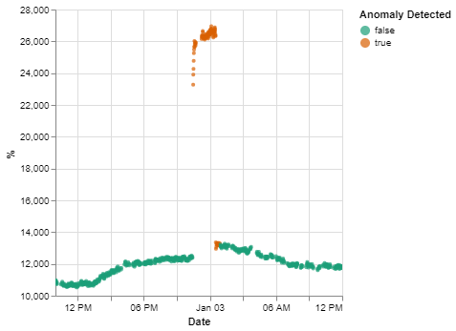
Week 6 Tasks Previous Week (June 7 - 13)

Slide 6
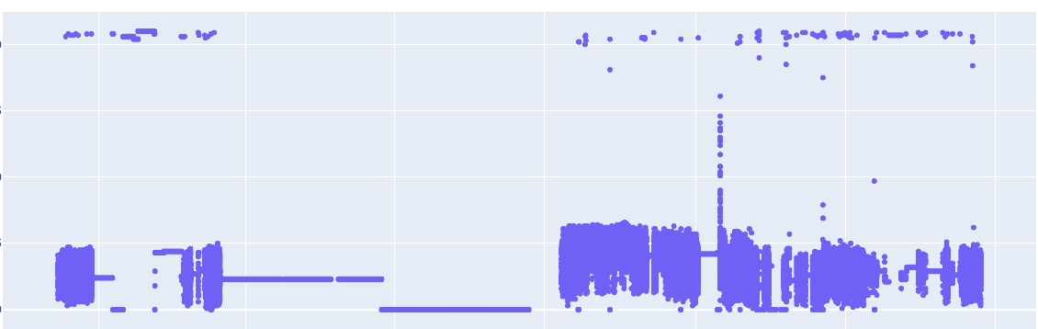
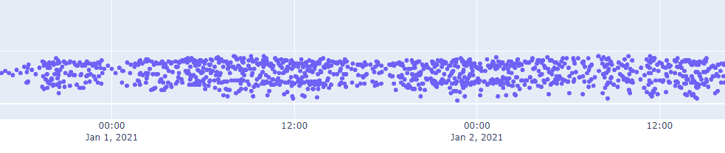
Week 6 Tasks Previous Week (June 7 - 13)

Slide 7
Week 6 Tasks Previous Week (June 7 - 13)
Continued Reporting
Mainly complete, just needs additional results and several figures
Targeting final draft report completion for Wednesday
Already started final presentation
On track (and ahead of schedule)

Slide 8
Week 6 Tasks Previous Week (June 7 - 13)
Dashboard and Notification System
Simple dashboard built directly into InfluxDB
Simple notification system – if an anomaly is predicted for a sensor a notification is sent to a Slack channel
Still finishing dashboard and notification system – wrapping up today

Slide 9
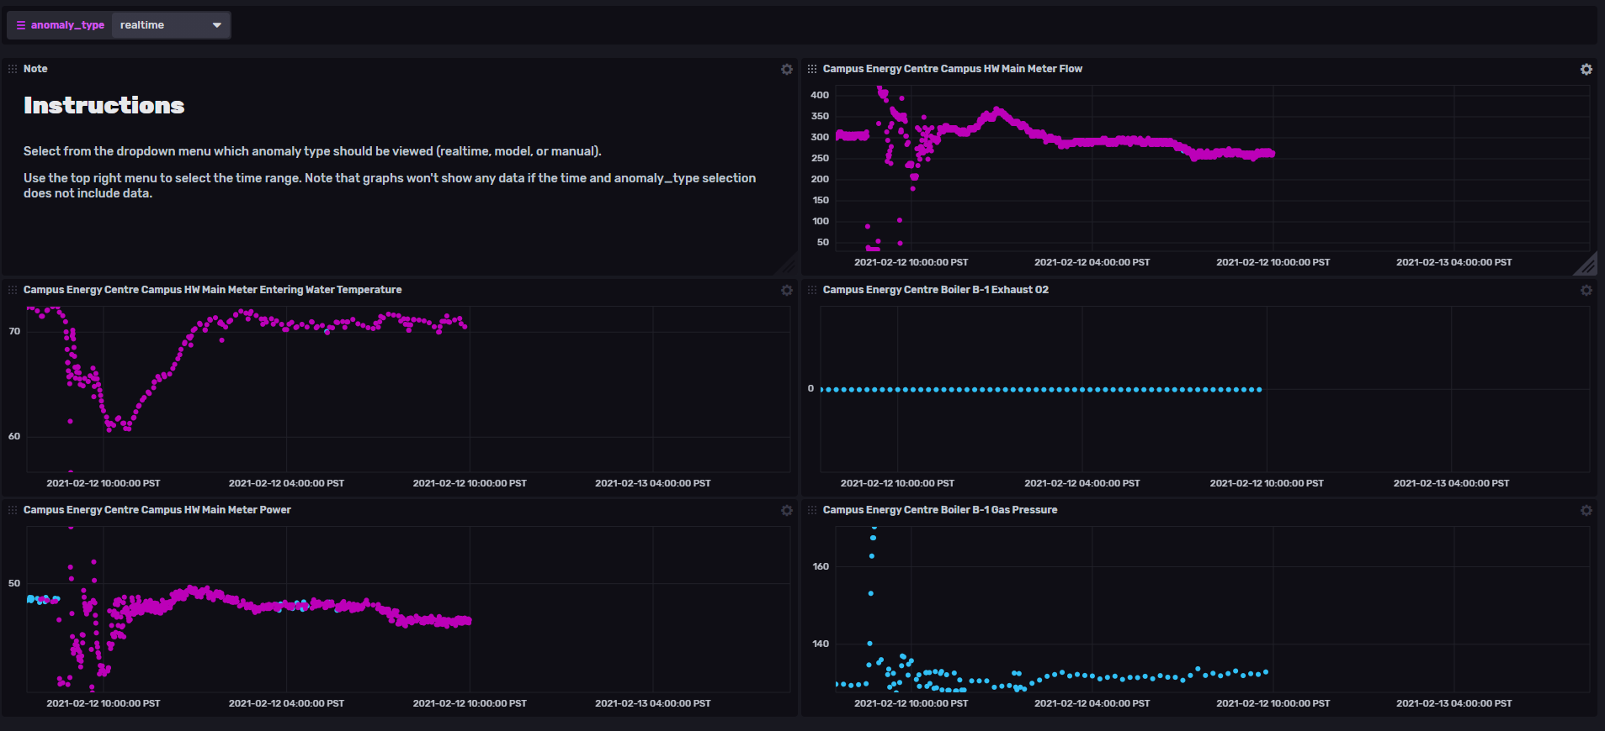

Week 6 Tasks Previous Week (June 7 - 13)

Slide 10
Week 6 Tasks Previous Week (June 7 - 13)
Model Implementation
Implementation in test environment with notebook walk-through
Still needs additional work
As real-time data streaming to InfluxDB is not available this will be the main implementation
Additional work required on this during the week

Slide 11
Challenges Previous Week (June 7 - 13)
Wrap-up
Needed to focus on wrapping up scope
Test environment walkthrough added some scope
Dashboard
Dashboard didn’t go as fast as hoped – while the Dashboard implementation in InfluxDB is easy, Boolean data is not handled well

Slide 12
Client Meetings Previous Week (June 7 - 13)
Thursday Sprint Planning
Plan for next week tasks, discuss final project wrap-up
Provide draft report to UDL Wednesday EOD
Present to UDL the following Wednesday

Slide 13
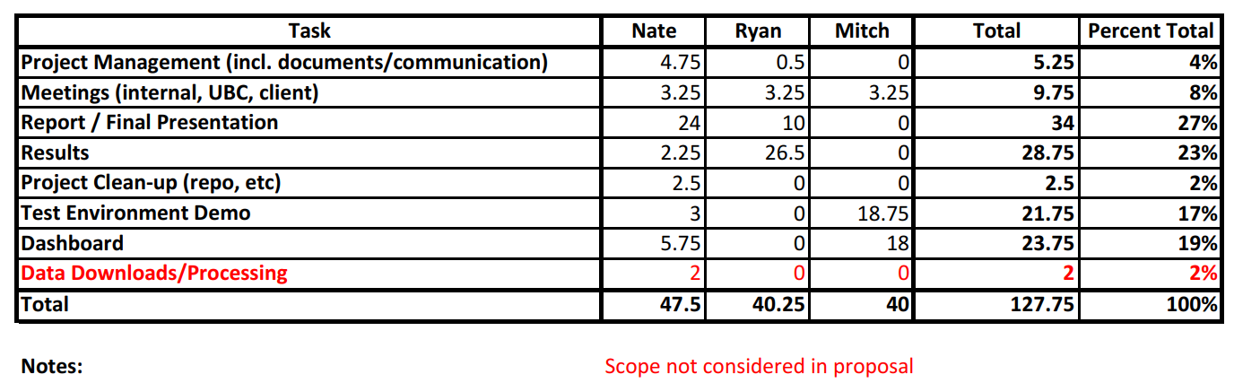
Time Summary Previous Week (June 7 - 13)

Slide 14
Next/Final Week Planning
Week 7 Goals: Reporting
Complete Report
Complete Presentation
Complete Walkthrough/Code/Repo Wrap-up Code

Slide 15
Individual Tasks Next Week (June 14 - 22)
Mitch: Complete Dashboard and Package Wrap-up
Ryan: Results Section of Report
Nate: Report, Presentation, Walkthrough, and Repo Wrap-up
We have a detailed daily task list to ensure we’re on track

Slide 16
Challenges Next Week (June 14 - 22)
Stick to Wrap-up and schedule

Slide 17
Timeline Reflection

Slide 18
Schedule Timeline Reflection
Week 6:
Dashboard (complete today)
Complete final model tests (complete Monday)
Continued reporting (ahead of schedule)
Test environment (not completed, ongoing)
Week 7:
Finish report and presentation
Finish dashboard and walkthrough
Wrap-up code/repo
Week | Goal
1 | Project Definitional and Proposal
2 | Data and System Understanding
3 | Anomaly Detection Model
4 | Implement Streaming Pipeline
5 | Value Week
6 | Dashboard
7 | Reporting

Slide 19
Impacts to Schedule Timeline Reflection
It’s going to be busy but we believe doable

Slide 20

Thank You
Mitch Harris
Ryan Koenig
Nathan Smith

