Slide 1
Real-time Sensor Anomaly Detection Urban Data Lab Master of Data Science Capstone Project
Mitch Harris, Ryan Koenig, Nathan Smith May 21, 2021

Slide 2
Outline
Introduction
Project Overview
Current Progress
Questions

Slide 3
Introduction
Project Team
Master of Data Science Program
General Capstone Project Goal

Slide 4
Project Team Introduction
Nathan Smith
BASc in Civil Engineer, UBC, 2008
~10 years water resource engineering
Ryan Koenig
BSc in Physics, UFV, 2012
~4 years in R&D in fireplace manufacturing
Mitch Harris
BSc in Applied Mathematics, UBCO, 2017
2 years junior data science in ad tech

Slide 5
Master of Data Science Program Introduction
10-month accelerated Masters program
8 months classes
2 months capstone
Blend of:
Computer science
Statistics
Machine learning
Data presentation

Slide 6
Capstone Project Objective Introduction
Goal: Apply skills using real-world a dataset in an end-to-end project
Example: Last year an MDS group completed a project with UDL on classifying sensor end use
Duration: 7 weeks, proposal to final report

Slide 7
Project Overview
Real-time Anomaly Detection with Smart Building Sensor Data

Slide 8
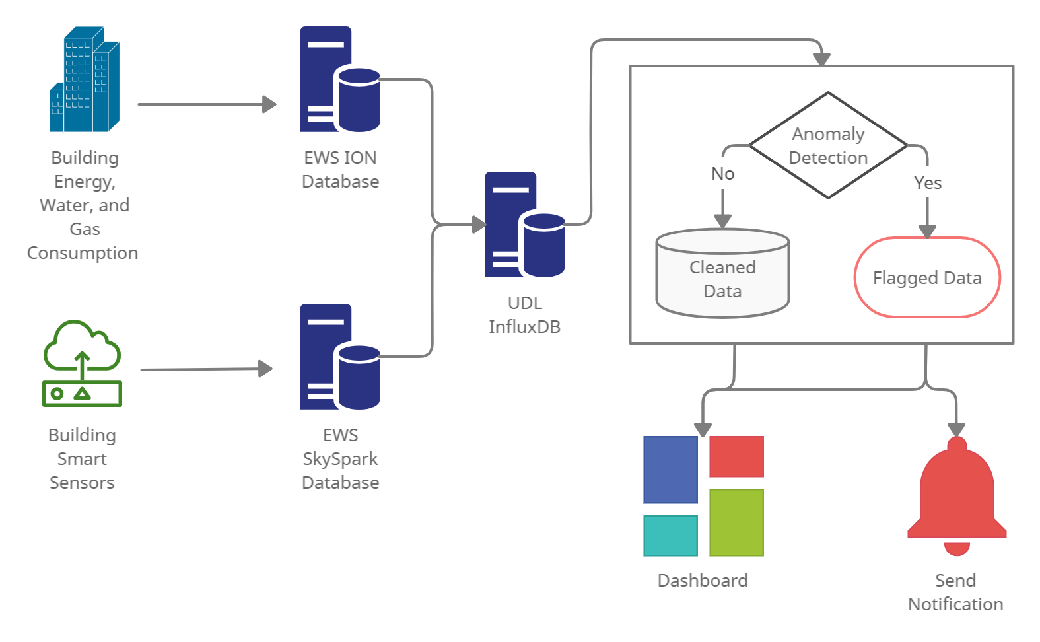
Background Project Overview
UDL store data from SkySpark and ION in InfluxDB
UDL are interested in deployment of an anomaly detection system capable of notifying users of unusual behavior
Specifically we’re looking at CEC data in SkySpark for this project

Slide 9
Proposal Approach Project Overview
Select a subset of SkySpark data (CEC)
Various anomaly detection models will be researched/explored
A pipeline with the anomaly detection model and any required data cleaning will be tested using offline streaming simulation
Pipeline will be implemented in the streaming framework with InfluxDB
The system may be tested/implemented on additional data sources
Output from the detection model will be provided in dashboard format, ideally with a notification system

Slide 10
Proposal Schedule Schedule
Week | Goal
1 | Project Definitional and Proposal
2 | Data and System Understanding
3 | Anomaly Detection Model
4 | Implement Streaming Pipeline
5 | Value Week
6 | Dashboard
7 | Reporting

Slide 11
Current Progress
Complete
In-Progress
Streaming Detection Framework
Anomaly Detection Model
Schedule

Slide 12
Complete Current Progress
Week 1:
Project selection and proposal
Background review
Week 2 (last week):
Select project data (CEC)
Initial exploration of available data (limited)
Support UDL implementing streaming data to InfluxDB (ongoing)
Anomaly detection research
Framework for simulating streaming offline
Learn InfluxDB and understand data systems

Slide 13
In-Progress Current Progress
Week 3 (this week):
Ongoing parsing/implementing streaming data to InfluxDB
Ongoing anomaly detection research
Ongoing EDA
Select/build initial streaming framework used to support streaming anomaly detection
Meet with domain experts
Week 4 (next week):
Build anomaly detection model
Select performance criteria and evaluate model performance (need understanding of anomalies)
Tune model and implement (likely push into Week 5)

Slide 14




Streaming Detection Frameworks Current Progress
Anomaly detection model are trained and parameters stored
Anomaly detector only reads latest points and uses stored parameters
This is the system we’ll be trying to build as it doesn’t rely on inline detection with Telegraf
Run Daily/Weekly to Update Model
Model Parameters Stored
Raw
Parsed
Detected
Continuous Read/Detect/Write

Slide 15
Streaming Detection Frameworks Current Progress
This inline detection system likely provides a better approach but estimating that we won’t have time to implement
Hoping that our implementation is general enough that it can be translated to this in the future
Model Parameters Stored
Continuous Detect
Run Daily/Weekly to Update Model
Raw
Parsed
Detected

Slide 16
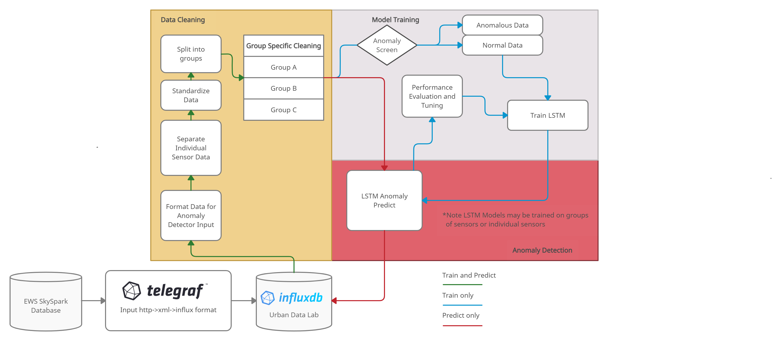
Anomaly Detection Model Current Progress
Training completed weekly/monthly
Predict on ongoing basis
Trains on normal data
Allows operational adjustment
Allows new sensor to use a similar sensor trained model to start detection

Slide 17
Anomaly Detection Model Current Progress
Data Preparation
Sensors will be grouped by behavior to provide generalization in cleaning data and detecting anomalies.
Data standardized (mean=0, stdev=1) allows transferability of model to other sensors
Anomaly Screen/Filter
The model trains on normal data only and anomalies are flagged on data predicted with a low probability
Labelling anomalies to initially train the model will be done manually
LSTM-AD
2-layers Stacked LSTM for initial model
Modify with other methods (such as using a sliding window) or adding secondary model if needed
Tuning
Changing the threshold of labelling an anomaly for preferred results or changing the period a sensor is trained on

Slide 18
Anomaly Detection Model Current Progress
Additional Notes/Comments
The model framework is not tailored specifically to the boiler dataset (there are potentially approaches that would work better specifically to boiler data) but the hope is that it provides an approach allowing models to be trained on groups of similar sensors.
This could provide a good initial anomaly detection framework applied to different buildings/sensor types and then customized algorithms/rules could be integrated as necessary.
It is recognized that ideally we would have time in the project to consider various approaches but given the timeline we feel this is a reasonable approach to use.

Slide 19
Schedule Current Progress
Week 3:
Anomaly detection model not built
Streaming framework on track
Week 4:
Not implementing model yet
Added task of anomaly labelling and performance measures
Week 4 is becoming testing/building and Week 5 implementing
Week 6/7 are Dashboard, Wrap-up, Reporting
Week | Goal
1 | Project Definitional and Proposal
2 | Data and System Understanding
3 | Anomaly Detection Model
4 | Implement Streaming Pipeline
5 | Value Week
6 | Dashboard
7 | Reporting

Slide 20
Questions
How are anomalous data currently identified?
What is the current notification system based on?
Are there any identified anomalies that we can use?
Thoughts on approach?

Slide 21
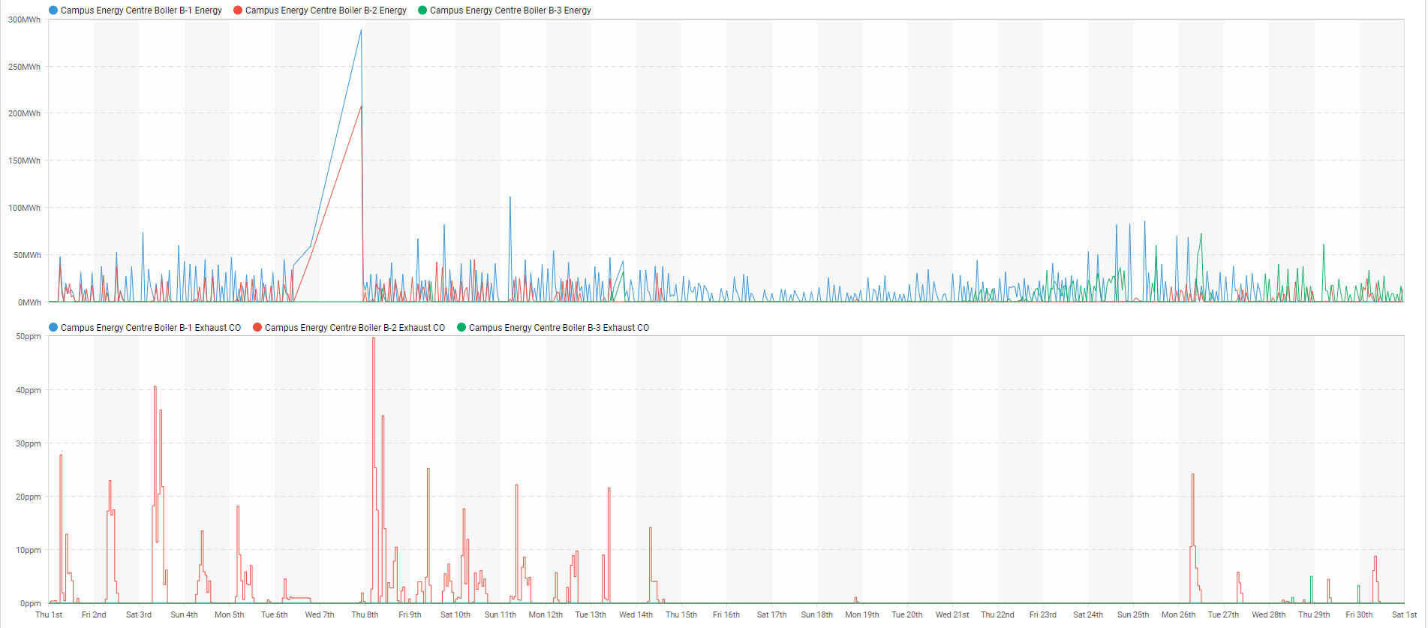
Specific Data Questions
For a month period we can see that all three boilers are operating yet boiler-2 is the only one consistently producing large CO levels.
Is this Anomalous Data or are the boiler setups different enough to account for this?

Slide 22
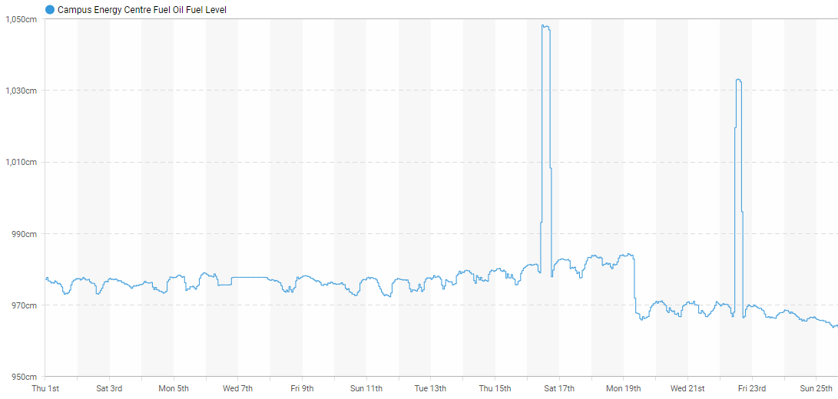
Specific Data Questions
Oil fuel level jump seems irregular but corresponds to several other sensors drop or increases.
This is something that will be flagged but is it an anomaly?

Slide 23
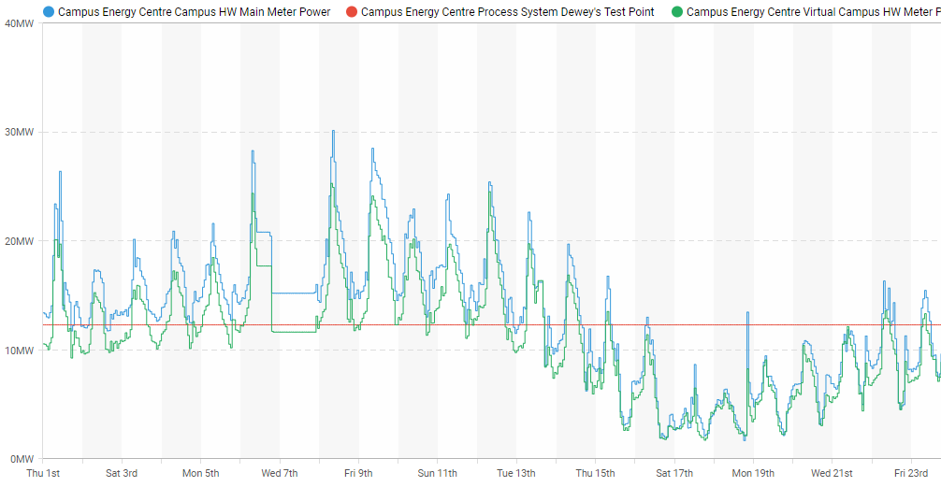
Specific Data Questions
This anomaly appeared through multiple sensors. Is this a connection error?
What is the Virtual Campus?
What is the Dewey’s Test Point?

Slide 24

Q&A
Mitch Harris
Ryan Koenig
Nathan Smith

