Slide 1
Realtime Anomaly Detection for Building Sensors Urban Data Lab Capstone Project Week 6 Status
Data 599 Mitch Harris, Ryan Koenig, Nathan Smith June 8, 2021

Slide 2
Outline
Previous Week Summary (May 31 – June 6)
Next Week Planning (June 7 – 13)
Timeline Reflection

Slide 3
Previous Week Summary
Week 5 Goals: Value Week
Complete model evaluation and performance tuning
Implement pipeline with InfluxDB
Start reporting

Slide 4
Week 5 Tasks Previous Week (May 31 – June 6)
Complete Model Evaluation and Performance Tuning
Finish evaluating on-hand sensors
Assess:
LSTM setup
if anomaly data removal is required for training
window length
Generate a threshold rule for anomaly flagging
On Track

Slide 5
Week 5 Tasks Previous Week (May 31 – June 6)
Two Model Setups Considered
X-2
X-1
X0
X-2
X-1
X0
X1’
X-2’
X-1’
X0’
Next Point Prediction
(Many-to-One)
Sequence Reconstruction
(Many-to-Many, Seq2Seq)

Slide 6
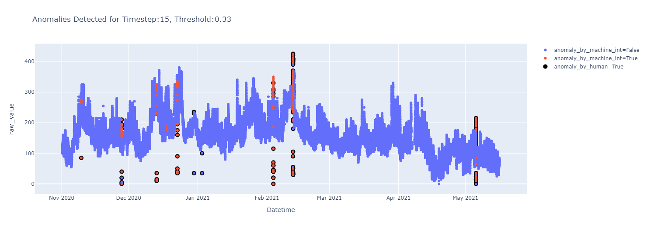
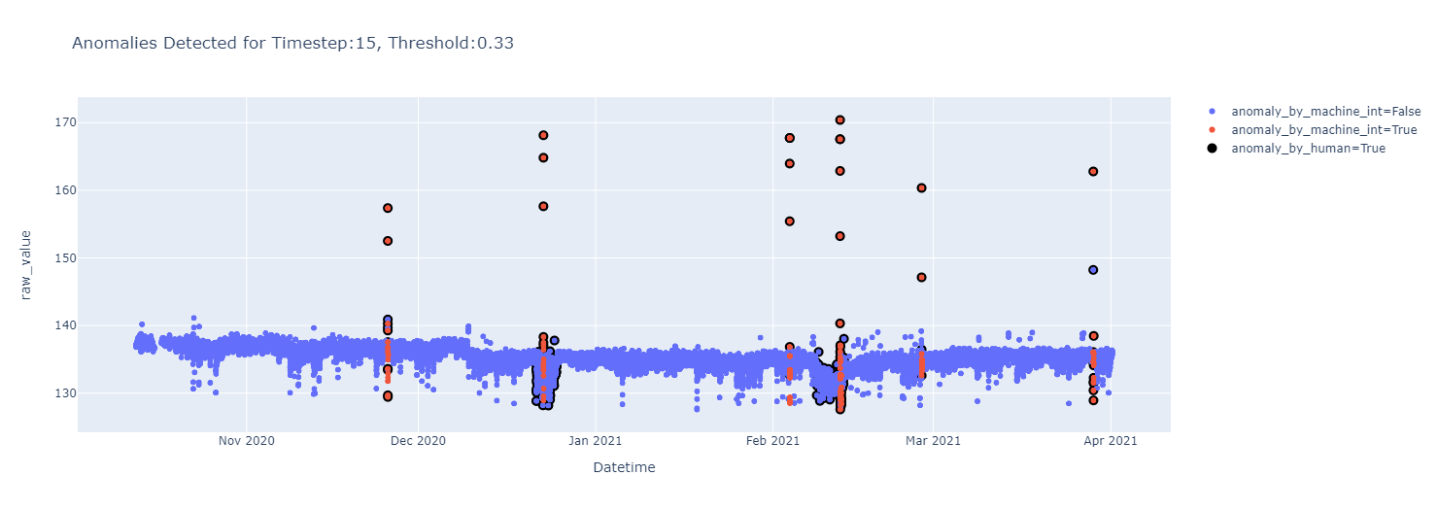
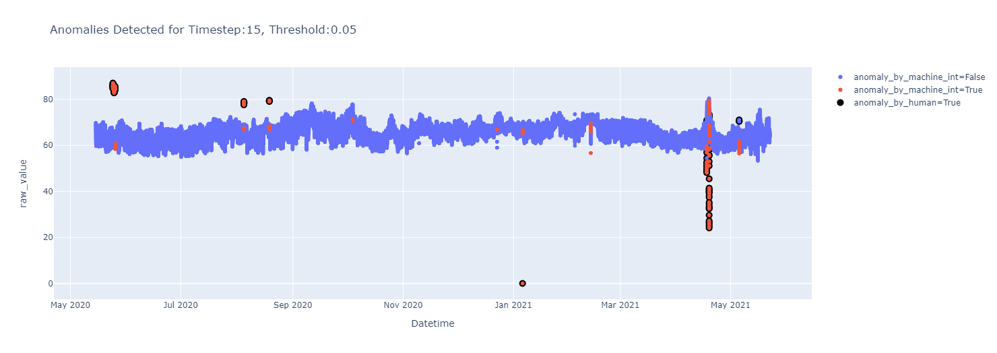
Week 5 Tasks Previous Week (May 31 – June 6)
CEC HW Main Meter Flow Rate
CEC Boiler B-1 Gas Pressure
CEC HW Main Meter Entering Water Temperature

Slide 7
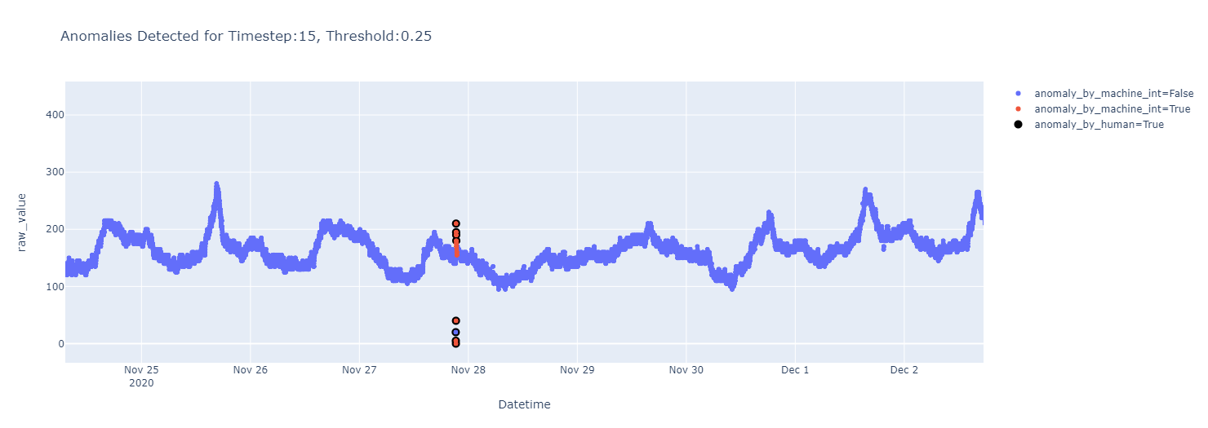
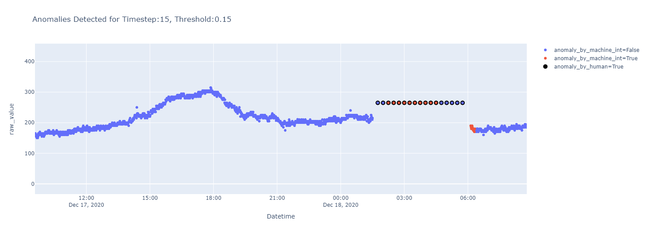
Week 5 Tasks Previous Week (May 31 – June 6)

Slide 8
Week 5 Tasks Previous Week (May 31 – June 6)
Implement Pipeline with InfluxDB
Created a test environment in InfluxDB with on-hand sensor data
Implemented pipeline and example in interactive notebook
On Track

Slide 9





Week 5 Tasks Previous Week (May 31 – June 6)
Anomaly detection model are trained and parameters stored
Anomaly detector only reads latest points and uses stored parameters
Run Weekly/Monthly to Update Model
Raw
Model Parameters Stored
Parsed
Detected
Train Parameters
Continuous Read/Detect/Write

Slide 10
Week 5 Tasks Previous Week (May 31 – June 6)
Started Reporting
Dashboard couldn’t be started until InfluxDB pipeline implemented in test env.
Started report recognizing the dashboard will be pushed to start in Week 6
On track

Slide 11
Challenges Previous Week (May 31 – June 6)
Test Environment in InfluxDB
Ideally would have been able to implement the pipeline directly
Still need to implement it in real-time (if the database is ready by the end of the project and there is time)
Minimal Sensor Data
Only 5 sensors studied to date – will look at an additional 5 this week

Slide 12
Client Meetings Previous Week (May 31 – June 6)
Monday Technical Project Meeting
Presented preliminary results and discussed LSTM model
Thursday Sprint Planning
Plan for next week tasks
Friday Presentation to Energy and Water Services
Keep EWS in the loops as they are supporting UDL with various projects

Slide 13
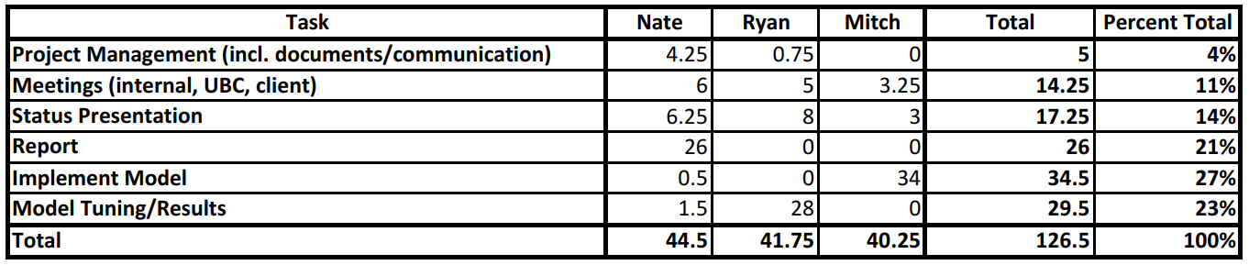
Time Summary Previous Week (May 31 – June 8)

Slide 14
Next Week Planning
Week 6 Goals: Dashboard
Dashboard
Report
Wrap-up Code/Implementation

Slide 15
Individual Tasks Next Week (June 7 - 13)
Mitch: Dashboard and wrap-up code/implementation
Ryan: Additional sensor testing and wrap-up results
Nate: Project management, review, and work on report

Slide 16
Challenges Next Week (June 7 - 13)
Start Project Wrap-up
Wrap-up the project and minimize additional scope
Real-time InfluxDB Implementation
Would like to do this but may be time limited
Evaluate on Additional Sensors
Pushing model evaluation later than we would like but feel it’s important

Slide 17
Timeline Reflection

Slide 18
Schedule Timeline Reflection
Week 5:
Pipeline implemented (test env.)
Model complete but on limited sensors
Week 6:
Complete the dashboard
Continue reporting
Evaluate additional sensors
Start wrap-up
Week | Goal
1 | Project Definitional and Proposal
2 | Data and System Understanding
3 | Anomaly Detection Model
4 | Implement Streaming Pipeline
5 | Value Week
6 | Dashboard
7 | Reporting

Slide 19
Impacts to Schedule Timeline Reflection
Back on track with the project due to using Value Week for catching up
Would be good to do more scope but need to start focusing on project completion

Slide 20

Thank You
Mitch Harris
Ryan Koenig
Nathan Smith

Slide 21
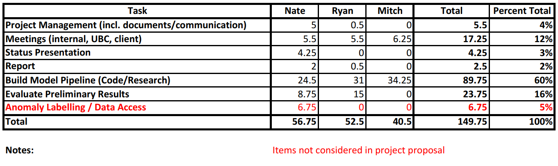
Time Summary (May 24 – May 30) Additional Slides

Slide 22
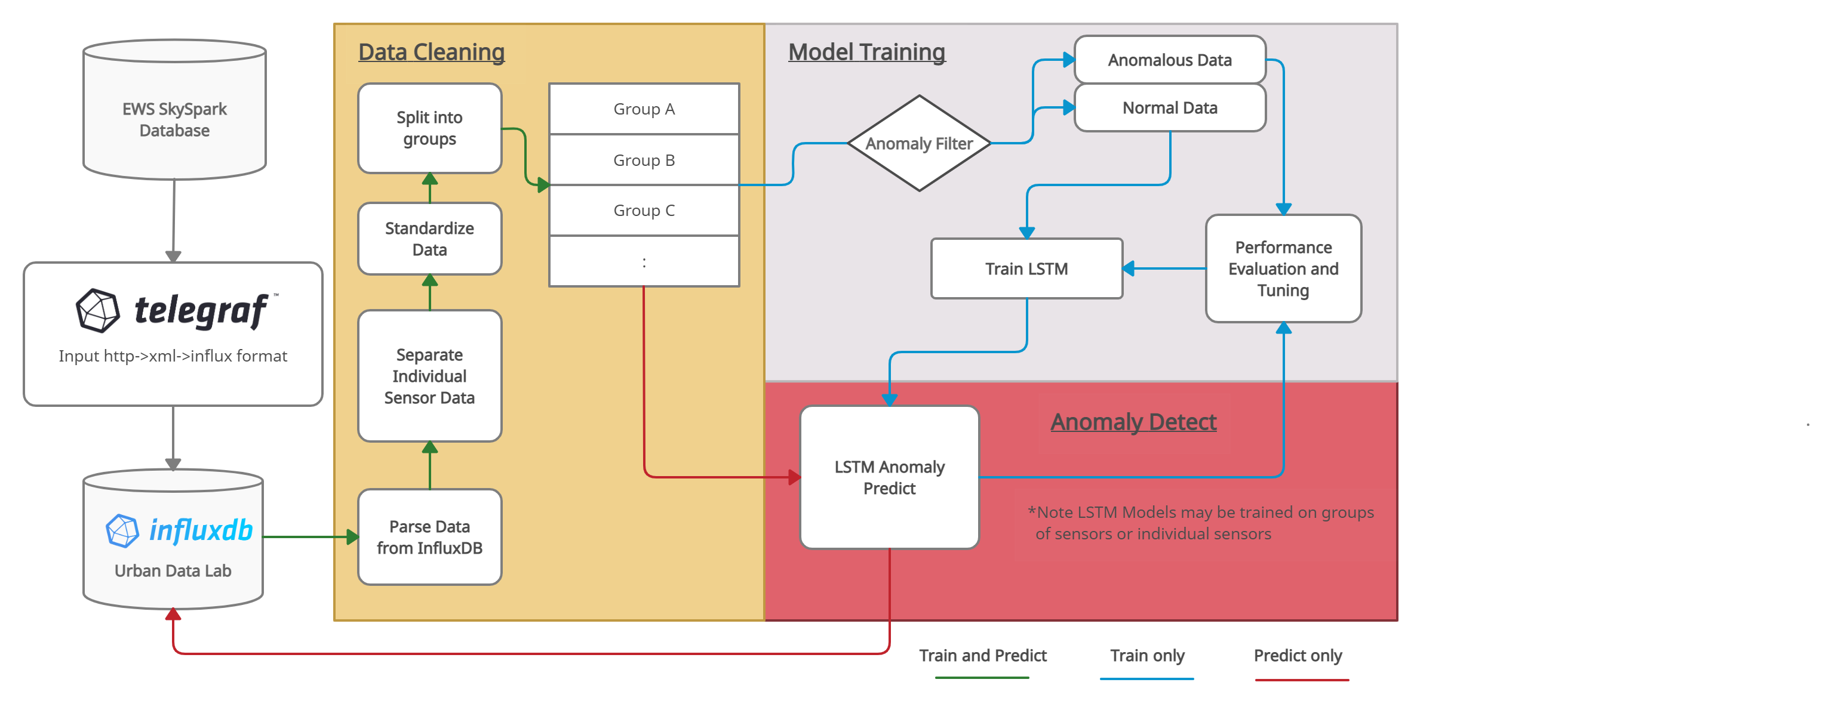
Pipeline Schematic Additional Slides

