Slide 1
Realtime Anomaly Detection for Building Sensors Urban Data Lab Capstone Project Week 7 Status
Data 599 Mitch Harris, Ryan Koenig, Nathan Smith June 15, 2021

Slide 2
Outline
Previous Week Summary (June 7 – 13)
Next/Final Week Planning (June 14 – 22)
Timeline Reflection

Slide 3
Previous Week Summary
Week 6 Goals: Dashboard
Final Model Testing
Wrap-up Model Implementation and Code
Dashboard
Work on Report

Slide 4
Week 6 Tasks Previous Week (June 7 - 13)
Final Model Testing
Selected threshold rule and default window length
Downloaded an additional 5 sensors (had to do this manually)
Summarized results
Evaluating 5 additional sensors Monday but now complete

Slide 5
Week 6 Tasks Previous Week (June 7 - 13)

Slide 6
Week 6 Tasks Previous Week (June 7 - 13)
Continued Reporting
Mainly complete, just needs additional results and several figures
Targeting final draft report completion for Wednesday
Already started final presentation
On track (and ahead of schedule)

Slide 7
Week 6 Tasks Previous Week (June 7 - 13)
Model Implementation
Implementation in test environment with notebook walk-through
Still needs additional work
As real-time data streaming to InfluxDB is not available this will be the main implementation
Additional work required on this during the week

Slide 8
Week 6 Tasks Previous Week (June 7 - 13)
Dashboard and Notification System
Simple dashboard built directly into InfluxDB
Simple notification system – if an anomaly is predicted for a sensor a notification is sent to a Slack channel
Still finishing dashboard and notification system – hopefully wrapped up today

Slide 9
Week 6 Tasks Previous Week (June 7 - 13)

Slide 10
Challenges Previous Week (June 7 - 13)
Wrap-up
Needed to focus on wrapping up scope
Test environment walkthrough added some scope
Dashboard
Dashboard didn’t go as fast as hoped – while the Dashboard implementation in InfluxDB is easy, Boolean data is not handled well

Slide 11
Client Meetings Previous Week (June 7 - 13)
Thursday Sprint Planning
Plan for next week tasks, discuss final project wrap-up
Provide draft report to UDL Wednesday EOD
Present to UDL the following Wednesday

Slide 12
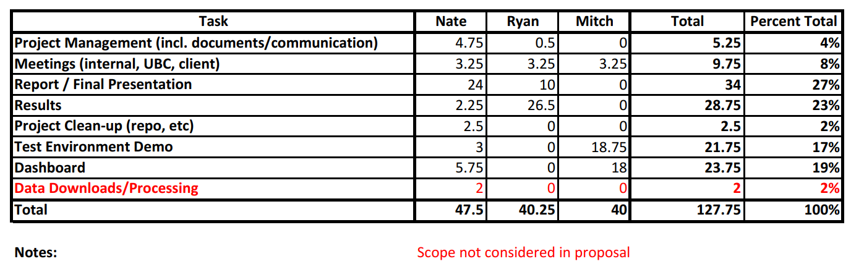
Time Summary Previous Week (June 7 - 13)

Slide 13
Next/Final Week Planning
Week 7 Goals: Reporting
Complete Report
Complete Presentation
Complete Walkthrough/Code/Repo Wrap-up Code

Slide 14
Individual Tasks Next Week (June 14 - 22)
Mitch: Complete Dashboard and Package Wrap-up
Ryan: Results Section of Report
Nate: Complete Walkthrough and Repo Wrap-up
We have a detailed daily task list to ensure we’re on track

Slide 15
Challenges Next Week (June 14 - 22)
Stick to Wrap-up and schedule

Slide 16
Timeline Reflection

Slide 17
Schedule Timeline Reflection
Week 6:
Dashboard (complete today)
Complete final model tests (complete Mon)
Continued reporting (ahead of schedule)
Test environment (not completed, ongoing)
Week 7:
Finish report and presentation
Finish dashboard and walkthrough
Wrap-up code/repo
Week | Goal
1 | Project Definitional and Proposal
2 | Data and System Understanding
3 | Anomaly Detection Model
4 | Implement Streaming Pipeline
5 | Value Week
6 | Dashboard
7 | Reporting

Slide 18
Impacts to Schedule Timeline Reflection
It’s going to be busy but we believe doable

Slide 19

Thank You
Mitch Harris
Ryan Koenig
Nathan Smith

Slide 20





Anomaly Detection Framework Additional Slides
Anomaly detection model are trained and parameters stored
Anomaly detector only reads latest points and uses stored parameters
Run Weekly/Monthly to Update Model
Raw
Model Parameters Stored
Parsed
Detected
Train Parameters
Continuous Read/Detect/Write

Slide 21
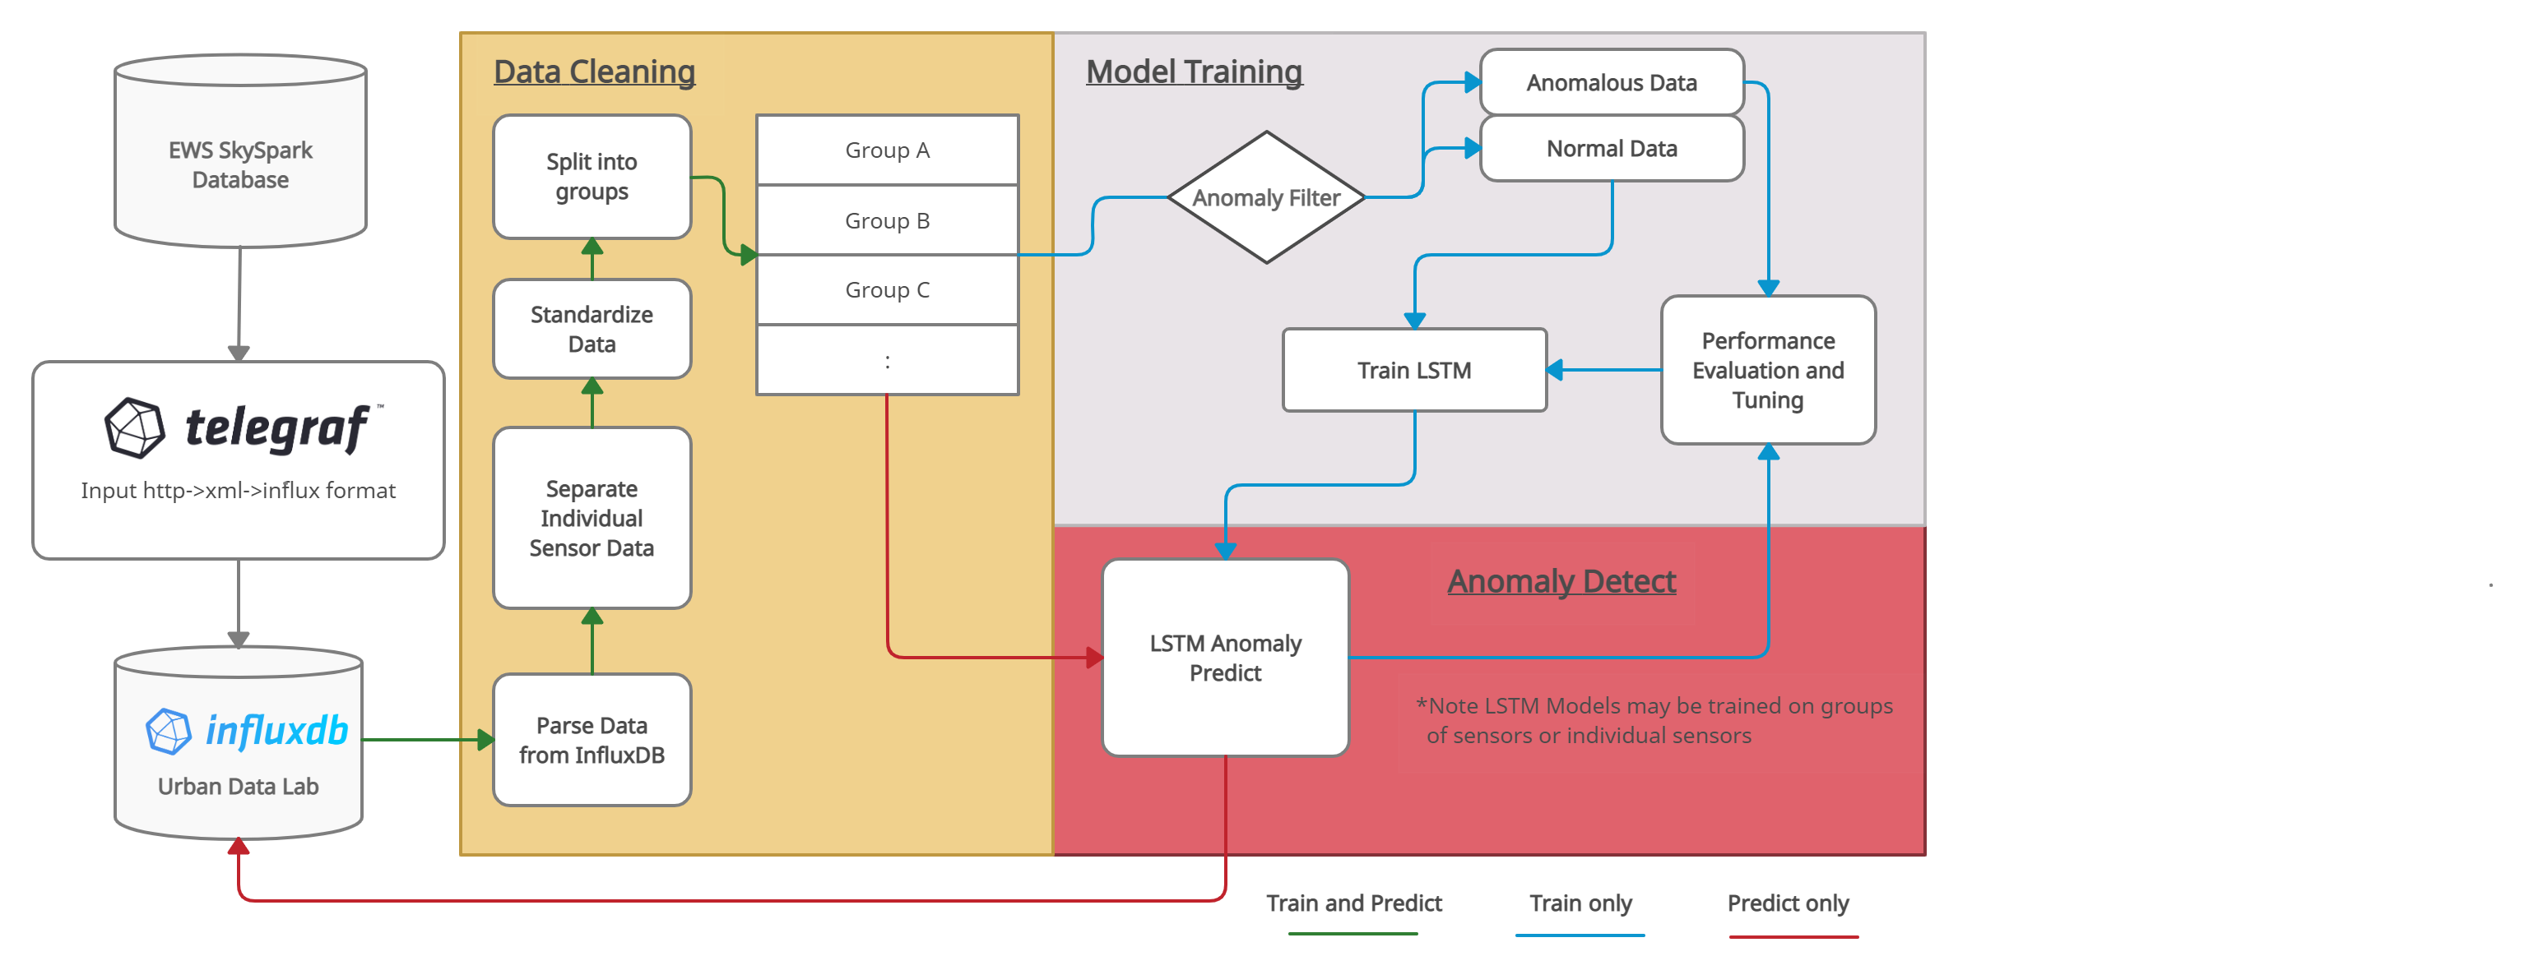
Pipeline Schematic Additional Slides

