Slide 1
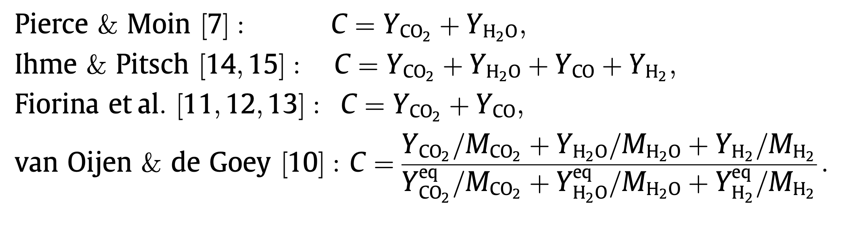
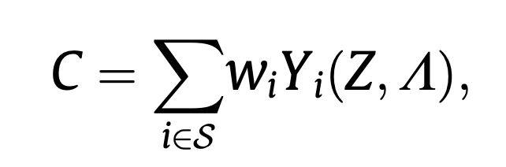
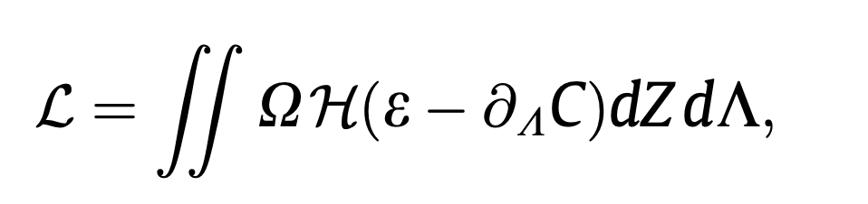
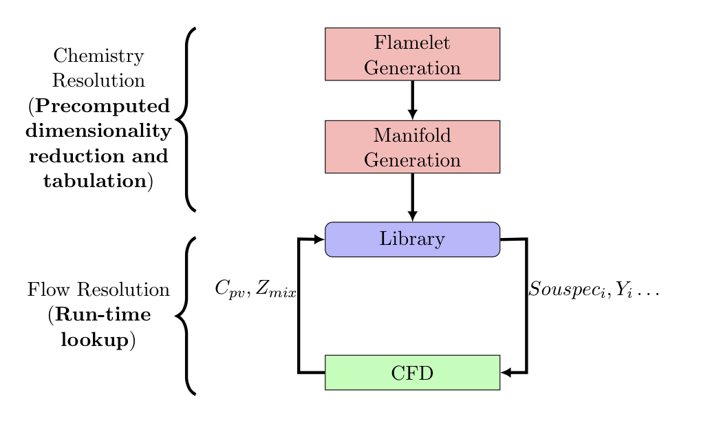
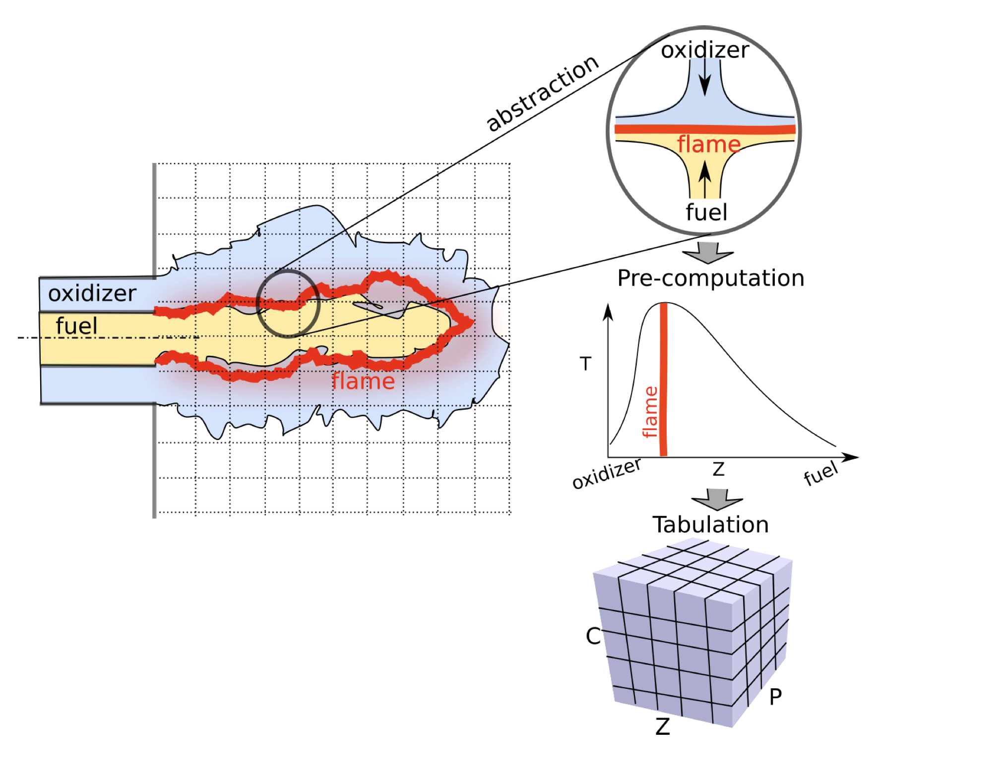
ChemTab: Integrated Framework for joint Reduced Basis Learning & Regression Learning using Shallow Autoencoder and Deep Regressor Author(s) Amol Salunkhe, Dwyer Deighan, Paul Desjardin, Varun Chandola Email: aas22@buffalo.edu, dwyerdei@buffalo.edu, ped3@buffalo.edu, chandola@buffalo.edu
Introduction
Chemistry Tabulation/Reduced Basis Learning
The thermochemical manifold is parameterized :
Conserved scalar (mixture fraction, Z)
Reaction progress variables
The reaction progress variable “C” calculated
Intrinsic low dimensional manifold
Flame Generation Manifolds (FGM)
Guiding principles for “C”
Resulting transport equation that can be conveniently solved
Reactive scalars should evolve on comparable time scales
Parameters should be independent of each other
A bijective mapping between spaces
Fixed Expressions
Combustion Modelling
Results
All the ML Frameworks perform better than the current framework
(re) Solved Separately for Computational Efficiency
Method | Total Absolute Error | Mean Absolute Error
Non-ML Framework | 3.68E+13 | 2.24E+09
ML Framework I (GP) | 3.98E+12 | 4.84E+08
ML Framework I (DNN) | 3.36E+12 | 4.09E+08
Physics Constrained DNN Framework I | 6.94E+12 | 8.44E+08
Physics Constrained DNN Framework II | 3.94E+12 | 4.04E+08
Chemistry
Modelling
Flow
Modelling
Data Driven Calculations
Issues
In order to satisfy (bijective mapping), several flames in the original data are removed before building the look-up table
Inaccurate estimation of the thermochemical space
This could be improved by including more progress variables
Would make interpolation even more inefficient
Polynomial growth of the look-up table
Machine Learning Framework
Reduced Basis Learning
Reverse Lookup Learning
Summary
The Physics Constrained Deep Neural Network II (PCDNN II) shows quantitatively accurate predictions for source energy terms and is comparable in performance to the PCA and GP Framework.
This is a significant first step in creation of a broader framework that helps jointly optimize reduced basis learning and reverse lookup learning
Existing Framework
Reduced Basis Parameterization in 2 dimensions: Zmix, C
Tabulation using Conformal Mapping
Reverse Lookup using Lagrange Polynomial Interpolation
Machine Learning Framework I
Physics Constrained DNN Framework II
ML predictive model
Neural network
Constrained PCA
Low-dimensional state
High dimensional input vector
Thermochemical state variables
High dimensional input vector
Future Work
To incorporate the 1-D Flame Generation to the DNN as a part of the Physics Constraint
To Expand the DNN to give confidence intervals around the point estimates
To create a Gaussian Process based joint framework
Pre-computation
Run-time
AutoEncoder
Regressor
Thermochemical state variables
Reduced Basis Learning
Reverse Lookup Learning
Kernel Constraints
Activity Regularizer
Regularizer
Prediction
Loss
Reduced Basis Learning
Reverse Lookup Learning
Physics Constrained DNN Framework I
The linear embedding is trained with following constraints:
Unit Norm
Orthogonality of Basis Vectors (weights)
Uncorrelated Features (covariance of outputs from the linear layer)
The constraints get added to the Prediction Cost Function and aid in Joint Optimization
References
Formulation and assessment of flamelet generated manifolds for reacting interfaces
Regularization of reaction progress variable for application to flamelet based combustion models
Combustion modeling using principal component analysis
Physics-guided Neural Networks (PGNN): An Application in Lake Temperature Modeling
Combustion modeling using Principal Component Analysis: A posteriori validation on Sandia flames
Neural network 1
The Physics Constrained DNN II combines the two steps into a coupled neural network architecture
The first layer can be conceptualized as a Linear Shallow Autoencoder which does Reduced Basis Learning (learn linear embedding from input high-dimensional input vector )
The subsequent layers form a Deep Regressor that predicts the target state variables (source energy, temperature, etc.) from the linear embedding
Both networks are jointly trained
Linear layer
Thermochemical state variables
High dimensional input vector
PCA reduced representation
Acknowledgements
Funded by the United States Department of Energy’s (DoE) National Nuclear Security Administration (NNSA) under the Predictive Science Academic Alliance Program III (PSAAP III) at the University at Buffalo, under contract number DE-NA0003961.
Neural network 2
Reduced Basis Learning
Reverse Lookup Learning

