Slide 1
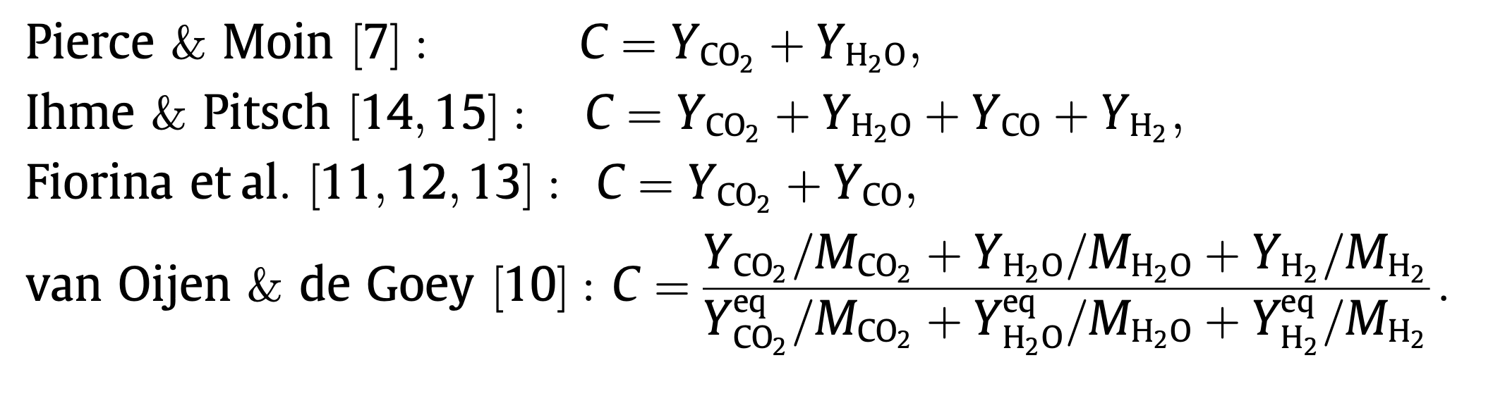
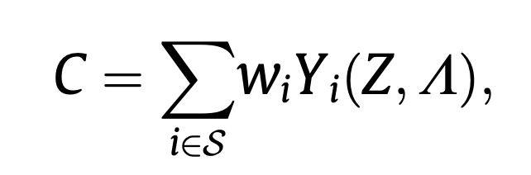
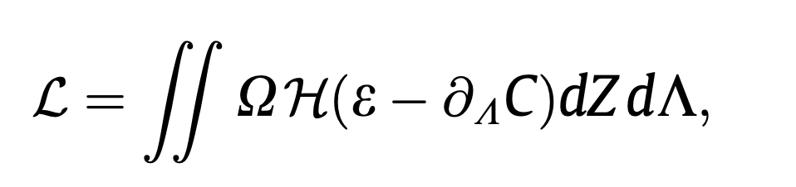
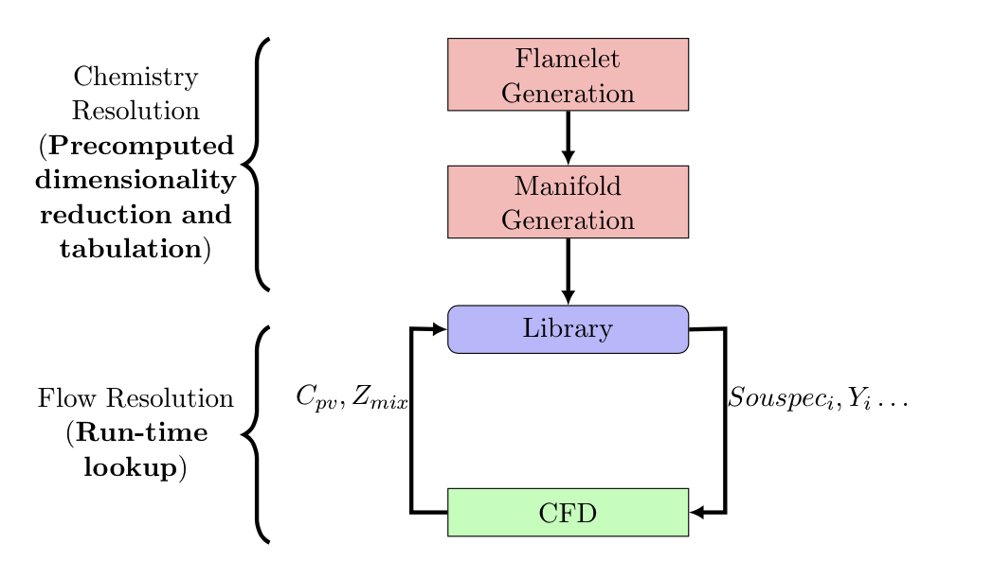
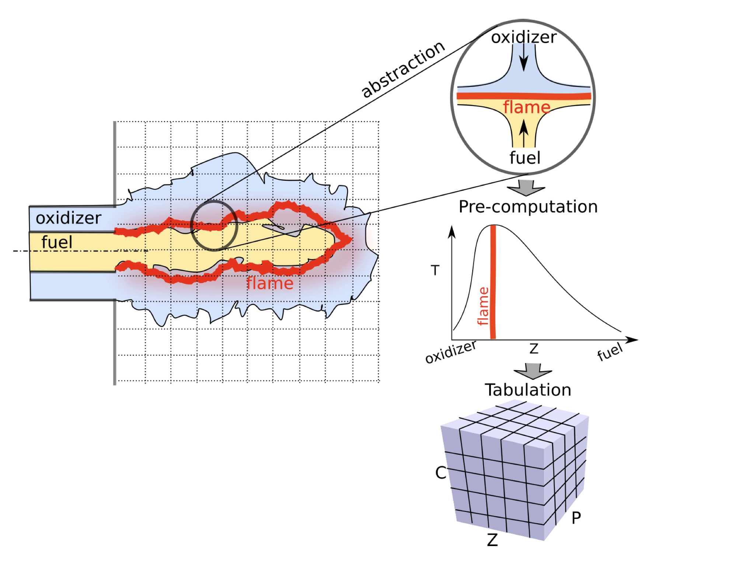
ML Framework For Chemistry Tabulation & Lookup Author(s) Amol Salunkhe, Siddhant Aphale, Paul Desjardin, Varun Chandola Email: aas22@buffalo.edu, saphale@buffalo.edu, ped3@buffalo.edu, chandola@buffalo.edu
Introduction
Chemistry Tabulation/Reduced Basis Learning
The thermochemical manifold is parameterized :
Conserved scalar (mixture fraction, Z)
Reaction progress variables
The reaction progress variable “C” calculated
Intrinsic low dimensional manifold
Flame Generation Manifolds (FGM)
Guiding principles for “C”
Resulting transport equation that can be conveniently solved
Reactive scalars should evolve on comparable time scales
Parameters should be independent of each other
A bijective mapping between spaces
Fixed Expressions
Combustion Modelling
Results
All the ML Frameworks perform better than the current framework
(re) Solved Separately for Computational Efficiency
Method | Total Absolute Error | Mean Absolute Error
Non-ML Framework | 3.68E+13 | 2.24E+09
ML Framework I (GP) | 3.98E+12 | 4.84E+08
ML Framework I (DNN) | 3.36E+12 | 4.09E+08
Physics Constrained DNN Framework | 6.94E+12 | 8.44E+08
Chemistry
Modelling
Flow
Modelling
Data Driven Calculations
Issues
In order to satisfy (bijective mapping), several flames in the original data are removed before building the look-up table
Inaccurate estimation of the thermochemical space
This could be improved by including more progress variables
Would make interpolation even more inefficient
Polynomial growth of the look-up table
Machine Learning Framework
Reduced Basis Learning
Reverse Lookup Learning
Summary
The Physics Constrained Deep Neural Network (PCDNN) shows quantitatively accurate predictions for source energy terms and is comparable in performance to the PCA and GP Framework.
This is a significant first step in creation of a broader framework that helps jointly optimize reduced basis learning and reverse lookup learning
Existing Framework
Reduced Basis Parameterization in 2 dimensions: Zmix, C
Tabulation using Conformal Mapping
Reverse Lookup using Lagrange Polynomial Interpolation
Machine Learning Framework I
Physics Constrained DNN Framework
Neural network 1
Constrained PCA
ML predictive model
Low-dimensional state
High dimensional input vector
Thermochemical state variables
Linear layer
Future Work
To incorporate the 1-D Flame Generation to the DNN as a part of the Physics Constraint
To Include the Manifold Regularization in the DNN as a Physics Constraint
To create a Gaussian Process based joint framework
Pre-computation
Run-time
High dimensional input vector
Thermochemical state variables
Reduced Basis Learning
Reverse Lookup Learning
PCA reduced representation
ML Framework I
Step 1: Use principal component analysis (PCA) to learn the progress variables
Orthogonal basis vectors (C3)
A constrained PCA formulation used to include Z_{mix}
Step 2: Replace Tabular Lookup using ML Model
A Gaussian Process Regression model
Also provides uncertainties with the predictions
Computationally inefficient
A neural network
Could be computationally inefficient
The reduction and the ML model lookup steps are decoupled in the first framework
PCA focuses on maximizing the variance of the high-dimensional data in the low-dimensional reduction (C1, C2, C3)
Is not necessarily informed by the subsequent task of predicting the high-dimensional state (C4)
Neural network 2
Reduced Basis Learning
Reverse Lookup Learning
References
Formulation and assessment of flamelet generated manifolds for reacting interfaces
Regularization of reaction progress variable for application to flamelet based combustion models
Combustion modeling using principal component analysis
Physics-guided Neural Networks (PGNN): An Application in Lake Temperature Modeling
Combustion modeling using Principal Component Analysis: A posteriori validation on Sandia flames
The Physics Constrained DNN combines the two steps into a coupled neural network architecture
The first neural network is trained to accurately predict the target state variables (source energy, temperature, etc.) from the input high-dimensional input vector
The first layer has a linear activation and a bottleneck – width of the layer corresponds to the dimensionality of the reduced space
The second neural network is trained to recover the PCA based reduction of the high-dimensional input
Both networks are jointly trained
Acknowledgements
Funded by the United States Department of Energy’s (DoE) National Nuclear Security Administration (NNSA) under the Predictive Science Academic Alliance Program III (PSAAP III) at the University at Buffalo, under contract number DE-NA0003961.

