Slide 1
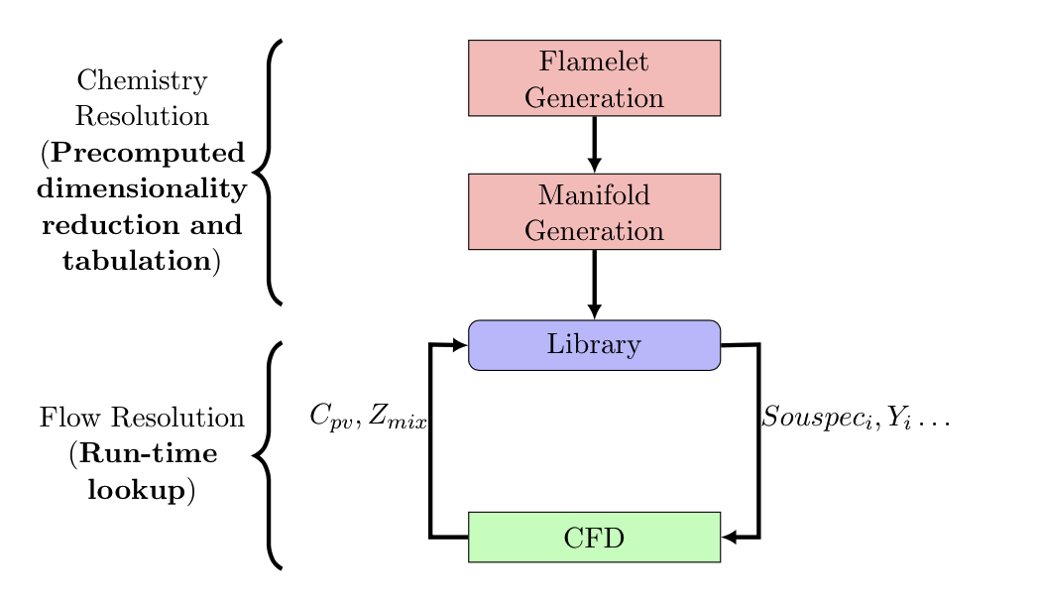
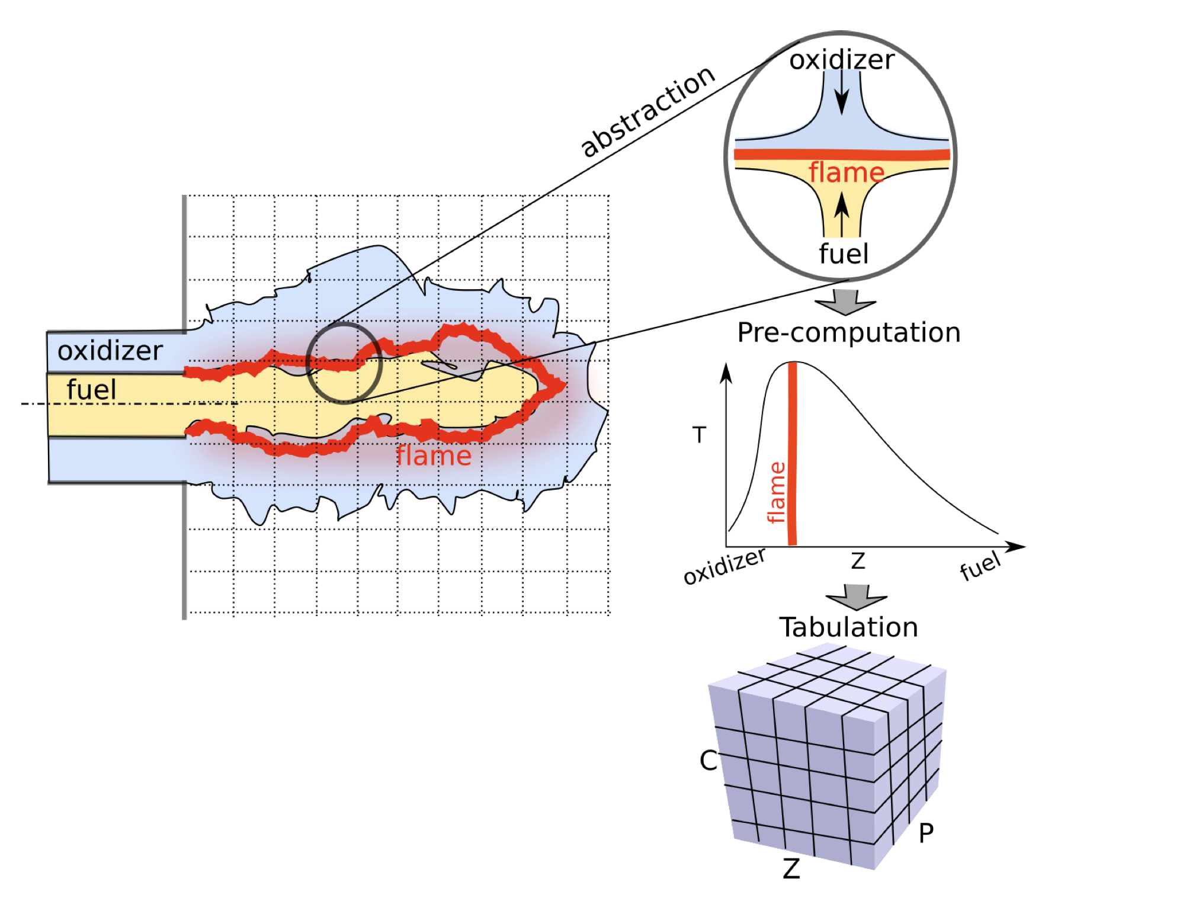
Turbulent Combustion Modeling
Numerical simulations of turbulent combustion problems is expensive
Large number of molecular species present
Large disparity between the scales for the flame (combustion) and the flow
A typical model reduction strategy is to project the high-dimensional thermochemical state-space on a low-dimensional manifold
The state-space is precomputed and parameterized in terms of a reduced set of scalar variables (tabulation)
The flow system is solved using the scalar variables (model reduction)
The full state space (chemistry) is efficiently looked up during run-time
Advantage: decouple the turbulent flow field (exists at a coarser time/spatial scale) and the chemical reactions (exist at a much finer time/spatial scale)
Src: S. Bhalla et al., 2019, ECML-PKDD

Slide 2
Tabulation Famework Properties
Accuracy
Memory Efficiency
Speed
Interpretability
Uncertainty Quantification

Slide 3
Reducing Chemistry
The thermochemical manifold is parameterized using:
Conserved scalar (mixture fraction, Z)
Reaction progress variables (e.g., C_{pv} in Bojko and Desjardin, 2016)
The reaction progress variable, C, can be calculated in several ways
Intrinsic low dimensional manifold (ILDM – Mass and Pope, 1992)
Flame Generation Manifolds (FGM)
Guiding principles for C
C1 - Result in transport equation that can be conveniently solved
C2 - The reactive scalars should evolve on comparable time scales
C3 - Parameters should be independent of each other
C4 - A bijective mapping from manifold space to the thermo-chemical state space

Slide 4
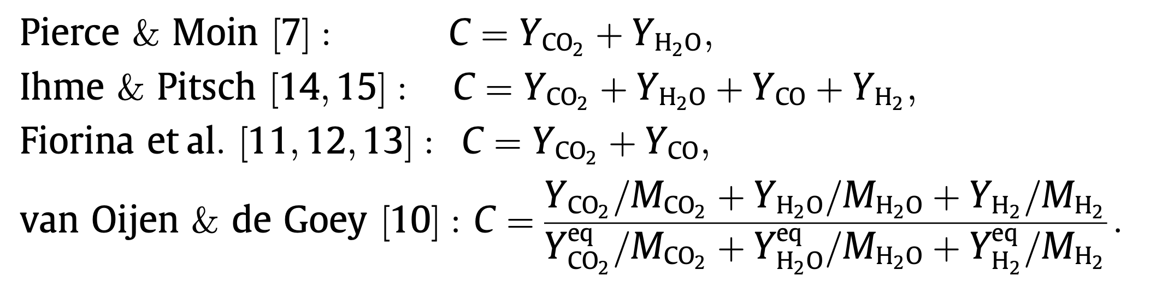
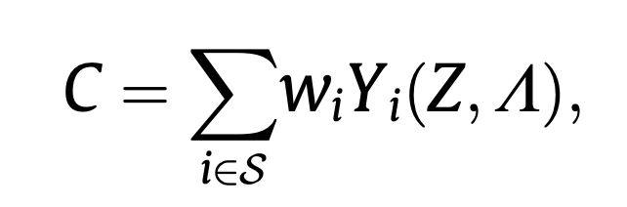
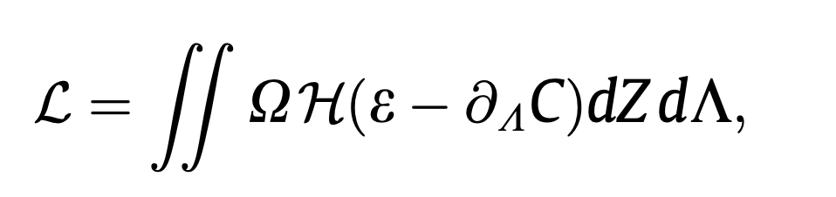
Example of existing approaches
Fixed expressions
Data-driven calculations
The weights are estimated by optimizing over a cost-function that imposes the monotonicity requirement (for C4)

Slide 5
Issues
The look-up could be computationally inefficient
In order to satisfy C4 (bijective mapping), several flames in the original data are removed before building the look-up table
Inaccurate estimation of the thermochemical space
This could be improved by including more progress variables
Would make interpolation even more inefficient
Exponential growth of the look-up table

Slide 6
Proposed Machine Learning Based Framework 1
ML predictive model
Constrained PCA
Low-dimensional state
High dimensional input vector
Thermochemical state variables
Pre-computation
Run-time

Slide 7
Proposed Machine Learning Based Framework 2
Neural network 1
The second neural network is trained to recover the PCA based reduction of the high-dimensional input
Both networks are jointly trained
Linear layer
High dimensional input vector
Thermochemical state variables
PCA reduced representation
Neural network 2

Slide 8
Proposed Machine Learning Based Framework 2
Neural network
The linear embedding is trained with following constraints:
Unit Norm
Orthogonality of Basis Vectors (weights)
Uncorrelated Features (covariance of outputs from the linear layer)
The constraints get added to the Prediction Cost Function and aid in Joint Optimization
Zmix
Linear layer (5)
High dimensional input vector
Thermochemical state variables
Kernel Constraints
Activity Regularizer
Linear Layer O/P = (W (ip) + bias)
Kernel Constraints + Activity Regularizer Loss + Prediction Loss

Slide 9
Oxidizer
Flame
x - Axial Coordinate
r - Radial Coordinate
Fuel

Slide 10
CHEMISTRY PDE DATA
Dimensionality Reduction
Chemistry
(Precomputed)
MANIFOLD GENERATION
Tabulation
REVERSE LOOKUP
Cpv
Zmix
Zst
Yi
Souspeci
……
….
Flow
(Run-time lookup)
CFD

Slide 11
FLAMELET GENERATION
Dimensionality Reduction
Chemistry
(Precomputed)
MANIFOLD GENERATION
Tabulation
LIBRARY
Cpv
Zmix
Zst
Lagrange Polynomial Interpolation
Yi
Souspeci
……
….
Flow
(Run-time lookup)
CFD

Slide 12
Combustion Modelling
(re) Solved Separately for Computational Efficiency
Chemistry
Modelling
Flow
Modelling
Machine Learning Framework
Reduced Basis Learning
Reverse Lookup Learning

Slide 13
Constrained PCA
ML predictive model
Low-dimensional state
High dimensional input vector
Thermochemical state variables
Reduced Basis Learning
Reverse Lookup Learning

Slide 14
Neural network I
Linear layer
Thermochemical state variables
High dimensional input vector
PCA reduced representation
Neural network II

Slide 15
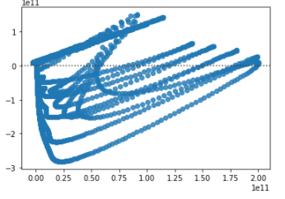
True vs Residuals

Slide 16
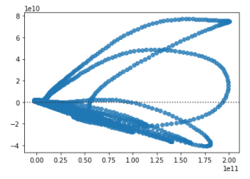
True vs Residuals

Slide 17
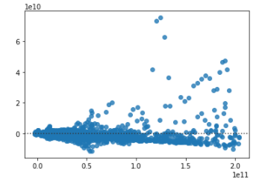
True vs Residuals

Slide 18
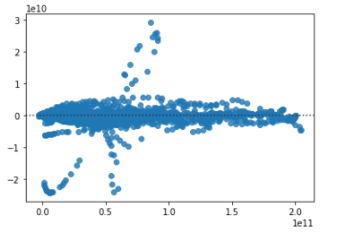
True vs Residuals

Slide 19
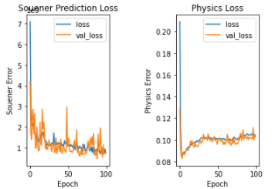

Slide 20
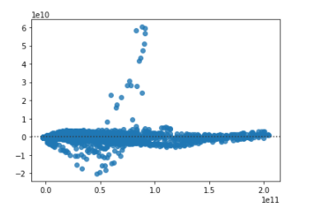
True vs Residuals

