Slide 1
Oxidizer
Flame
x - Axial Coordinate
r - Radial Coordinate
Fuel

Slide 2
CHEMISTRY PDE DATA
Dimensionality Reduction
Chemistry
(Precomputed)
MANIFOLD GENERATION
Tabulation
REVERSE LOOKUP
Cpv
Zmix
Zst
Yi
Souspeci
……
….
Flow
(Run-time lookup)
CFD

Slide 3
FLAMELET GENERATION
Dimensionality Reduction
Chemistry
(Precomputed)
MANIFOLD GENERATION
Tabulation
LIBRARY
Cpv
Zmix
Zst
Lagrange Polynomial Interpolation
Yi
Souspeci
……
….
Flow
(Run-time lookup)
CFD

Slide 4
Combustion Modelling
(re) Solved Separately for Computational Efficiency
Chemistry
Modelling
Flow
Modelling
Machine Learning Framework
Reduced Basis Learning
Reverse Lookup Learning

Slide 5
Constrained PCA
ML predictive model
Low-dimensional state
High dimensional input vector
Thermochemical state variables
Reduced Basis Learning
Reverse Lookup Learning

Slide 6
Neural network I
Linear layer
Thermochemical state variables
High dimensional input vector
PCA reduced representation
Neural network II

Slide 7
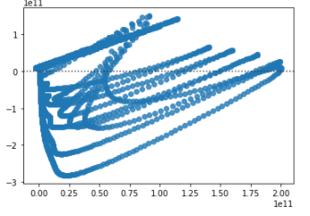
True vs Residuals

Slide 8
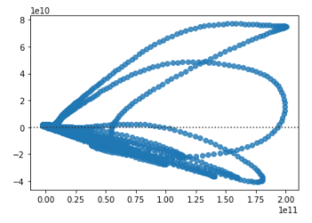
True vs Residuals

Slide 9
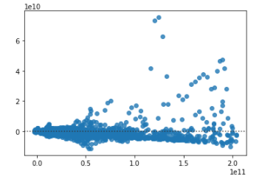
True vs Residuals

Slide 10
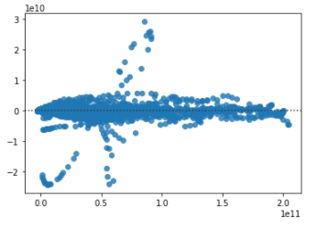
True vs Residuals

Slide 11
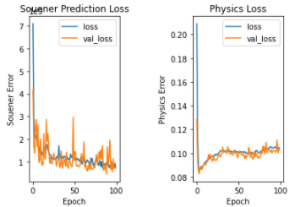

Slide 12
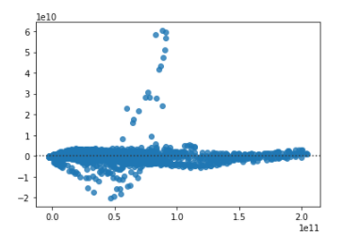
True vs Residuals

