Slide 1




TEAM - 10
SYSTEM DESIGN

Slide 2
SYSTEM ARCHITECTURE APPROACH
MODULAR
MONOLITH
HYBRID
APPROACH
MICRO-
SERVICES

Slide 3
LEVEL 1 DFD

Slide 4
Some Interesting Use Cases
01 – Participate in Peer Review
includes:
Send Peer Review Feedback (Student)
View Peer Review Feedback (Student)
Assign Peer Review Submissions (Instructor)
Manage Peer Review Submissions (Instructor)
02 - Sending User Reports to Admin

Slide 5
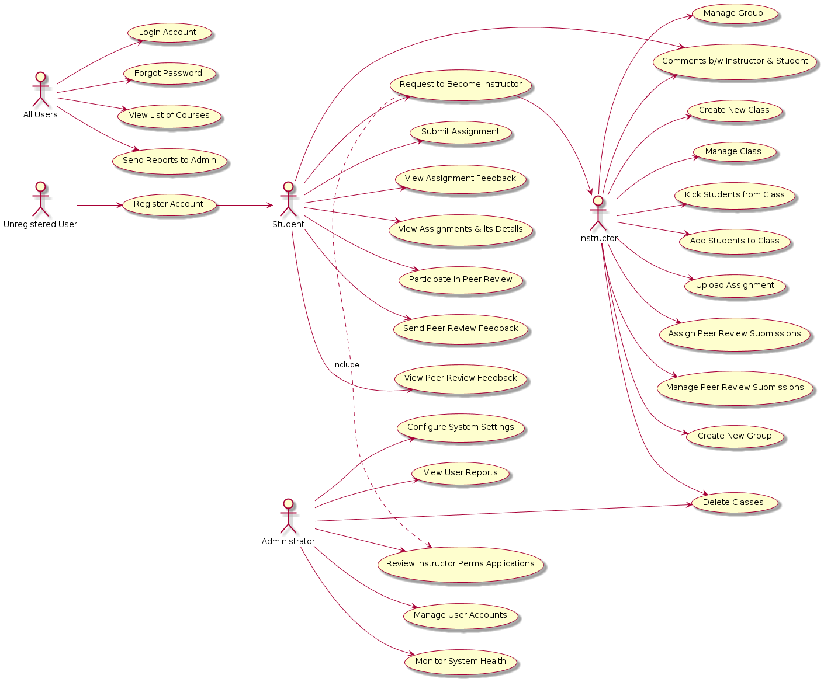

Slide 6
DB DIAGRAM

Slide 7
UI MOCK-UP

