Slide 1
Fine-Tuning GPT-2 for Personalized Recipe Recommendation
Nikhil Gupta
Krishnakumar Chavan
Venkatakrishnan Veeraraghavan

Slide 2
Project Description
The proposed project aims to develop an AI-powered system for personalized recipe recommendation utilizing advanced Deep Learning techniques. By fine-tuning the GPT model the project seeks to enhance users' culinary experiences through tailored recipe suggestions.
Brief description of the problem: Generating personalized recipe recommendations based on user preferences and dietary restrictions.
Importance: Enhancing user experience and accessibility for home cooking by providing tailored recommendations and visual guides.

Slide 3
GPT Background
GPT-2 is a powerful model used for text-generation tasks.
GPT-2 trains on vast amount of data to learn statistical patterns and structure of language with the help of tokenizer.
It generates contextually relevant text based on a given prompt.

Slide 4
Dataset
We have taken Recipes data consisting of 522,517 recipes from 312 different categories.
Features such as Title, Cooking times, Servings, Ingredients, Nutrition, Instructions, etc.
Preprocessing is done to add missing data, treat Nan values, filtering irrelevant data, Label Encoding, etc.
Feature Engineering is done to extract important features such as Name, Description, Keywords, Health Category, Instructions, Rating, and Difficulty Level, rest are dropped.
Lastly, all relevant data is converted to a txt file to feed as an input for GPT-2 model after Feature Engineering.

Slide 5
Training Methods
GPT-2 model consists of multiple layers of self-attention enabling it to maintain context for long range dependencies in input text.
First, we tokenize data using GPT2Tokenizer to convert text to numerical tokens.
Then, tokenized data is prepared as training dataset, with each recipe encoded as an input sequence.

Slide 6
Fine Tuning Hyperparameters
Tokenizer Length: 512
Learning Rate: 2e-5
Step Learning Rate Scheduler: 500
Gamma Value: 8
Gradient Clipping: 1.0
Optimizer: AdamW
Epochs: 200
Batch Size: 8

Slide 7
Results
Testing Input Prompt:
I'm craving a vegetarian Indian curry with lentils and aromatic spices.
Output:
Recipe suggestion:
Instructions:
I'm craving a vegetarian Indian curry with lentils and aromatic spices. This is the best recipe for me. I also advise you from personal experience to use only the freshest seeds for the most delicious curry.
If you are looking for a way to make a more Indian-inspired dish, try my recipe from one of my cookbooks. You will find that it is very easy to prepare and serve with any of the dishes you make. Make sure to add some chiles or onions as garnish. Let the curry cook over low heat for 15 minutes, stirring occasionally, Transfer the onions to food processor, Add chilies, garlic, ginger, cloves, peppercorns, cardamom seeds, cinnamon, coriander and cumin seeds and process until smooth, Strain through fine sieve Pour into baking pan or transfer to ice cream maker and blend until well blended, Return to pan and freeze until edges are solid but centre is soft Transfer to processor and add chile paste, yogurt and cinnamon mix well, Simmer, covered for at least 2 6 hours in refrigerator, In skillet heat oil over medium heat until fragrant, Remove chicken pieces from the sauce and set aside Add rice to sauce, bring to boil, and cook, uncovered over high heat, 45 minutes or until chicken is tender…

Slide 8
Evaluation Metrics

Slide 9
Perplexity
Perplexity is the value of how surprised the model is by the next token in sequence of tokens.
Perplexity: 1.0167.

Slide 10
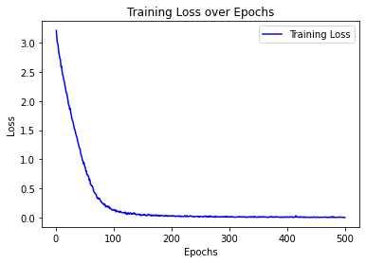
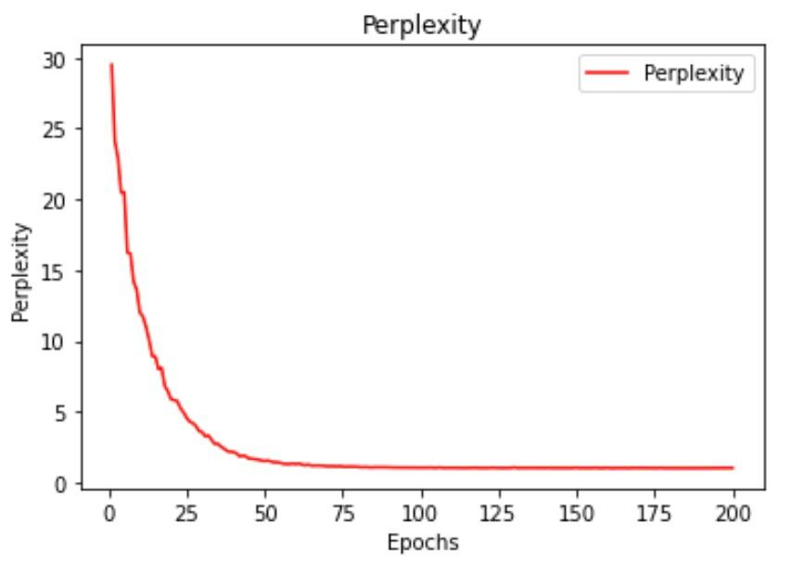
Training Loss and Perplexity Graph

Slide 11
BLEU Score
BLEU (Bilingual Evaluation Understudy) score is a metric used to evaluate the quality of machine-generated text.
It measures the similarity between the generated text and one or more reference texts provided by human annotators.
BLEU Score: 0.05432

Slide 12
ROUGE Score
ROUGE (Recall-Oriented Understudy for Gisting Evaluation) is a set of metrics used to evaluate the quality of automatic summarization and text generation tasks by measuring the similarity between generated output and reference texts.
ROUGE gives us a set of Precision, Recall, F1 Score values.
Precision: 0.104
Recall: 0.350
F1 Score: 0.160

Slide 13
Need of Fine Tuning
Existing Recipe Recommendation Systems lack:
Lack of Personalization (such as allergies, dietary restrictions, etc)
Static Recommendations (fixed recipe recommendations without considering requirement of ingredients)
Our Work aims:
Personalized Recommendations (output heavily depends on user’s input)
Dynamic Adaptation (model learns from previous inputs and adapts)
Checks if Recipe Generated is contextually correct (by using references)

Slide 14
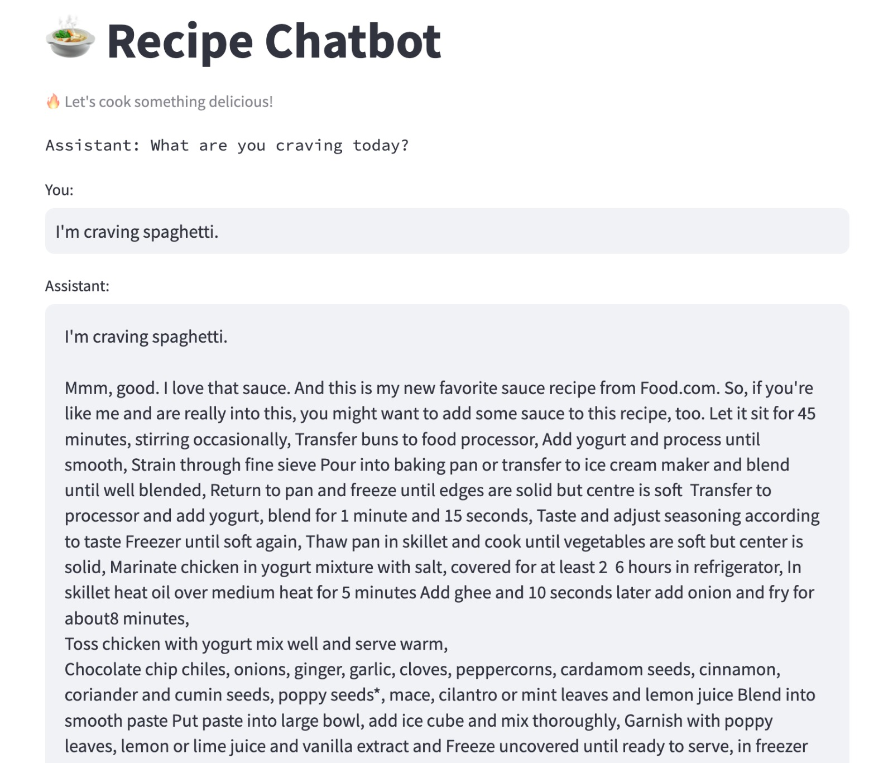
Website Demo

Slide 15
Conclusion
We are able to successfully generate Recipes using our GPT-2 Model.
We are able to achieve low perplexity and low loss values.
We have successfully made a product out of our model, a chatbot that suggests recipes for us called Recipe Chatbot

Slide 16
Future Work
Generate visualization of prompt result using GAN.
Training using more Food Dataset for improving model metrics.

Slide 17
References
How to Fine-Tune BERT for Text Classification? by Sun et al. (2019)
Fine-Tuning Pretrained Language Models: Weight Initializations, Data Orders, and Early Stopping by Raffel et al. (2019)
Language Models are Unsupervised Multitask Learners by Radford et al. (2019)
Image-to-Image Translation with Conditional Adversarial Networks by Isola et al. (2017)
Progressive Growing of GANs for Improved Quality, Stability, and Variation by Karras et al. (2018)
Semantic Image Synthesis with Spatially-Adaptive Normalization by Park et al. (2019)
Generative Adversarial Nets by Goodfellow et al. (2014)
Streamlit
Hugging Face GPT-2

Slide 18
Team Contribution Chart
Team Member | Project Part | Contribution (%)
Nikhil Gupta (ngupta22@buffalo.edu) | EDA, Text Processing, Model Training and Hyperparameter Tuning | 33.33%
Krishnakumar Chavan (kchavan@buffalo.edu) | Model Output, Visualizations and Hyperparameter Tuning | 33.33%
Venkatakrishnan Veeraraghavan (vveerara@buffalo.edu) | Data Cleaning, Evaluation Metrics and Hyperparameter Tuning | 33.33%

Slide 19
Thank You

