Slide 1
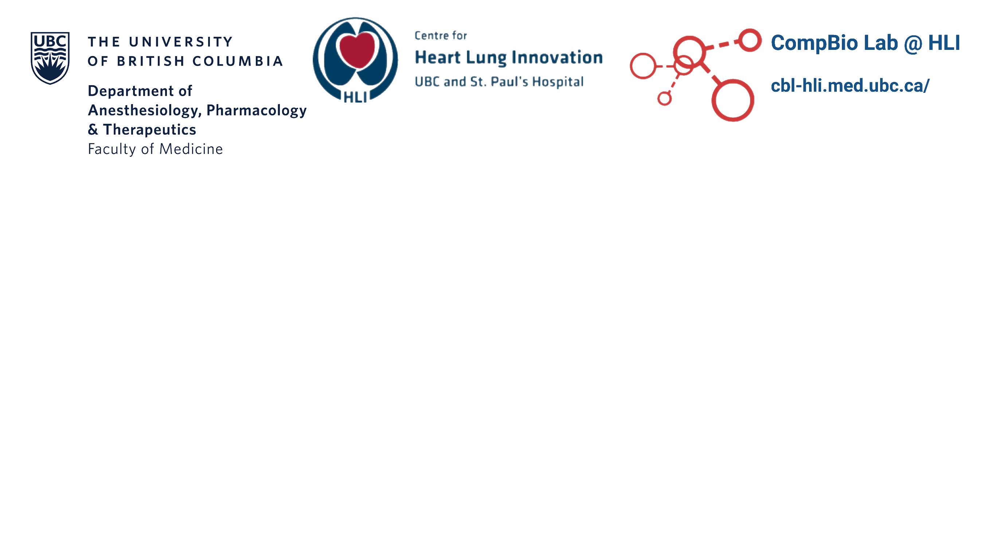
Reproducible and Portable Data Analysis Environments with Docker
UBC Biof. & Stats. Workshops
Feb 11, 2026
Notes:
Flow:
Present case study for reproducibility failure
Package unavailable due to differing versions of R
Package unavailable due to differing versions of packages
Same code, different results
Different people may also have different versions of these packages downloaded locally on their own devices. Not realistic to ask people to reinstall different versions of software packages every time a new pipeline needs to be run
Knowledge gap (for audience):
Is there a way to bypass all these issues?
Introduce Docker
A platform that allows users to run applications or pipelines in an isolated environment
Within that environment: users can specify exact packages and versions that are needed to run a particular analysis or pipeline. This bypasses the issue of code not working due to differing package versions
Introduce Docker concepts of container and images
Containers: Running instance of a Docker image
Images: An image is the built, read-only package that contains that complete environment, including the operating system, libraries, and your code.
Dockerfiles: A Dockerfile is a text file that specifies the exact software, dependencies, and setup steps needed to build a reproducible computing environment.
Go over how to:
Download Docker + DockerDesktop
How to build an image from dockerfile, where that dockerfile can be found on the DockerDesktop interface
Starting a docker container
How to mount current directory to docker image
How to share docker images (with dockerhub)
Recap
Add logos to title slide

Slide 2
Resources for today:
Slides + Code found on: https://github.com/UBCbioinformatics/DockerReproducibilityWorkshop
Notes:
Add link to github repo with slides here

Slide 3
What is Reproducibility?
To be able to obtain the same results by following the same methodology used in the past
Necessary for scientific integrity
For computational development: code not guaranteed to run exactly as expected
  Software dependencies can change over time
Notes:
From a computational perspective: just because you have access to someone’s code, doesn’t necessarily mean you’ll be able to recreate their results

Slide 4
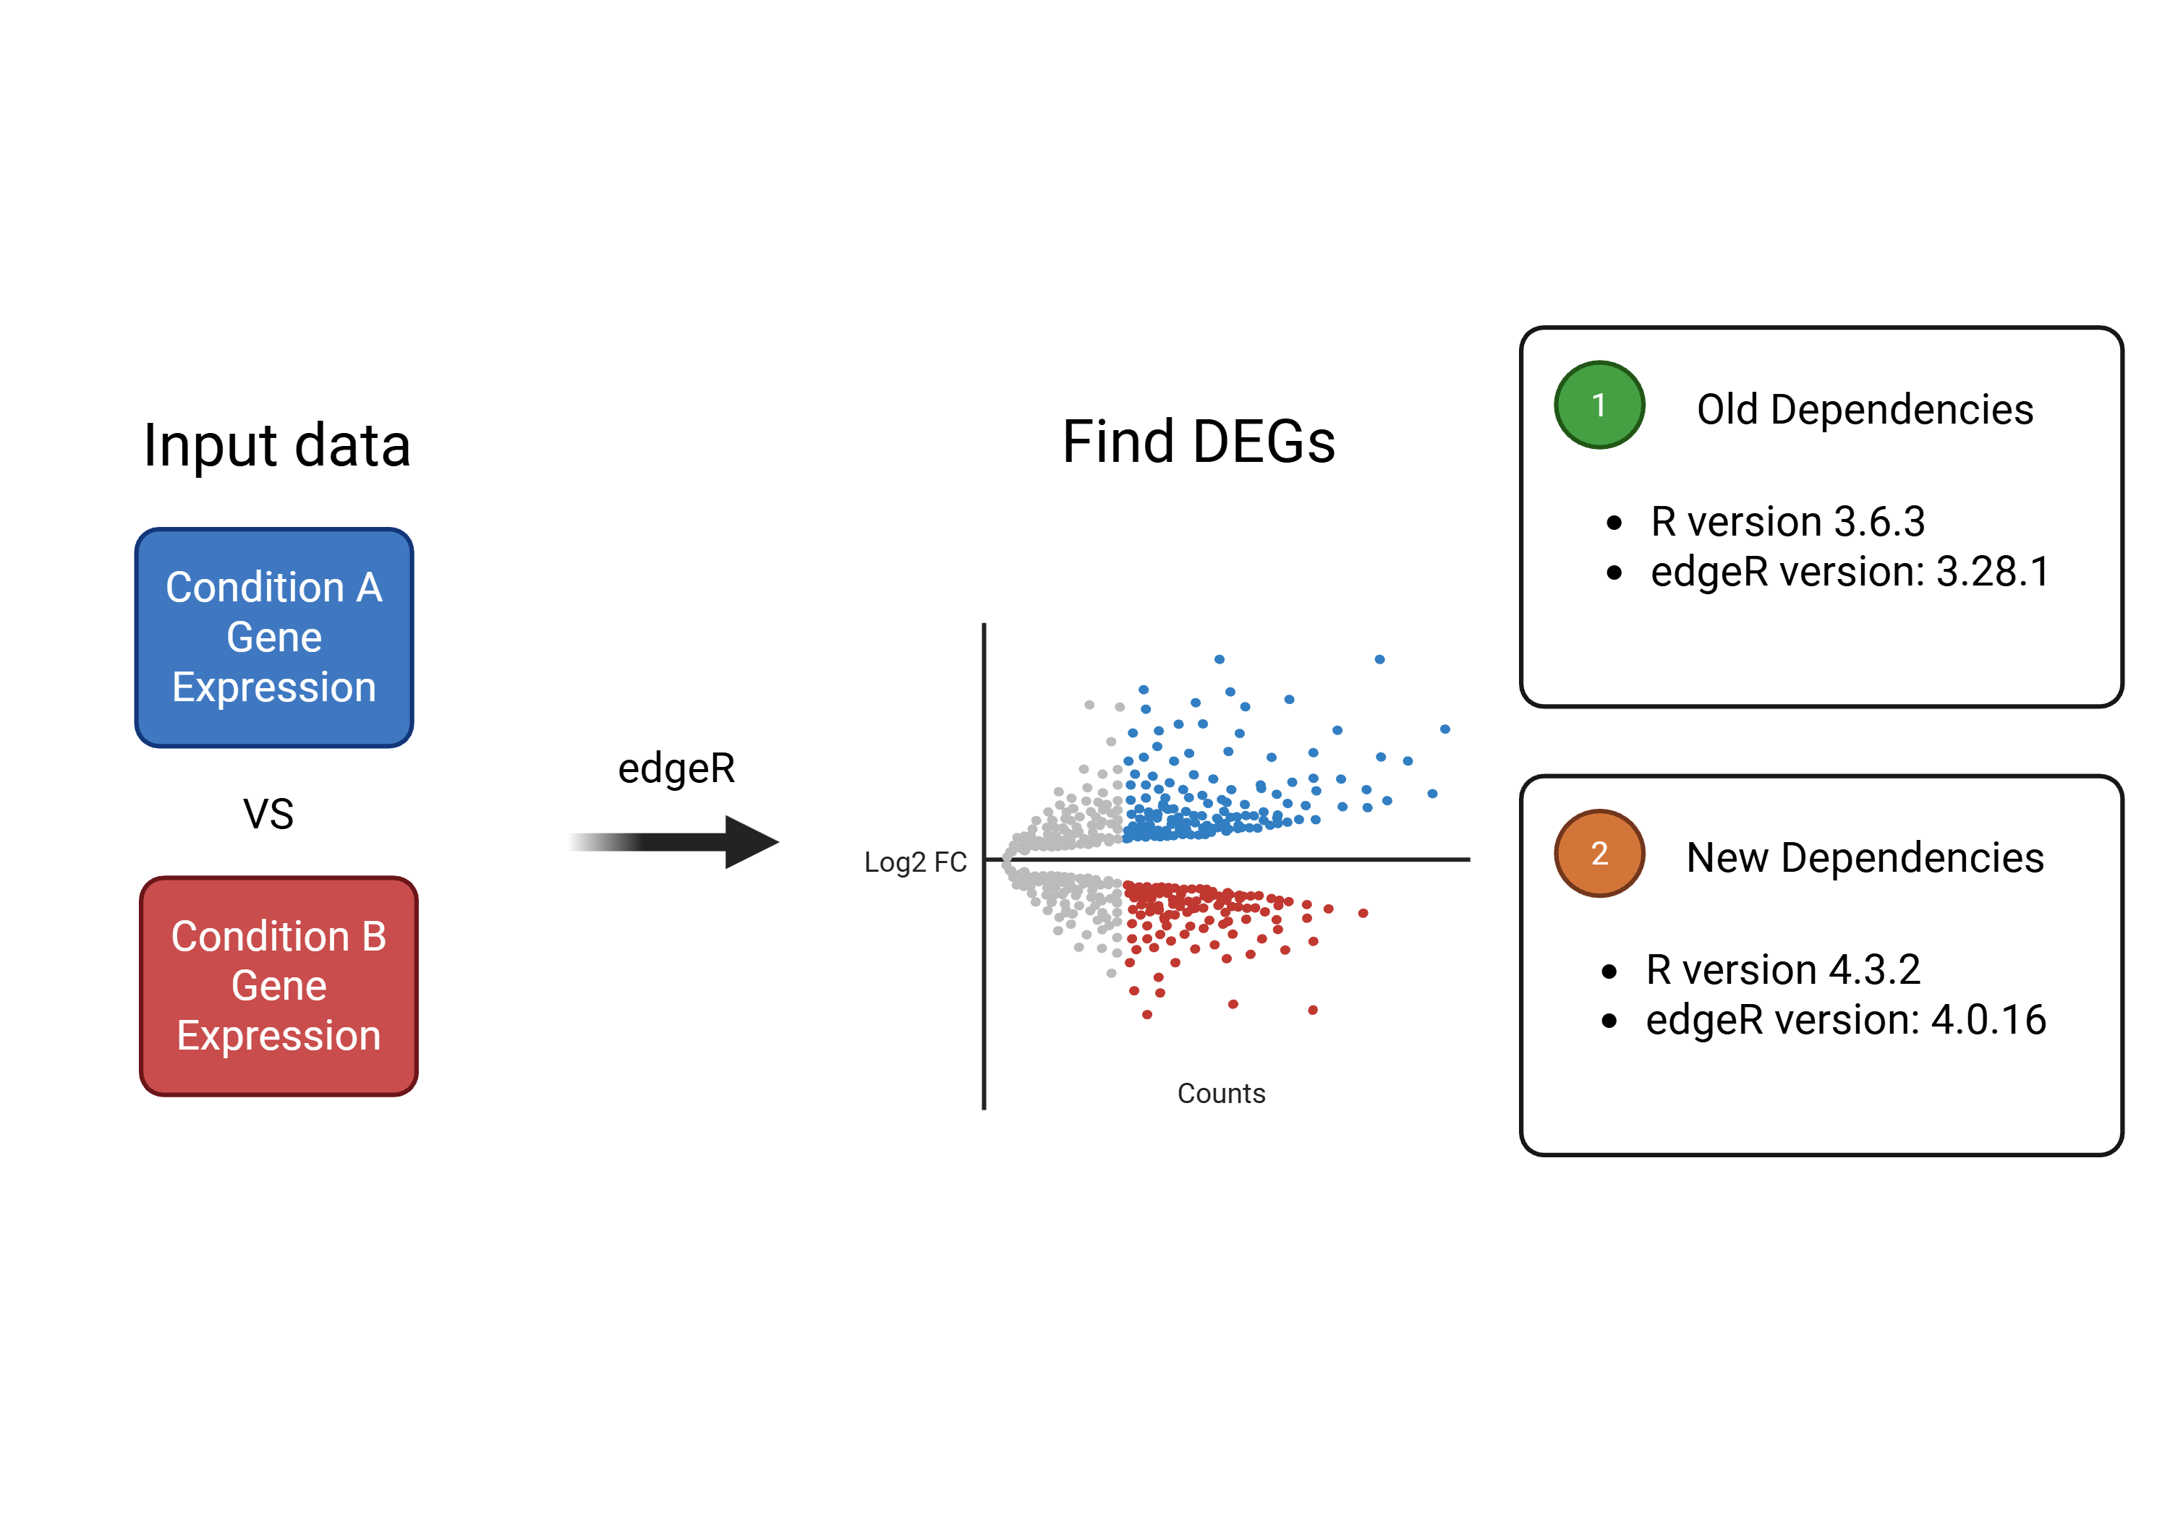
Reproducibility Failure Example
Made with Biorender
Notes:
As a toy example: I have here a DEG analysis pipeline
If I run all the code, we can see that it works, and produces these results
But software is never stagnant – updates to packages happen all the time. Even R updates every few months. Although these changes might be small, they may sometimes alter the results of the analysis at hand, or even cause the script to not work at all
In this other tab, I have the same script, but under the hood I’m using packages with different versions. When I try to run the script, I get these errors:
So: is there a way to mitigate issues like this? Yes: for a working pipeline, if we can somehow save a snapshot of all the software dependencies and versions which allow the pipeline to run successfully, then we know that if we run this code with these set of dependencies, it will always work

Slide 5
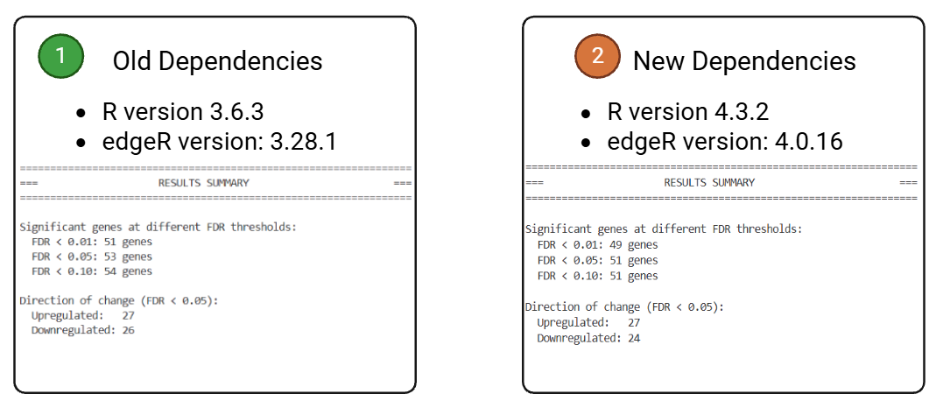
Reproducibility Failure Example
Made with Biorender
Notes:
As a toy example: I have here a DEG analysis pipeline
If I run all the code, we can see that it works, and produces these results
But software is never stagnant – updates to packages happen all the time. Even R updates every few months. Although these changes might be small, they may sometimes alter the results of the analysis at hand, or even cause the script to not work at all
In this other tab, I have the same script, but under the hood I’m using packages with different versions. When I try to run the script, I get these errors:
So: is there a way to mitigate issues like this? Yes: for a working pipeline, if we can somehow save a snapshot of all the software dependencies and versions which allow the pipeline to run successfully, then we know that if we run this code with these set of dependencies, it will always work

Slide 6
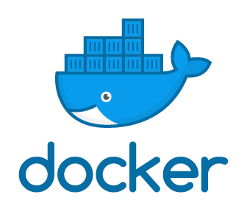
Docker
Docker is a platform that packages code together with all the software and settings it depends on
Helps ensure that code runs the same way across different devices
Notes:
- This is where Docker comes in, and it allows us to do exactly that.

Slide 7
Downloading Docker
Docker can be downloaded here: https://docs.docker.com/get-started/
Also downloads desktop app DockerDesktop
Notes:
- This is where Docker comes in, and it allows us to do exactly that.

Slide 8
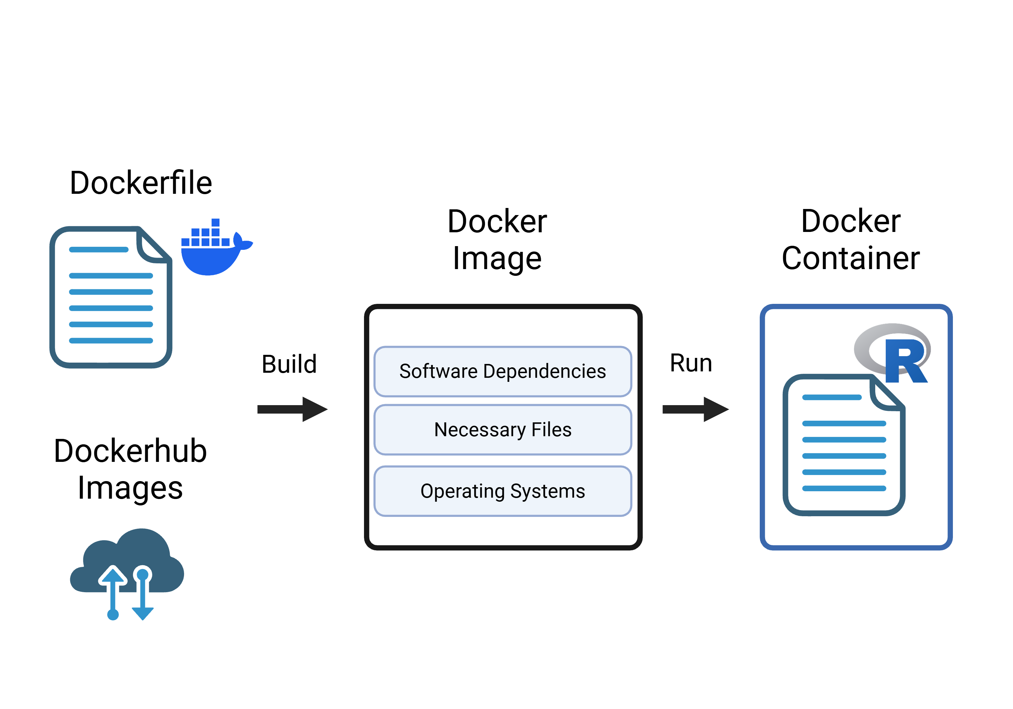
Docker Essential Concepts
Made with Biorender
Notes:
Containers: Running instance of a Docker image
Images: An image is the built, read-only package that contains that complete environment, including the operating system, libraries, and your code.
Dockerfiles: A Dockerfile is a text file that specifies the exact software, dependencies, and setup steps needed to build a reproducible computing environment.
Highlight keywords mentioned; analysis script should be only with runtime

Slide 9
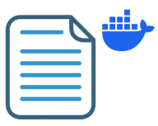
Creating a Dockerfile
Open a terminal within your project directory
Use the following command: “Touch Dockerfile”
OR
Create new file in RStudio
Save file as “Dockerfile”
NOTE: Typically use one Dockerfile for one task!
Notes:
Go over irl how to do this
- Plan out what to put in the dockerfiles

Slide 10
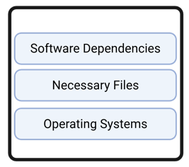
Creating a Docker Image
Use the following command:
docker build -t [IMAGE_NAME] -f [DOCKERFILE_PATH] .
What to name your docker image
Where your dockerfile is
Telling docker to use the current directory to build

Slide 11
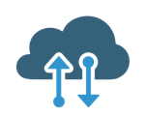
Using Public Images
Rather than compiling your own images from scratch: can use public images from DockerHub
Use this command:
docker pull [NAME_OF_REPO]/[NAME_OF_IMAGE]:[TAG_VERSION]
To share an image you’ve created:
docker push [YOUR_DOCKER_USERNAME]/[NAME_OF_IMAGE]:[TAG_VERSION]

Slide 12

Running a Docker Container
Use this command:
Delete Container when done task
Location of directory to give access
docker run --rm \
-v $$(pwd):/[CONTAINER_PATH] \
[DOCKER_IMAGE_TO_RUN] \
sh -c "Rscript [RSCRIPT_TO_RUN_PATH]"
Location of directory files/folders within container
Give container access to files in directory
Task to run in container

Slide 13
Run Rstudio with Docker
Use this command:
Where server will be hosted; access through web browser
docker run \
-p 8787:8787 \
-v $$(pwd):/[CONTAINER_PATH] \
-e USER=[YOUR_USERNAME] \
-e PASSWORD=[YOUR_PASSWORD] \
--name [YOUR_CONTAINER_NAME] \
[YOUR_IMAGE_NAME]

Slide 14
Make + Docker
More convenient way to build and run docker images/containers
# Run OLD environment only
run-old: build-old ## Run analysis with OLD environment (R 3.6.3)
docker run --rm \
-v $$(pwd)/output/old_docker:/analysis/output \
-v $$(pwd)/inputs:/analysis/inputs \
-v $$(pwd)/bin/R:/analysis/bin/R \
deg-analysis:old \
sh -c "Rscript bin/R/deg_analysis.R"
make run-old

Slide 15
Recap
Computational pipelines and analysis scripts are not guaranteed to work
  Issue of reproducibility
Docker helps define specific software dependencies to run code in
  If results and expected results don’t align: most likely not a software issue
Docker images can be created from user specifications and public ones from DockerHub
Can combine concepts from Makefile session to streamline development

Slide 16
Additional Resources
Documentation from Docker has guided tutorials on all the concepts discussed here, and more: https://docs.docker.com/get-started/introduction/
AI agents great at templating / creating Dockerfiles + Makefiles, use that to your advantage!

Slide 17
Thank you!

