Slide 1

> Day 2: Core Python for Bioinformatics

Slide 2
t
> Strings
“A string is a sequence of characters written inside quotes. It can include letters, numbers, symbols and spaces.”
Python does not have a separate character type.
A single character is treated as a string of length one.
Strings are commonly used for text handling and manipulation.

Slide 3
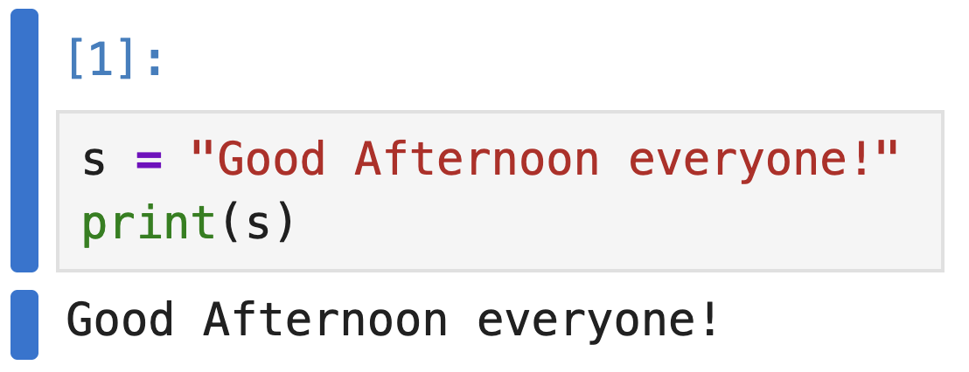
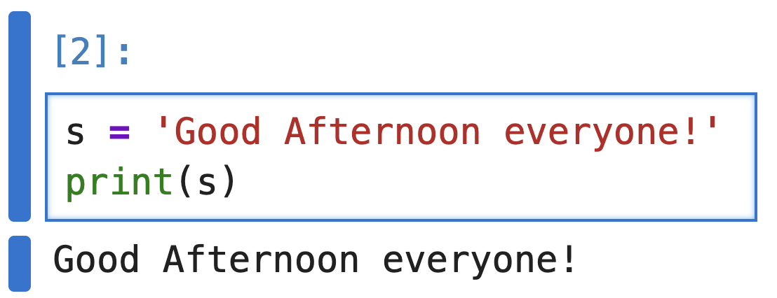
t
> Strings
How can I create a string?
Using double quotes
Using single quotes

Slide 4
t
> Strings
Accessing characters in a string
Strings are indexed sequences. Positive indices start at 0 from the left, negative indices start at -1 from the right as represented in below image
0 | 1 | 2 | 3 | 4 | 5 | 6 | 7
L | E | O | M | E | S | S | I
-8 | -7 | -6 | -5 | -4 | -3 | -2 | --1

Slide 5
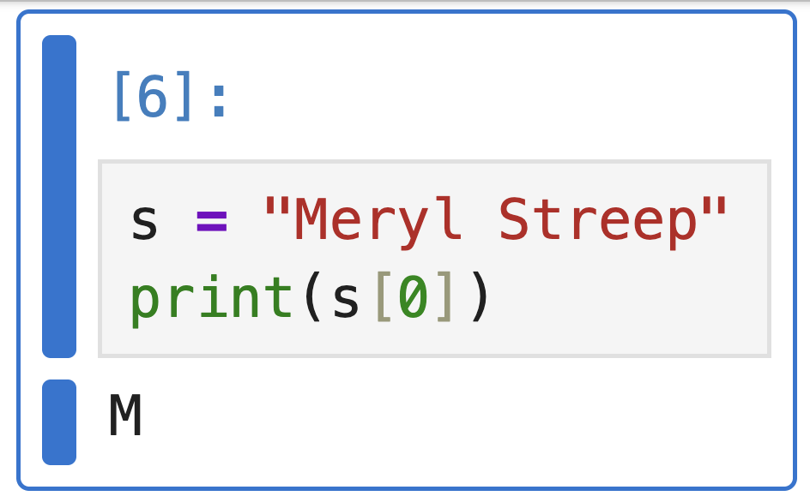
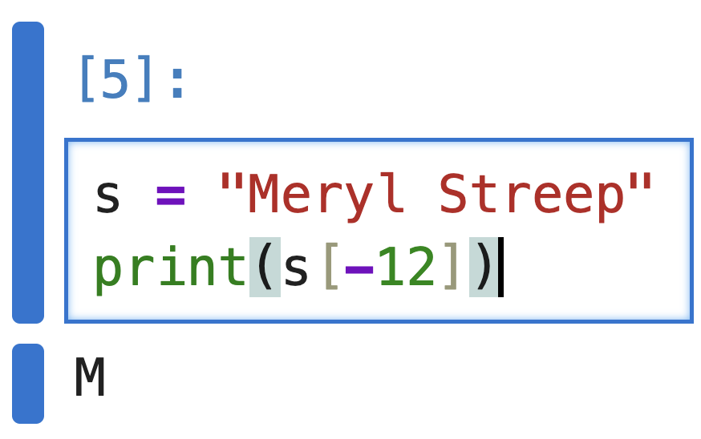
t
> Strings
Accessing characters in a string: Example
We want to extract first character of “Meryl Streep”
Option 1
Option 2

Slide 6
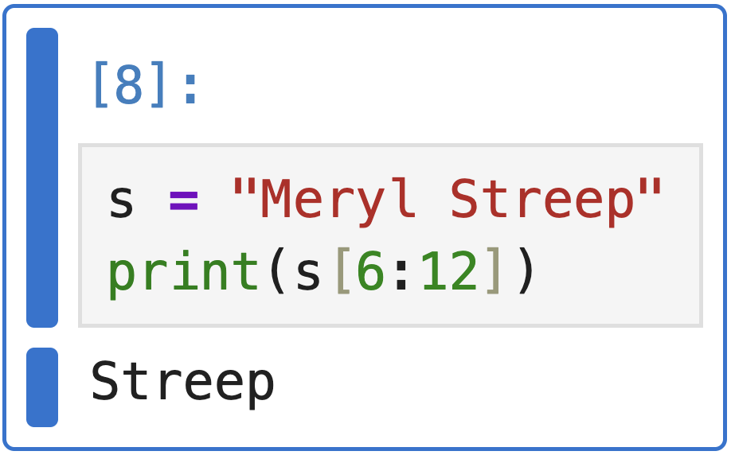
t
> Strings
String slicing
A way to extract a portion of a string by specifying the start and end indexes. Example: Extracting the surname of a person

Slide 7
t
> Strings
String Immutability
Strings are immutable, which means that they cannot be changed after they are created. To manipulate strings we can use:
Concatenation
Slicing
Formatting

Slide 8
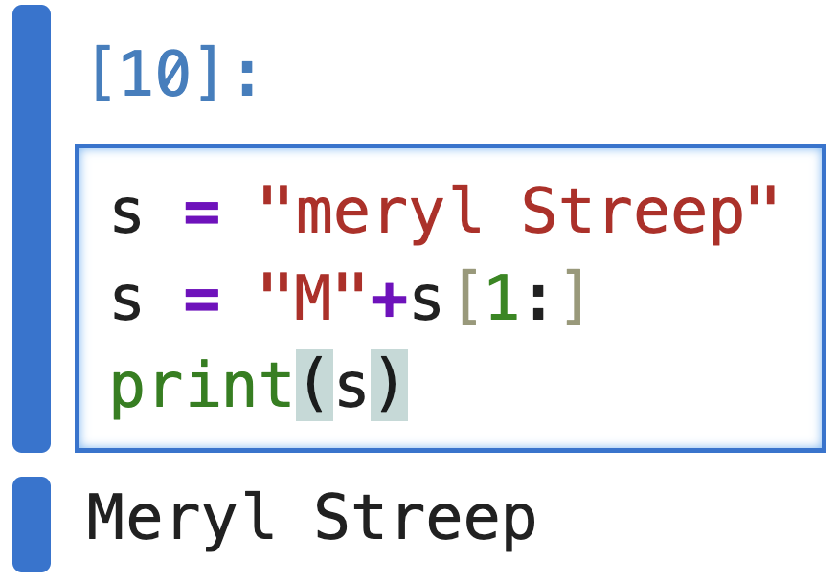
t
> Strings
String Immutability: Example
Capitalizing the name of a person

Slide 9
t
> Strings
String Immutability: Example
MERYL STREEP INDEX ADD!!!! VISUAL EXAMPLE!!

Slide 10
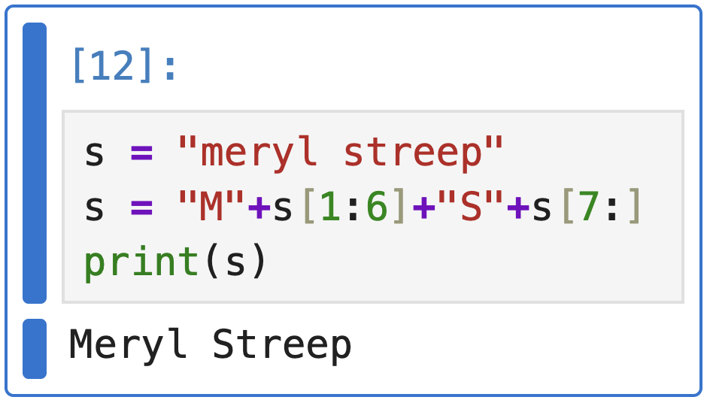
t
> Strings
String Immutability: Example
Capitalizing the name and surname of a person

Slide 11
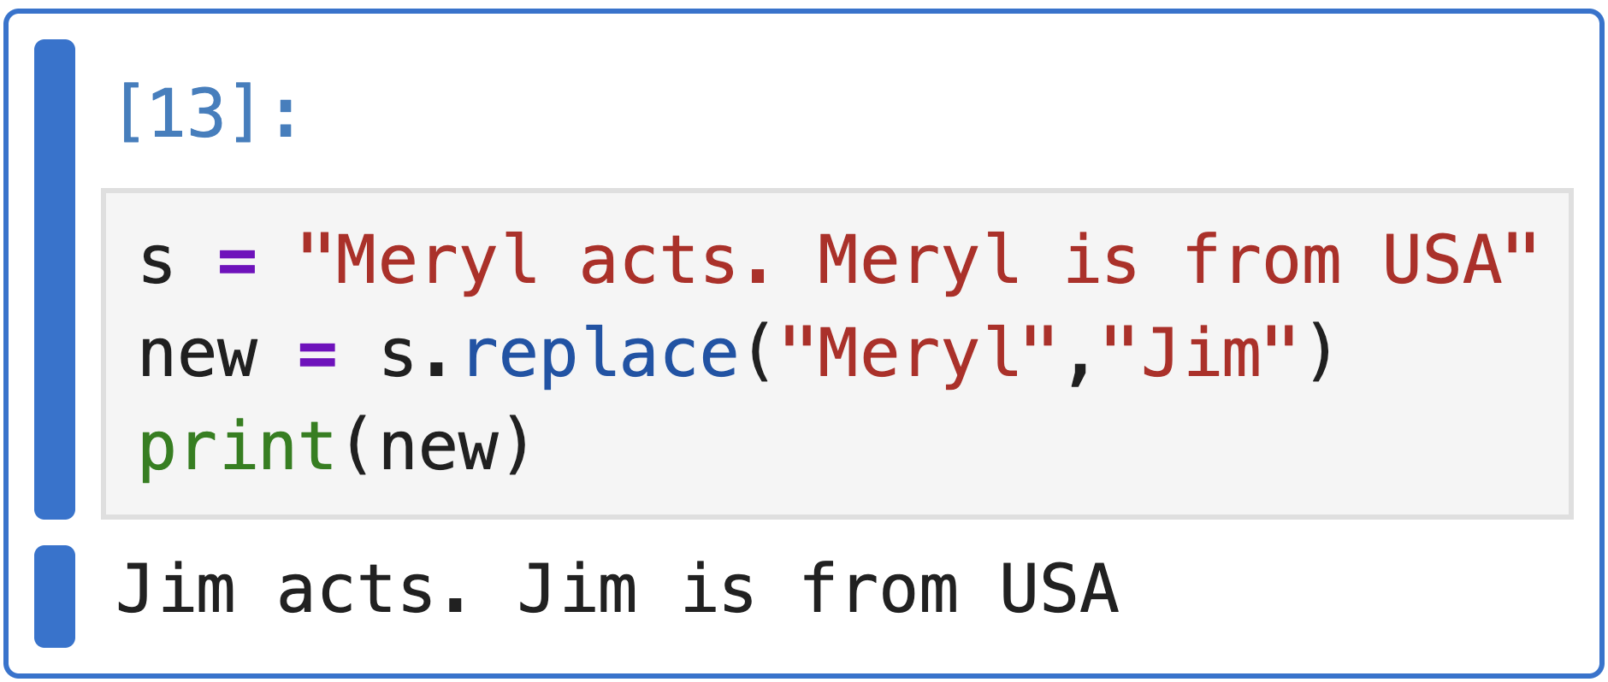
t
> Strings
String Methods: replace()
Returns a new string where all occurrences of a specified substring are replaced with another substring

Slide 12
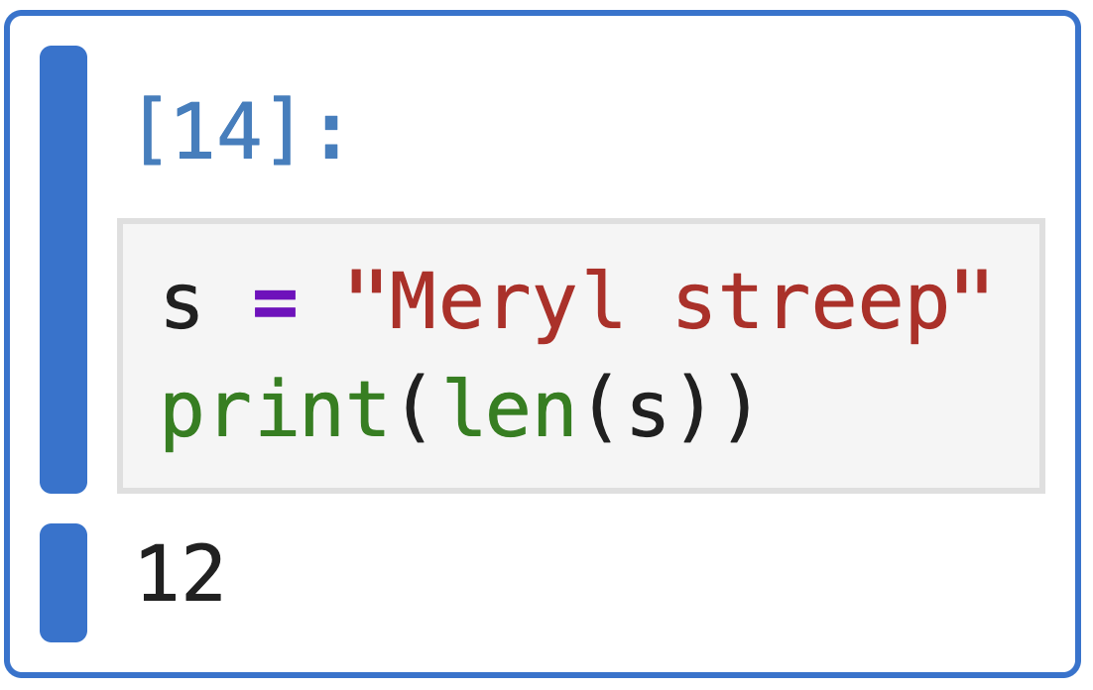
t
> Strings
String Methods: len()
Returns the total number of characters in a string:

Slide 13
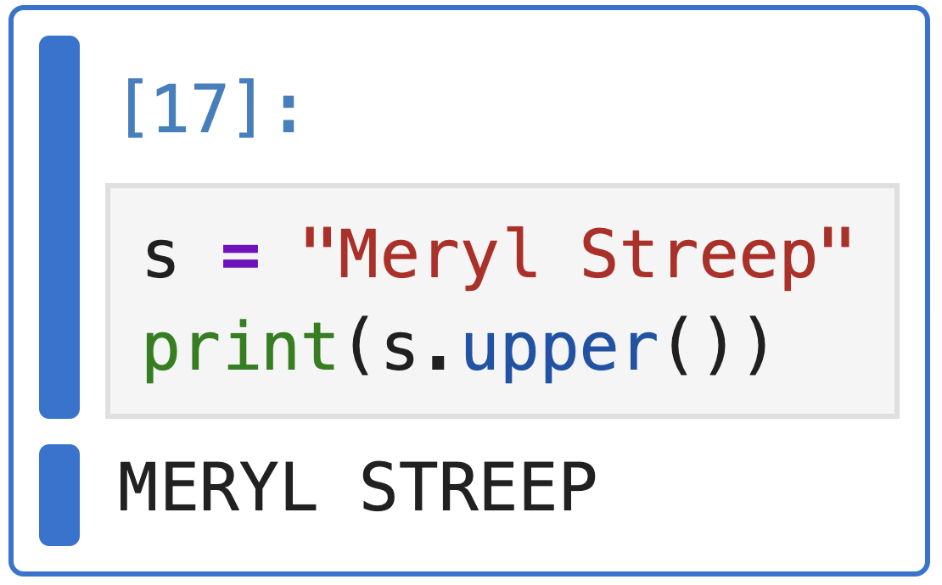
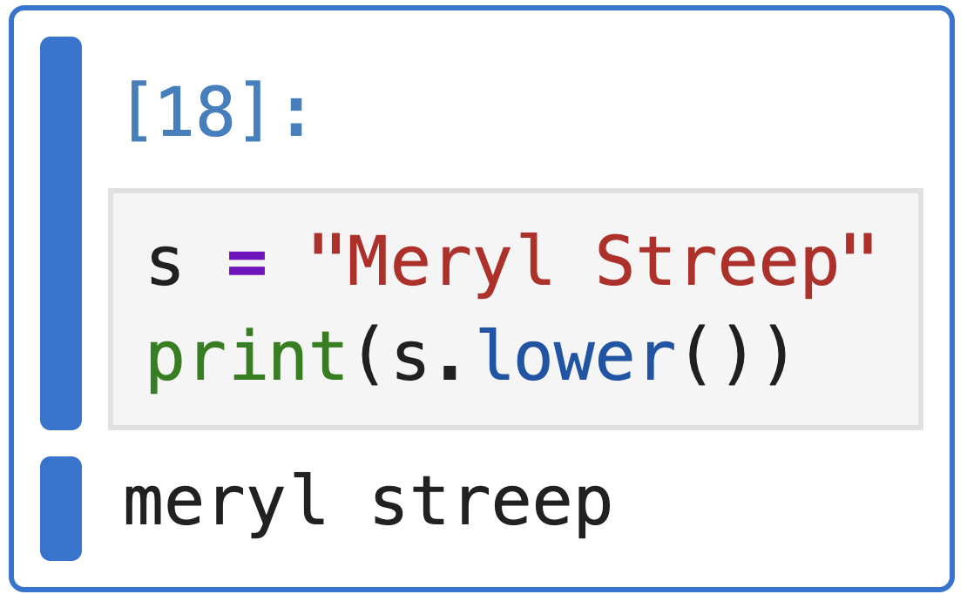
t
> Strings
String Methods: upper() and lower()
upper(): Converts all characters to uppercase
lower(): Converts all characters to lowercase

Slide 14
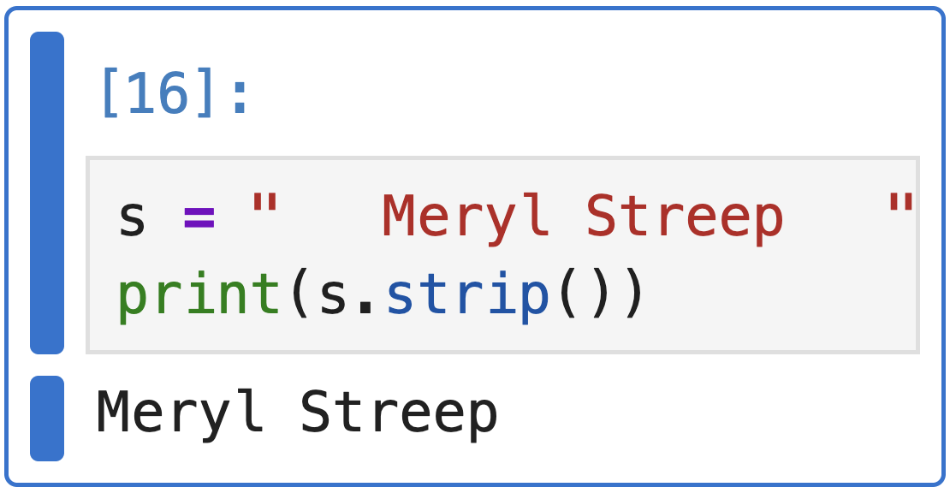
t
> Strings
String Methods: strip()
Removes all leading and trailing whitespace from the string

Slide 15
t
> Strings
String Methods: other methods
https://www.geeksforgeeks.org/python/python-string-methods/

Slide 16
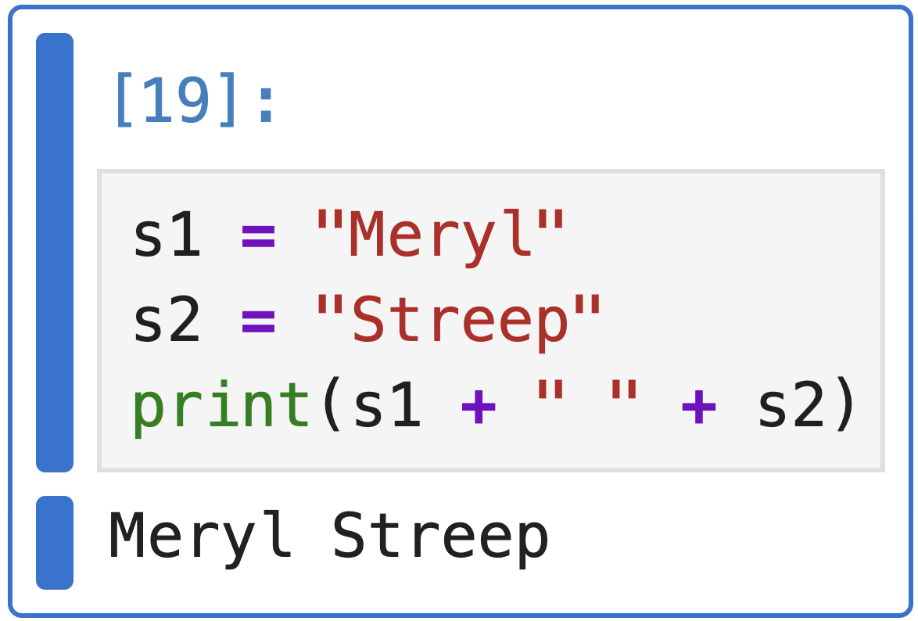
t
> Strings
String Concatenating
We can concatenate strings using + operator.

Slide 17
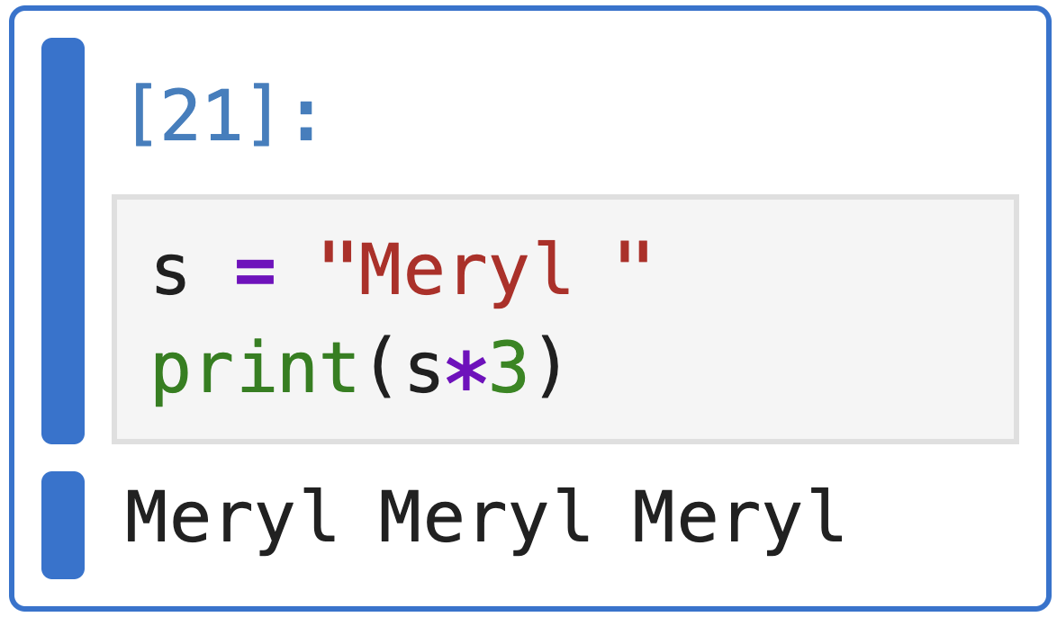
t
> Strings
String Repeating
We can repeat a string multiple times using * operator.

Slide 18
t
> Strings
Formatting strings
We can include variables inside strings. These are the two most used ways:
f-string
format()

Slide 19
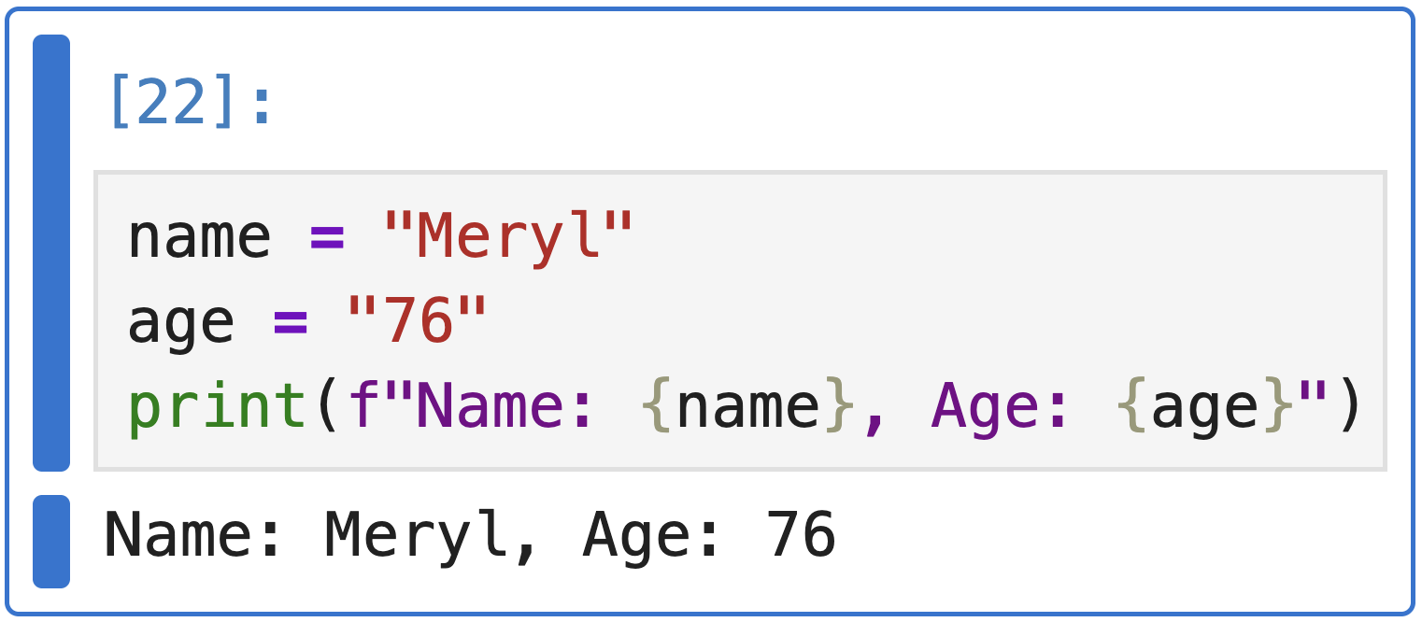
t
> Strings
Formatting strings: f-strings
Example: Embed variables directly using {} placeholders

Slide 20
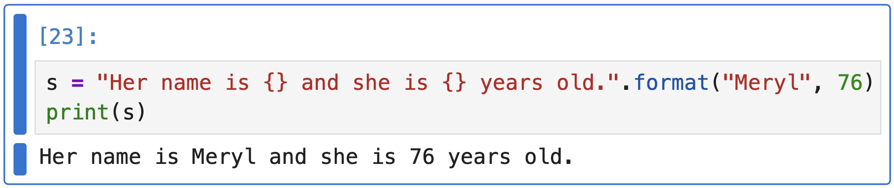
t
> Strings
Formatting strings: format()
Example: Use placeholders {} and pass values positionally

Slide 21
t
> Strings
Do problems 1, 2 ,3 and 4 of the strings chapter in your notebook!

Slide 22

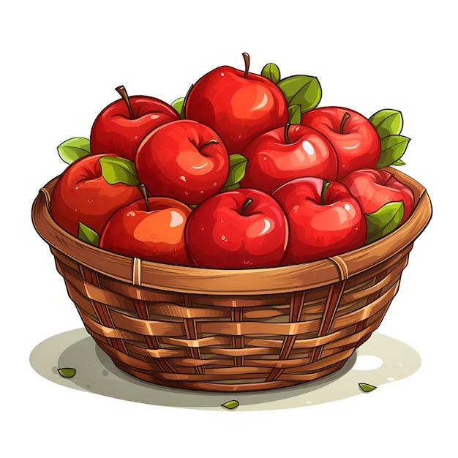

t
> Lists and dictionaries
Lists are used to store multiple items in a single variable.
Example:
Shopping list

Slide 23
t
> Lists and dictionaries
Lists are used to store multiple items in a single variable.
Example:
L = [“apple”, “banana”, “chocolate”]
Ordered: Items have a defined order
Changeable: Can change, add, and remove items in a list
Allow duplicates

Slide 24
t
> 2.2 Dictionaries
A data structure that stores information in key-value pairs.
Example:
Key
d = {‘a’: 10, ‘b’: 20}
Value
Unordered: Items stored without index value
Unique: Keys in dictionaries should be unique
Mutable: We can add/Modify/Remove key-value

Slide 25
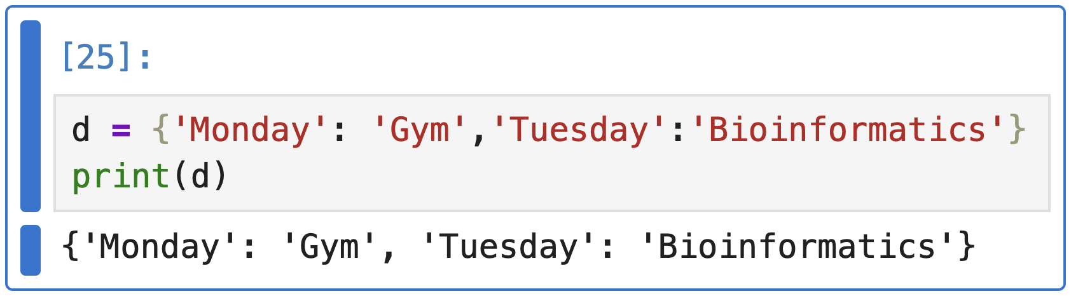
t
> 2.2 Dictionaries
Calendar
Monday | Tuesday
Gym | Bioinformatics
Creating a dictionary
A dictionary is created by writing key-value pairs inside { }, where each key is connected to a value using colon (:). Example:

Slide 26
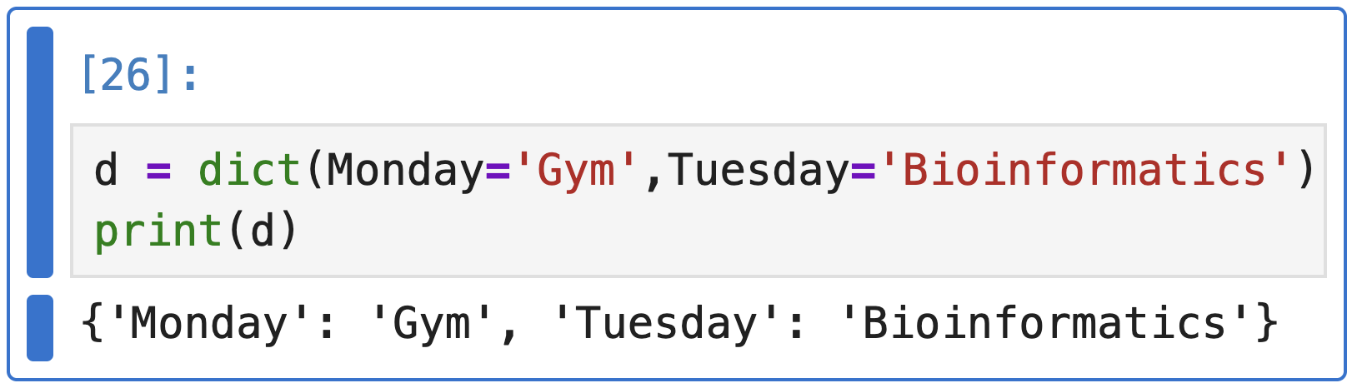
t
> 2.2 Dictionaries
Calendar
Monday | Tuesday
Gym | Bioinformatics
Creating a dictionary
A dictionary can also be created using the dict() function.
Example:

Slide 27
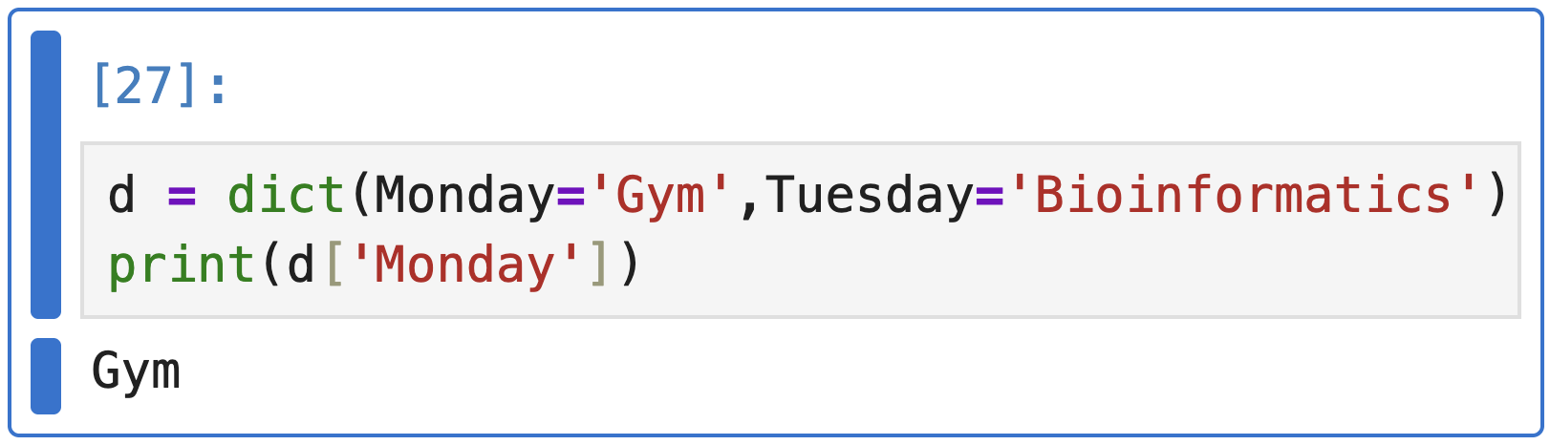
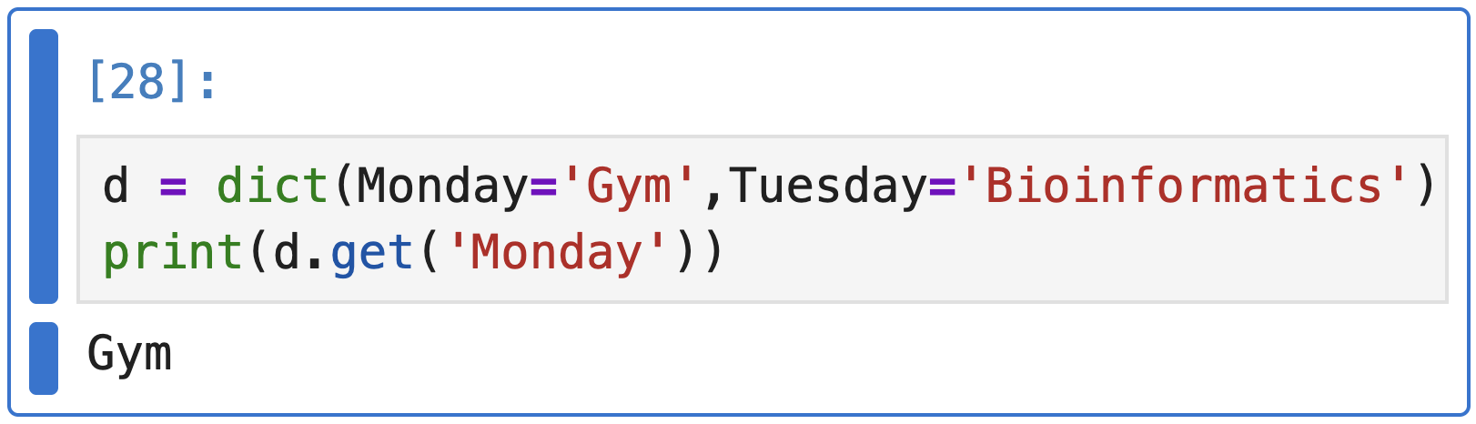
t
> 2.2 Dictionaries
Calendar
Monday | Tuesday
Gym | Bioinformatics
Accessing dictionary items
A value in a dictionary is accessed by using its key. Example:
Option 1: square brackets [ ]
Option 2: get() method

Slide 28
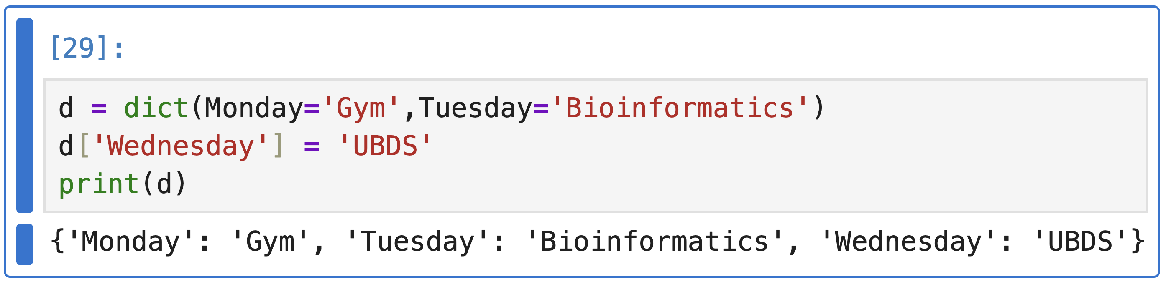
t
> 2.2 Dictionaries
Calendar
Monday | Tuesday | Wednesday
Gym | Bioinformatics | UBDS
Adding and Updating Dictionary Items
New items are added to a dictionary using the assignment operator (=) by giving a new key a value. Example:
What will happen with an existing key?

Slide 29
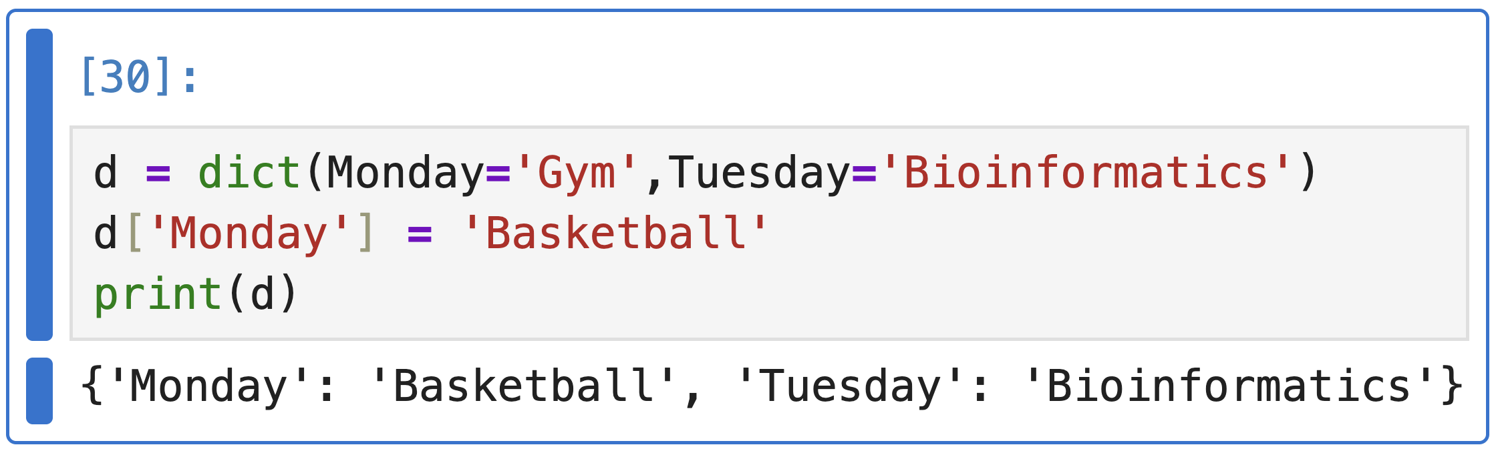
t
> 2.2 Dictionaries
Calendar
Monday | Tuesday
Gym | Bioinformatics
Adding and Updating Dictionary Items
If an existing key is used with the assignment operator, its value is updated with the new one. Example: Let’s change Monday activity!

Slide 30
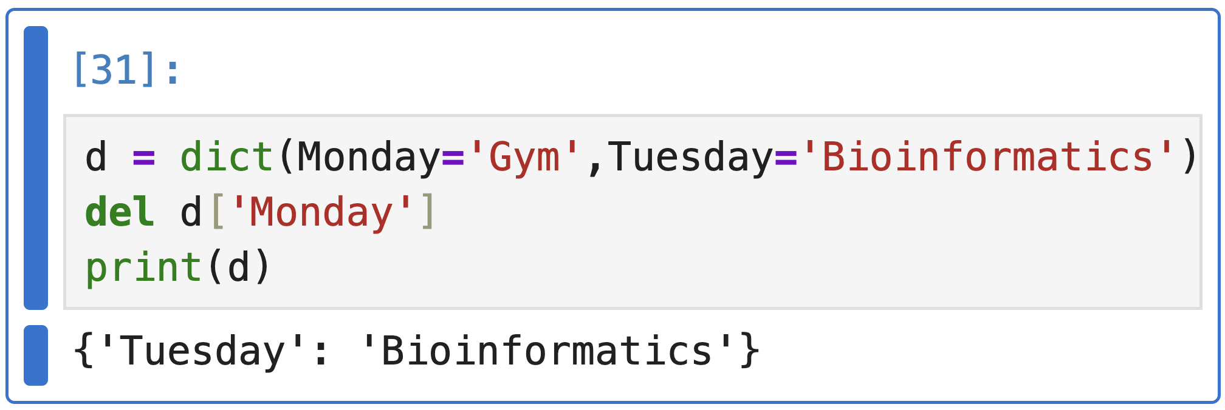
t
> 2.2 Dictionaries
Calendar
Monday | Tuesday
Gym | Bioinformatics
Removing Dictionary Items
Dictionary items can be removed using built-in deletion methods that work on keys:
del: removes an item using its key

Slide 31
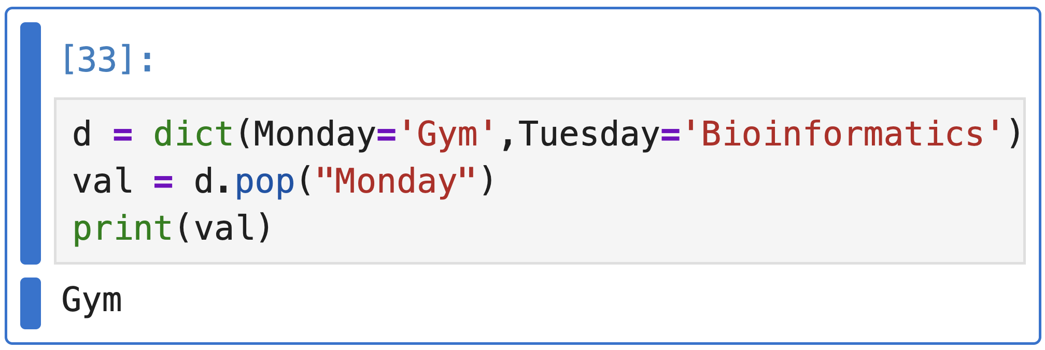
t
> 2.2 Dictionaries
Calendar
Monday | Tuesday
Gym | Bioinformatics
Removing Dictionary Items
Dictionary items can be removed using built-in deletion methods that work on keys:
pop(): removes the item with the given key and returns its value

Slide 32
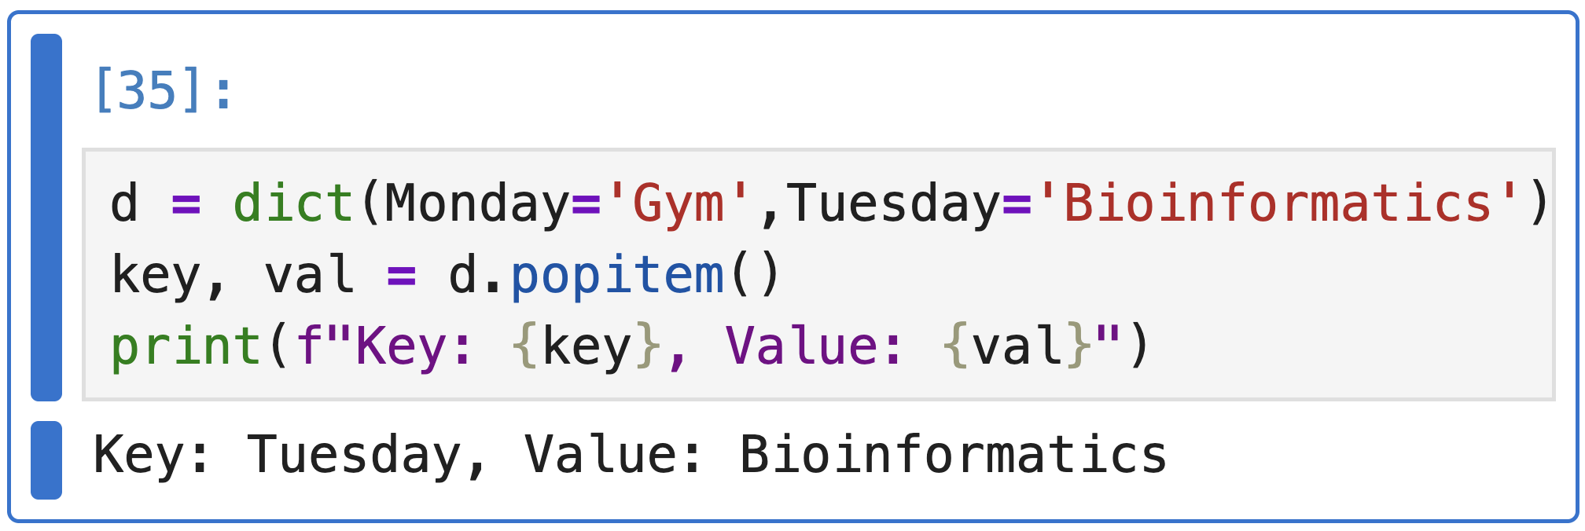
t
> 2.2 Dictionaries
Calendar
Monday | Tuesday
Gym | Bioinformatics
Removing Dictionary Items
Dictionary items can be removed using built-in deletion methods that work on keys:
popitem(): removes and returns the last inserted key–value pair

Slide 33
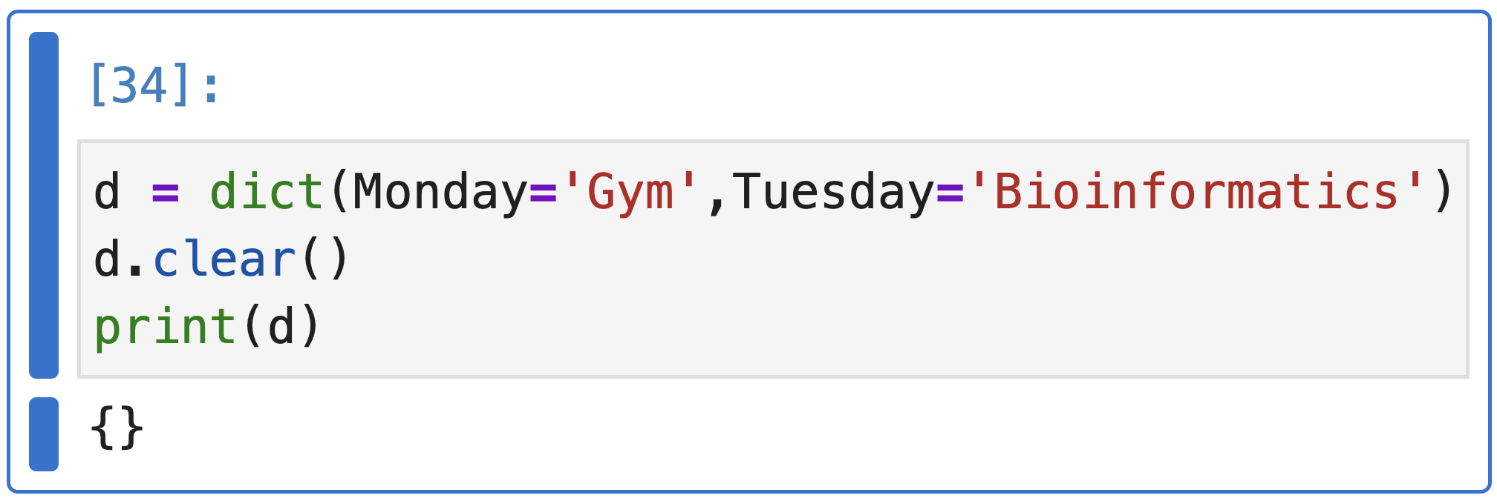
t
> 2.2 Dictionaries
Calendar
Monday | Tuesday
Gym | Bioinformatics
Removing Dictionary Items
Dictionary items can be removed using built-in deletion methods that work on keys:
clear(): removes all items from the dictionary

Slide 34
t
> 2.2 dictionaries
Calendar
Monday | Tuesday
Gym | Bioinformatics
Nested dictionaries
Dictionary that contains another dictionary as one of its values.
Keys
Values
Values
Monday
Gym
Coding
Basketball
Tuesday
Bioinformatics
Wednesday
Morning
Afternoon

Slide 35
t
> 2.3 Sets
Sets

Slide 36
t
> Lists and dictionaries
Do problems 5, 6 ,7 and 8 of the strings chapter in your notebook!

Slide 37
t
> Loops and conditions
Up to now we’ve seen that a calendar is a dictionary.
... But what happens when we want to know all the activities?
Could we check them one by one?
Calendar
Monday | Tuesday | Wednesday
Gym | Bioinformatics | Basketball

Slide 38
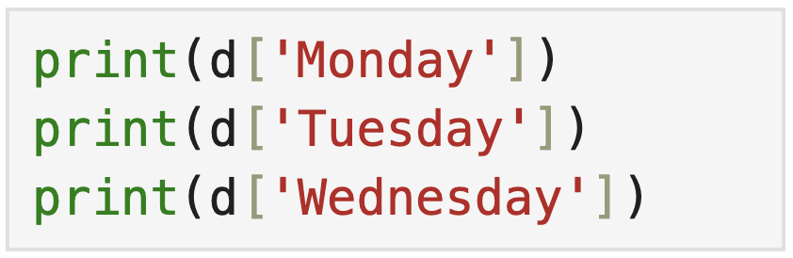



t
> Loops and conditions
NOT SCALABLE!
How would you do it?
We need to ITERATE through the items of this calendar
Calendar
Monday | Tuesday | Wednesday
Gym | Bioinformatics | Basketball

Slide 39
t
> Loops and conditions
Calendar
Monday | Tuesday | Wednesday
Gym | Bioinformatics | Basketball
1
2
3
4

Slide 40
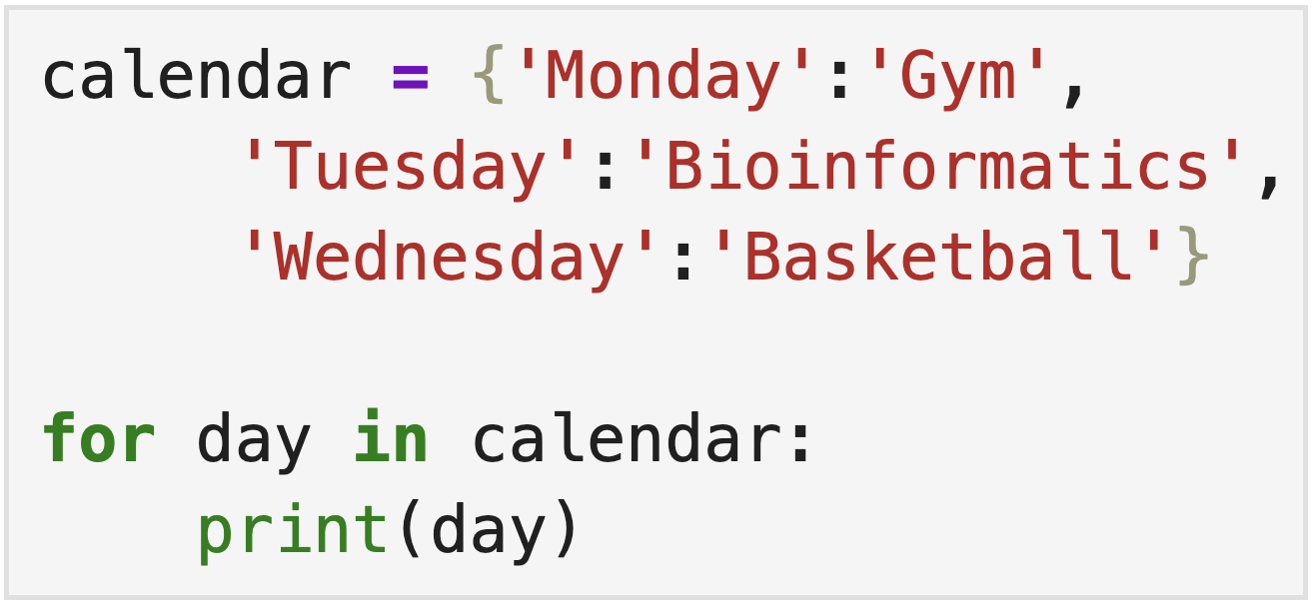
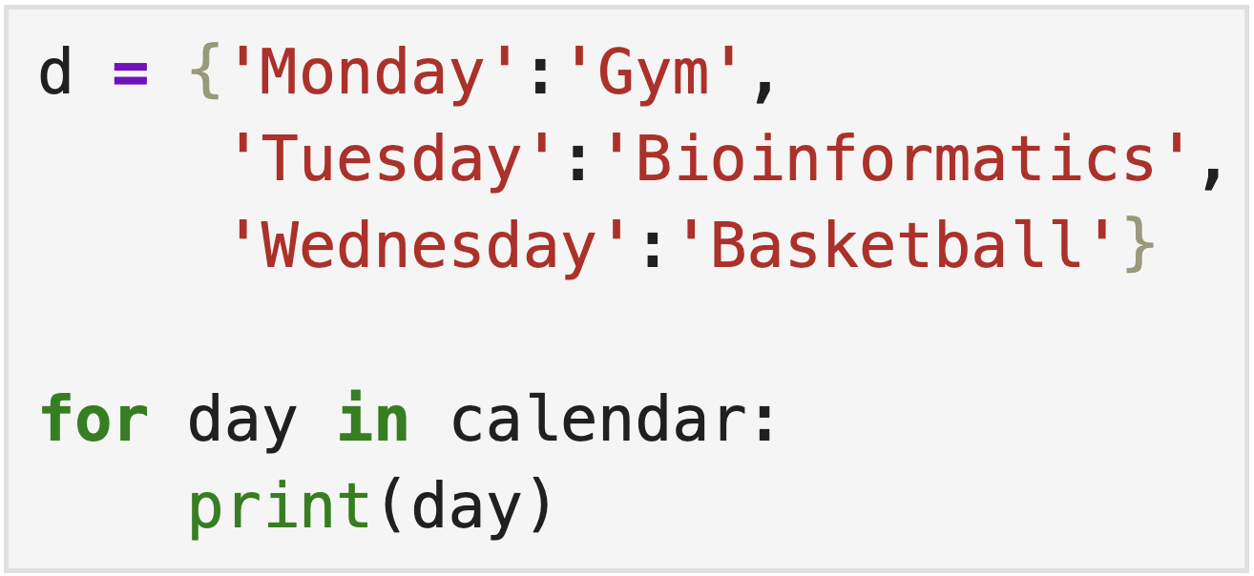
t
> Loops and conditions
Calendar
Monday | Tuesday | Wednesday
Gym | Bioinformatics | Basketball
What will this print?

Slide 41
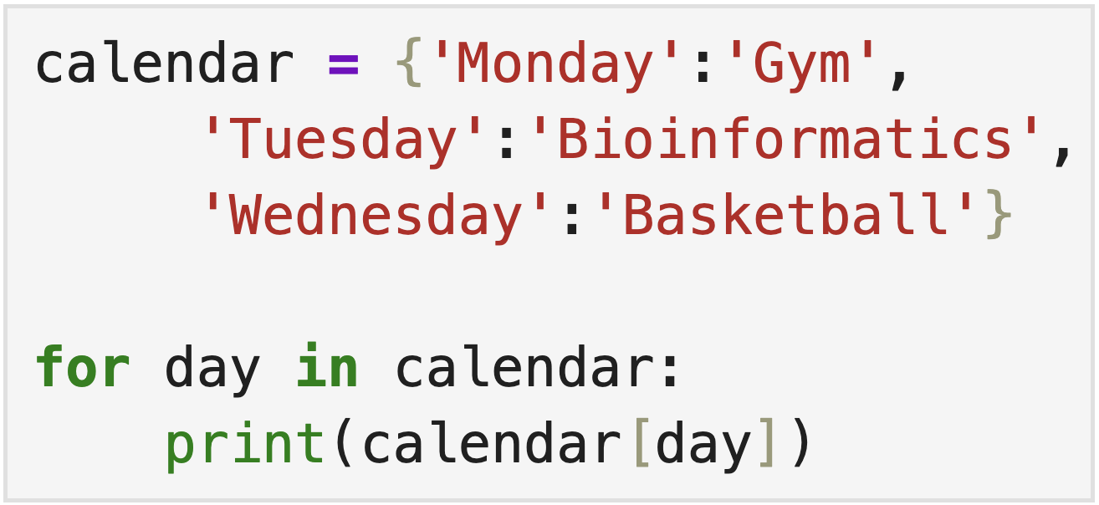
t
> Loops and conditions
Calendar
Monday | Tuesday | Wednesday
Gym | Bioinformatics | Basketball
And this?

Slide 42
t
> Loops and conditions
ADD .ITEMS() ITERATION!!!

Slide 43
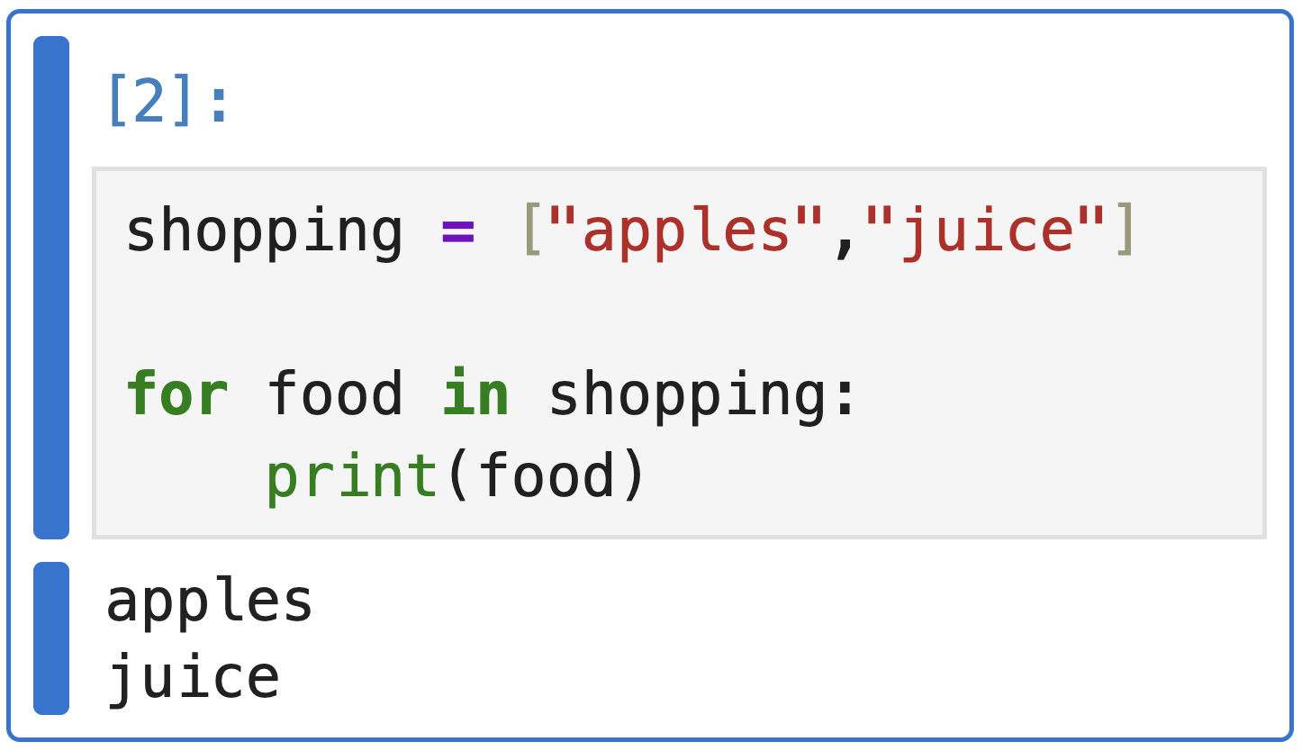
t
> Loops and conditions
We can use for loops with lists and strings also!
Example: Iterating through a list of elements

Slide 44
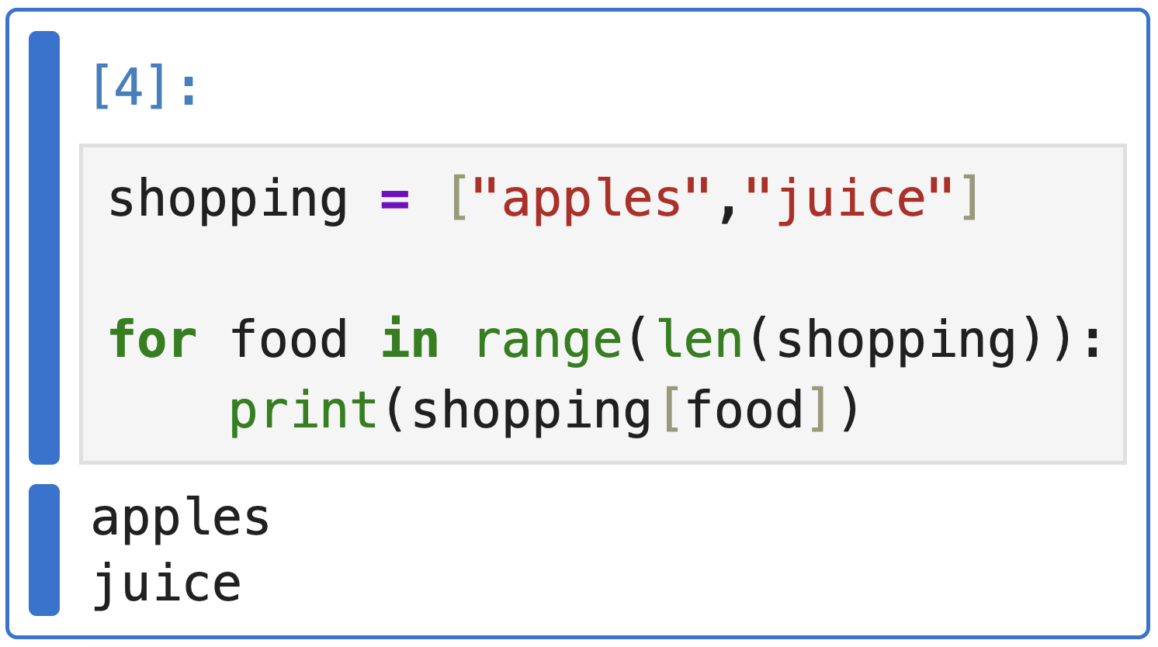
t
> Loops and conditions
We can use for loops for lists and strings also!
Example: Iterating through a list of elements using the index
This code iterates through each element of the list using its index and prints each element one by one. The range(len(list)) generates indices from 0 to the length of the list minus 1.

Slide 45
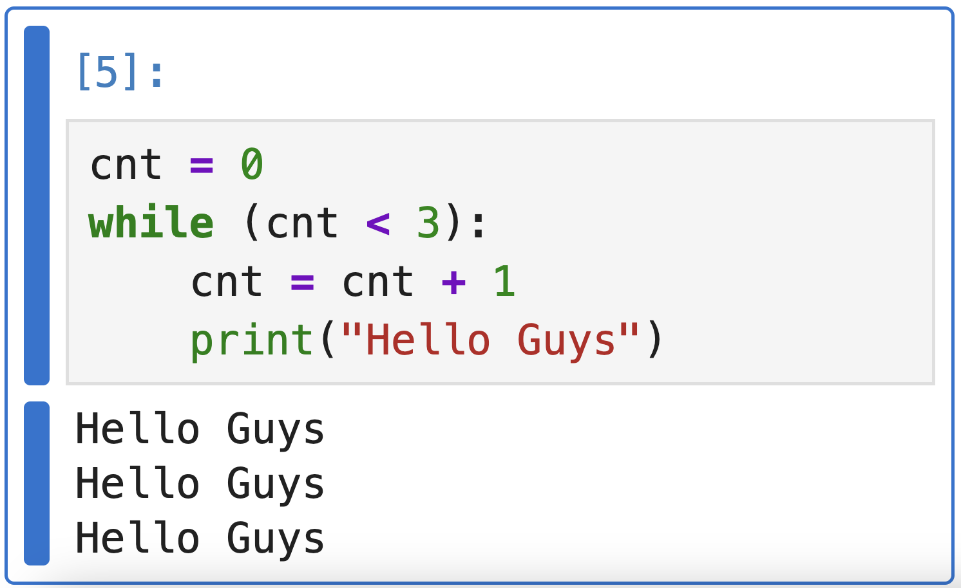
t
> Loops and conditions
In python there are also while loops. They are used to execute a block of statements repeatedly until a given condition is satisfied. When the condition becomes false, the line immediately after the loop in the program is executed.
Example:
Iterating until the
counter reaches
three

Slide 46
t
> Loops and conditions
Iteration: cnt = 0
→ We add 1 to cnt = cnt(0)+1
→ Hello Guys is printed
While loop in detail
1
Iteration: cnt = 1
→ We add 1 to cnt = cnt(1)+1
→ Hello Guys is printed
2
Iteration: cnt = 2
→ We add 1 to cnt = cnt(2)+1
→ Hello Guys is printed
3

Slide 47
t
> Loops and conditions
Iteration: cnt = 3
→ We do not accomplish the condition cnt lower than 3!!!
While loop in detail
4
Exiting the while loop…

Slide 48
t
> Loops and conditions
For vs While loop: which should I use?
for loop
while loop
- When you have a collection
- You know what to iterate through
- Simple and more save
- When you have a condition
- Don’t know how many iterations
- More flexible

Slide 49


t
> Loops and conditions
Conditional statements: if condition
Used to execute certain blocks of code based on specific conditions.
Buy
Don’t buy
Is this chocolate?

Slide 50
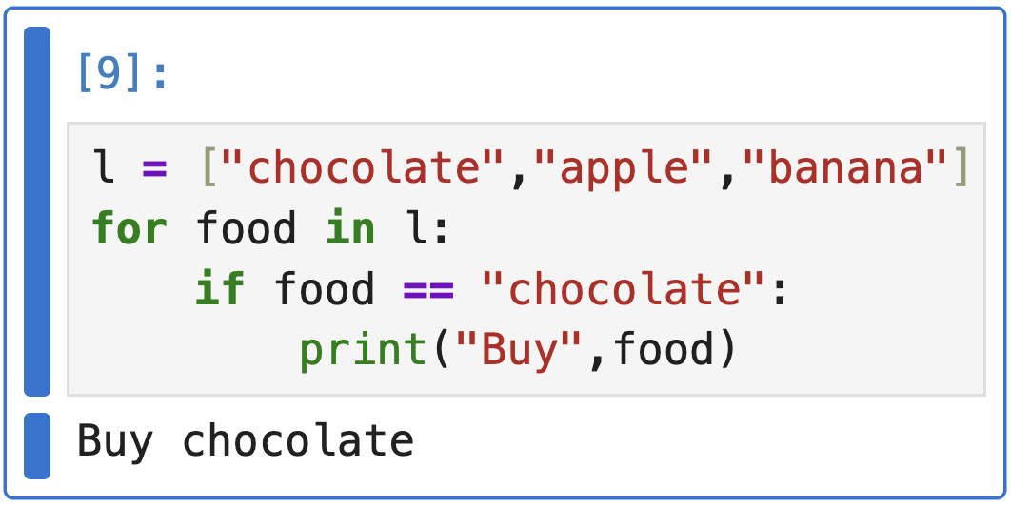
t
> Loops and conditions
Conditional statements: if condition
Used to execute certain blocks of code based on specific conditions.

Slide 51
t
> Loops and conditions
Conditional statements: if condition
For each product in the shopping list:
if product is chocolate:
buy

Slide 52
t
> Loops and conditions
Conditional statements: if/else condition
Allows us to specify a block of code that will execute if the condition associated with an if statement evaluates to False.
Buy
Don’t buy
Is this chocolate?

Slide 53
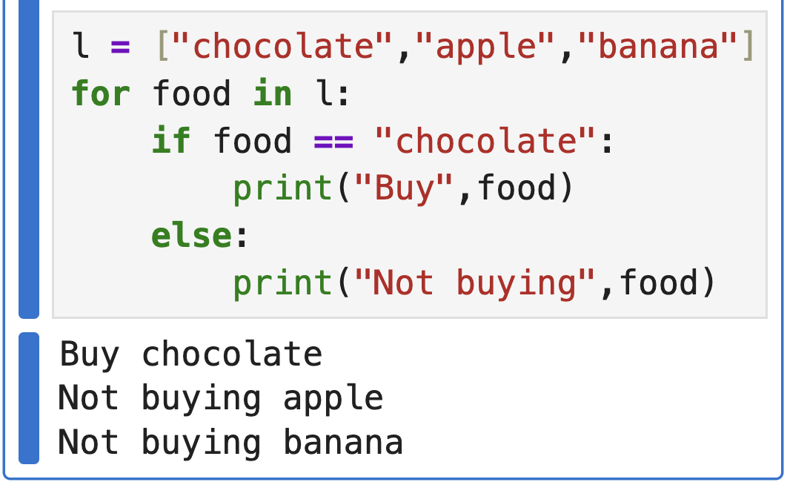
t
> Loops and conditions
Conditional statements: if/else condition
Allows us to specify a block of code that will execute if the condition associated with an if statement evaluates to False.

Slide 54
t
> Loops and conditions
Conditional statements: if/else condition
For each product in the shopping list:
if product is chocolate:
buy
if product is not chocolate:
not buying

Slide 55

t
> Loops and conditions
Conditional statements: elif condition
Stands for “else if”. Allows us to check multiple conditions, providing a way to execute different blocks of code based on which condition is true
Buy
Buy
Is this banana?
Is this chocolate?
Don’t buy

Slide 56
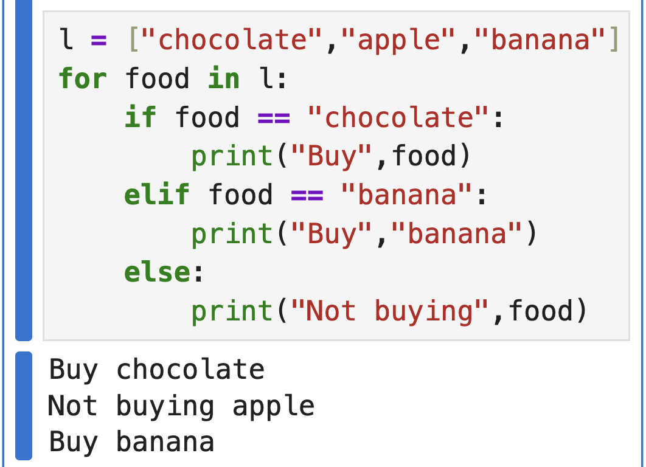
t
> Loops and conditions
Conditional statements: if/else condition
Stands for “else if”. Allows us to check multiple conditions, providing a way to execute different blocks of code based on which condition is true

Slide 57
t
> Loops and conditions
Conditional statements: if/else condition
For each product in the shopping list:
if product is chocolate:
buy
elif product is banana:
buy
if product is not chocolate nor banana:
not buying

Slide 58
t
> Lists and dictionaries
Do problems 9, 10 ,11 and 12 of the strings chapter in your notebook!

Slide 59
t
> Functions
Conditional statements: elif condition
Stands for “else if”. Allows us to check multiple conditions, providing a way to execute different blocks of code based on which condition is true

