Slide 1
Intro to Pandas & Data Visualisation
Beginners Python
Day 3

Slide 2

What is Pandas?
I LOVE Data Analysis xoxo
Pandas is a Python library for working with structured (tabular) data it helps Python programmers to perform data analysis
Think rows and columns, like Excel spreadsheets
But with superpowers:
Sort and filter data instantly
Group data and summarise it
Calculate statistics (mean, median, etc.)
Apply functions across datasets
Works seamlessly with large datasets
💡 Think Excel… but automated, reproducible, and scalable

Slide 3


Why Pandas?
I am better than excel, I am reproducible, faster and I can handle big data
Handles large datasets effortlessly
Eliminates manual work.
Reproducible analysis (no clicking mistakes!)
Integrates with:
NumPy (numerical work)
Matplotlib (visualisation)
Widely used in:
Bioinformatics 🧬
Data science 📊
Finance 💰
Key idea:
👉 If your data is in a table, Pandas is your
✨Best Friend✨
TRASH

Slide 4
Meet the Dataframe
Behold my Dataframe!
A Dataframe = table of data (rows + columns)
Each column has a name
Each column represents a single observation
import pandas as pd
data = {
"Species": ["Human", "Mouse", "Zebrafish"],
"Genes": [20000, 22000, 26000]
}
df = pd.DataFrame(data)
print(df)
Species Genes
0 Human 20000
1 Mouse 22000
2 Zebrafish 26000

Slide 5
What is Matplotlib?
Stare at my columns and numbers forever and find nothing
A Python library for creating plots and figures
Used for:
Scientific figures
Publications
Data exploration
Highly customizable
💡 Turns your data into visual stories that you can see and understand
Matplotlib brings meaning to my existence

Slide 6
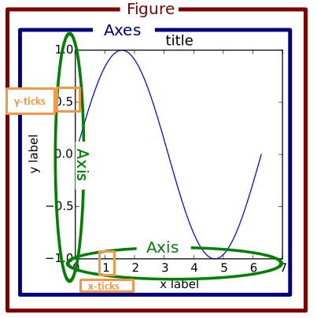
How Matplotlib thinks
Matplotlib builds plots in layers
You usually:
Create a figure (the canvas)
Add axes (the plotting area)
Draw your data onto it
💡 Think of it like painting

Slide 7
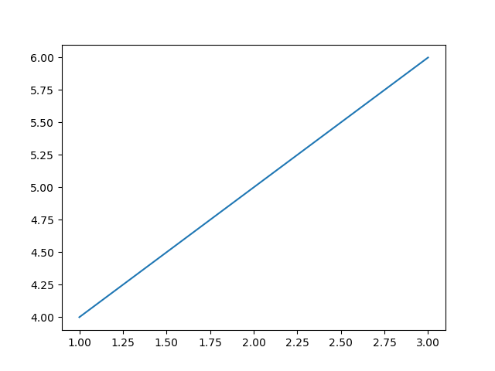
Using Matplotlib
import matplotlib.pyplot as plt
plt.plot([1,2,3], [4,5,6])
plt.show()
What is plt?
plt is just a nickname (alias) for matplotlib’s plotting module
It contains functions like:
plt.plot()
plt.scatter()
plt.title()
💡 You’re calling functions from matplotlib using plt

