Slide 1
Multimodal NGS analysis of gene expression and chromatin state in the olfactory epithelium
RNA-seq workflow
UBDS^3 2026 | Week 2, Day 2
Tutor: Lisa Korneeva TA: Oleksandr Lykhenko

Slide 2
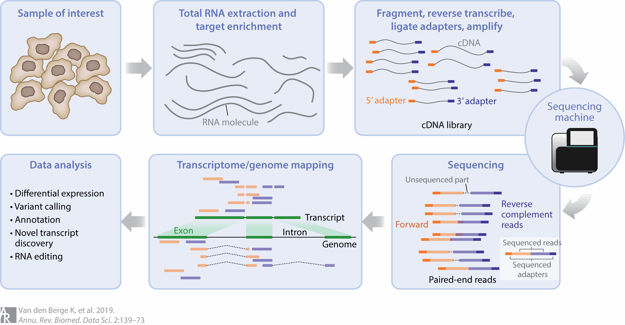
RNA-Seq workflow

Slide 3
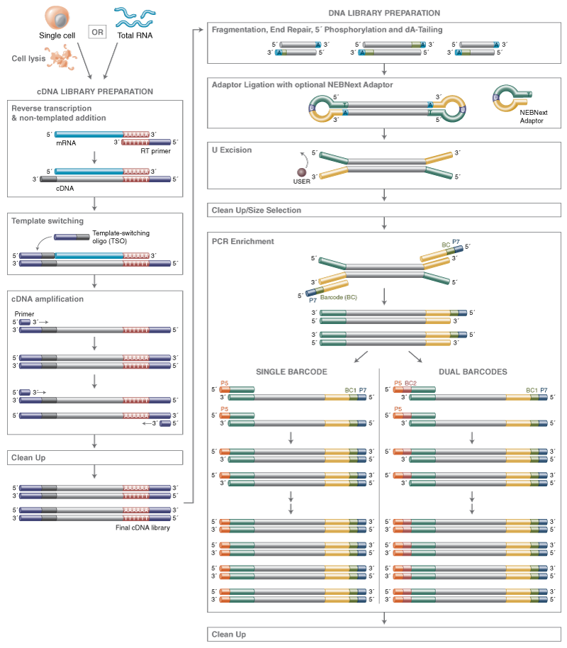
NEBNext® Single Cell/Low Input RNA Library Prep Kit for Illumina®

Slide 4
Which RNA do we need for conventional RNA-Seq?

Slide 5
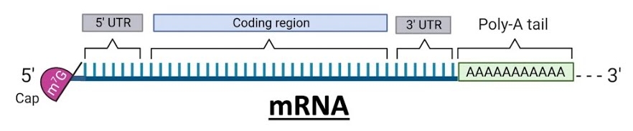
1-5% of total RNA

Slide 6
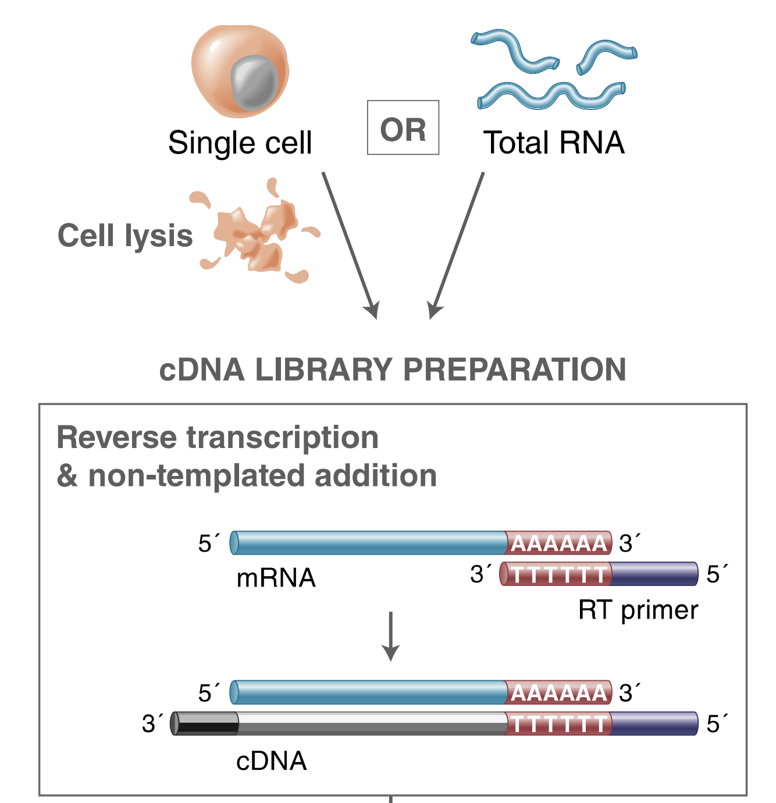
Step 1: RNA capture and cDNA synthesis

Slide 7
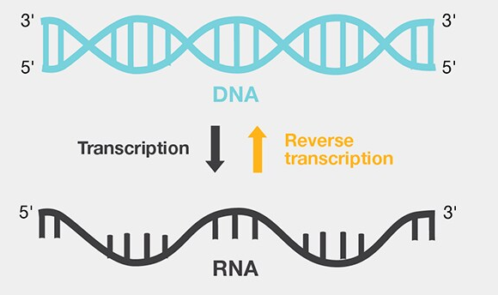

Reverse Transcription
Template RNA
Reverse transcriptase
Primers:
With random hexamers (e.g. ATGCGT)
With oligo-dT primers
Notes:
https://www.thermofisher.com/it/en/home/life-science/cloning/cloning-learning-center/invitrogen-school-of-molecular-biology/rt-education/reverse-transcription-basics.html

Slide 8
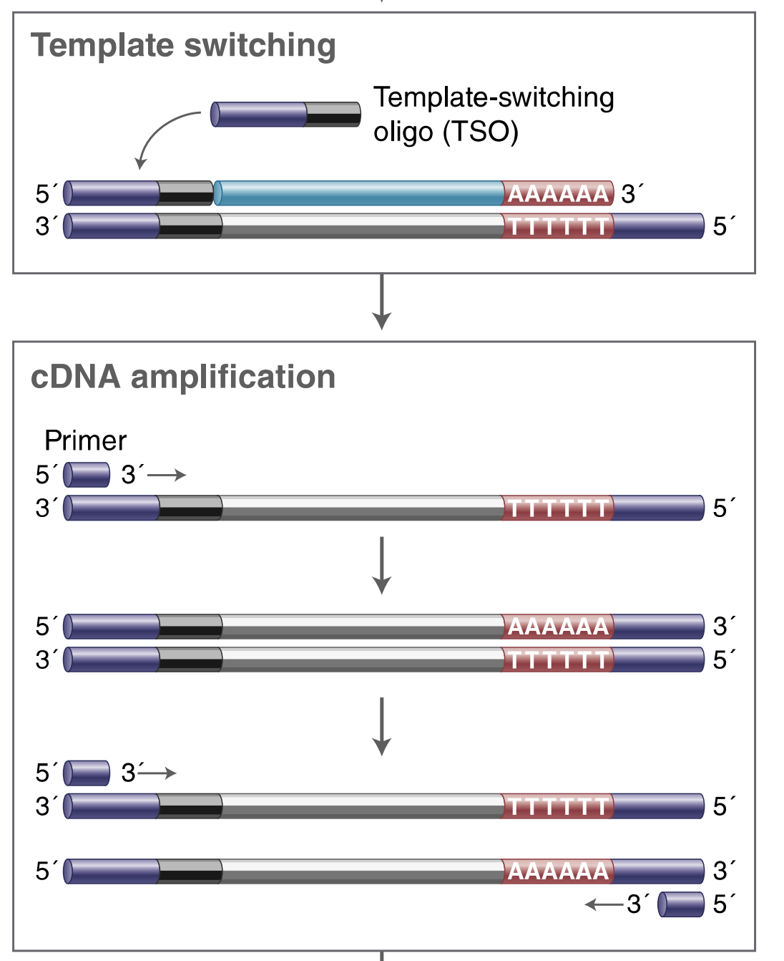
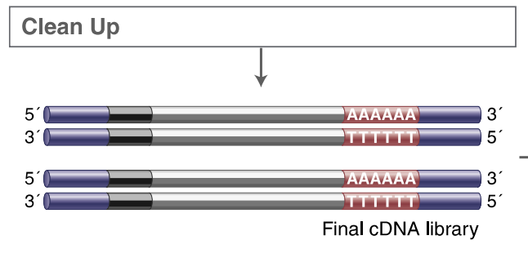
Step 2: Template switch and PCR

Slide 9
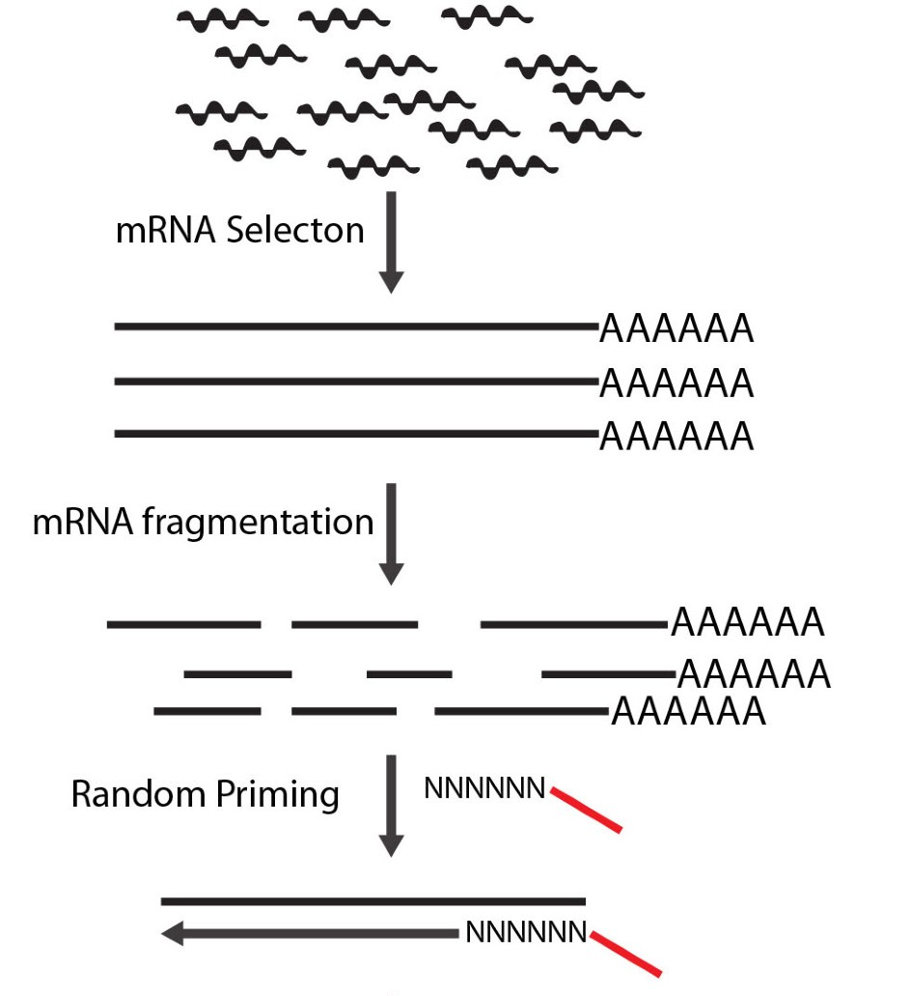
Fragmentation
Chemical (heat, Mg²⁺ / Zn²⁺)
Enzymatic
Or you fragment after RNA was reverse transcribed into DNA
Notes:
https://www.nature.com/articles/srep09570

Slide 10
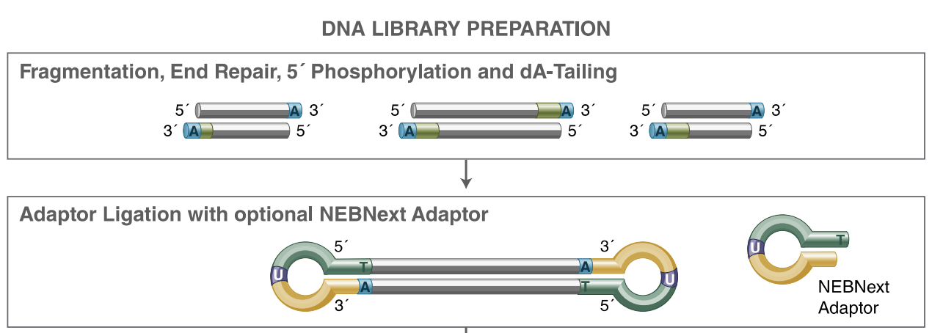
Step 3: End repair, A-tailing, Adapter ligation

Slide 11
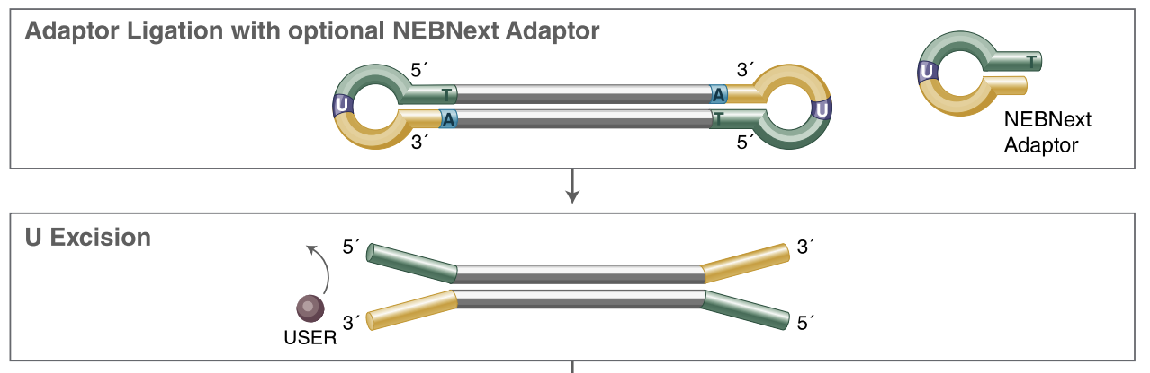
Step 4: Stem loop opening

Slide 12
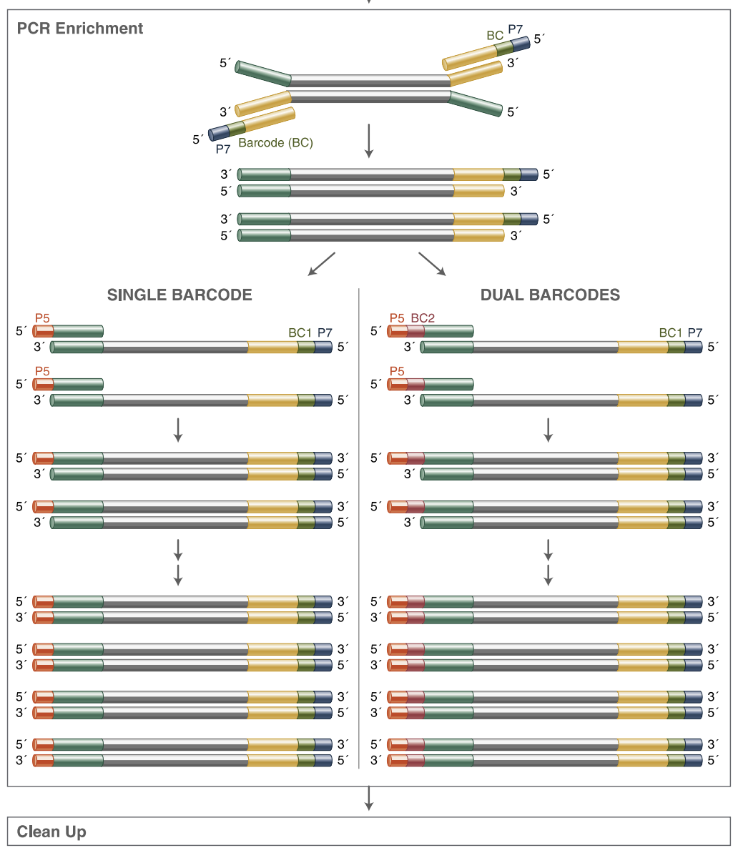
Step 5: PCR enrichment and clean-up

Slide 13
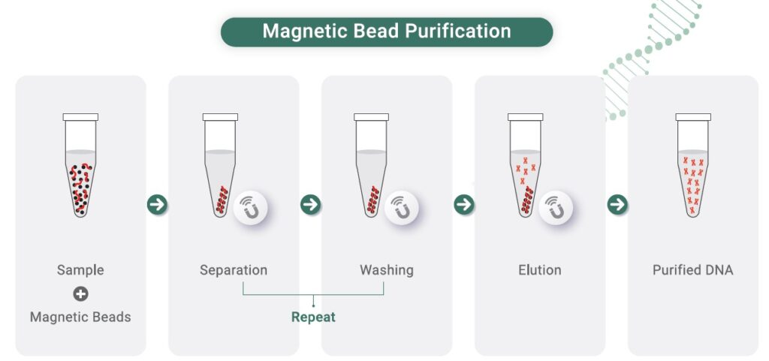

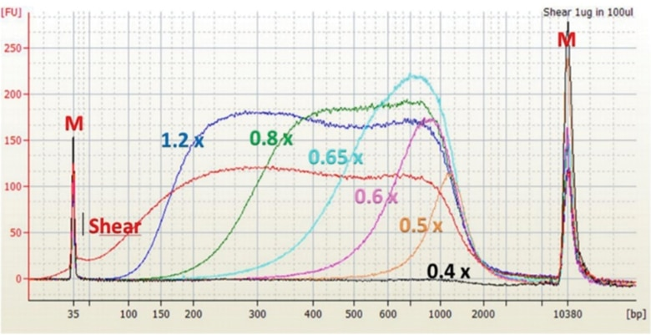

Clean-up/size selection with SPRI beads
Notes:
https://www.celemics.com/resources/blogs/efficient-dna-purification-with-celemag-clean-up-beads-for-next-gen-sequencing/
https://www.beckman.it/reagents/genomic/cleanup-and-size-selection/size-selection/spriselect-protocol

Slide 14
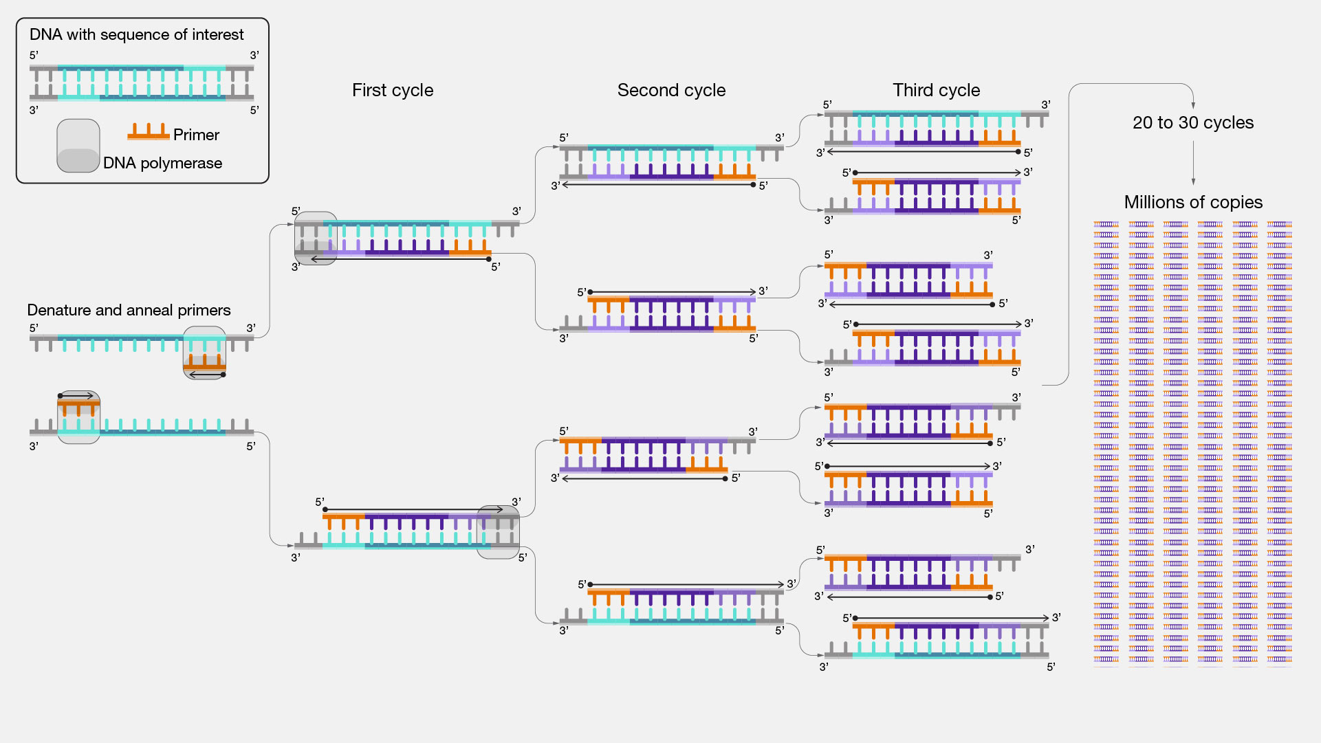
Polymerase Chain Reaction (PCR)

Slide 15
Polymerase Chain Reaction (PCR)
Template
Primers
dNTPs
PCR Buffer
DNA Polymerase

Slide 16
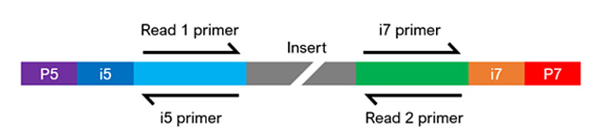

Slide 17








There are a loooooot of kits and protocols

Slide 18
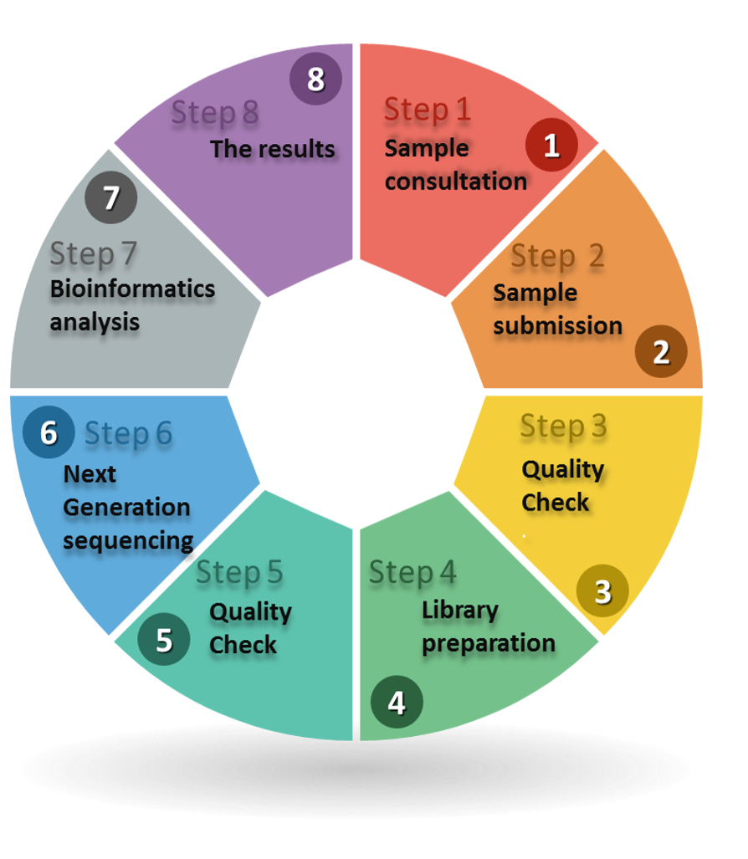

Slide 19
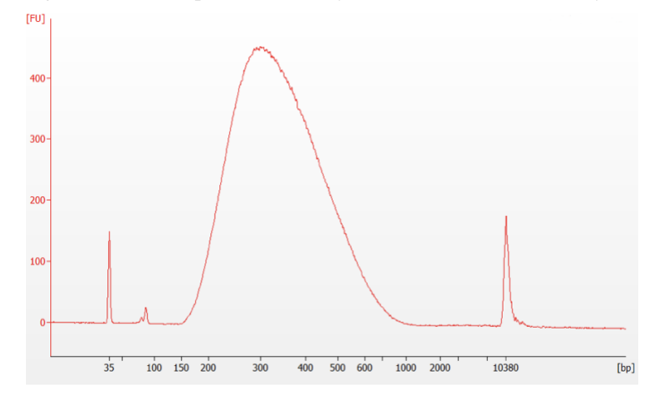
Quality control – size & concentration

Slide 20
RNA-seq Library Prep Challenges
RNA instability: RNases everywhere, rapid degradation
Secondary structures: Interfere with reverse transcription
rRNA abundance: 80-90% of total RNA (unwanted)
Strand specificity: Which strand was transcribed?
RNA modifications: Can interfere with enzymes
Dynamic range: High-abundance vs low-abundance transcripts

Slide 21
RNA-Seq workflow

