Slide 1
Multimodal NGS analysis of gene expression and chromatin state in the olfactory epithelium
NGS library construction: general principles
UBDS^3 2026 | Week 2, Day 2
Tutor: Lisa Korneeva TA: Oleksandr Lykhenko

Slide 2
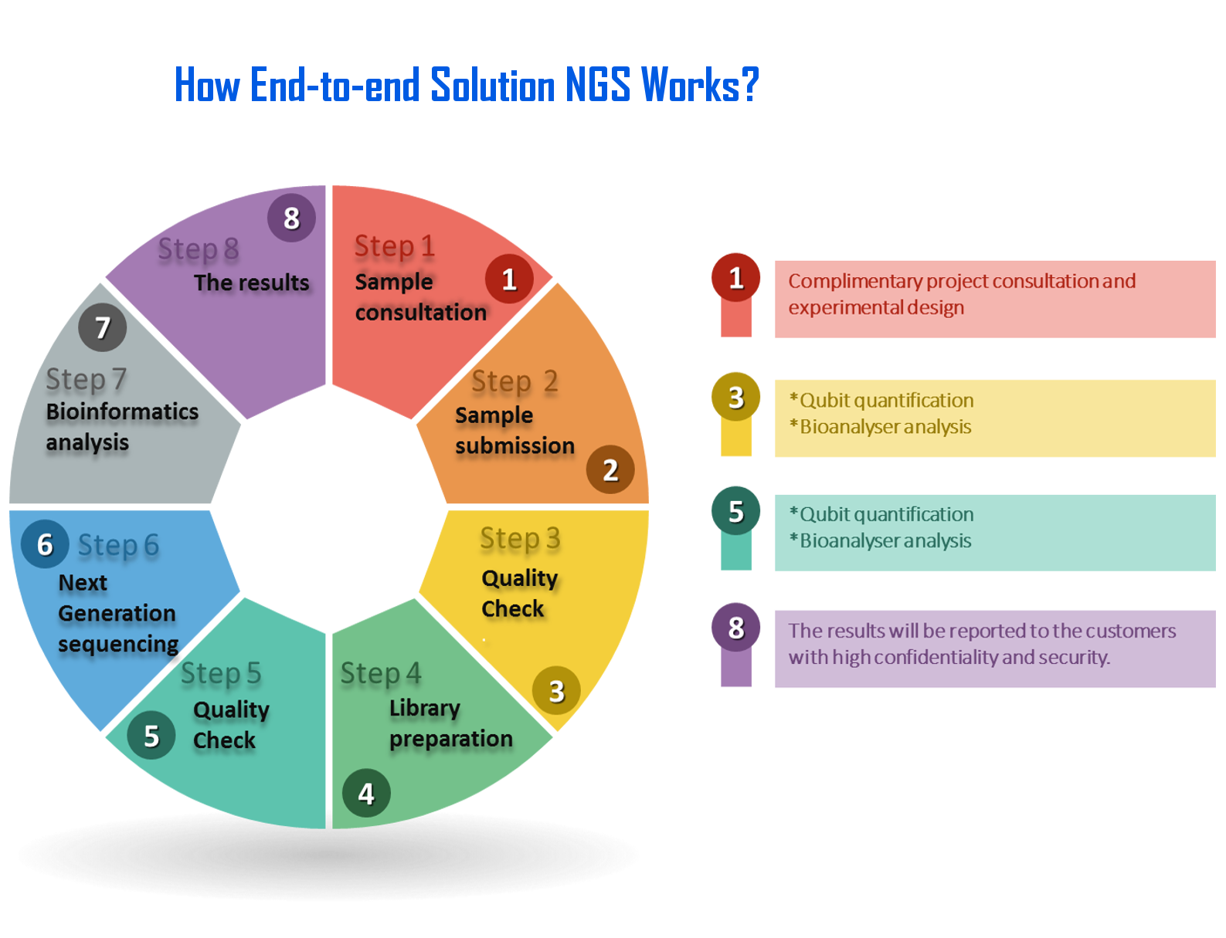

Slide 3
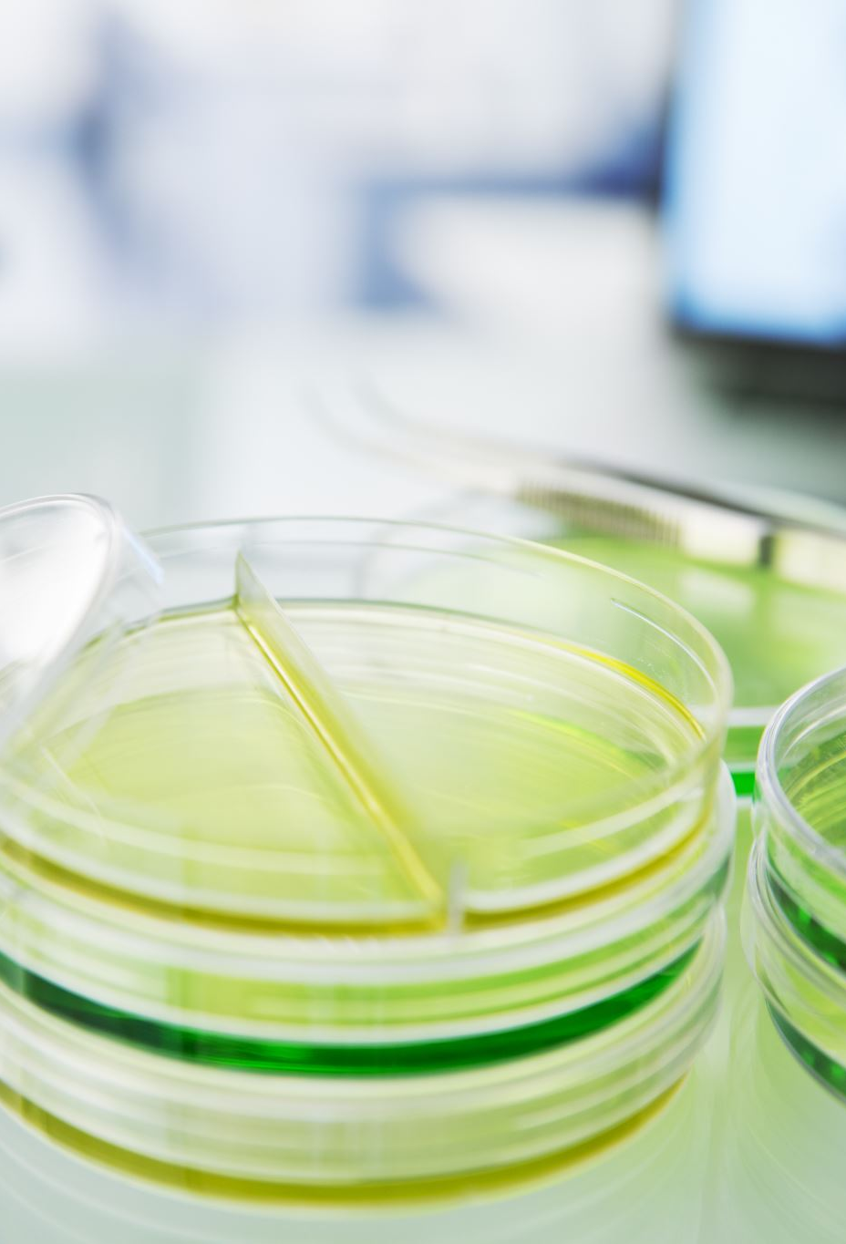
Sample types
Clinical samples: Blood, saliva, tissue biopsies, FFPE samples
Research samples: Cell cultures, model organisms, single cells
Environmental: Soil, water, microbiome samples
Forensic: Degraded/ancient DNA, trace amounts
Plant/Agricultural: Seeds, leaves, roots

Slide 4
Standards and Challenges
Fresh samples: Ideal but not always possible
Frozen samples: -80°C gold standard
FFPE tissues: Challenging but increasingly important
Single cells: Revolutionary but technically demanding
Plasma/serum: Circulating RNA for liquid biopsies
RNA challenges: RNases everywhere, degradation, low abundance

Slide 5
Step 1:
Sample consultation
Step 2:
Sample submission and extraction

Slide 6
Extraction Methods
Column-based kits: Fast, standardized (Qiagen, Zymo)
Magnetic beads: Automation-friendly (Beckman, Thermo)
Direct lysis: Minimal processing (good for single cells)

Slide 7
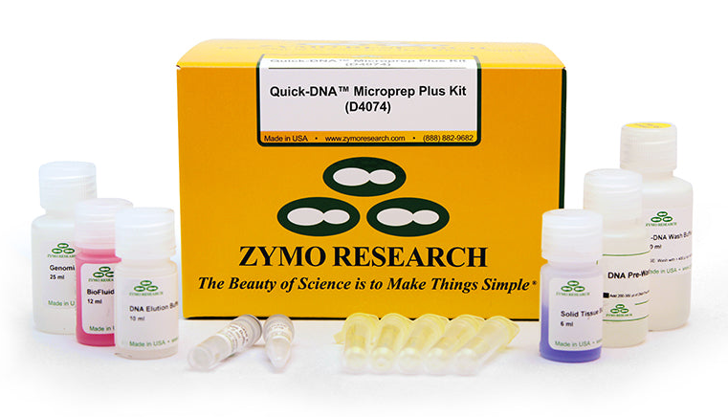
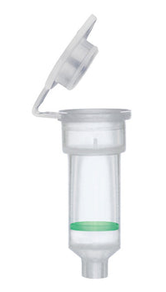
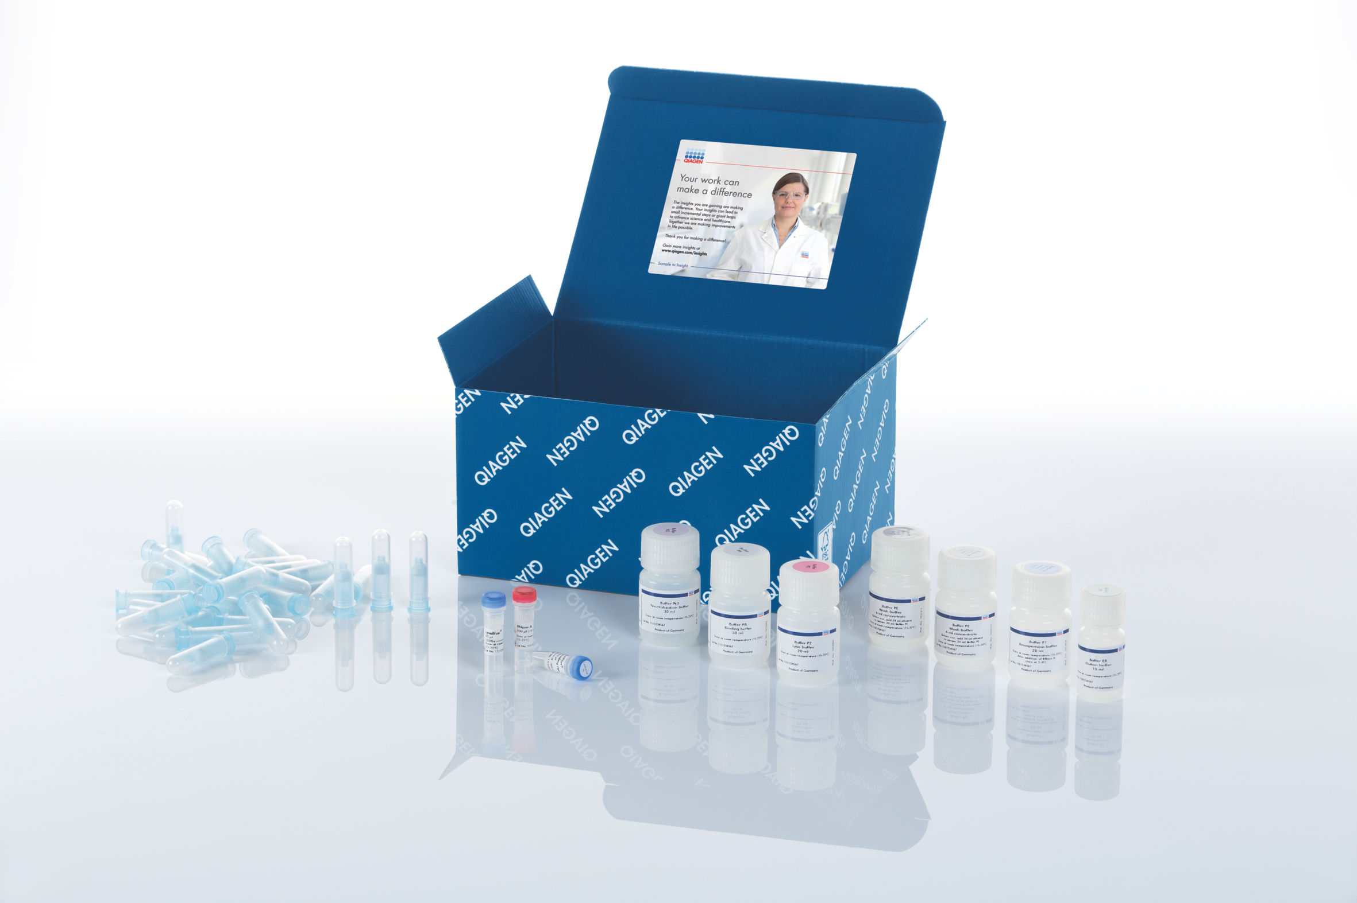
Extraction methods: Column-based
Column-based kits: Fast, standardized (Qiagen, Zymo)

Slide 8
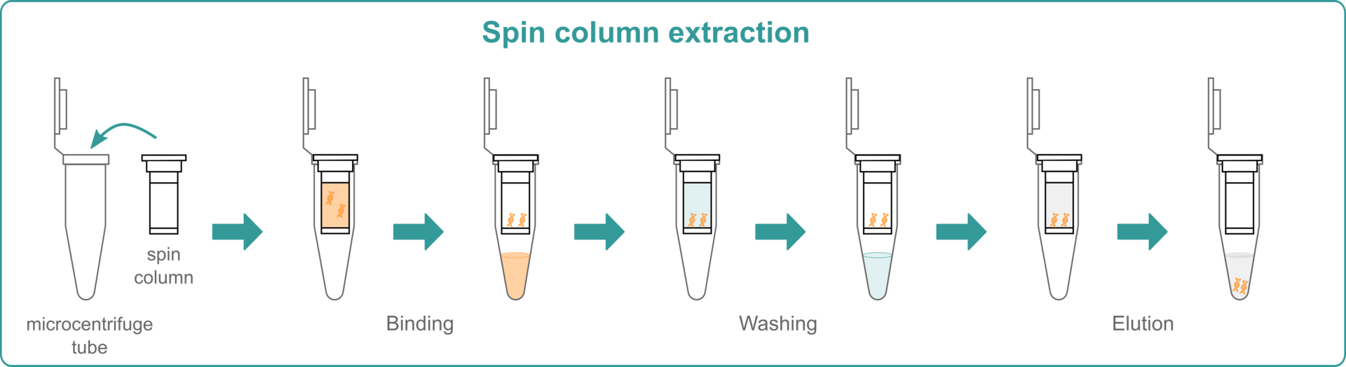
Extraction methods: Column-based
https://www.integra-biosciences.com/global/en/stories/automated-nucleic-acid-purification-assist-plus-pipetting-robot
Notes:
https://youtu.be/fz2OpjxQKKM
1. Lysis and Binding:
Cells are lysed to release their nucleic acids (DNA and/or RNA).
The lysate is mixed with a high-salt buffer, which promotes binding of nucleic acids to the silica membrane in the spin column.
Other cellular components and proteins that do not bind to the silica pass through the column during centrifugation or vacuum application.
2. Washing:
A series of wash steps with specific buffers (often containing ethanol or isopropanol) are performed to remove remaining contaminants like salts, proteins, and other cellular debris.
The buffers used in the wash steps maintain the binding conditions, ensuring that the nucleic acids remain bound to the silica membrane.
3. Elution:
A low-salt buffer or water is added to the column, disrupting the interaction between the nucleic acids and the silica membrane.
The purified nucleic acids are eluted, meaning they are released from the column and collected in the buffer.
The eluted nucleic acids are then ready for downstream applications such as PCR, sequencing, or other molecular biology techniques.

Slide 9
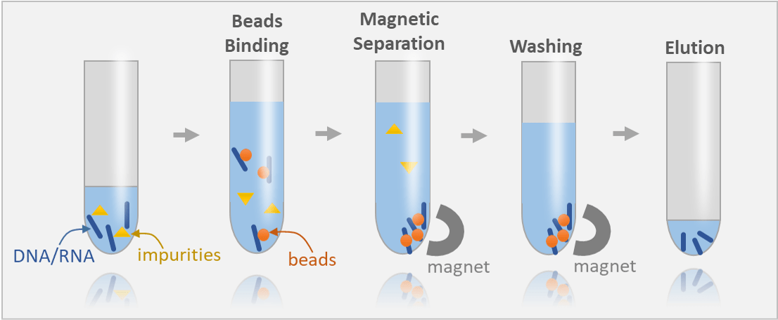
Extraction methods: Magnetic beads
https://nucleusbiotech.com/produkt/dna-and-rna-concentrator-magnetic-beads/
Notes:
https://youtu.be/SMMVSN6QSso?si=L4njWlY-uBY4WvRG

Slide 10
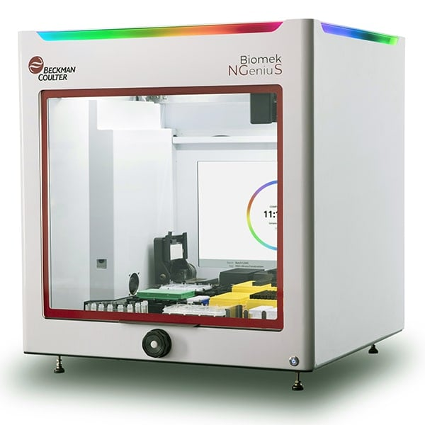
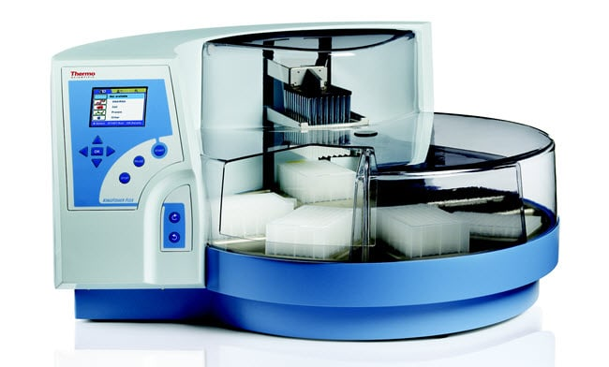
Extraction methods: Magnetic beads
Magnetic beads: Automation-friendly (Beckman, Thermo)
Notes:
https://youtu.be/SMMVSN6QSso?si=L4njWlY-uBY4WvRG

Slide 11
Extraction Methods
Column-based kits: Fast, standardized (Qiagen, Zymo)
Magnetic beads: Automation-friendly (Beckman, Thermo)
Direct lysis: Minimal processing (good for single cells)
Trade-offs: Quality vs speed vs cost vs throughput
Notes:
https://zymoresearch.eu/blogs/blog/how-to-extract-rna-from-hard-to-lyse-samples-in-trizol%C2%AE

Slide 12
Step 3:
Quality check

Slide 13
Garbage in = Garbage out
no matter how good your sequencer is

Slide 14
Extraction Quality Requirements
DNA requirements:
ng - µg (depends on application)
RNA requirements:
ng - μg (depends on application)

Slide 15

No degradation
No contamination
Sufficient amounts

Slide 16
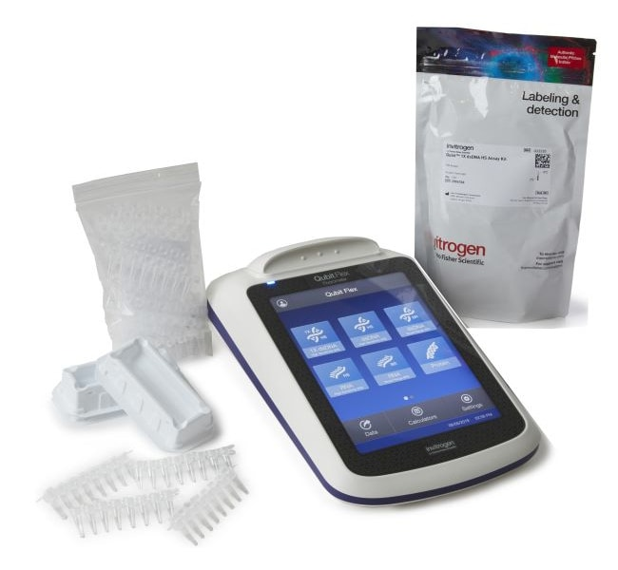
Concentration
ng/µL
Qubit – Yes!

Slide 17

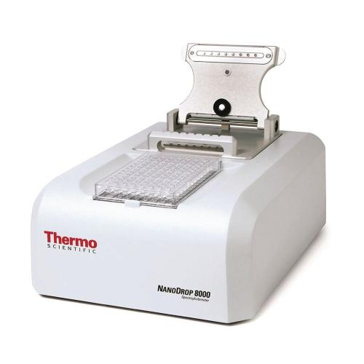
Concentration
Nanodrop – No!

Slide 18
Extraction Quality Requirements
DNA requirements:
ng - µg (depends on application)
Minimal degradation (DIN score >7)
RNA requirements:
ng - μg (depends on application)
RIN score >7 (ideally >8)
No DNA contamination!!
DIN/RIN = DNA/RNA Integrity Number

Slide 19
Which RNA do we need for conventional RNA-Seq?

Slide 20
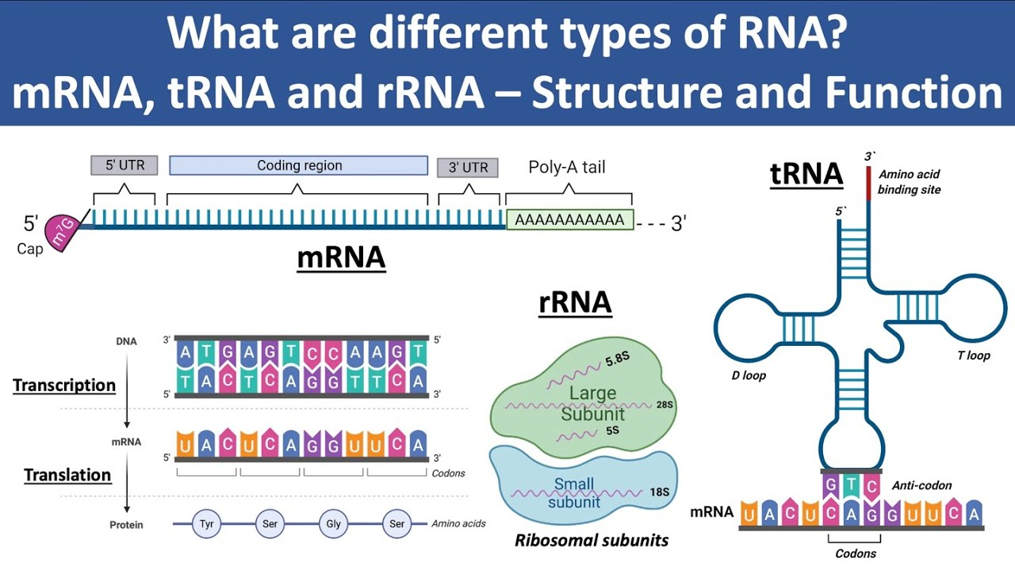
1-5% of total RNA

Slide 22
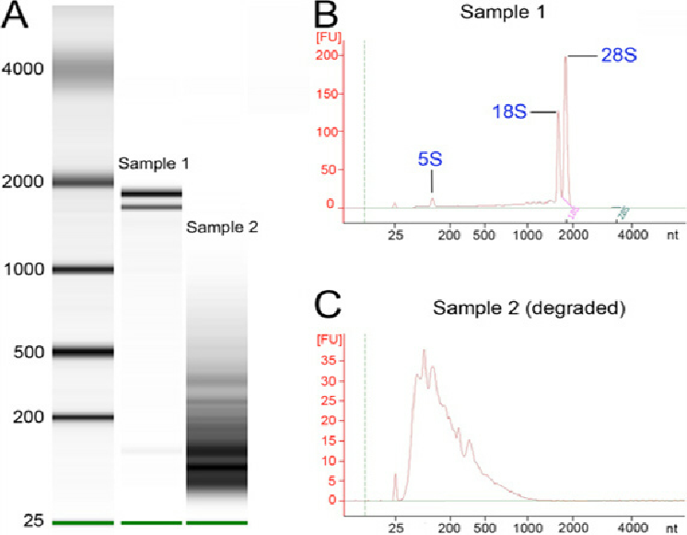

Slide 24
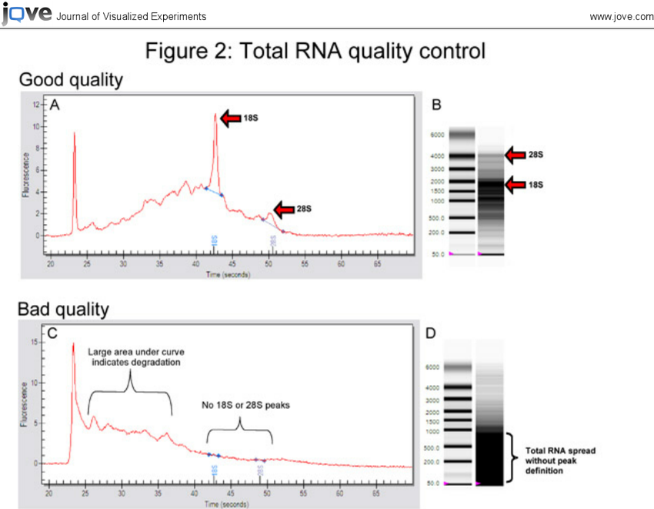

Slide 25
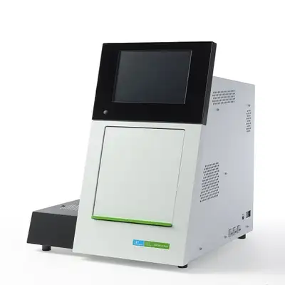
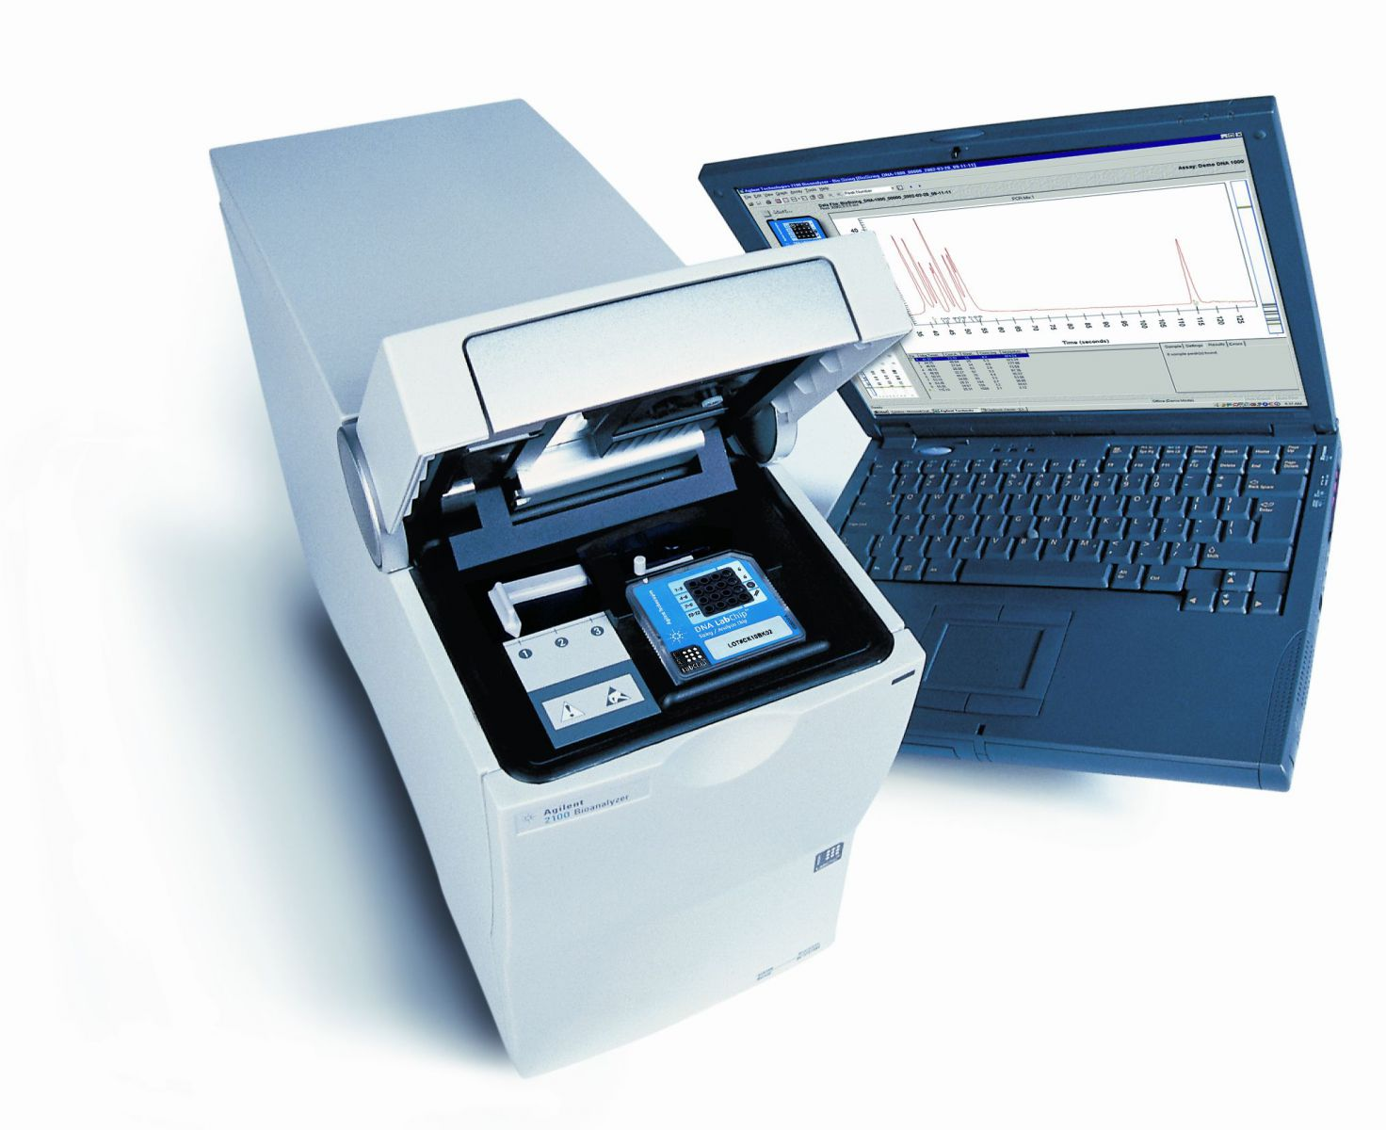
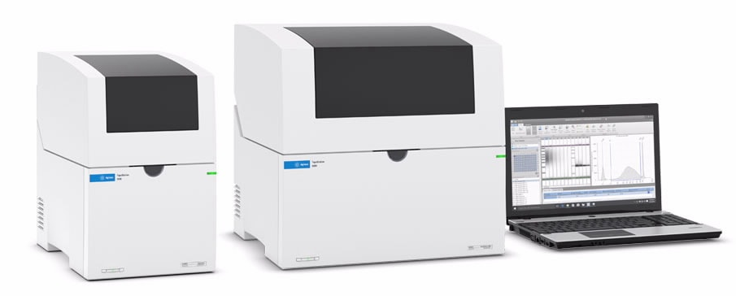
Degradation and sizes
Microfluidic capillary gel electrophoresis
LabChip (Revity)
Bioanalyzer (Agilent)
TapeStation (Agilent)

Slide 26
Case 1:
Low sample concentration

Slide 27
Case 2:
Sample is degraded

Slide 28
Case 3:
Sample is contaminated

Slide 29
Step 4:
Library preparation

Slide 30
Library preparation
- converting (preparing) nucleic acid samples (RNA / DNA) into a set (library) of uniformly sized, adapter-ligated DNA fragments, which can then be sequenced using an NGS instrument.

Slide 31
Why Library Prep is THE Critical Step
70% of failed NGS experiments = library prep issues
Good library prep can salvage poor samples
Bad library prep ruins even perfect samples

Slide 32
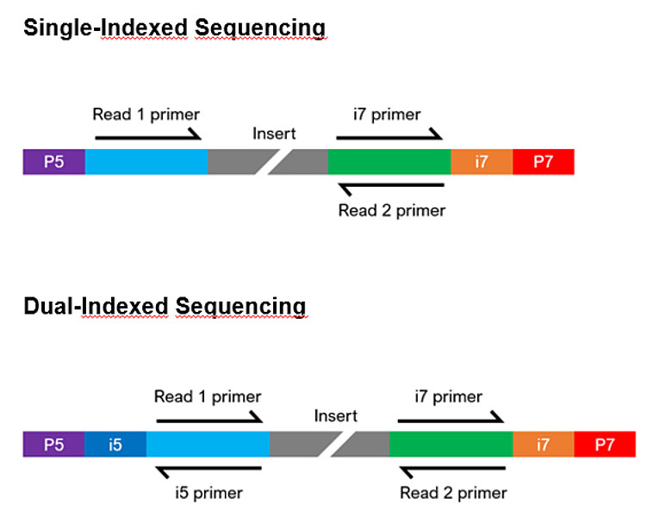
Library Architecture: The Universal Design
P5/P7 adapters: Platform-specific sequences for flow cell binding
Indexes/Barcodes: Sample identification sequences
Insert: Your actual sample DNA/cDNA
Read primers: Enable sequencing chemistry

Slide 33
Single-indexed / Dual-indexed

Slide 34
Flow-cell adapters (P5/P7)
Complementary to oligos on flow cell surface
Enable cluster generation/amplification
Platform-specific (Illumina vs Ion Torrent vs etc.)

Slide 35
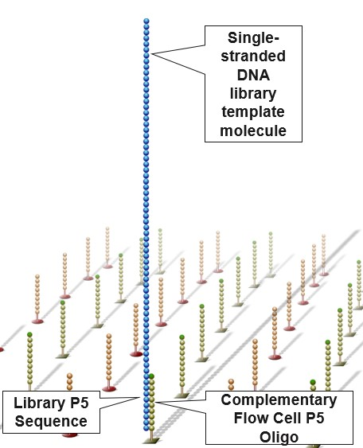


Slide 36
Indexes/Barcodes (i5/i7)
6-12 nucleotide unique sequences
Enable sample multiplexing (combine multiple samples)
Dual indexing reduces index hopping

Slide 37
Sequencing primers (i5 / i7 primer)
Initiate sequencing chemistry

Slide 38
Multiplexing
Many Samples, One Flow Cell
Benefits: Cost reduction, processing efficiency

Slide 39

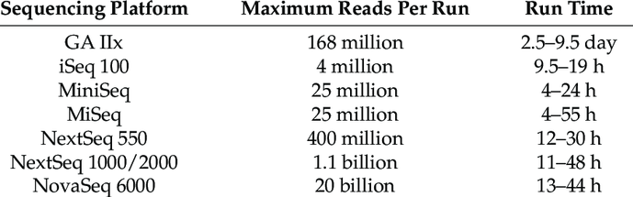
Multiplexing
Notes:
https://www.researchgate.net/figure/Comparison-of-the-maximum-number-of-single-reads-per-flow-cell-and-run-time-of-the-Genome_tbl1_354145721

Slide 40
Multiplexing
Considerations:
Index compatibility (avoid similar sequences)
Balanced GC content
Sufficient sequence diversity

