Slide 1
Real-Time Capabilities in Functional Languages
Jeffrey C Murphy
Bhargav Shivkumar
Lukasz Ziarek
Notes:
What are the benefits?
Is it feasible?
Are there any FP languages out there that are used for real-time systems.

Slide 2
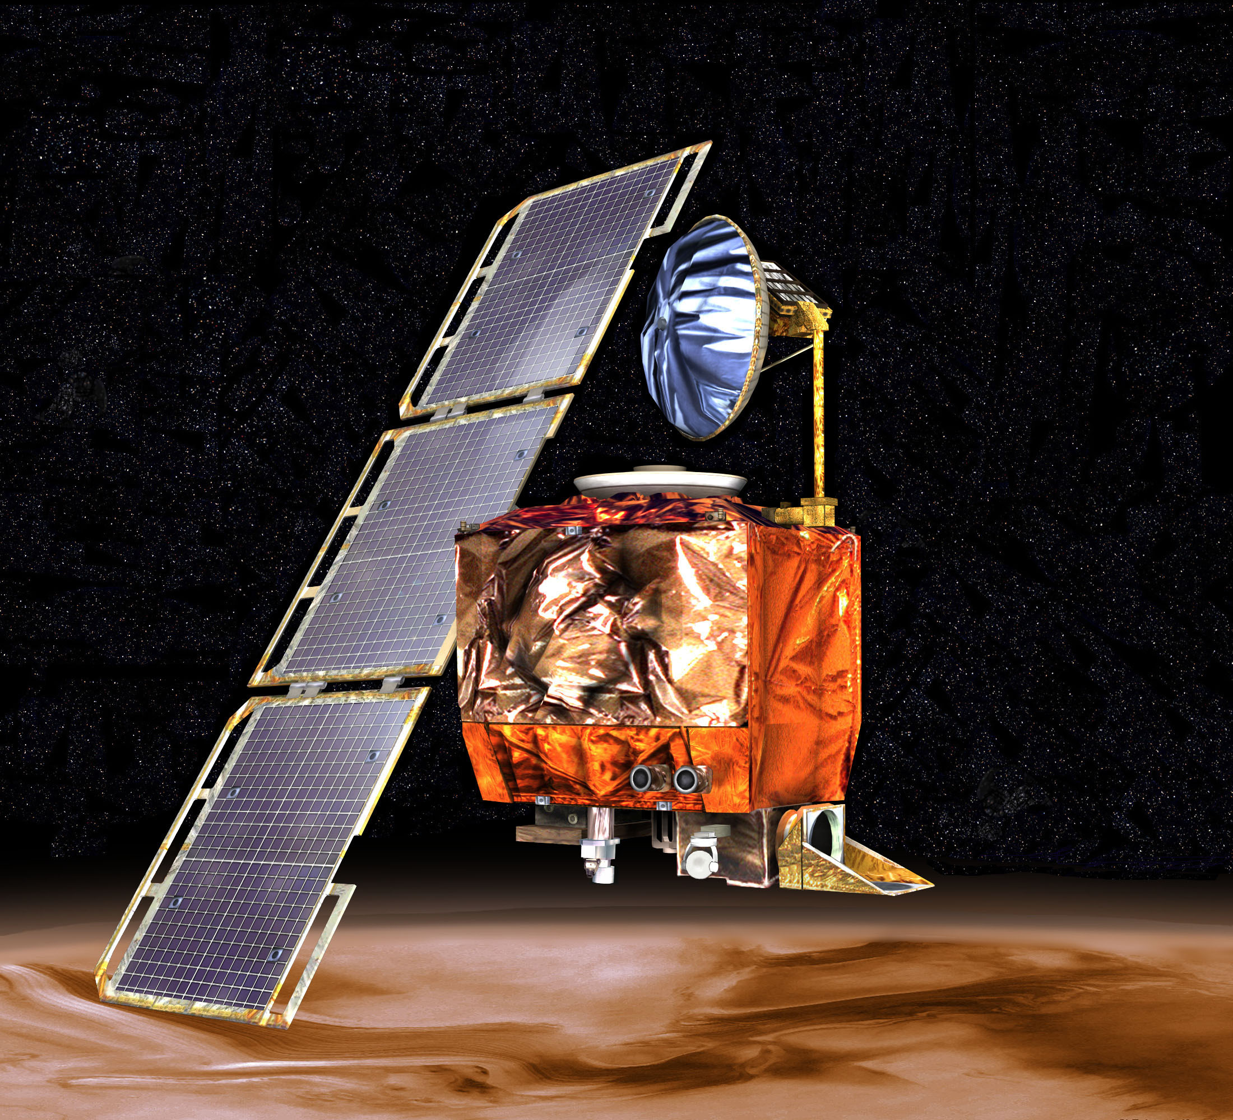

Why is correctness so more important in real-time systems?
Failures lead to severe consequences
Economic loss or even loss of life
Real-time systems need to work correctly!
Mars Climate Orbiter
Therac 25
Notes:
Harmed the patients

Slide 3
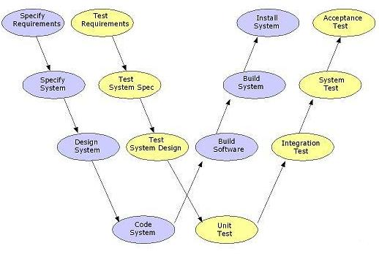
How do we ensure correctness?
Verification and Validation processes help
Rely on exhaustive testing
Typical of languages like C/ Java
Expensive, Time intensive
Prove the correctness of the program?
V&V model
Notes:
Each development phase is associated with an associated validation phase
Expensive, involves time and substantantial human effort

Slide 4
Formal methods to ensure correctness?
Guidelines (DO-178C) allow for use of formal methods
Guidelines also open to possibility of use of managed languages
Advances in formal verification - Automatic verifiers
Formal verification of real-time systems?
Functional languages for real-time systems?
Notes:
Use of formal methods in RT systems is an interesting area of exploration
Formal methods are difficult. Pointers implicit type coercion, fp greatly curtails these side effects, making FP for RT interesting

Slide 5

Benefits of Functional languages
Tools exist to automatically verify pure functional programs
Immutable objects means no side effects
Closer to Formal specifications
A Robust type system catches specific errors
Explore Functional Reactive models of programming
Notes:
Some properties of functional languages:
More natural translation from dpec to functional

Slide 6
How can functional languages help real-time systems?
McDermid’s* criteria :
Correctness
Concurrency
Determinacy
Bounded time/space
Asynchronicity
Periodic Scheduling & Interrupts
Functional languages:
Closer to Specs, Auto verifiers
No synchronization issues
Immutability has no side effects
Needs work
Needs work
Needs work
*J. McDermid. Engineering Safety-Critical Systems, pages 217–245. Cambridge University Press, 1996
Notes:
concurrency – the language must allow the construction of systems as communicating units of independent computation;
correctness – the language must allow a high degree of confidence that constructed systems meet their formal requirements .
determinacy – the language should allow the construction of determinate systems, by which we mean that under identical environmental constraints, all executions of the system should be observationally equivalent;
bounded time/space – the language must allow the construction of systems whose resource costs are statically bounded – so ensuring that hard real-time and real-space constraints can be met;
asynchronicity – the language must allow the construction of systems that are capable of responding to inputs as they are received without imposing total 2 ordering on environmental or internal interactions;
periodic scheduling to ensure that real-time constraints are met; interrupts and polling to deal with connections to external devices.

Slide 7
What do we get out of the Box?
Top defects in safety-critical medical devices¹
Buffer Under/Overflow
Null object dereference
Uninitialized variable
Inappropriate cast
Division by zero
Memory Leaks
Does not occur
Does not occur
Does not occur
Does not occur
Checked by runtime
Garbage Collection /
Scoped Memory
1: Medical DeviceLink:
“Diagnosing Medical Device Software Defects.”
Notes:
Memory leaks taken care of by GC as most functional languages are managed languages

Slide 8
Aren’t Managed Languages unsuitable for RT?
NOT REALLY!
Real-time Java is a mature runtime and there are a plethora of real-time JVMs e.g. FijiVM
We know how to make automatic memory management predictable : Scoped memory, real-time GCs, region based management
Notes:
Scoped memory. (region based)
We know how to make auto mem management predictable.

Slide 9







BUT…..
There are lots of functional languages! Which one is more suited for real-time systems?
Paper presents a preliminary exploration
Implementation details of a handful of languages
How easy is it to incorporate real-time constructs?

Slide 10
What do we need for real-time?
Real-time systems perform I/O!
A way to differentiate and specify priorities to computations.
A way to impose timing constraints on computations.
An predictable memory management technique.
Notes:
Real-time systems interact with the real world and thus need to perform IO. The language must provide constructs to do the same.

Slide 11
How we classify our ideal functional language
Purity
Thread/Task Support
Interaction Style
FRP support
Real-time suitability
-Pure, Semi-pure, Impure
-Native,Green,None or Other
-Shared Mem/Message passing
-Ready / supported /none
-Soft / Hard real-time
Notes:
Pure languages do not mutate state and also do not support IO
Semi pure languages maintain referential transparency and also support IO , Impure – multi programming paradigm i.e. support more than one paradigm of prog
Real time suitability If it has linguistic support for realtime constructs – as seen above – and overall performance and predictability.
Suitable for soft real-time if the memory management has good performance and linusitc support for RT systems present
Suitable for hard realtime – explicit support for predictable support for mem management, RT ling constructs and proof of predictable performance

Slide 12
Language | Purity | RT support | Thread/Task support | Interaction style ^* | FRP
Atom | Semi | Hard | Other | SM | Supported
Clojure | Semi | Soft | Both | SM | Ready
CoPilot | Semi | Hard | Other | SM | Supported
Erlang | Impure | Soft | Green | MP | Ready
Haskell | Semi | Soft | Other | Both | Ready
Hume | Semi | Hard | Green | MP | Supported
Idris | Semi | Soft | Both | Both | None
Racket | Impure | Soft | Other | MP | Supported
Scala | Impure | Soft | Other | MP | Ready
SML | Semi | Soft | Green | Both | Supported
Timber | Semi | Hard | Native | MP | Ready
^*SM=Shared memory, MP=Message Passing
Notes:
Highlighted in green are the ones that are that are suitable for hard real time. One observation made is that most of these use static memory/cyclic executives
There are more languages in the paper that didn’t make it too the table as they were not suitable for real-time as they lacked I/O or a threading model or other constructs needed to build a RT system

Slide 13
Are there any functional languages that fit the bill out there?
Nothing measures up to what we want!
Highly predictable general purpose functional language
Nothing is quite fully RT ready out of the box
BUT…
Here are some languages that show some potential.
Notes:
Hard time FP very specific to certain applications. WE want something that someone can pick up and use without worrying about making changes to the language
2. Example Some have only periodic some have only priority sched.

Slide 14
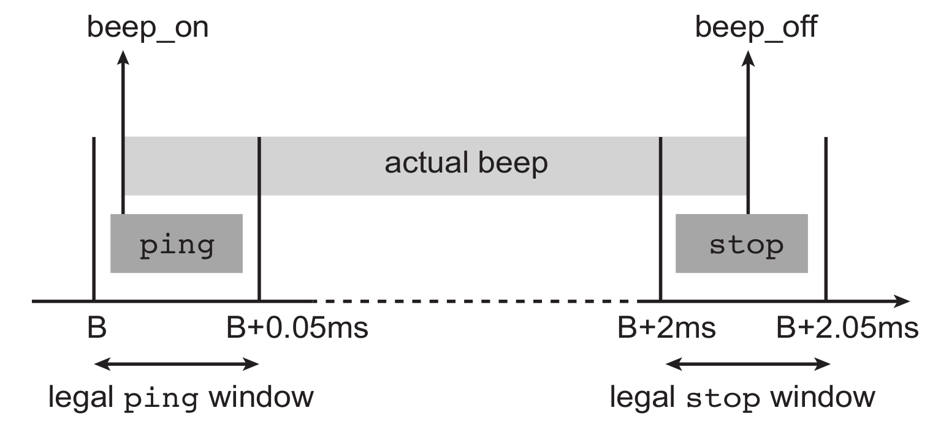
Example : Sonar Driver
Jitter
Release
Sonar application
Example specifies periodic scheduling of tasks.
Ability to specify acceptable jitter.
Notes:
Beep is 2ms long, jitter 50 micro sec
Period of beep is 3s

Slide 15

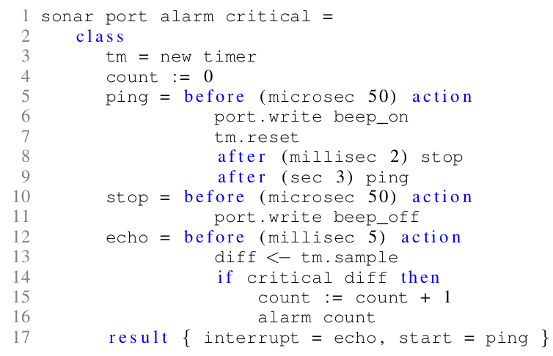

The Timber Example
Can specify actions if deadline is missed
Easy periodic scheduling
Cannot specify priorities

Slide 16
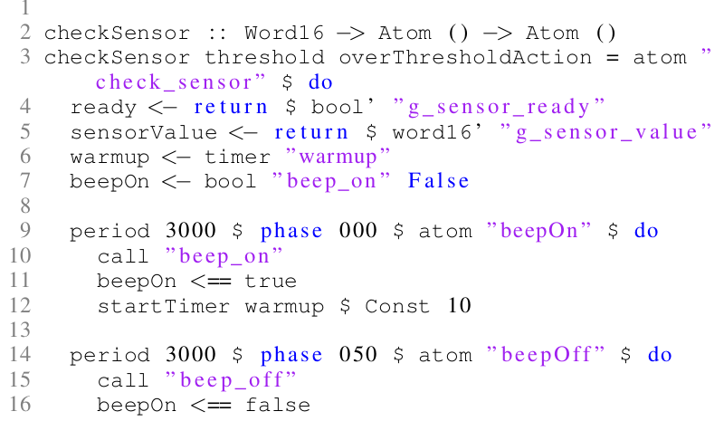
The Atom example
Easy periodic scheduling
Jitter is not intrinsic
Cannot specify priorities

Slide 17
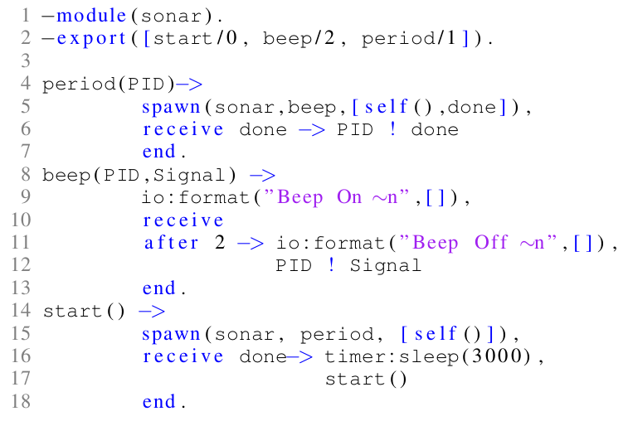
The Erlang Example
Focuses on priority based scheduling
No explicit periodic scheduling
Timers are not predictable
Notes:
No explicit periodic scheduling
Focuses on priority based scheduling
Example is not predictable.

Slide 18
Tell me about Haskell!
Haskell’s GC is not suitable for real-time, exploration in adapting Immix done
Much research in terms of RT DSLs
But those DSLs use static allocation and/or cyclic executives to simplify provability
We feel Haskell is primed for someone to make contributions in areas like priority scheduling and/or predictable GCs
State transition rules
GHC
Cyclic Executive
ATOM DSL
Notes:
Immix is a high throughput GC
Immix may help Haskell with soft RT applications
Some real time systems cannot be expresses as a cyclic executive

Slide 19
Flavors of Standard ML
MLKit has region based memory management
Ways to make region based memory management more predictable
No tasks/threads
RTMLton, a derivative of MLton we are currently working on
Why did we choose MLton?
Focus on building a real-time Garbage Collector
Preliminary work on priority based scheduling
Notes:
We chose Mlton because
Produces efficient code in both time and space
its whole program optimizing it gives us more info about objects and allocations and this can be leveraged to optimize RTGC approaches
Easy to adapt to embedded workflow by making it emit C code and then using a C cross compiler

Slide 20
Where we are headed with RTMLton…
Slack based hybrid fragmenting GC
Periodic scheduling of tasks and specification of jitter
Exploration of FRP models

Slide 21
Future work on survey
How suitable is the GC towards real-time application?
Are JVM based languages easier to adapt to RT?
Does lazy evaluation make the program less predictable?

Slide 22

Call to Action
Lots of new research opportunities
How to make functional languages more useful to real-time systems?
Make it more robust for use in real-time systems
Work towards a general purpose functional programming model for RT
Notes:
Call to action to researchers in similar fields ,

Slide 23
THANK YOU Questions?

