Slide 1
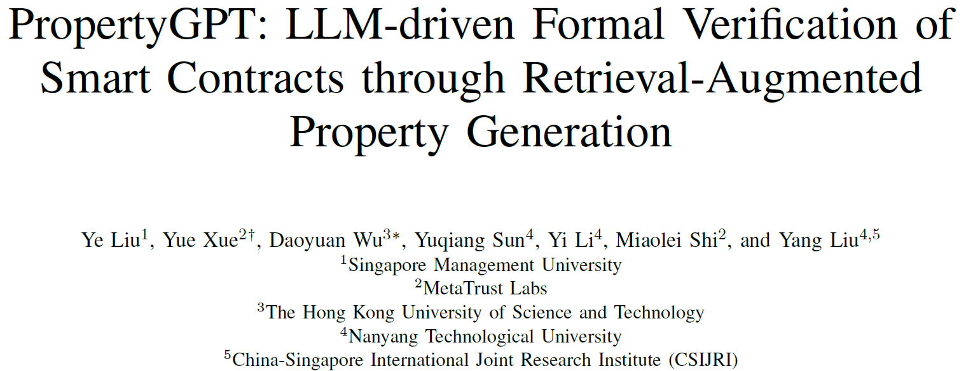

Slide 2
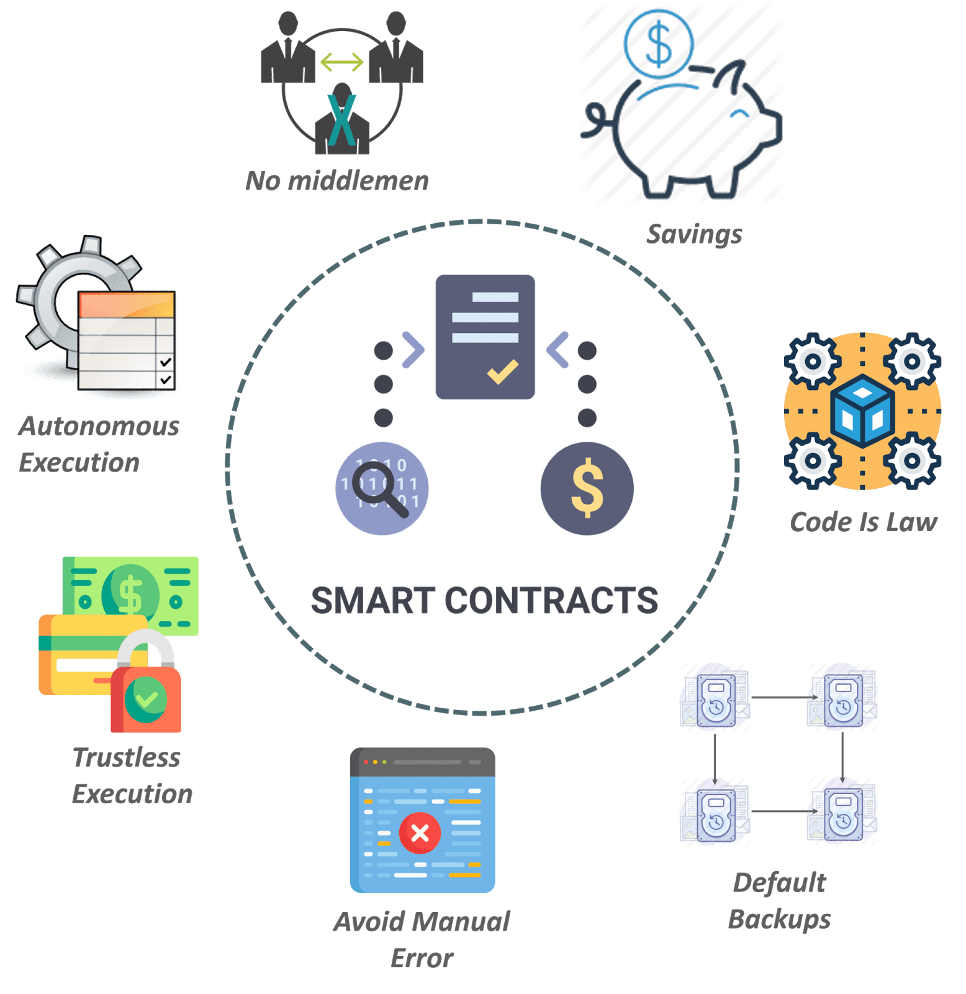
Smart Contract
Integer Overflow
Front-running
Access control Attack
Reentrancy

Slide 3
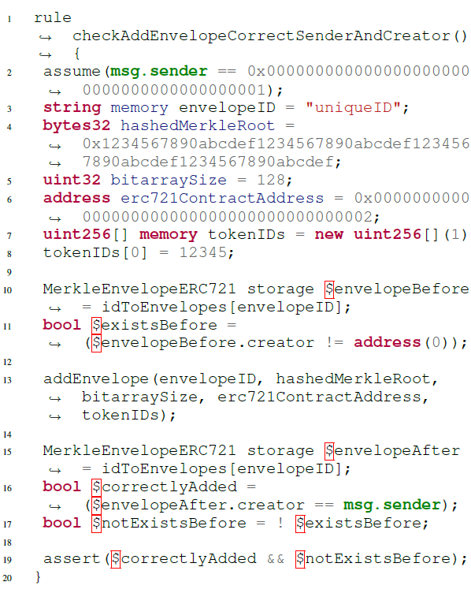
Formal Verification for Smart Contract
Verify with properties:
Invariants:
Properties that holds for any contract execution
Function pre-/post-conditions
Properties that functions should satisfy
Rules:
Varied assumptions and customized assertions
An example of rule

Slide 4


How to write properties automatically?
GPT-4-Turbo
Previous works:
InvCon:
Infer from historical transactions
Cider, SmartInv:
ML-based with labels
Only works for Invariant
Certora:
Human Expert
Can we invite our superman to solve it?

Slide 5
PropertyGPT
How to make LLMs work?
Appropriate prompts
LLM tuning techniques
Fine-tuning
Needs many samples
Not feasible for powerful LLMs
In-context Learning
One-shot/few-shot is enough

Slide 6
PropertyGPT
How to design the in-context learning?
Feed all training samples?
Feed the most similar one!

Slide 7
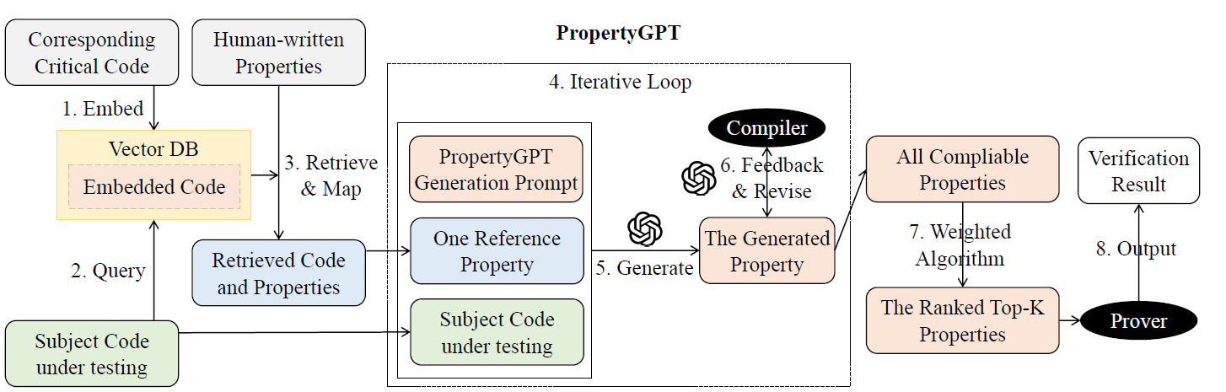
PropertyGPT
Collect a dataset (Certora)
Embed the code (text-embedding-ada-002)
Find a similar one

Slide 8
PropertyGPT
How to prepare appropriate prompt?

Slide 9
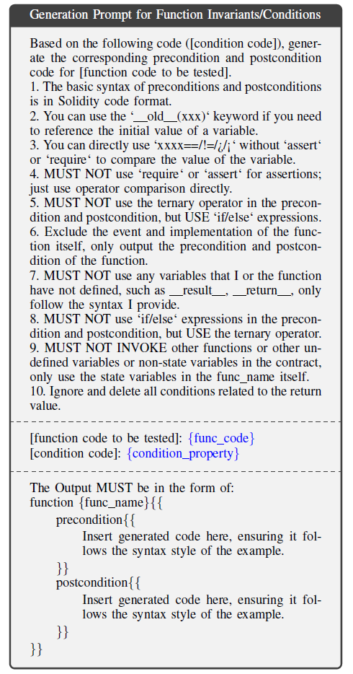
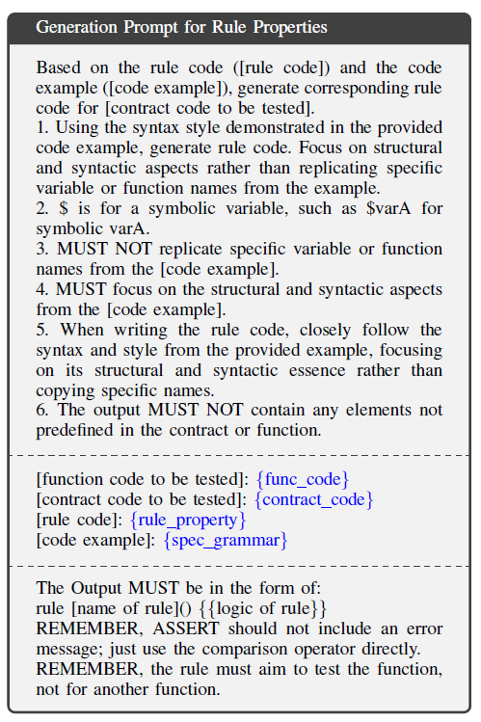
PropertyGPT
How to prepare appropriate prompt?

Slide 10
PropertyGPT
We have the generated property, now what?
Need to ensure:
Compilable
Appropriate
Verifiable

Slide 11
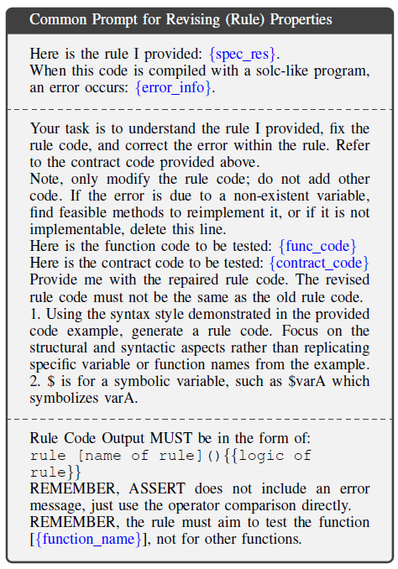
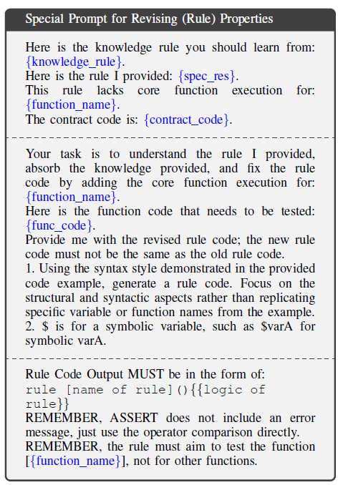
PropertyGPT
Compilable
Revise if compiler reports error
Revise if target function is missed

Slide 12
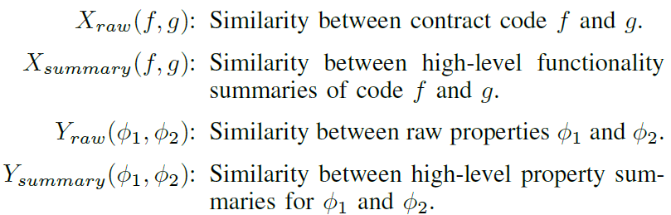
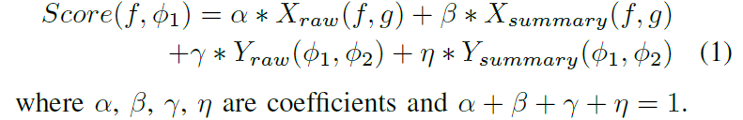
PropertyGPT
Appropriate
Rank the generated properties

Slide 13
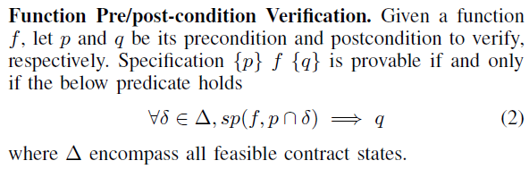
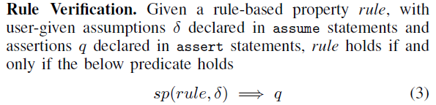
PropertyGPT
Verifiable
Ensure that for the correct test cases, the properties can pass

Slide 14
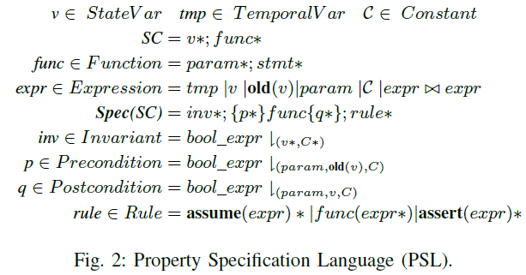
PropertyGPT
System engineering work
To make the property better support security verification
They improved Solidity into property specification language (PSL)

Slide 15
PropertyGPT
Evaluation
RQ1: Property Generation effectiveness
RQ2: Vulnerability Detection effectiveness
RQ3: Generalizability on very different samples
RQ4: Influencing Factors on performance
RQ5: Zero-day vulnerability discovery
Datasets
23 Certora projects (623 properties; 90 for testing) ➔ RQ1, RQ4
13 CVEs + 24 projects from the SmartInv benchmark ➔ RQ2, RQ3
Popular projects on Secure3 and Code4Rena ➔ RQ5
LLM
gpt-4-0125-preview

Slide 16
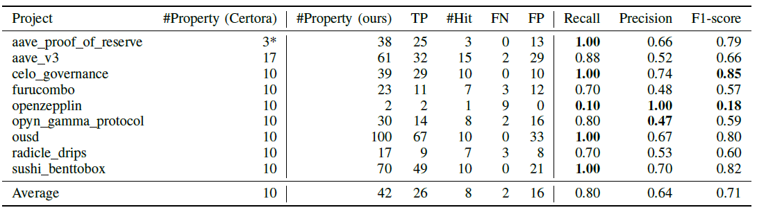
PropertyGPT
Evaluation
RQ1: Property Generation effectiveness

Slide 17
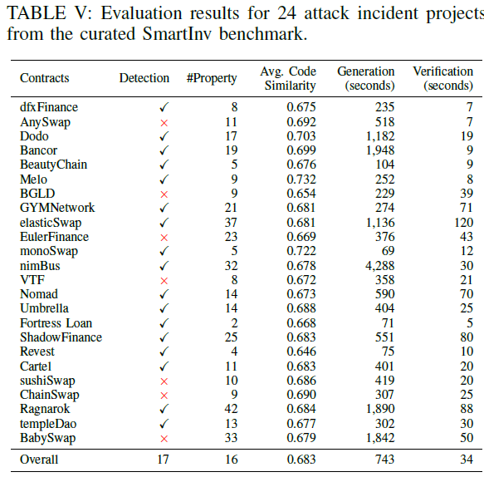
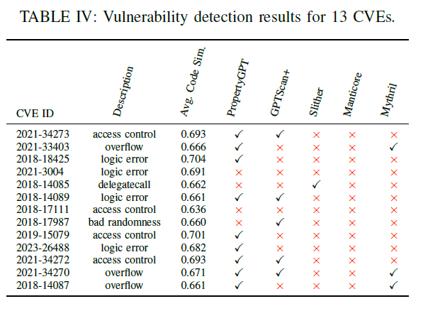
PropertyGPT
Evaluation
RQ2: Vulnerability Detection effectiveness
GPTScan+: Leverage LLMs to instantiate high-level detection patterns for logic bugs
Slither: a popular static analysis tool used to detect a wide range of common vulnerability types
Manticore and Mythril: byte-code level symbolic execution tools

Slide 18
PropertyGPT
Evaluation
RQ3: Generalizability on very different samples
Detection correctness has little correlation to the code similarity

Slide 19
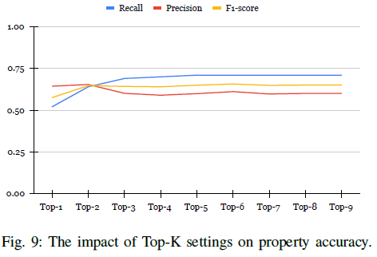
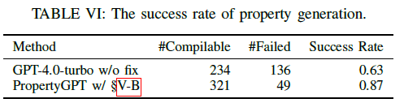
PropertyGPT
Evaluation
RQ4: Influencing Factors on performance
There is a tradeoff between precision and recall
PropertyGPT can generate much more compilable properties.

Slide 20
PropertyGPT
Evaluation
RQ5: Zero-day vulnerability discovery
Successfully generated 22 bug findings for 4 projects
12 of which have been confirmed
received $8,256 in bug bounties from vendors

Slide 21
Comments?

