Slide 1













Multi-model Intercomparison Project on the Saskatchewan-Nelson-Churchill River Basin (Nelson-MiP project)
Monthly meeting - 12 February 2020
Manitoba Infrastructure

Slide 2
Agenda
Presentation of gauging stations submitted
Selection of gauge stations for calibration/validation for Phase 0 & Phase 1
Decision on time periods for model calibration/validation
Discussion on a standardized meteorological forcing data
Discussion on a common routing scheme and geophysical input data

Slide 3
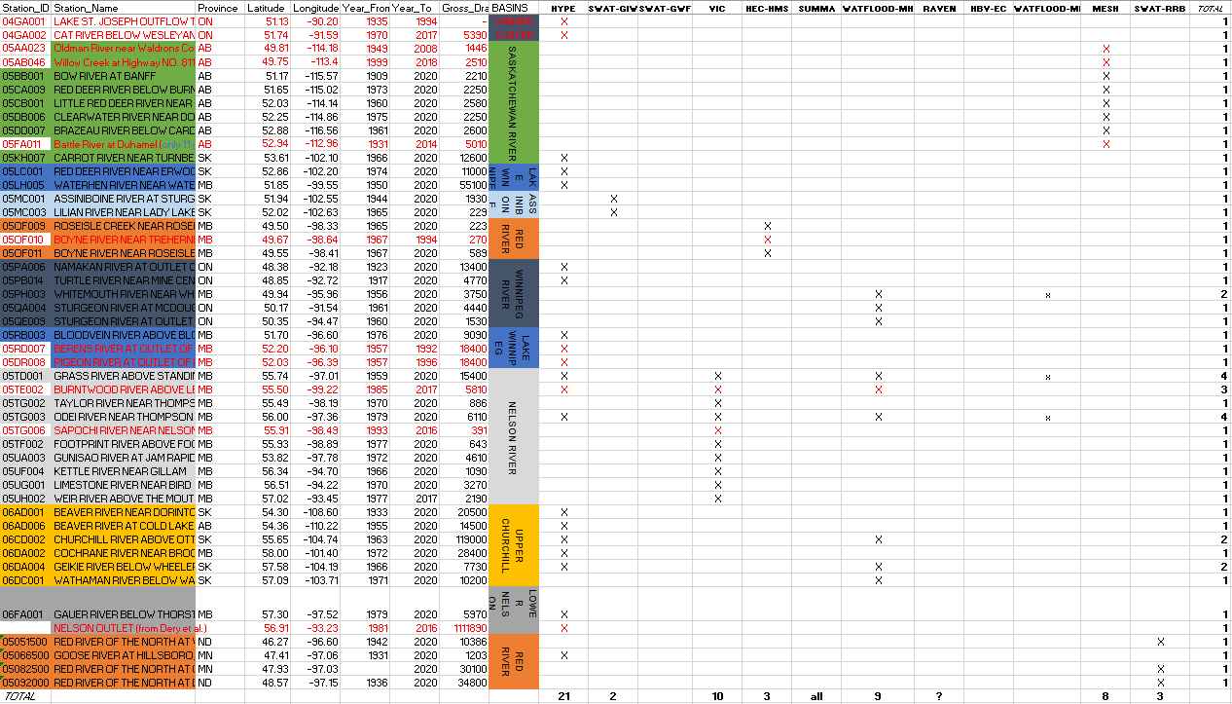
Presentation of the gauge stations submitted

Slide 4
Selection of gauge stations for calibration/validation (Phases 0 & 1)
Search criteria:
Station == Natural
Data Period == 1970 to 2016
Total Years >= 35
Drainage area >= 200 km²
+
Stations submitted but not meeting search criteria
291 (natural) gauge stations identified + 11 stations added

Slide 5
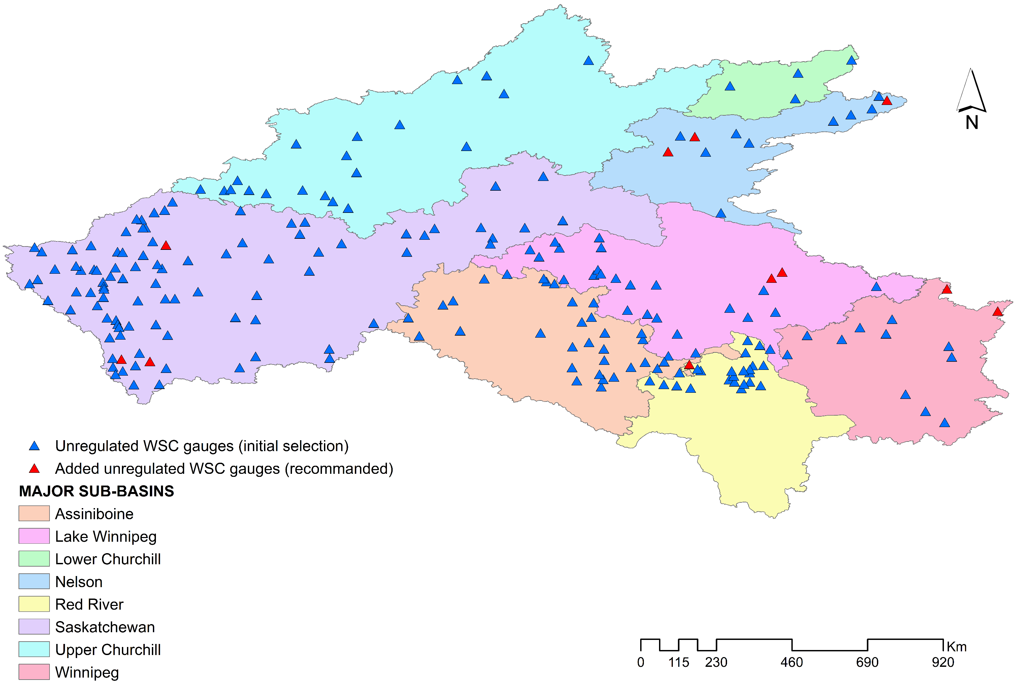
Selection of gauge stations for calibration/validation (Phases 0 & 1)
Sub-basins | Number of WSC natural stations
Assiniboine | 32
Lake Winnipeg | 28
Winnipeg river | 13
Upper Churchill | 20
Lower Churchill | 4
Saskatchewan river | 94
Red River | 23
Nelson river | 12

Slide 6
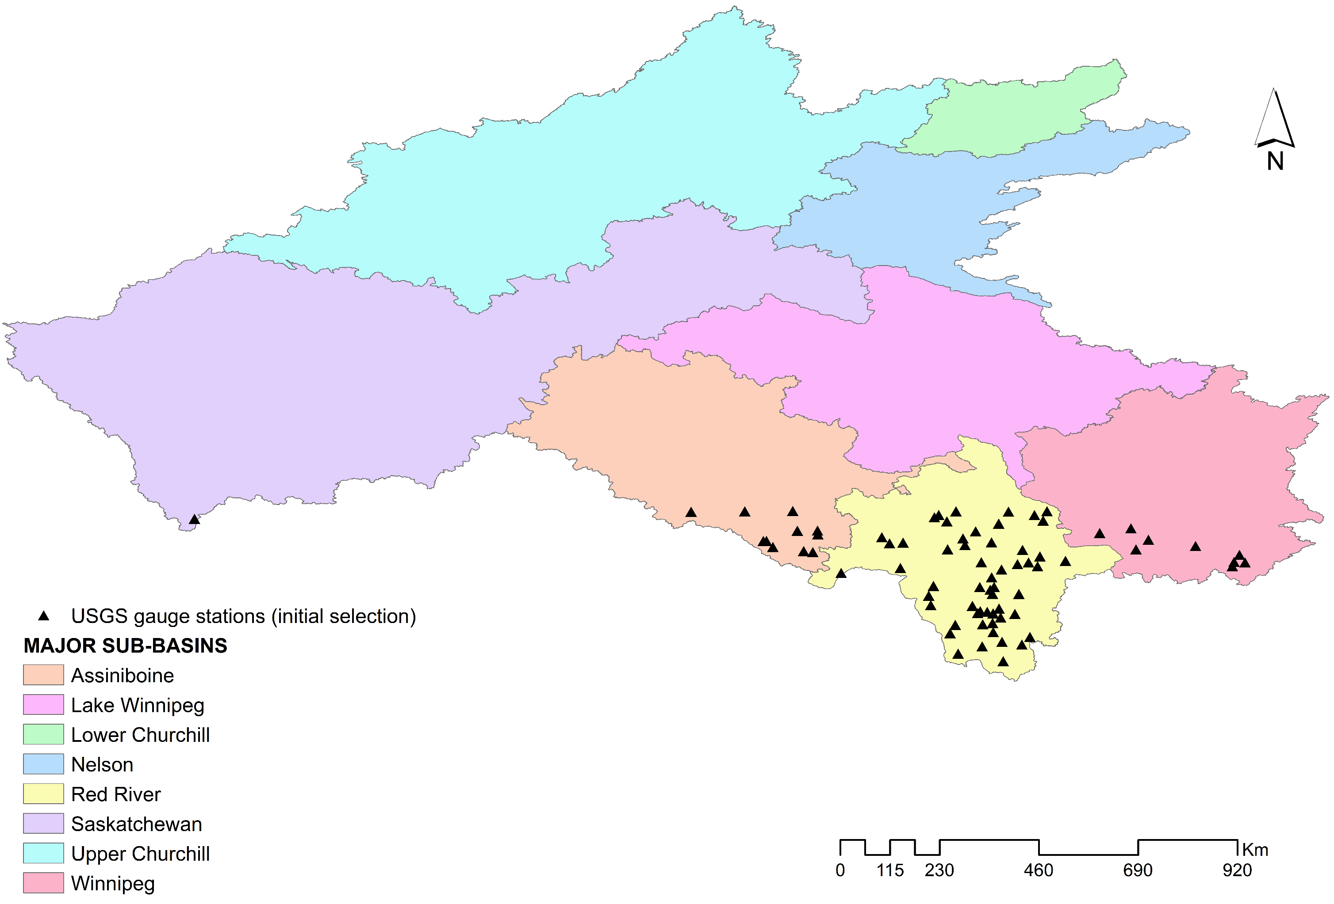
Selection of gauge stations for calibration/validation (Phases 0 & 1)
Sub-basins | Number of USGS stations
Assiniboine | 11
Lake Winnipeg | -
Winnipeg river | 9
Upper Churchill | -
Lower Churchill | -
Saskatchewan river | 1
Red River | 55
Nelson river | -

Slide 7
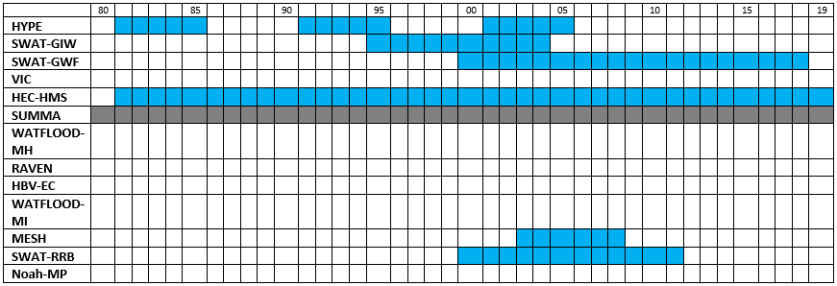
Time periods for calibration/validation
Calibration
No calibration for SUMMA

Slide 8
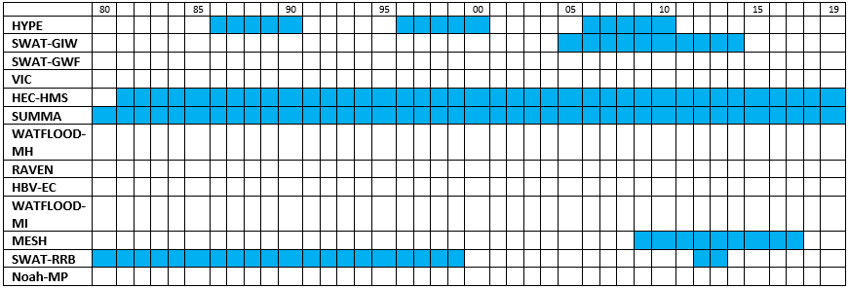
Time periods for calibration/validation
Validation

Slide 9
Standardized meteorological forcing data
 | ERA5 | WFDEI-GEM-CaPA | NCEP-CFRS | Standard MiP data
HYPE | X |  |  | X
SWAT-GIW |  | X | X
SWAT-GWF
VIC
HEC-HMS | X |  |  | X
SUMMA | X
WATFLOOD-MH
RAVEN
HBV-EC
WATFLOOD-MI
MESH |  | X
SWAT-RRB |  | X |  | X
Noah-MP
We have to choose between ERA5 and WFDEI-GEM-CaPA
WFDEI-GEM-CaPA ➔ 3-hourly, 0.125ᵒ ~ 10 km, 1979-2016
(huss, pr, ps, rlds, rsds, sfcWind, tas)
ERA 5 ➔ 1-hourly, ~31km-grid, 137 levels to 0.01hPA, 1979-near real time

Slide 10
Routing scheme and other geophysical inputs
Land use/ land cover: North American Land Change Monitoring System (NALCMS)
NALCMS is provided at 250m and 30m spatial resolution, contains 19 land cover classes, and is publicly available from http://www.cec.org/tools-and-resources/map-files/land-cover-2010-landsat-30m.
Soil data: Global Soil Dataset for Earth System Modelling (GSDE)
GSDE is provided at 30 arc-second resolution (~1km), and contains 11 types of soil general information for soil profiles and 34 soil properties for 8 depths up to 2.3 m. It can be downloaded from http://globalchange.bnu.edu.cn/research/soilw#download.

Slide 11
Routing scheme and other geophysical inputs
We should decide on using a standardized routing scheme or not.
Bryan Tolson’s group (UWaterloo) offers to produce a routing scheme (including lakes) if all modelers will use it.
If Bryan idea is accepted, we shoud also decide whether the routing scheme shall be derived using HydroSHEDS 3-arc sec DEM (~90m) or MERIT Hydro 3-arc sec data products (https://doi.org/10.1029/2019WR024873).

Slide 12
Follow up
Ajay will follow up with analysis of wet/dry periods from 1980-2016 for selection of calibration and validation periods.
Recommendation to be made before next meeting
Forcing data selection will be circulated (based on discussion and follow up) before next meeting
Hervé will refine and circulate an updated gauge selection map.
All groups to explore soil datasets to be used
Provide recommendations of datasets to Hervé by March 9
All groups to consider offline routing advantages/disadvantages
Next meeting scheduled for Wednesday March 11 @10:00AM MST

