Slide 1













Multi-model Intercomparison Project on the Saskatchewan-Nelson-Churchill River Basin (Nelson-MiP project)
Monthly meeting - 11 March 2020
Manitoba Infrastructure

Slide 2
Agenda
Selection of natural gauge stations for calibration/validation for Phase 0 & Phase 1
Decision on time periods for model calibration/validation
Discussion on a standardized meteorological forcing data: WFDEI-GEM-CaPA vs ERA5
Discussion on routing scheme and geophysical input data
Deliverables for next meeting

Slide 3
Selection of gauge stations for calibration/validation (Phases 0 & 1)
Search criteria:
Station == Natural
Data Period == 1970 to 2016
Total Years >= 35
Drainage area >= 200 km²
+
Stations submitted but not meeting search criteria
291 (natural) gauge stations identified + 11 stations added

Slide 4
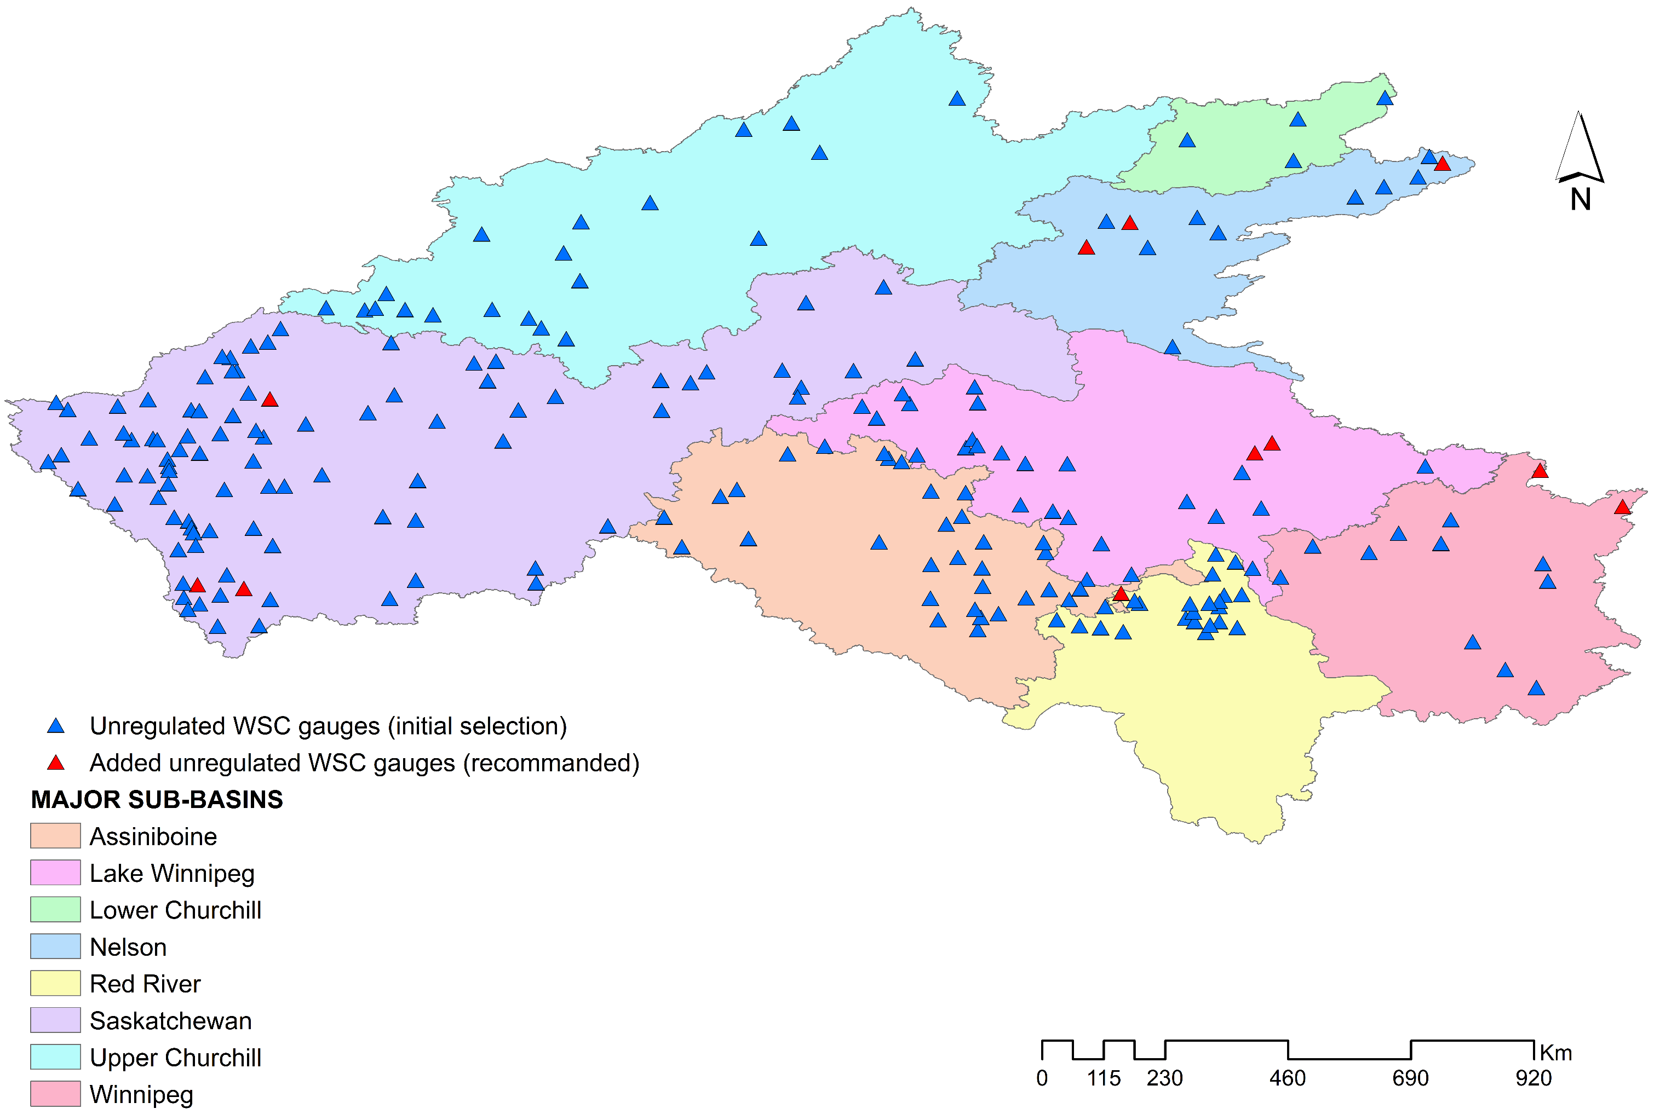
Selection of natural gauge stations for calibration/validation (Phases 0 & 1)
Sub-basins | Number of WSC natural stations
Assiniboine | 32
Lake Winnipeg | 28
Winnipeg river | 13
Upper Churchill | 20
Lower Churchill | 4
Saskatchewan river | 94
Red River | 23
Nelson river | 12

Slide 5
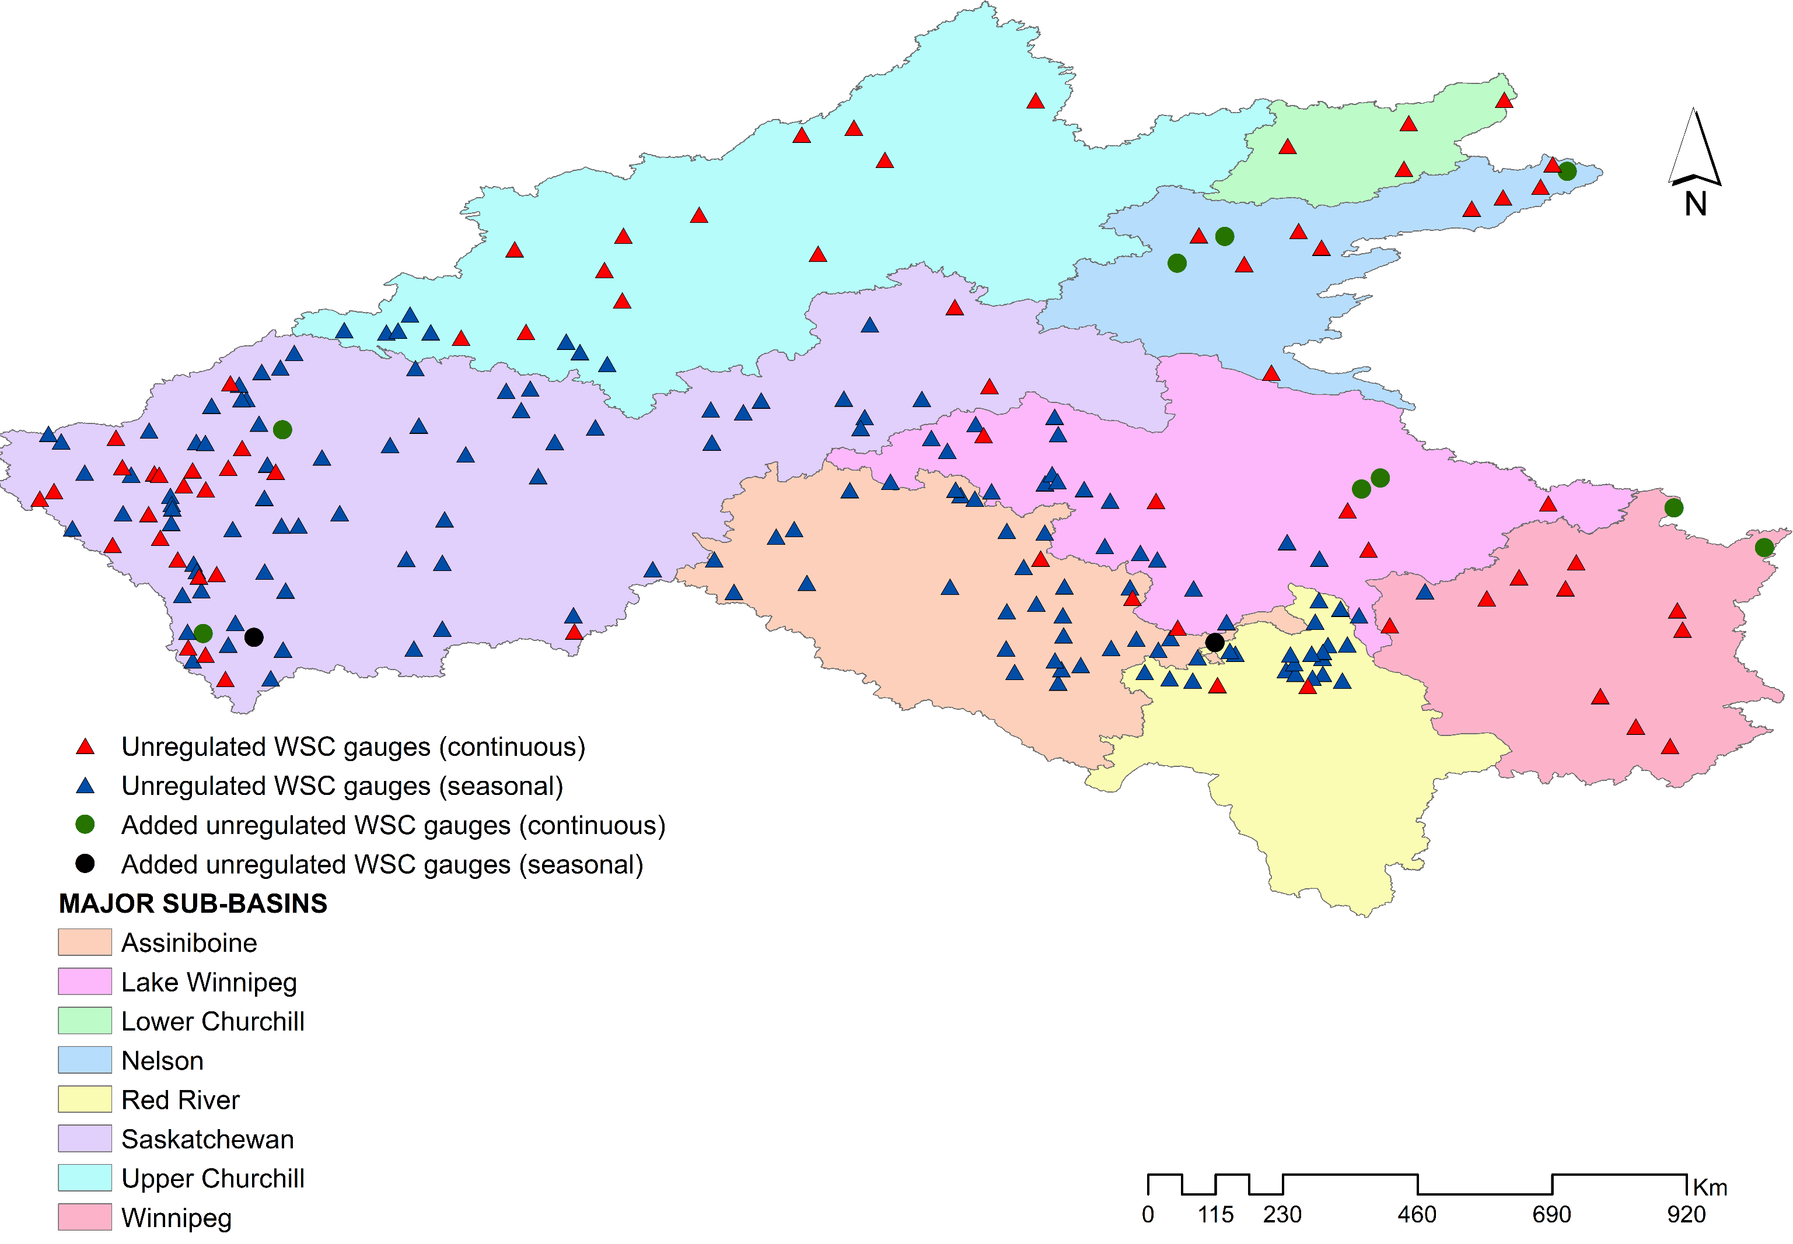
Selection of natural gauge stations for calibration/validation - continuous vs seasonal
Sub-basins | Number of WSC natural stations
Assiniboine | 32
Lake Winnipeg | 28
Winnipeg river | 13
Upper Churchill | 20
Lower Churchill | 4
Saskatchewan river | 94
Red River | 23
Nelson river | 12

Slide 6
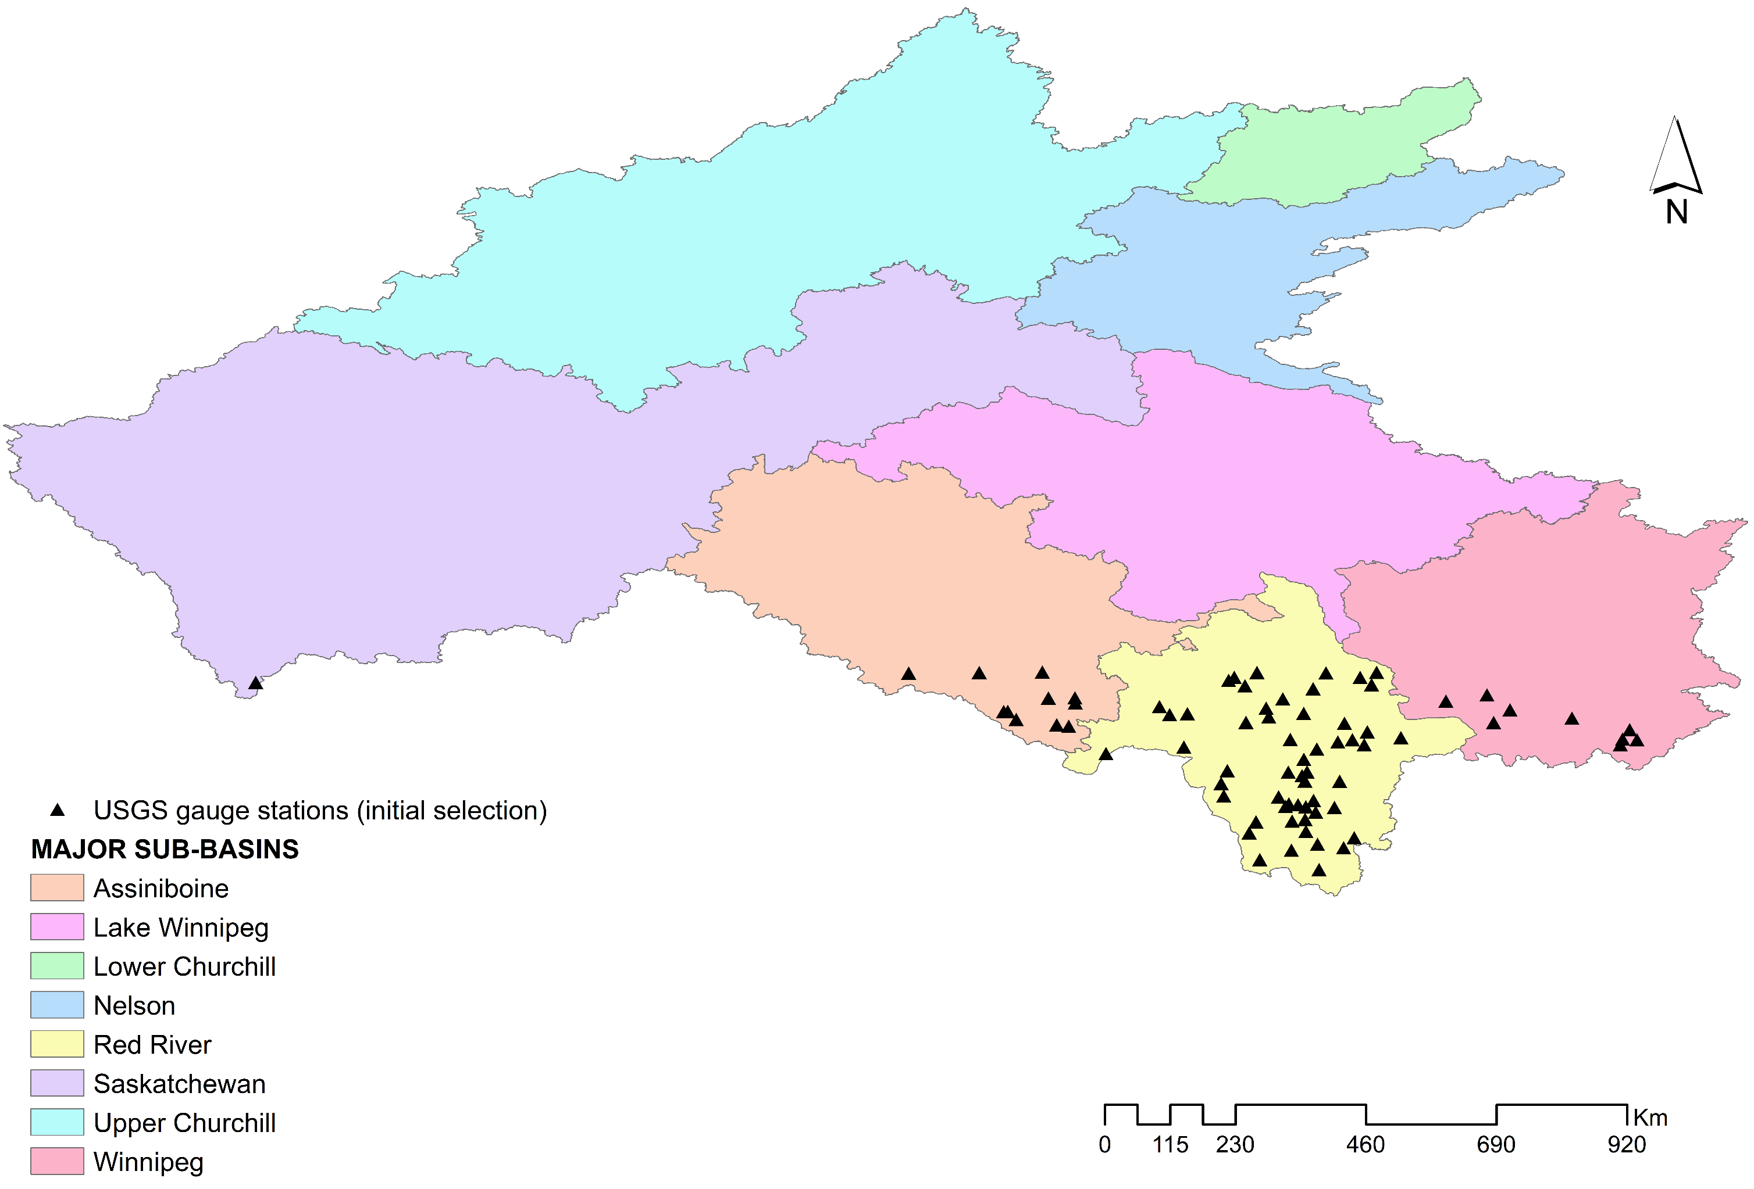
Selection of natural gauge stations for calibration/validation (Phases 0 & 1)
Sub-basins | Number of USGS stations
Assiniboine | 11
Lake Winnipeg | -
Winnipeg river | 9
Upper Churchill | -
Lower Churchill | -
Saskatchewan river | 1
Red River | 55
Nelson river | -

Slide 7
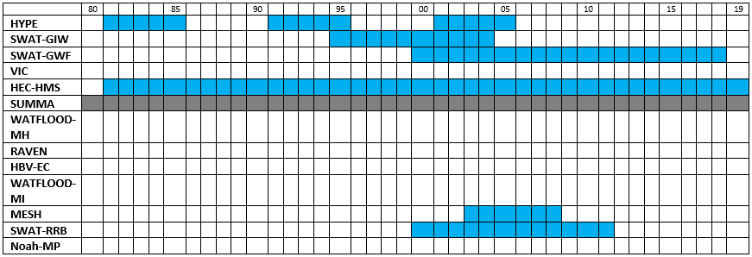
Time periods for calibration/validation
Calibration
No calibration for SUMMA

Slide 8
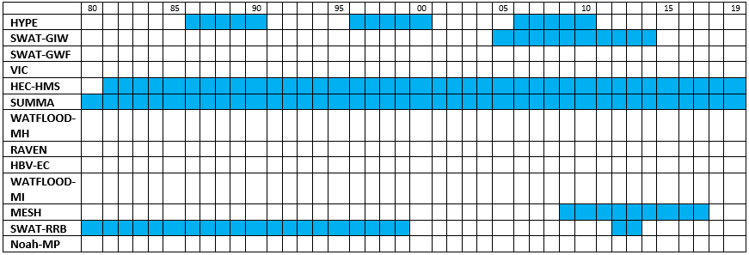
Time periods for calibration/validation
Validation

Slide 9
Time periods for calibration/validation
Wet
The wet and dry years selection is based on precipitation fields derived from the HydroGFD met. forcing product
Calibration | Validation
1981-1985 (wet) | 1986-1990 (Dry)
1991-1995 (Dry) | 1996-2000 (wet and Dry)
2001-2005 (Wet and Dry) | 2006-2010 (Wet)
2011-2018 (Wet and dry)

Slide 10
Time periods for calibration/validation
Wet
Dry
Wet
Dry

Slide 11
Standardized meteorological forcing data
 | ERA5 | WFDEI-GEM-CaPA | NCEP-CFRS | Standard MiP data
HYPE | X |  |  | X
SWAT-GIW |  | X | X
SWAT-GWF
VIC
HEC-HMS | X |  |  | X
SUMMA | X
WATFLOOD-MH
RAVEN
HBV-EC
WATFLOOD-MI
MESH |  | X
SWAT-RRB |  | X |  | X
Noah-MP
We have to choose between WFDEI-GEM-CaPA and ERA5
WFDEI-GEM-CaPA (https://doi.org/10.5194/essd-2018-128) ➔ 3-hourly, 0.125ᵒ ~ 10 km, 1979-2016 (variables are: huss, pr, ps, rlds, rsds, sfcWind, tas)
ERA5 (https://www.ecmwf.int/en/forecasts/datasets/reanalysis-datasets/era5) ➔ 1-hourly, ~31km-grid, 137 levels from surface up to 0.01hPA (~ 80 km), 1979-near real time

Slide 12
Hydrologic routing scheme
We should decide on using a standardized routing scheme or not.
All groups were tasked to consider offline routing advantages/ disadvantages
Bryan Tolson’s group (UWaterloo) offers to produce a routing scheme (including lakes) if all modelers will use it.
If Bryan idea is accepted, we should also decide whether the routing scheme shall be derived using HydroSHEDS 3-arc sec DEM (~90m) (https://hydrosheds.cr.usgs.gov/dataavail.php) or MERIT Hydro 3-arc sec data products (https://doi.org/10.1029/2019WR024873).

Slide 13
Hydrologic routing scheme
The discretization methodology can be applied for any user provided DEM
The resolution of subbasins and lakes represented can be customized
The outputs of the discretization are a vector-based routing network with complete information needed for lakes and river hydrologic routing
RAVEN is used to do the routing simulation

Slide 14
Routing scheme and other geophysical inputs
Land use/ land cover: North American Land Change Monitoring System (NALCMS)
NALCMS is provided at 250m and 30m spatial resolution, contains 19 land cover classes, and is publicly available from http://www.cec.org/tools-and-resources/map-files/land-cover-2010-landsat-30m.
Soil data: Global Soil Dataset for Earth System Modelling (GSDE)
GSDE is provided at 30 arc-second resolution (~1km), and contains 11 types of soil general information for soil profiles and 34 soil properties for 8 depths up to 2.3 m. It can be downloaded from http://globalchange.bnu.edu.cn/research/soilw#download.
All groups were tasked to explore soil datasets & provide recommendations.

Slide 15
Deliverables & Follow-up
All modellers should prepare a 5-min presentation of their model for the next meeting. The 1-3 slides presentation should be sent to Hervé by April 1st 2020 at the latest.
Next meeting scheduled for Wednesday April 8 @10:00AM MST

