Slide 1

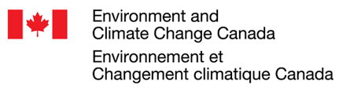













Multi-model Intercomparison Project on the Saskatchewan-Nelson-Churchill River Basin (Nelson-MiP project)
Monthly meeting - June 10th, 2020
Manitoba Infrastructure

Slide 2
Agenda
Presentation on lake and river routing support for the Nelson-MiP (Bryan - UWaterloo)
Presentation of HEC-HMS configuration and input (Scott – Strategic Consulting)
Presentation of SWAT-GWF configuration and input (Pouya - UAlberta)
Comparison of ERA5 and WFDEI-GEM-CaPA (Scott - Strategic Consulting)
Deliverables for next meeting & follow-up

Slide 3
Lake and river routing support for the Nelson-MiP
By:
Bryan Tolson
(University of Waterloo – btolson@uwaterloo.ca)

Slide 4
HEC-HMS
By:
Scott Pokorny
(Strategic Consulting)

Slide 5
1. Study Area
Red River Basin
Gross Area
~126k square kilometers
Outlet Elevation
~217m
Extent of model domain still under development
Figure 1 Red River basin in relation to the rest of the Nelson Churchill watershed
Characteristic/ Data type | Information/Product | Source
Topography | USGS: Hydro1K | https://lta.cr.usgs.gov/HYDRO1K
Soil characteristics | Harmonized World Soil Database V1.2 | Nachtergaele et al. (2010)
Land use | ESA CCI LC 2010 v1.4 | ESA Climate Change Initiative
Lake and wetland | Global Lake and Wetland Database (GLWD) | Lehner and Doll (2004)
Reservoirs | Global reservoir and Dam database (GRanD) v1.1 | Lehner et al. (2011)
Discharge | HYDAT, 2. USGS | Environment Canada waterdata.usgs.gov/nwis
Meteorological | Hydro-GFD | Berg et al. (2017)
Snow | GlobSnow | www.globsnow.info
Glacier fluctuations | World Glacier Monitoring Service (WGMS) | Zemp et al. (2009)
Evapotranspiration | FLUXNET | fluxnet.ornl.gov

Slide 6
2. Model Description
Tentative
Process | HEC-HMS method
Canopy Interception | Simple (Bucket method)
Surface Storage | Simple (Bucket method)
Infiltration | SMA
Overland Translation | Clark Unit Hydrograph
Baseflow | Linear Reservoir
Snowmelt | Temperature Index
Evapotranspiration | Hargreaves
Routing | Muskingum

Slide 7
3. Input Data Used
Table 1 Tentative Selection of Input and Calibration Data
Characteristic/ Data type | Information/Product | Source
Topography | USGS: Hydrosheds | https://www.hydrosheds.org/
Soil characteristics | Harmonized World Soil Database V1.2 | Nachtergaele et al. (2010)
Land use | ESA CCI LC 2010 v1.4 | ESA Climate Change Initiative
Lake and wetland | Global Lake and Wetland Database (GLWD) | Lehner and Doll (2004)
Reservoirs | Global reservoir and Dam database (GRanD) v1.1 | Lehner et al. (2011)
Discharge | HYDAT, 2. USGS | Environment Canada waterdata.usgs.gov/nwis
Meteorological | ERA5/WFDEI-GEM-CaPA | https://www.earth-syst-sci-data-discuss.net/essd-2018-128/
Snow | GlobSnow | www.globsnow.info
Evapotranspiration | FLUXNET | fluxnet.ornl.gov

Slide 8
Soil and Water Assessment Tool – Global Water Futures (SWAT-GWF)
By:
Pouya Khalili
(University of Alberta)

Slide 9
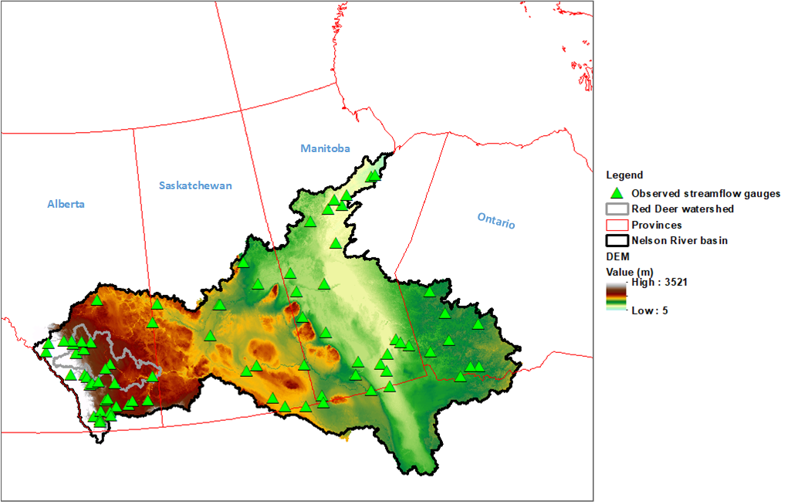
STUDY AREA
Nelson river basin
Gross Area
~1.2 million square kilometers
Elevation range
Up to 3521 M.S.L
Fig. 1 Map of the study area showing major topographic features and gauging stations

Slide 10
NRB Project
My PhD is also a part of a larger project, where two other PDFs and another PhD are/will work on the following objectives:
Simulate and assess crop yield response to climate change and different management strategies for understanding water-food nexus in the Nelson watershed
Simulate and assess water quality and nutrients in agricultural and natural lands of Nelson watersheds
To study spatiotemporal dynamics of blue and green water resources in the Nelson watershed

Slide 11
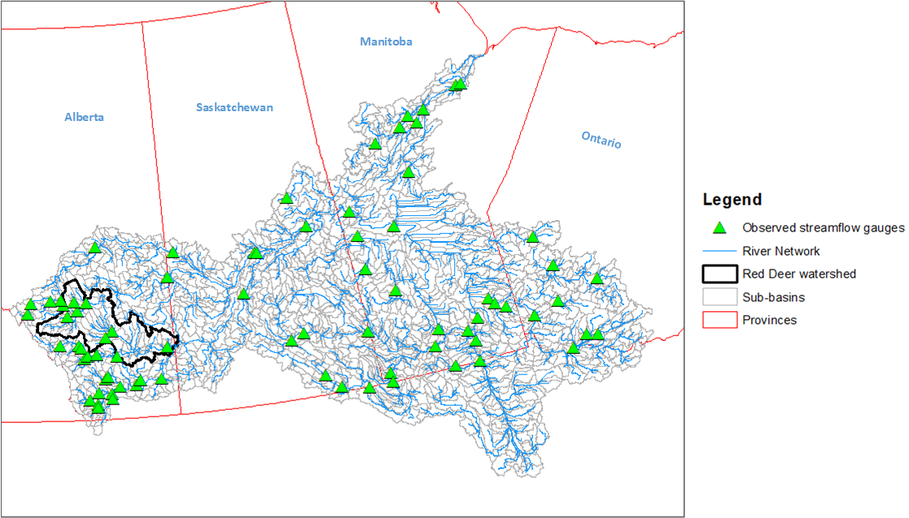
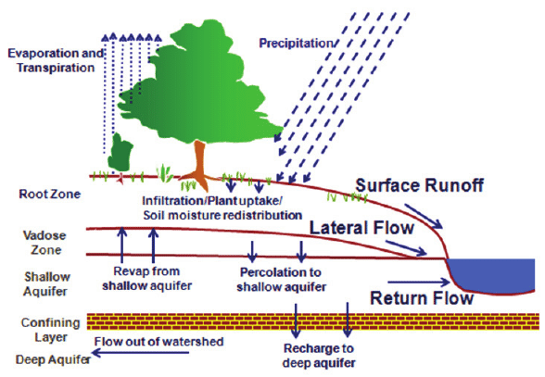
Model Description
Delineation of catchment
DEM
Land Use
Soil
Slope classes
Meteorological station data:
Precipitation
Temperature
Relative humidity
Solar radiation
Wind speed
Defining HRUs
Fig. 2 Sub-basin discretization in SWAT model (1975 sub-basins)
Fig. 3 Schematic of hydrologic processes simulated in SWAT

Slide 12
Table 1 Description of the input data used for the model setup (not finalized yet!)
Characteristic | Information | Source
Topography | SRTM | http://srtm.csi.cgiar.org/
Soil characteristics | Soil Landscape of Canada (SLC) + FAO | http://sis.agr.gc.ca/cansis/nsdb/slc/index.html
Land use | 2015 Land Cover of Canada | https://open.canada.ca/data/en/dataset/4e615eae-b90c-420b-adee-2ca35896caf6
Discharge | HYDAT | https://www.canada.ca/en/environment-climate-change/services/water-overview/quantity/monitoring/survey/data-products-services/national-archive-hydat.html
Meteorological | CFSR - WFDEI | https://globalweather.tamu.edu/ http://www.eu-watch.org/
Evapotranspiration | Penman Monteith method | Simulated in SWAT model

Slide 13
Comparison of ERA5 and WFDEI-GEM-CaPA
By:
Scott Pokorny
(Strategic Consulting)

Slide 14
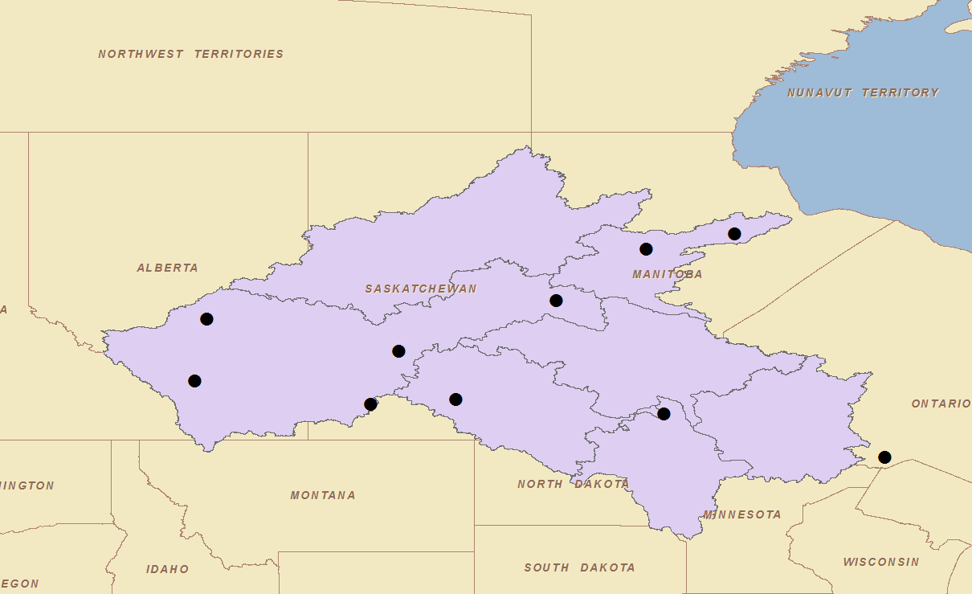

Slide 17
RMSE values (temperature)
RMSE | CALGARY INTL A | EDMONTON INTL A | GILLAM A | REGINA INTL A | SASKATOON DIEFENBAKER INTL A | SWIFT CURRENT CDA | THE PAS A | THOMPSON A | THUNDER BAY A | WINNIPEG RICHARDSON INTL A
WGC | 2.45 | 3.05 | 2.59 | 2.75 | 2.50 | 2.45 | 2.46 | 2.78 | 2.87 | 2.59
ERA5 | 2.67 | 2.36 | 2.24 | 2.55 | 2.30 | 2.21 | 2.50 | 2.47 | 2.47 | 2.37

Slide 18
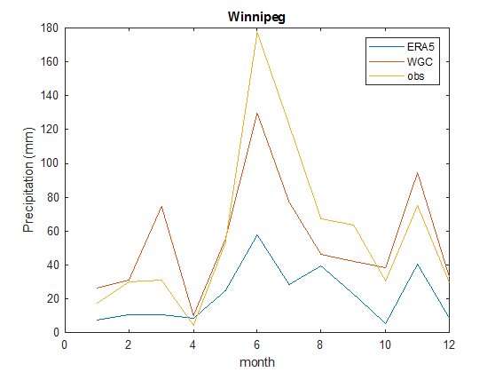
Precipitation Comparison
Precipitation comparison is more challenging
ERA5 units are not consistent with the documentation
ERA5 had a strong dry bias
Year 2000
?

Slide 19
Deliverables & Follow-up
During next meeting we will discuss on the challenges encountered during the setup of our models. Modellers can prepare a slide to explain the challenges/issues.
Presentation on MESH model (USask), RAVEN (UWaterloo), HBV-EC & WATFLOOD-MI (Manitoba Infrastructure)
Next meeting scheduled for Wednesday July 8 @ 10:00AM MDT
SLACK channel to facilitate informal communication for Nelson-MiP
Channel link: https://uc-hal.slack.com/archives/C011BTG7GL8
Channel name: #ncrb_mip
Nelson-MiP data available at: https://uofc-my.sharepoint.com/:f:/g/personal/tricia_stadnyk_ucalgary_ca/EtnMyjMpPopNhU1-qCSgCJ4Bp7LCRZ57_18veRI5ynLmOQ?e=hXO0ip

