Slide 1

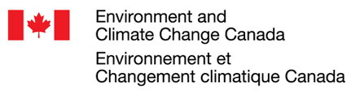












Multi-model Intercomparison Project on the Saskatchewan-Nelson-Churchill River Basin (Nelson-MiP project)
Monthly meeting – October 13th, 2020
Manitoba Infrastructure

Slide 2
Agenda
Choice of metrics for model calibration against streamflow
Process calibration – Data & Metrics
Date for next meeting in November
Presentation of UWaterloo group plan for Nelson-MiP

Slide 3
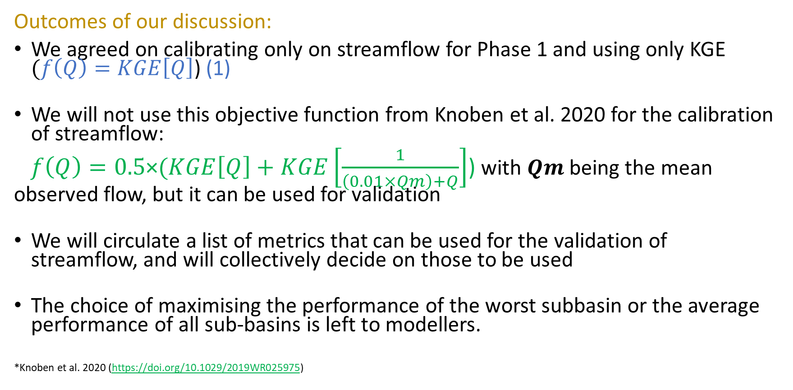
Metrics for streamflow calibration
Outcomes of our discussion:
We agreed on calibrating only on streamflow for Phase 1 and using only KGE $(f\left(Q\right)=KGE\left[Q\right]$) (1)
We will not use this objective function from Knoben et al. 2020 for the calibration of streamflow:
$f\left(Q\right)=0.5\text{×}(KGE\left[Q\right]+KGE\left[\frac{1}{\left(0.01×Qm\right)+Q}\right]$) with $Qm$being the mean observed flow, but it can be used for validation
We will circulate a list of metrics that can be used for the validation of streamflow, and will collectively decide on those to be used
The choice of maximising the performance of the worst subbasin or the average performance of all sub-basins is left to modellers.
*Knoben et al. 2020 (https://doi.org/10.1029/2019WR025975)

Slide 4
Process calibration/validation
Initial suggestion:
Variables | Data product | Spatial resolution | Temporal resolution | Data source | Link
Snow cover | MODIS | 500m | Daily 2000-02-24 to Present | satellite | https://modis.gsfc.nasa.gov/data/dataprod/mod10.php
 | GlobSnow 2.1 | 0.01° | Daily 1995 to 2012 | Satellite | https://www.globsnow.info/se/
Snow depth and SWE | CMC snow depth analysis data | 24 km × 24 km | Daily 08-1998 to 12-2019 | in-situ observations | https://nsidc.org/data/NSIDC-0447
 | AMSR-E/Aqua | 25 km EASE-Grid | Daily 06-2002 to 04-2011 |  | https://nsidc.org/data/amsre
 | GlobSnow 3.0 | 0.25° | Daily & Monthly 1979 to 2018 | satellite | https://www.globsnow.info/
 | SnowCCI | 15-69 km | Daily 03-1970 to 05-2018 | satellite | https://climate.esa.int/en/odp/#/project
 | SNODAS | 1 km x 1 km | Daily 09-2003 to present | Satellite + in-situ + model | https://nsidc.org/data/g02158
 | CSSD-gridded | 0.10° | 15-day 1951-2016 | In-situ + model | https://open.canada.ca/data/en/dataset/f57afb37-90c7-4ff0-a757-ba792a4f40a1
Evapotranspiration | MODIS | 500m | 8-day 2001-01-01 to Present | Satellite +ground observations | https://modis.gsfc.nasa.gov/data/dataprod/mod16.php
 | GLEAM v.3 | 0.25° | Daily 1980-2015 | Satellite + model | https://www.gleam.eu/
Surface and root-zone Soil moisture | GLEAM v.3 | 0.25° | Daily 1980-2015 | Satellite + model | https://www.gleam.eu/
 | SMAP L3 | 36km EASE-Grid 2.0 Global | Daily 04-2015 to present | Satellite | https://nsidc.org/data/SPL3SMP
Metrics for process calibration: KGE???

Slide 5
Process calibration/validation
Outcomes of our discussion:
For Phase 1 we collectively decided to validate some hydrological processes after streamflow calibration instead of doing process calibration as well.
We will circulate a list of metrics that can be used for process validation. We will try different metrics for different processes. A single metric like KGE cannot be used for every process.
Based on a literature review, we will selected a set of relevant data to be used for process validation. Emphasis will be put on the metrics instead of the data.
In a subsequent Phase, we will do process calibration after learning from the process validation in Phase 1.

Slide 6
Next meeting
November 18, 2020

Slide 7
UWaterloo group plan for Nelson-MiP
Drs J. Craig, J. Mai & B.Tolson

