Slide 1

Multi-model Intercomparison Project on the Saskatchewan-Nelson-Churchill River Basin (Nelson-MiP project)
First meeting
8 January 2020

Slide 2
Agenda
Project background, scope & objectives
Study domain of interest
Gauge locations
Project phases and expected model outputs
Data exchange/data dissemination
Tentative timeline & Meeting Schedule
Contributing modeling groups/models

Slide 3
Project Background
GWF global vision is to position Canada as a global leader in water science and provide new capability for adapting to unprecedented climate, environmental, and societal change
Under GWF umbrella, IMPC aims to develop pan-Canadian modelling capability for the prediction and management of change at the scale of the major basins in Canada on a 7-year time frame
Nelson-MiP and GRIP fall under Theme A5 “Hydrologic model inter-comparison and multi-model analysis for improved prediction” led by Tolson, co-lead: Stadnyk & Razavi
Theme A5 is tasked to benchmark the GWF land surface hydrologic models (MESH, VIC, HYPE, etc.) against each other on multiple distinct modelling case studies (e.g. Nelson-Churchill and Great Lakes)

Slide 4
GRIP-E/GL objectives
Develop strategies to handle cross-border issues of available data and develop unifying approaches
Test relative performance of different models
Identify respective strengths of models
GRIP-E/GL focuses on forecasting applications
(operational i.e., shorter term)
GRIP-E/GL is led by Bryan Tolson (U. Waterloo) and Tricia Stadnyk (U. Calgary) and coordinated by Juliane Mai (U. Waterloo)

Slide 5
GRIP-E/GL achievements
In years 1-3, 18 models from 14 institutions have participated to GRIP-E over Lake Erie watershed (incl. Lake St. Clair)
All models in GRIP-E used different geophysical data but a standard meteorological forcing dataset (RDRS: 15km – hourly – 2010-2014)
Models in GRIP-E were calibrated (global and/or on-site) for multiple sub-watersheds against measured streamflow only
Going forward, GRIP-GL is also standardizing the geophysical data for model setup, and expanding both the spatial and temporal coverage of the modelling efforts

Slide 6
Nelson-MIP Objectives (Y4-7)
Main goal: Evaluate internal model processes and generate an ensemble of GWF land surface hydrological models for the Nelson River basin
compare participating hydrologic and land surface models with respect to their performance in reproducing long-term runoff and various hydrologic signatures;
understand the drivers of the differences among models from an internal process perspective;
assess the realism of different algorithms in simulating the same processes;
assess the reliability of the models for the prediction of key hydrologic processes and streamflow under changing climate conditions;
develop robust ensemble averaging methods to reduce the range of uncertainties in streamflow projection under changing climate conditions.

Slide 7
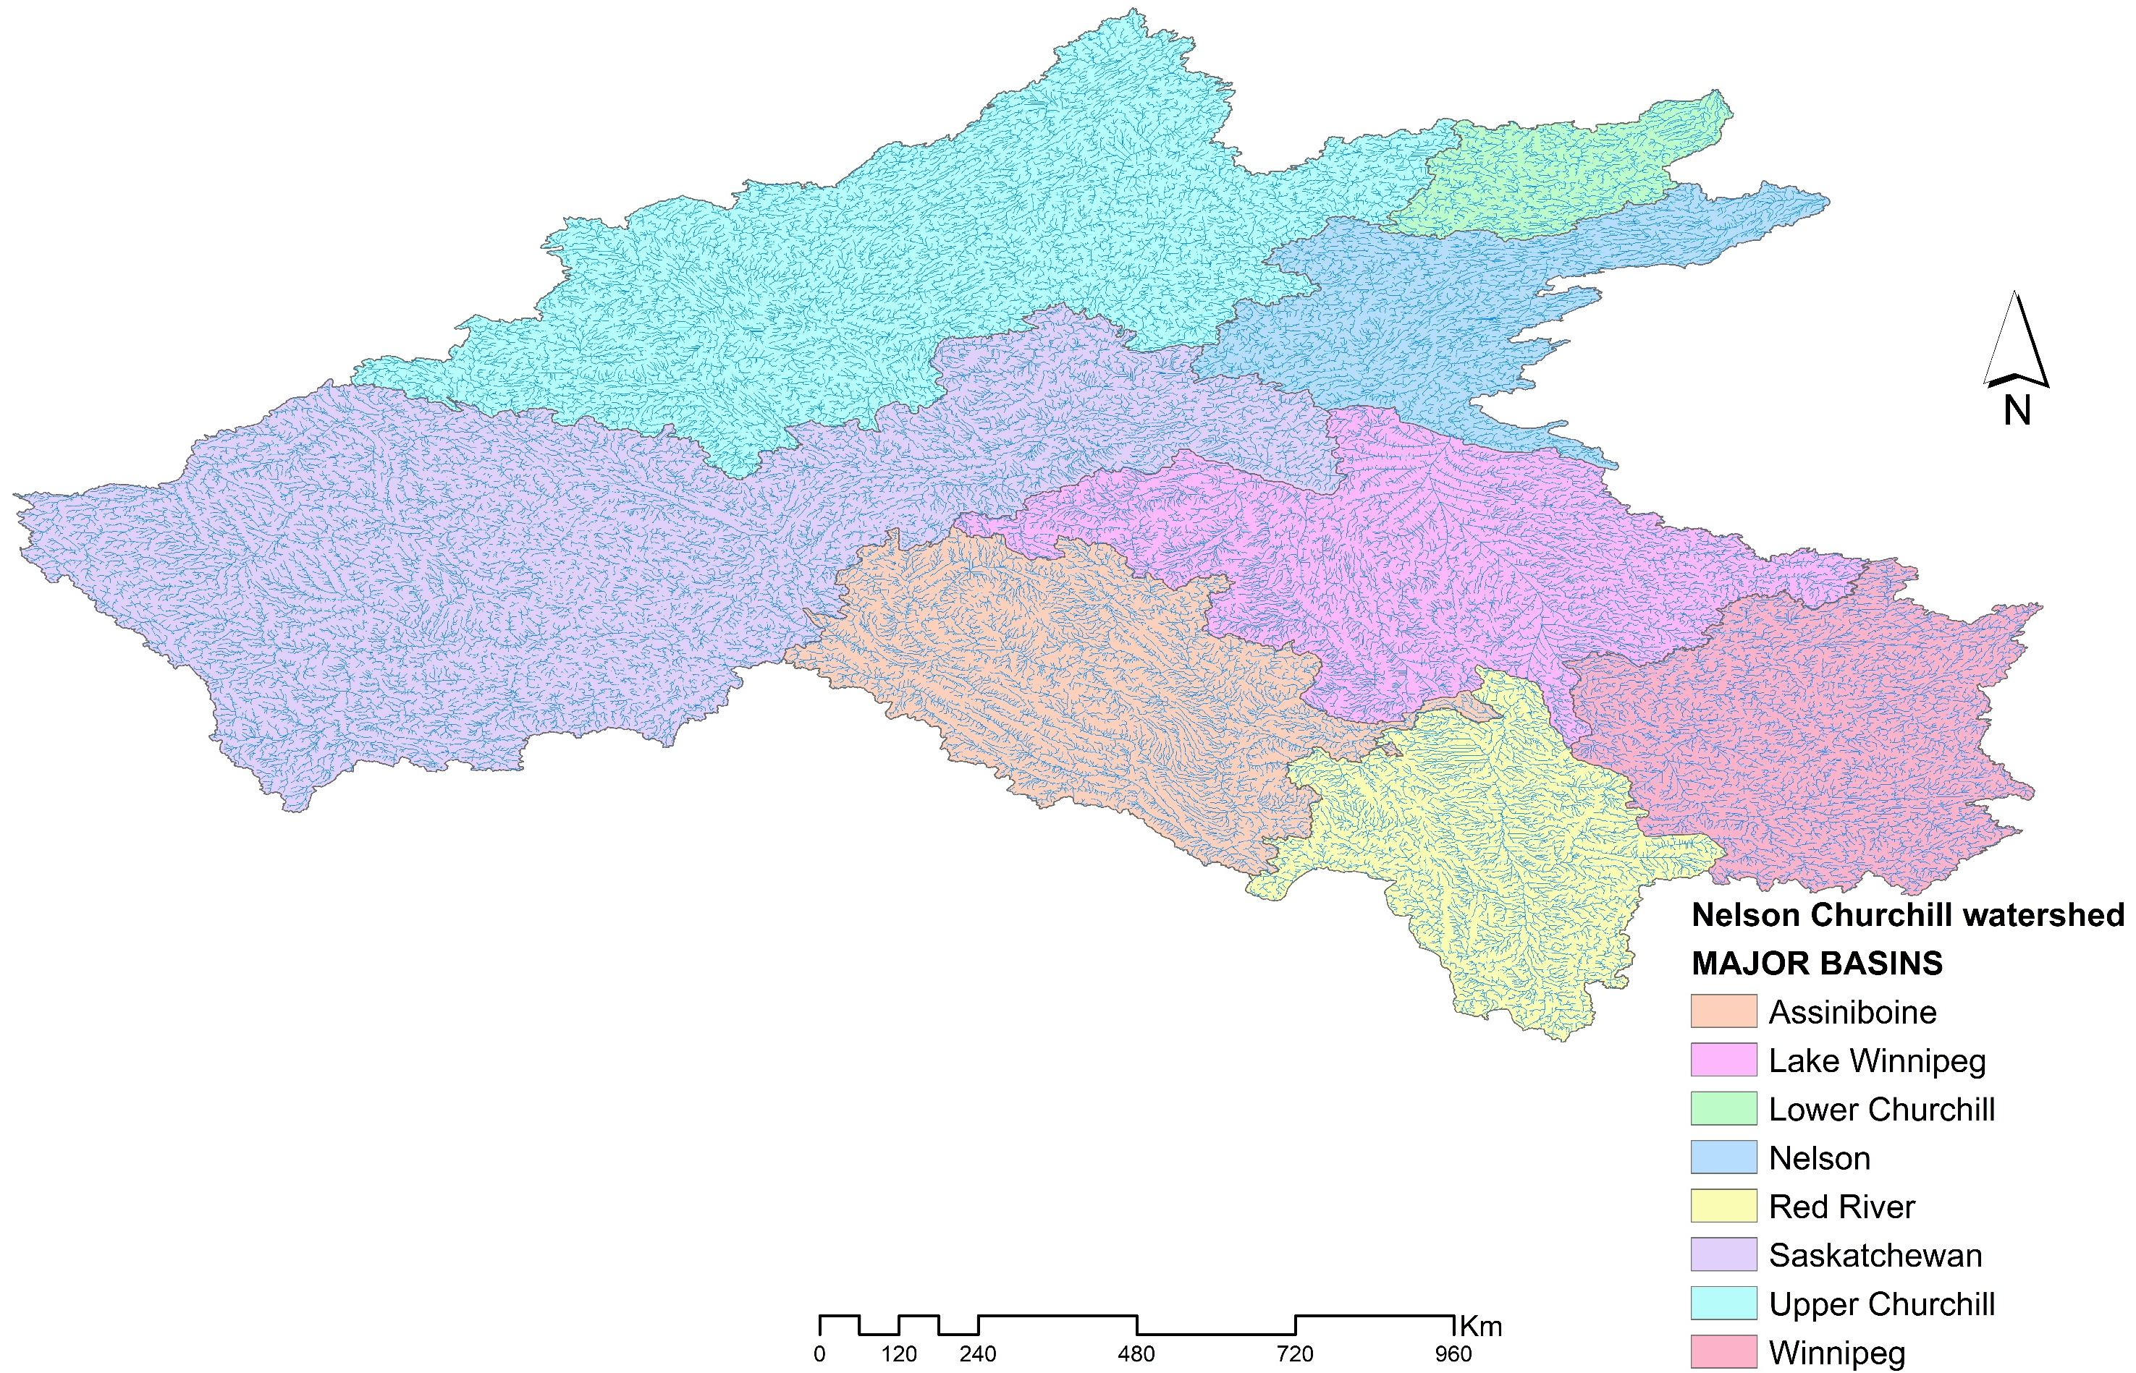
Study Domain (decision to be made on the research scales)
Modelers are NOT required to simulate processes for all basins.
BUT modelers should decide on the scale they are contributing to and inform participants (through project coordination) of chosen domain

Slide 8
Gauges Of Interest
Modelers should suggest per basin the gauge locations they are interested in for model calibration and validation.
UC-HAL will compile the suggestions and prepare a standardized list of calibration and validation gauge locations, and disseminate the related streamflow data per basin for our next meeting.

Slide 9
Project phases and expected model outputs
Phase 0: Current model status/baseline (run with user-defined parameter sets)
Phase 1: Recalibrated model run at unregulated (headwater) gauges
Phase 2: Recalibrated model run at regulated gauges
Phase 3: Ensemble modeling of climate change impacts using CMIP6 to drive the models developed in Phase 1 and/or Phase 2.
OUTPUT: All states and flux at a daily time step to gain a better understanding of the modelled processes. To conserve storage space, some output may be designated as spatial averages per drainage basins (to be determined later).
Modelers are NOT required to participate in all phases,
but we need to know who is doing what and where!

Slide 10
Data exchange/data dissemination
UC-HAL will provide a private GitHub for data exchange/data transfer for this project.
Other ideas for data exchange/data transfer? Do let us know.
All modelers will have access to the GitHub repository and thus can access/download inputs and other modelers’ outputs.
If you are NOT willing to share your model outputs and model configuration open source with others? Please let us know before submitting any data. Accommodations can be made, but the preference is that all models and data are shared.
Webpage for the project as results come out.
Conferences and joint publications are encouraged and will be initiated by project coordination
You can publish your own model outputs anytime. When using data from other modelers, we require you to get their written consent and inform the project coordination prior to any form of publication.

Slide 11
Tentative timelines (open to discussion)
Total project duration: 2020 - 2023
Submission of model outputs and model configuration
Phase 0: submission of model outputs by December 2020
Phase 1: submission of model outputs by December 2020
Phase 2: submission of model outputs by December 2021
Phase 3: submission of model outputs by December 2022
Monthly online meeting schedule (1-hour long)
Goal: Report on status, discuss challenges among group, and provide support as needed.
Webex or zoom.us meeting every second Wednesday of the month starting at 10:00 am MST (suggestion). Connection link, meeting agenda and reminder will be sent via email a least a weak before the next meeting.

Slide 12
Participating modeling groups and models
MODELS | Watersheds/Scale | Institutions | Contact persons
HYPE | Nelson Churchill | UC-HAL | Tricia Stadnyk tricia.stadnyk@ucalgary.ca Hervé Awoye oyemonbade.awoye@ucalgary.ca Ajay Bajracharya ajay.bajracharya@ucalgary.ca
SWAT-GIW | Upper Assiniboine | Water Security Agency | Ameer Muhammad Ameer.Muhammad@wsask.ca Curtis Hallborg curtis.hallborg@wsask.ca
SWAT-GWF | To be determined | University of Alberta | Monireh Faramarzi faramarz@ualberta.ca Pouya Khalili khalili@ualberta.ca Badrul Masud masud@ualberta.ca
VIC | Lower Nelson River | UNBC | Stephen Dery stephen.dery@unbc.ca Rajtantra Lilhare Rajtantra.lilhare@unbc.ca

Slide 13
Participating modeling groups and models
MODELS | Watersheds/Scale | Institutions | Contact persons
HEC-HMS | Lower Nelson & Red rivers | Strategic Consulting | Scott Pokorny umpokors@myumanitoba.ca Henry David (Hank) Venema hank@strategiccc.ca
SUMMA | Nelson Churchill | University of Saskatchewan | Martyn Clark martyn.clark@usask.ca Wouter Knoben wmk934@usask.ca Shervan Gharari shervan.gharari@usask.ca
WATFLOOD-MH | To be determined | Manitoba Hydro | Kristina Koenig kkoenig@hydro.mb.ca Shane Wruth swruth@hydro.mb.ca Phillip Slota pslota@hydro.mb.ca Mark Gervais mgervais@hydro.mb.ca Kevin Sagan ksagan@hydro.mb.ca

Slide 14
Participating modeling groups and models
MODELS | Watersheds/Scale | Institutions | Contact persons
RAVEN | To be determined | University of Waterloo | James Craig jrcraig@uwaterloo.ca
HBV-EC | To be determined | Manitoba Infrastructure | Fisaha Unduche fisaha.unduche@gov.mb.ca
WATFLOOD-MI | To be determined | Manitoba Infrastructure | Fisaha Unduche fisaha.unduche@gov.mb.ca
Noah-MP | Assiniboine & Red rivers | Western University | Mohammad Reza Najafi mnajafi7@uwo.ca
MESH | Saskatchewan river | ECCC | Bruce Davison bruce.davison@canada.ca
SWAT-RRB | Red River Basin | University of Manitoba | Masoud Asadzadeh Masoud.Asadzadeh@umanitoba.ca
All groups need an alternate - Please specify someone
and send us your alternate(s) email address(es)!

Slide 15
Collaborators
Institutions | Contact persons
ECCC | Frank Seglenieks frank.seglenieks@canada.ca Daniel Princz daniel.princz@canada.ca André Guy Temgoua andreguy.temgoua@canada.ca
University of Waterloo | Bryan Tolson btolson@uwaterloo.ca Juliane Mai juliane.mai@uwaterloo.ca
University of Saskatchewan | Mohamed Elshamy mohamed.elshamy@usask.ca Saman Razavi saman.razavi@usask.ca

Slide 16
Additional Participants?
It’s not too late to join!
Know of anyone else that may be interested? Please feel free to invite additional participants to the MIP. Pass on the project coordination team information
Hervé Awoye - oyemonbade.awoye@ucalgary.ca
Tricia Stadnyk - tricia.stadnyk@ucalgary.ca

Slide 17
Deliverables (due by January 22 2020)
Specify your alternate contact
Geophysical inputs template to be filled
List of gauges for your current model setup
Gauges you are willing to contributed to Nelson-MiP calibration and validation
Time periods of interest (calibration vs validation)
Meteorological forcing data suggestion

Slide 18
Preparation for February 12, 2020
Would you be willing to setup your model with standardized geophysical data?
What process validation data do you recommend?
Discussion of the gauges selection (calibration/validation), time periods (calibration/validation) and forcing data

