Slide 1
UC OSPO Education Activities
Cultivating Open Source Literacy Across the University of California
Tim Dennis | Director, Data Science Center, UCLA Library
UC Open | April 22–23 | UC Berkeley
Notes:
Thanks for having me. I'm Tim Dennis, Director of the Data Science Center at UCLA Library. What I want to share today is what a UC-wide OSPO education program actually looks like in practice — not the vision, but the built thing. We're in Year 2 of Sloan Foundation funding, all 10 campuses are involved, and the platform is live. Let's dig in

Slide 2
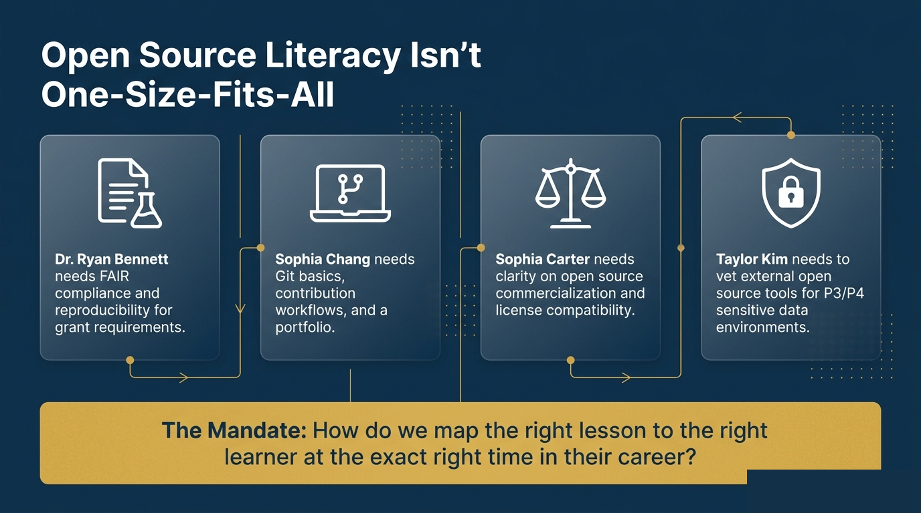
Notes:
Here's the problem we started with. Open source literacy isn't a single thing. A faculty researcher applying for an NIH grant needs FAIR compliance and reproducibility documentation. A grad student needs Git basics and a portfolio. A tech transfer officer needs to know what 'commercializing open source' even means at a UC institution. A research computing admin needs to vet tools for P3/P4 data environments.
These are real people with real, divergent needs. And nobody had mapped the right lesson to the right person at the right moment in their career. That's the mandate this project took on.

Slide 3
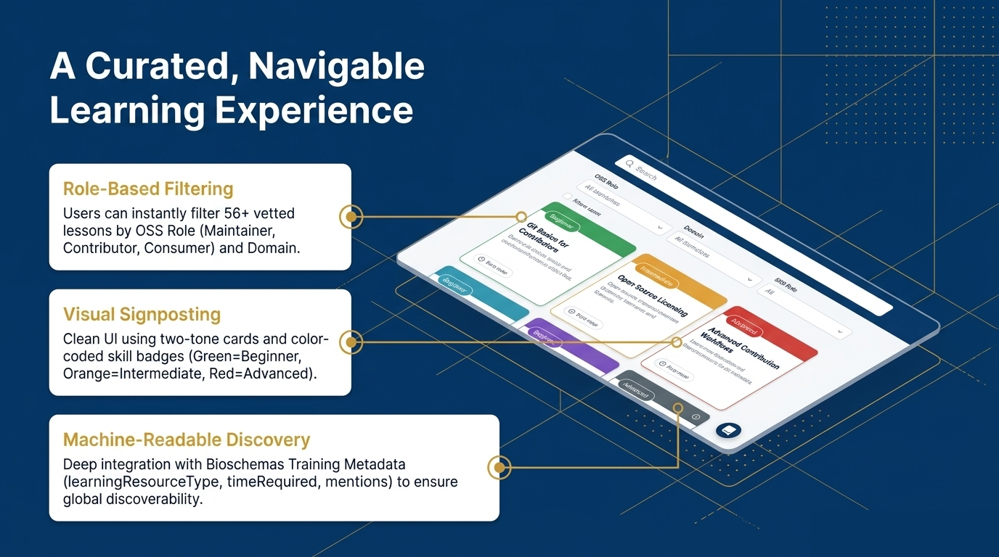
Notes:
The answer to the 'right lesson, right person, right time' problem is education.ucospo.net. It's live right now, go look at it on your phone.
> Three things make it work. First, role-based filtering — you tell it whether you're a maintainer, contributor, or consumer, and it filters the 56+ vetted lessons accordingly. Second, visual signposting — color-coded skill badges so you can immediately see if something is beginner, intermediate, or advanced. And third — and this one matters for the open science crowd — every lesson is tagged with Bioschemas Training Metadata. learningResourceType, timeRequired, mentions. That means these lessons are globally discoverable by systems like TeSS and schema.org scrapers, not just findable by people who already know we exist."

Slide 4
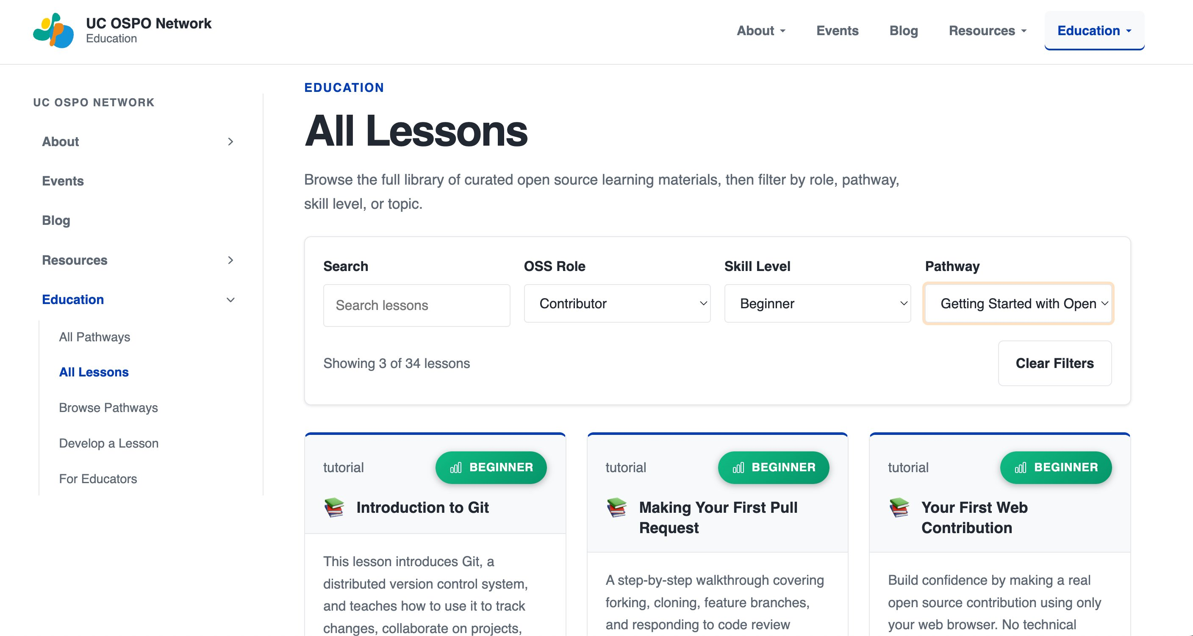
ucospo.net — role-based filtering in action

Slide 5
A Curated, Navigable Learning Experience
Role-Based Filtering
Users can instantly filter 56+ vetted lessons by OSS Role (Maintainer, Contributor, Consumer) and Domain.
education.ucospo.net
56+ curated lessons
Visual Signposting
Clean UI using two-tone cards and color-coded skill badges (Green=Beginner, Orange=Intermediate, Red=Advanced).
across 6 structured pathways
Role-based filtering Beginner → Advanced Machine-readable metadata
Machine-Readable Discovery
Deep integration with Bioschemas Training Metadata (learningResourceType, timeRequired, mentions) to ensure global discoverability.

Slide 6
Structuring the Open Source Journey
Getting Started with Open Source
Contributing to a Project
Maintaining & Sustaining Software
For learners new to open collaboration
Pull requests, issues, and documentation
CI/CD, code review, project management
→
→
Building Inclusive Communities
Understanding Licensing & Compliance
Strategic Practices & Career Development
Governance, event organization, DEI
License selection, UC policies, dependencies
FAIR software, reproducibility, grant alignment
→
→

Slide 7
Eliminating Technical Debt Through Automation
35+
98%
88%
hrs of manual labor saved
time estimate coverage
author attribution coverage
Raw Input
Processing Pipeline
Deployment
Google Sheets Inventory • Fragmented URLs • Missing tags • Inconsistent dates • No time estimates
• Slug generation (100% coverage) • IETF language standardization • Word-count → ISO 8601 time estimation • Automated web-scraping for authors/licenses
Keystatic CMS ↓ Astro Frontend ↓ GitHub Pages
➔
➔

Slide 8
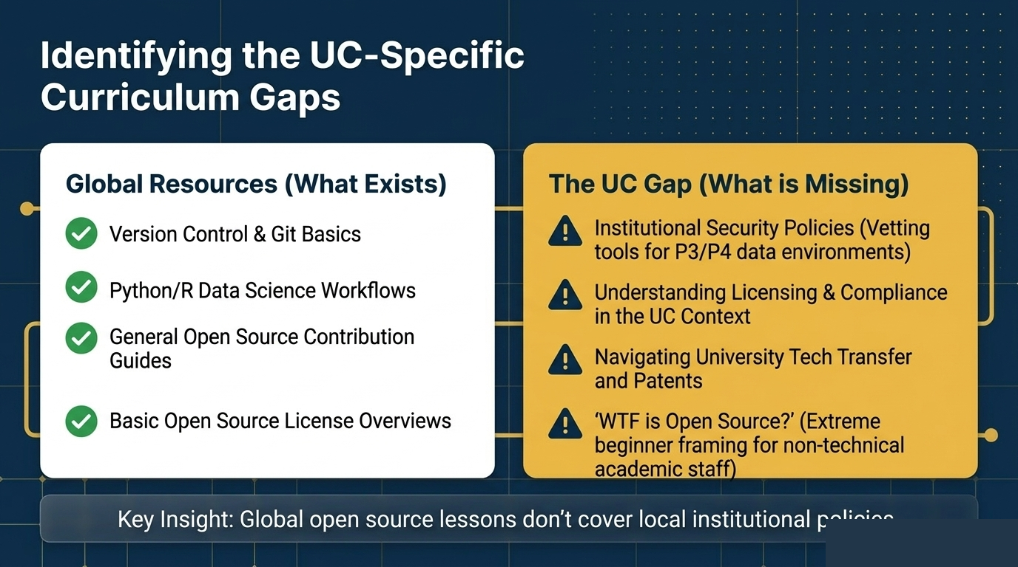

Slide 9
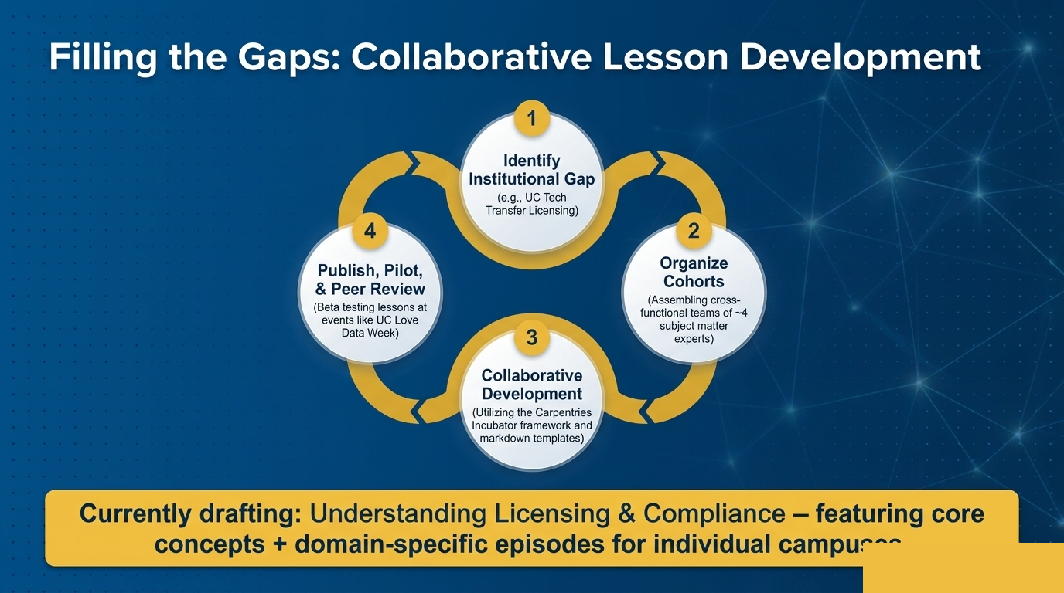

Slide 10
Built by a System-Wide Community
Education Committee
UI/UX Design
Student Developers
(Content & Strategy)
(The Interface)
(The Infrastructure)
Tim Dennis, Reid Otsuji (UCSD), Karla Padilla (UCSD), David Minor (UCSD), Laura Langdon (OSPO Community Mgr) Curriculum mapping, gap analysis, and learner persona development.
Lauren Reyes (UCSD) Executing the Figma-to-Astro transition, creating the 3-column responsive grid, and unified navigation.
OSPO Student Developer Team: Shawn Wang & Gia Kim (UCLA) Engineering the Keystatic CMS migration, automated metadata pipelines, and legacy data ingestion.
Notes:
This is a distributed UC team. Reid Otsuji, Karla Padilla, and David Minor at UCSD anchored the education committee. Lauren Reyes at UCSD led the UI/UX work. Laura Langdon keeps the community coordinated. And student developers did the heavy engineering lift on the infrastructure side. No single campus owns this — which is exactly the point. Keep that in mind as I show you what we built.

Slide 11
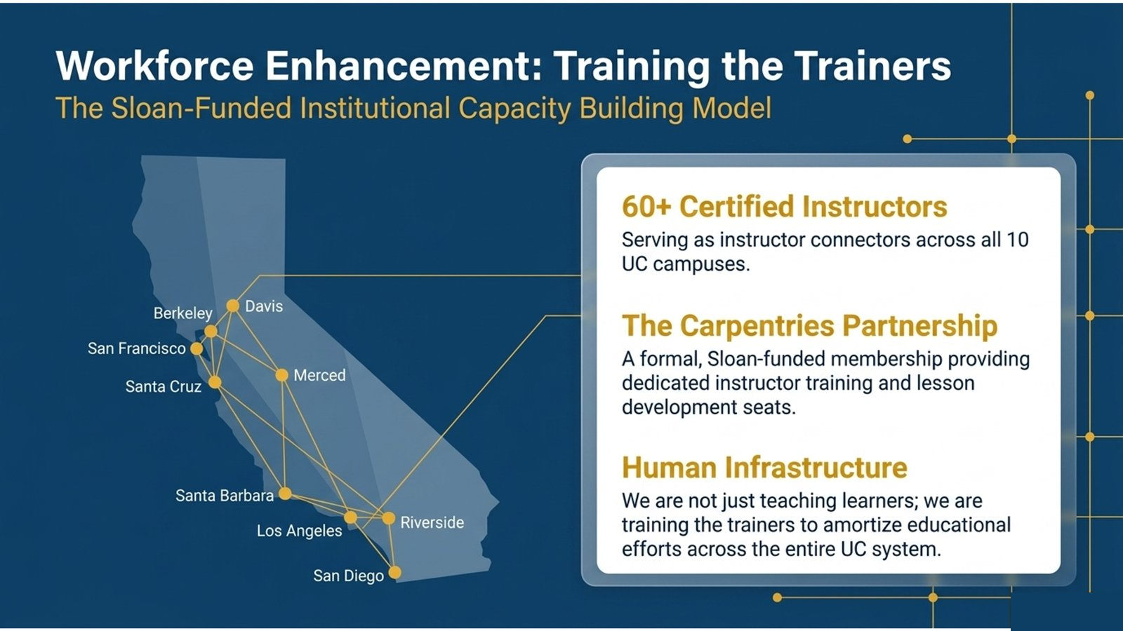

Slide 12
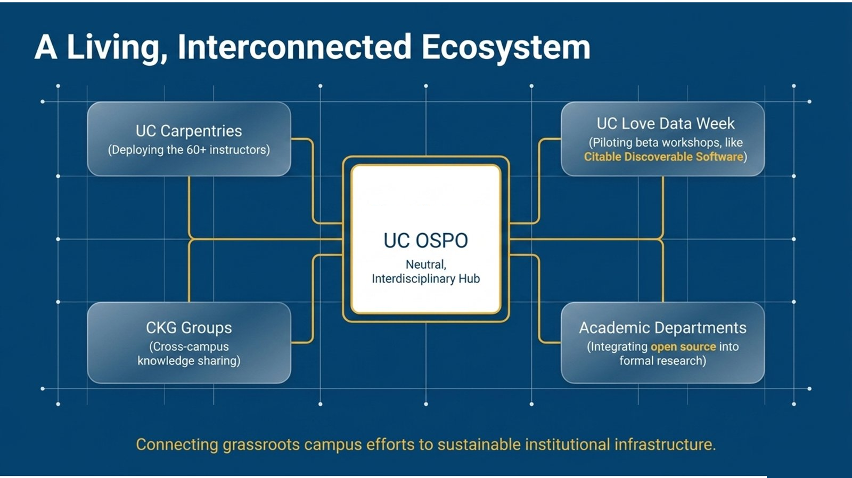

Slide 13
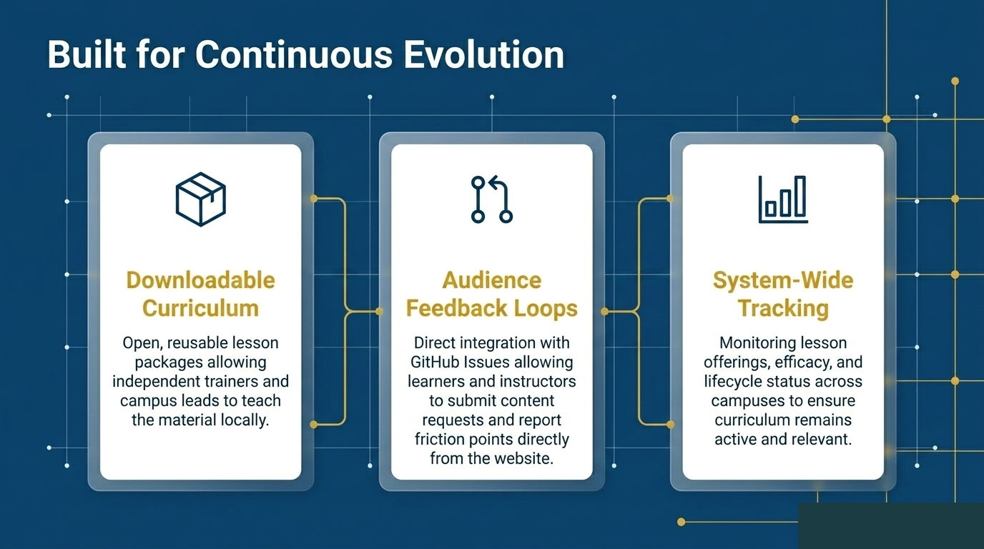

Slide 14

Let's Build Together
Learn:
Browse the 6 curated pathways.
Website:
https://uc-ospo-network.github.io/education/
GitHub:
Teach:
Identify a lesson and run a workshop.
UC-OSPO-Network/education
Build:
Express an interest being an author on the missing curriculum gaps.

