Slide 1
Open Source as Institutional Infrastructure
Lessons from the UC OSPO Network Tim Dennis

Slide 2
The invisible layer
Research data workflows run on open source:
Data collection, cleaning, analysis, visualization
Reproducibility tooling: containers, workflows, version control
Repositories and scholarly infrastructure
92% of researchers use software; 67% say their research would be impossible without it.
The people keeping it running are increasingly called Research Software Engineers (RSEs), a growing professional community with no standard institutional home.
If every organization had to replace open source with proprietary equivalents, the cost would exceed $8.8 trillion.
Hettrick et al. (SSI, 2014/2022) · Hoffmann, Nagle & Zhou (2024) doi:10.2139/ssrn.4693148
Jupyter
Python
R
Git
Spark
Pandas
NumPy
Docker
Ray
ggplot2
dplyr
Snakemake
Nextflow
Notes:
92%/67% stats: set the stakes before the slide text does; audience already lives this
RSE identity = researchers organizing around the support gap; US-RSE launched 2018, now thousands of members
The gap: maintainer burns out → library abandoned; licensing question → publication blocked; nowhere to turn
$8.8T breakdown: supply-side cost to recreate top 5,000 packages = $4.15B; demand-side if OSS disappeared = $8.8T (~2,000x ratio)
Use that ratio with admins or funders who think this is a niche concern

Slide 3
We’ve been here before
People in this room helped build the open data movement:
FAIR principles: from aspiration to institutional expectation
Data management plans embedded in grant workflows
Curation, provenance, and stewardship as professional services
Open science infrastructure: repositories, PIDs, metadata standards
FAIR4RS: FAIR principles now extended to research software
Software is the next frontier, and UC has been showing the way for 50 years: BSD Unix, Ceph, Apache Spark, RISC-V, Ray. The pipeline from university research to global infrastructure is not rare or accidental.
“The research done in academia was the seed. Foundations provided the soil. But the community was the sun.”
Barker et al. (2022) doi:10.1038/s41597-022-01710-x · Ruff, N. (2026) “The Role of Foundations in Advancing Open Collaboration and Innovation,” UC Open Summit. youtu.be/eBriL3CDNeo
Notes:
FAIR didn’t happen by accident: data professionals insisted data deserved first-class treatment as a scholarly output
FAIR4RS (Barker et al. 2022, RDA/FORCE11/ReSA) = same inflection point for software that FAIR was for data
UC pipeline is the proof that research → global infrastructure is a pattern, not a fluke (details on next slide)
Ruff: “The students writing their class projects this very semester may be creating the next Ray” — not a metaphor, a track record

Slide 4
The UC research-to-infrastructure pipeline
UC Berkeley
Jupyter
Apache Spark
RISC-V
Ray
BSD Unix
UC Santa Cruz
Ceph
UCSC Genome Browser
UC San Diego
Cytoscape EEGLAB
UCSD Pascal
UCLA
Processing
Named Data Networking
tz database
UC San Francisco
ChimeraX
OpenMM
UC Davis
sourmash
ERPLAB
Notes:
Berkeley = audience-recognizable headlines; point to the whole grid: systems (Berkeley, UCSC), bioinformatics/neuroscience (UCSD, UCSF, Davis), internet infrastructure (UCLA)
Jupyter: Pérez procrastinating on his physics PhD, built IPython in an afternoon
Spark: Zaharia’s classmate needed faster distributed ML to compete in the $1M Netflix Prize; Databricks now $60B+
RISC-V: 3-month summer project so grad students could experiment without paying ARM royalties; now in 10B devices; moved to Switzerland in 2020 to stay neutral in US-China trade war
Ray: two PhD students tired of rewriting Python to scale past one machine; now core OpenAI compute infrastructure
Ceph: Weil’s 2004 dissertation → Inktank → Red Hat acquisition → CROSS funded the first UC OSPO (seed of this network)
Genome Browser: Jim Kent assembled the genome on 50 borrowed PCs (details next slide)
Cytoscape: molecular interaction tables too big for spreadsheets → visual “living maps” of the cell; de facto standard for network biology
EEGLAB: funded by the inventor of laser barcoding who wanted to decode the brain’s scanning systems
Processing: Reas + Fry, MIT Media Lab 2001; teach programming through visual art; now the Processing Foundation
tz database: Eggert used 19th-century astrologers’ almanacs to reconstruct pre-1883 timezone history; every OS clock depends on it
sourmash: FracMinHash sketching — a laptop now searches billions of genome sequences in seconds

Slide 5
Summer 2000. UC Santa Cruz.
PhD student Jim Kent assembled the human genome on 50 borrowed PCs, icing his wrists to keep coding.
He finished three days before a corporate competitor’s supercomputer.
The genome stayed in the public domain.
Kent, J.W. (2002). BLAT - The BLAST-Like Alignment Tool. Genome Research 12, 656–664. · genome.ucsc.edu
Notes:
Take a beat. Let the room absorb it.
Celera: $300M private funding, dedicated supercomputer cluster; Kent: 50 off-the-shelf PCs assembled in a hallway
GigAssembler (~10,000 lines of C) in a few intense weeks, reportedly while icing his wrists to prevent carpal tunnel
This is the open data argument — scientific outputs belong in the commons — applied to software and won by a grad student
After the beat: “That is what UC research infrastructure looks like at the start.”

Slide 6
What is an academic OSPO?
An Open Source Program Office supports, governs, and promotes open source within an institution.
Originated in industry: ~77% of large tech companies have one
First academic OSPOs: Johns Hopkins, UC Santa Cruz, and RIT (2021)
34 academic OSPOs in CURIOSS worldwide and growing
Core functions: policy, licensing guidance, best practices, education, community
//| echo: false //| output: false world_topo = fetch("https://cdn.jsdelivr.net/npm/world-atlas@2/countries-110m.json").then(r => r.json()) members = FileAttachment("curioss-members.csv").csv({typed: true})
//| echo: false Plot.plot({ projection: { type: "equal-earth", domain: { type: "MultiPoint", coordinates: members.map(d => [+d.lon, +d.lat]) }, inset: 40 }, width: 660, height: 340, style: {background: "transparent"}, marks: [ Plot.graticule({stroke: "#e8eef8", strokeWidth: 0.5}), Plot.geo(topojson.feature(world_topo, world_topo.objects.land), { fill: "#e8eef8", stroke: "#ccc", strokeWidth: 0.5 }), Plot.dot(members, { x: d => +d.lon, y: d => +d.lat, r: 7, fill: d => d.uc_network === "yes" ? "#ff9100" : "#003cb3", stroke: "white", strokeWidth: 1.2, tip: true, title: d => d.name }) ] })
🟠 UC OSPO Network · 🔵 CURIOSS member
World map showing 34 CURIOSS member institutions. Six UC campuses (orange) in California: Santa Cruz, Berkeley, Davis, Los Angeles, Santa Barbara, and San Diego. Twenty-eight additional institutions (blue) across the US, UK, Switzerland, Spain, Ireland, Luxembourg, and France.
Notes:
Map is live and interactive — hover for institution names; UC = orange cluster on the west coast
CNI late 2024: ~20 members; now 34, growing fast
Academic model: less compliance, more enabling researchers and students already doing OSS work without any support structure

Slide 7
The UC OSPO Network
A multi-campus collaboration treating open source as shared infrastructure.
6 campuses: Santa Cruz, Berkeley, Davis, Los Angeles, Santa Barbara, San Diego
Launched April 2024, funded by the Alfred P. Sloan Foundation
$1.85M in external funding to date
Lead: UC Santa Cruz, the first OSPO in a large state university system
Serves 280,000+ students and 25,000+ faculty
Acts as a neutral convener: no single campus, company, or grant cycle can pull the work away.
Ruff (2026) UC Open Summit · youtu.be/eBriL3CDNeo
//| echo: false //| output: false ca_states = fetch("https://cdn.jsdelivr.net/npm/us-atlas@3/states-10m.json").then(r => r.json()) uc_network_campuses = [ {name: "UC Santa Cruz", short: "UCSC", lon: -122.0583, lat: 36.9741}, {name: "UC Berkeley", short: "UCB", lon: -122.2595, lat: 37.8724}, {name: "UC Davis", short: "UCD", lon: -121.7619, lat: 38.5382}, {name: "UC Los Angeles", short: "UCLA", lon: -118.4452, lat: 34.0689}, {name: "UC Santa Barbara", short: "UCSB", lon: -119.8489, lat: 34.4140}, {name: "UC San Diego", short: "UCSD", lon: -117.2340, lat: 32.8801} ]
//| echo: false Plot.plot({ projection: { type: "mercator", domain: {type: "MultiPoint", coordinates: [[-124.5, 32.4], [-114, 42.1]]} }, width: 500, height: 420, style: {background: "transparent"}, marks: [ Plot.geo( topojson.feature(ca_states, ca_states.objects.states).features.find(d => +d.id === 6), {fill: "#e8eef8", stroke: "#b0bbcc", strokeWidth: 0.8} ), Plot.dot(uc_network_campuses, { x: d => d.lon, y: d => d.lat, r: 10, fill: "#ff9100", stroke: "white", strokeWidth: 1.8, tip: true, title: d => d.name }), Plot.text(uc_network_campuses, { x: d => d.lon, y: d => d.lat, text: d => d.short, dy: -18, fontSize: 13, fontWeight: "bold", fill: "#1f335e", stroke: "white", strokeWidth: 3 }) ] })
Map of California showing six UC OSPO Network campuses: Santa Cruz, Berkeley, Davis, Los Angeles, Santa Barbara, and San Diego.
Notes:
Six campuses span the length of the state
UCSC head start: Ceph (Weil’s 2004 dissertation) → Inktank → Red Hat → CROSS → first UC OSPO 2022 → Sloan funded the network
Neutral convener framing (Ruff, UC Open 2026, 8:17–8:49): “code held in a neutral trust place — no single company can pull on it, no single country can claim it”; UC OSPO Network does this at system scale for policy and governance

Slide 8
Three thematic areas
🔭
Discovery
Mapping who does what across the UC system: repos, contributors, tools, and practices
🌱
Sustainability
Keeping projects and communities healthy through licensing, project health, and community support
Notes:
All network activity falls under these three. Governance maps to them: OSPO Leadership Group plus one working group per theme.

Slide 9
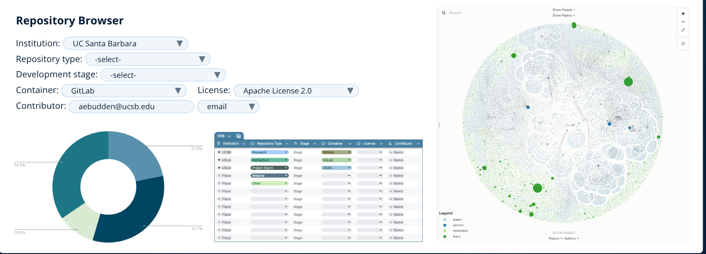
Discovery: knowing what’s there
The 4 Ps framework, applied at system scale:
People: who contributes to OS software at UC?
Product: what has been built?
Practice: how do faculty and staff engage?
Perception: what are contributors’ experiences?
Tools: GitHub pipeline (200,000+ repos scanned; ~52,000 institutionally affiliated across 10 campuses), network-wide survey (294 respondents), UC Open Repository Browser (UC ORB)
Gomez et al. (2025) arxiv:2506.18359 · Scarlett et al. (2025) doi:10.31235/osf.io/p8bx6_v1
UC Open Repository Browser showing filter controls, repository type breakdown, data table of UC campus repos, and a network visualization of project relationships
Notes:
This is a methods story the audience recognizes: inventory, assess, make visible — what data librarians do
Juanita Gomez led GitHub analysis and built UC ORB; full FOSSY talk: “Recipe for Discovery: Building the UC Open Source Repository Browser From Scratch”
200,000+ = full pipeline scan; 52,000 = repos with strong institutional affiliation after filtering
Survey preprint data going to Dryad

Slide 10
Sustainability: keeping it running
58% of UC open source contributors are also maintainers. Not users: stewards.
What they asked for most: sustainability grants, computing infrastructure, learning communities.
#1 challenge: finding time to write documentation.
Nationally: 60% of maintainers are unpaid; 43% report burnout.
Network services:
Cross-campus licensing working group (UCOP + tech transfer + IT)
Project health assessment (OSSPREY)
Containerization support · Community management
Scarlett et al. (2025) doi:10.31235/osf.io/p8bx6_v1 · Tidelift (2024) State of the Open Source Maintainer Report
58%
of UC OSS contributorsare also maintainersnot just users, stewards
60%
unpaid nationally
43%
report burnout
Tidelift (2024) State of the Open Source Maintainer Report
Notes:
58% = the key reframe: not people who downloaded a package, but sustaining infrastructure others depend on — mostly without institutional recognition
Licensing working group = clearest example of what only the network can do: UCOP + tech transfer (UCLA, UCB, UCSC) + IT; that table doesn’t exist without a network-level convener

Slide 11
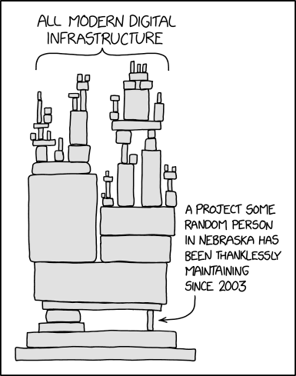
The dependency problem
xkcd #2347 (CC BY-NC 2.5) · UC survey: 58% of contributors are maintainers · Tidelift (2024): 60% unpaid, 43% burnt out
XKCD #2347 ‘Dependency’: a towering stack of blocks labeled ‘All modern digital infrastructure’ balances on a single tiny block labeled ‘A project some random person in Nebraska has been thanklessly maintaining since 2003’. By Randall Munroe.
Notes:
Let the comic breathe. The joke lands on its own.
“A project some random person in Nebraska has been thanklessly maintaining since 2003” — that person is at every UC campus and most of your institutions too

Slide 12
AI and open source: a new pressure
AI code generation is changing what it means to maintain a project.

Slide 13
Slop PRs: AI-generated contributions that look complete but are off-spec, shallow, or carry subtle bugs
Review burden grows while maintainer capacity stays flat
The OSS projects that trained the models are now flooded by their output
Security risk: AI-generated code in dependencies with undetected vulnerabilities
OSPOs are developing responses: contribution disclosure policies, AI-aware code review norms, project-level guidance.
Baltes, Cheong & Treude (2026) arxiv:2603.27249 · GitClear (2024) “Coding on Copilot”
The structural shift
70% of new AI PhDs go straight to industry
(a decade ago: 50/50)
90% of notable AI models come from a handful of companies
Academia is being sidelined from the systems it helped create.
Ruff (2026) UC Open Summit · youtu.be/eBriL3CDNeo
Notes:
70%/90% stats = direct quotes from Ruff keynote, UC Open 2026 (6:15–7:15)
Baltes, Cheong & Treude (2026) arXiv:2603.27249: frames “slop PRs” as tragedy of the commons — individual productivity gains push costs onto maintainers
Real examples: curl shut down its bug bounty in early 2026 (AI vulnerability reports turned 15-min verifications into days of work); Godot + RubyGems saw 10x spikes in low-quality AI contributions
GitClear (2024): AI-assisted dev measurably increases code churn and reduces reuse — more review work on lower-quality patches
Ruff on urgency: “The governance layer for AI is being written in 18–36 months. If you’re not in the room, you’ll inherit a system you have to live with.”

Slide 14
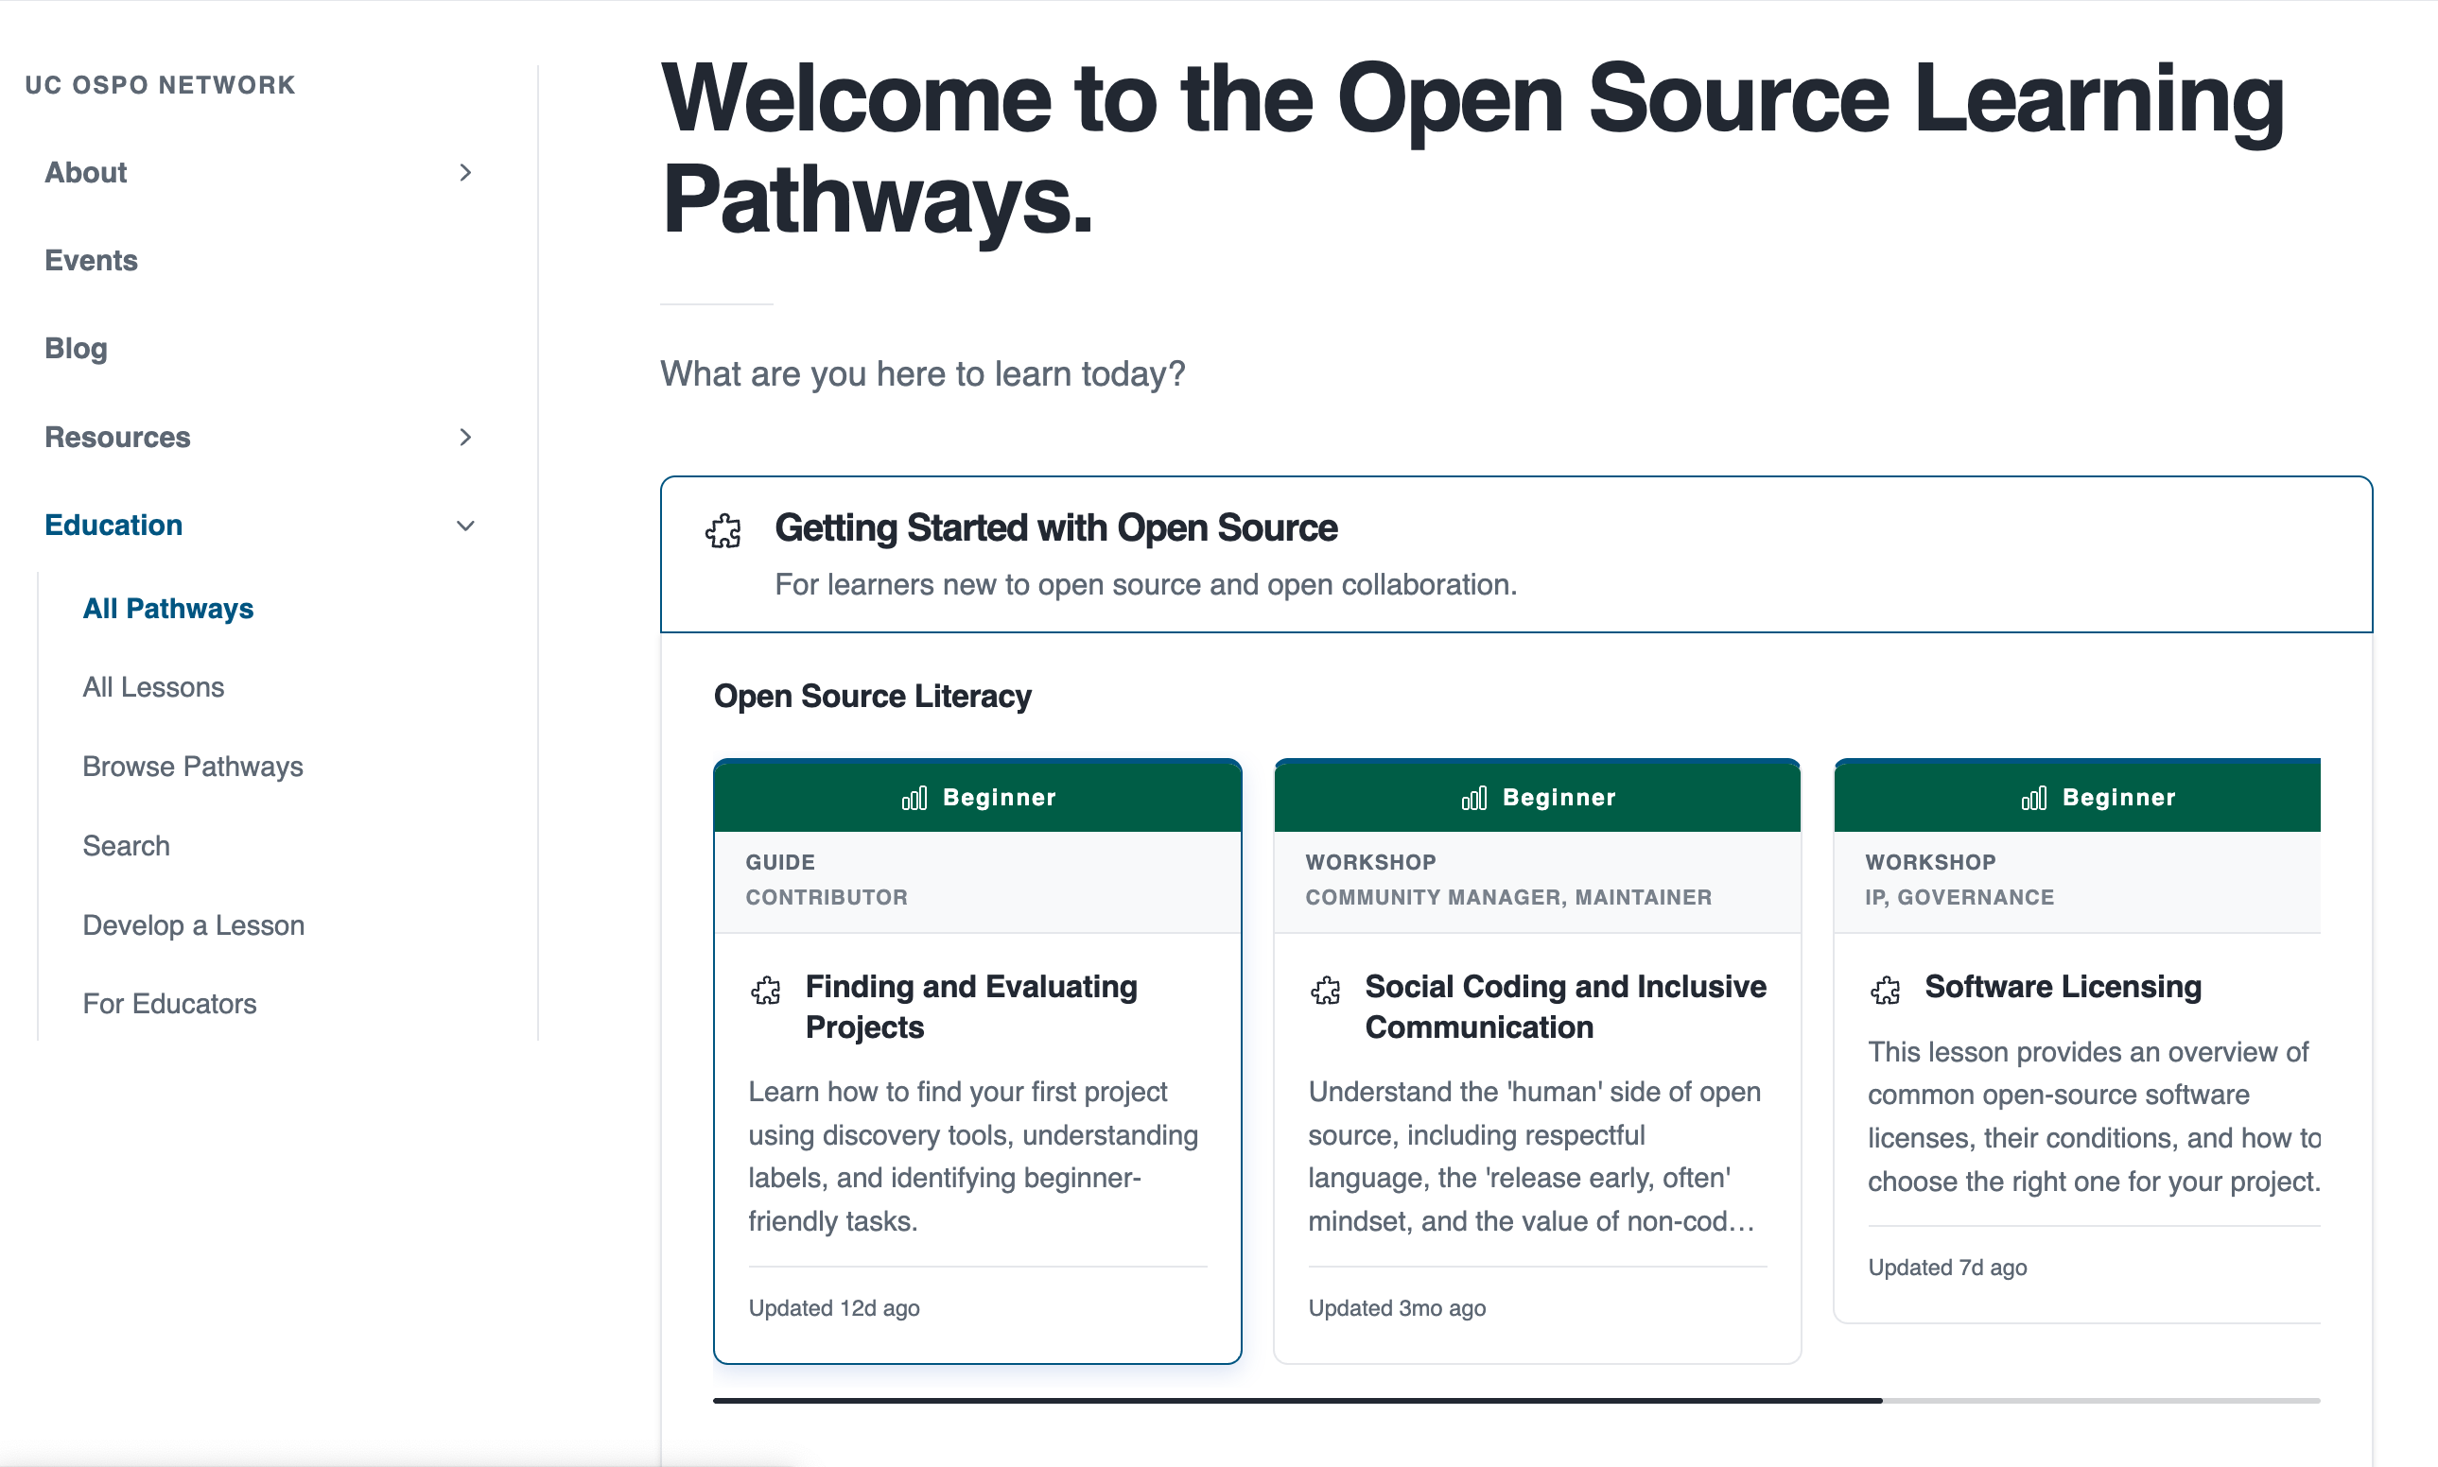
Education: training as infrastructure
Gap analysis → curriculum inventory → learning pathways
Inventoried existing materials: Carpentries, CodeRefinery, The Turing Way, UC-specific content
Organized by topic (licensing, sustainability, community) and by role (contributor, maintainer, manager)
Published at ucospo.net/education
Coordinated with data literacy programs and Carpentries infrastructure
UC OSPO Network Education site showing the Open Source Learning Pathways, organized by role, skill level, and pathway, with beginner lesson cards including Software Licensing, Social Coding, and Finding and Evaluating Projects
Notes:
Most direct connection to IASSIST members’ world
Treat training the way data professionals treat data: find what exists, identify gaps, don’t duplicate
It’s a living curriculum inventory, not a course catalog

Slide 15
Distributed expertise, system-wide capacity
Each campus brings what others don’t. The network routes it to where it’s needed.

Slide 16
Each campus contributes
Unique domain expertise and staff knowledge
Local relationships with researchers and faculty
Pilots that can only run with campus context
Specialized capacity others can learn from
The network multiplies it
Expertise flows across all six campuses
Shared staffing no single campus could fund
Smaller campuses build capacity they couldn’t alone
A success at one becomes a template for five

Slide 17
Governed by an OSPO Leadership Group and thematic working groups, one per campus, coordinated at system level.
Notes:
Each campus is a node that both contributes and draws from the network (not competing priorities)
Campus specializations: Davis → software sustainability research; UCLA → library integration + data services; UCSD → educational outreach; UCSC → deepest OSS governance history (CROSS)
Governance: OSPO Leadership Group (one rep per campus) sets direction; three thematic working groups do the work; GitHub-based project management keeps it open and legible
Key point for this audience: a librarian at a smaller campus now has access to expertise from six campuses — that’s what the network actually delivers

Slide 18
Lessons from two years
What the network model enables that single campuses cannot:
Shared staffing: community manager, licensing specialist, technical roles
Policy leverage: the network has standing with UCOP; individual campuses do not
Data at scale: the GitHub and survey analyses require system-wide scope to mean anything
Equity: smaller campuses get services they could not build alone
A replicable model: $1.85M produced something other state systems can follow
Notes:
Two years in, the model works
Open question: moving from grant funding to permanent infrastructure — working on Sloan extension, exploring UCOP pathways
The pattern (distributed nodes, shared governance, thematic working groups) is transferable to any large university system

Slide 19
Where this meets your work
For data professionals, the OSPO sits at the intersection of:
Research software engineering ↔ data management
Licensing compliance ↔ open data policy
Reproducibility tooling ↔ FAIR / FAIR4RS
Training infrastructure ↔ data literacy programs
RSE community ↔ library research support
For your institution:
Where does open source software governance currently live?
What would it take to treat it as infrastructure rather than a side project?
Notes:
This is the invitation: IASSIST members should be at the OSPO table — you work across the research lifecycle, understand data governance, run training programs
RSEs are natural collaborators, many already embedded in or adjacent to library services
Question for the room: does your institution have an RSE group, research computing team, or data science center? That’s where this conversation belongs.

Slide 20
You’re already doing this work
If you do technical data services, researchers are already bringing you these questions:
“What license should I use for this code?”
“Is this library still maintained? Should I depend on it?”
“How do I make this reproducible and citable?”
“My funder wants a software management plan.”
“How do I accept contributions from collaborators?”
That is OSPO work. The frame makes it legible to you, your institution, and the researchers you serve.
Raise the floor, not just solve the ticket
Fixing their immediate problem gets them through the week.
Moving them from “it runs on my machine” to maintainable, licensed, citable software gets their whole lab there, and their students after them.
You don’t need a formal OSPO to do this. You need the frame.
OSPO heuristics already in your toolkit: health signals · bus factor · governance files · FAIR4RS · software DMPs · contributor conventions · community governance
Notes:
Core distinction: reactive (fixes the week) vs. capacity-building (shifts lab practice that compounds across students and grants)
Not about turning every data librarian into an OSPO director — about shifting what a researcher walks away knowing
Health signals (bus factor, issue velocity, contributor diversity) = will this project be there next year?
Governance files (README, CONTRIBUTING, CODE_OF_CONDUCT) = data README equivalent; make the project legible to the next person
FAIR4RS + software DMPs = policy anchors that give researchers a reason to care now
You don’t need institutional approval: use the vocabulary and resources from ucospo.net in consultations today — you’re already in the room where these questions get raised
Carpentries angle: adding a session on software health, licensing, and CITATION.cff is low lift for every researcher in that room

Slide 21
What you can do right now
If you advise on data-intensive research, you are probably already helping with code.
The network has already built the resources (Laura Langdon, UC OSPO):
README.md - template + guide
LICENSE - guide includes UC-approved options
CONTRIBUTING.md - template + guide
CODE_OF_CONDUCT.md - Contributor Covenant + guidance
CITATION.cff + Zenodo release → citable, versioned DOI
Going further:
Growing a Community Around a Project - UC OSPO
Sharing Research Software: Reproducible, Citable, and Discoverable - Carpentries Incubator lesson (covers pixi, CITATION.cff, Zenodo, discoverability)
Notes:
Don’t build these yourself: Laura Langdon published templates + guides for all four key files in September 2025 — on ucospo.net now
Carpentries lesson (mine, pre-alpha but usable): full workflow from licensing through environment management to minting a DOI on Zenodo
A researcher who already deposits data with your help is one conversation away from a fully citable software package
You need the consultation habit and a link to these resources. That’s it.

Slide 22
Learn more / connect
UC OSPO Network: ucospo.net
Education site: ucospo.net/education
Mailing list, Slack, events calendar
Global network: curioss.org, 34 academic OSPOs worldwide and growing
Tim Dennis Data Science Center, UCLA Library tdennis@library.ucla.edu
🖥 Slides: tinyurl.com/iassist2026
📄 Handout: tinyurl.com/iassist2026-handout
QR code linking to tinyurl.com/iassist2026 — slides for this presentation
QR code linking to tinyurl.com/iassist2026 — slides for this presentation
tinyurl.com/iassist2026
Notes:
UC ORB: good follow-up for anyone who wants to see the discovery tooling
CURIOSS community: good follow-up for anyone whose institution is thinking about starting an OSPO
Leave time for questions — AI and sustainability slides tend to generate them

Slide 23
Barker, M., Chue Hong, N. P., Katz, D. S., Lamprecht, A.-L., Martinez-Ortiz, C., Psomopoulos, F., Harrow, J., Castro, L. J., Gruenpeter, M., Martinez, P. A., & Honeyman, T. (2022). Introducing the FAIR principles for research software. Scientific Data, 9, 622. https://doi.org/10.1038/s41597-022-01710-x
Brown, C. T., & Irber, L. (2016). Sourmash: A library for MinHash sketching of DNA. Journal of Open Source Software, 1(5), 27. https://doi.org/10.21105/joss.00027
Cerf, V. G., & Kahn, R. E. (1974). A protocol for packet network intercommunication. IEEE Transactions on Communications, 22(5), 637–648. https://doi.org/10.1109/TCOM.1974.1092259
Delorme, A., & Makeig, S. (2004). EEGLAB: An open source toolbox for analysis of single-trial EEG dynamics including independent component analysis. Journal of Neuroscience Methods, 134(1), 9–21. https://doi.org/10.1016/j.jneumeth.2003.10.009
Eastman, P., Swails, J., Chodera, J. D., McGibbon, R. T., Zhao, Y., Beauchamp, K. A., Wang, L.-P., Simmonett, A. C., Harrigan, M. P., Stern, C. D., Wiewiora, R. P., Brooks, B. R., & Pande, V. S. (2017). OpenMM 7: Rapid development of high performance algorithms for molecular dynamics. PLOS Computational Biology, 13(7), e1005659. https://doi.org/10.1371/journal.pcbi.1005659
Gomez, J., Lovell, E., Lieggi, S., Cardenas, A. A., & Davis, J. (2025). Recipe for discovery: A pipeline for institutional open source activity. https://arxiv.org/abs/2506.18359
Hettrick, S., Antonioletti, M., Carr, L., Chue Hong, N., Crouch, S., De Roure, D., Emsley, I., Goble, C., Hay, A., Inupakutika, D., et al. (2014). UK Research Software Survey 2014. Software Sustainability Institute. https://doi.org/10.5281/zenodo.14809
Hoffmann, M., Nagle, F., & Zhou, Y. (2024). The value of open source software (Working Paper Nos. 24-038). Harvard Business School. https://doi.org/10.2139/ssrn.4693148
Kent, W. J., Sugnet, C. W., Furey, T. S., Roskin, K. M., Pringle, T. H., Zahler, A. M., & Haussler, D. (2002). The human genome browser at UCSC. Genome Research, 12(6), 996–1006. https://doi.org/10.1101/gr.229102
Kluyver, T., Ragan-Kelley, B., Pérez, F., Granger, B., Bussonnier, M., Frederic, J., Kelley, K., Hamrick, J., Grout, J., Corlay, S., Ivanov, P., Avila, D., Abdalla, S., & Willing, C. (2016). Jupyter Notebooks — a publishing format for reproducible computational workflows. In F. Loizides & B. Schmidt (Eds.), Positioning and power in academic publishing: Players, agents and agendas (pp. 87–90). IOS Press. https://doi.org/10.3233/978-1-61499-649-1-87
Moritz, P., Nishihara, R., Wang, S., Tumanov, A., Liaw, R., Liang, E., Elibol, M., Yang, Z., Paul, W., Jordan, M. I., & Stoica, I. (2018). Ray: A distributed framework for emerging AI applications. 13th USENIX Symposium on Operating Systems Design and Implementation (OSDI), 561–577.
Olson, A. D., & Eggert, P. (1986). tz database (IANA time zone database). IANA. https://www.iana.org/time-zones
Ruff, N. (2026). The role of foundations in advancing open collaboration and innovation. UC Open Summit. https://youtu.be/eBriL3CDNeo
Scarlett, V., Curty, R. G., Gomez, J., Langdon, L., Janée, G., & Budden, A. E. (2025). A system-wide snapshot: A multi-campus survey of open source contributors at the University of California. SocArXiv. https://doi.org/10.31235/osf.io/p8bx6_v1
Shannon, P., Markiel, A., Ozier, O., Baliga, N. S., Wang, J. T., Ramage, D., Amin, N., Schwikowski, B., & Ideker, T. (2003). Cytoscape: A software environment for integrated models of biomolecular interaction networks. Genome Research, 13(11), 2498–2504. https://doi.org/10.1101/gr.1239303
Stonebraker, M., & Rowe, L. A. (1987). The design of POSTGRES (UCB/ERL M86/85). University of California, Berkeley.
Stonebraker, M., Wong, E., Kreps, P., & Held, G. (1976). The design and implementation of INGRES. ACM Transactions on Database Systems, 1(3), 189–222. https://doi.org/10.1145/320473.320476
Tidelift. (2024). The 2024 Tidelift maintainer impact report. Tidelift. https://dev.to/tidelift/the-open-source-maintainer-community-is-getting-grayer-1gc2
Waterman, A., & Asanović, K. (2019). The RISC-V instruction set manual, volume I: Unprivileged ISA. RISC-V Foundation. https://github.com/riscv/riscv-isa-manual
Weil, S. A., Brandt, S. A., Miller, E. L., Long, D. D. E., & Maltzahn, C. (2006). Ceph: A scalable, high-performance distributed file system. 7th USENIX Symposium on Operating Systems Design and Implementation (OSDI), 307–320.
Zaharia, M., Chowdhury, M., Das, T., Dave, A., Ma, J., McCauly, M., Franklin, M. J., Shenker, S., & Stoica, I. (2012). Resilient distributed datasets: A fault-tolerant abstraction for in-memory cluster computing. 9th USENIX Symposium on Networked Systems Design and Implementation (NSDI), 15–28.
Zhang, L., Afanasyev, A., Burke, J., Jacobson, V., claffy, kc, Crowley, P., Papadopoulos, C., Wang, L., & Zhang, B. (2014). Named data networking. ACM SIGCOMM Computer Communication Review, 44(3), 66–73. https://doi.org/10.1145/2656877.2656887

