Slide 1


February 9 - 13, 2026
UC LOVE DATA WEEK:
A SERIES OF VIRTUAL TALKS, PRESENTATIONS, AND WORKSHOPS BEING OFFERED AS A WEEK-LONG EVENT FOCUSED ON DATA ACCESS, MANAGEMENT, SECURITY, SHARING, AND PRESERVATION, FOR THE UC COMMUNITY.
ALL EVENTS ARE FREE TO ATTEND AND OPEN TO ANY MEMBER OF THE UC COMMUNITY.
FOR MORE INFORMATION AND TO REGISTER FOR A
SPECIFIC WORKSHOP, PLEASE VISIT OUR WEBSITE:
https://uc-love-data-week.github.io/
Notes:
https://jt14den.github.io/research-software-citable-discoverable/

Slide 2
Code of Conduct
Expected Behavior
Use welcoming and inclusive language
Be respectful of different viewpoints and experiences
Gracefully provide and accept constructive criticism
Focus on what is best for the community
Show courtesy and respect towards other community members
By participating in this community, participants accept to abide by the UC Love Data Week (UCLDW) Code of Conduct and accept the procedures by which any Code of Conduct incidents are resolved. Any form of behavior to exclude, intimidate, or cause discomfort is a violation of the Code of Conduct.
If you believe someone is violating the Code of Conduct, we ask that you report it to the instructor/helper in your session or to the UCLDW email address (uclovedataweek@gmail.com)
Code of Conduct Full Document

Slide 3

Making Research Software Citable & Discoverable
UC Love Data Week 2026
Reid Otsuji, University of California San Diego
Karla Padilla, University of California San Diego
Leigh Phan, University of California Los Angeles
Tim Dennis, University of California Los Angeles
Laura Langdon, University of California OSPO Network

Slide 4
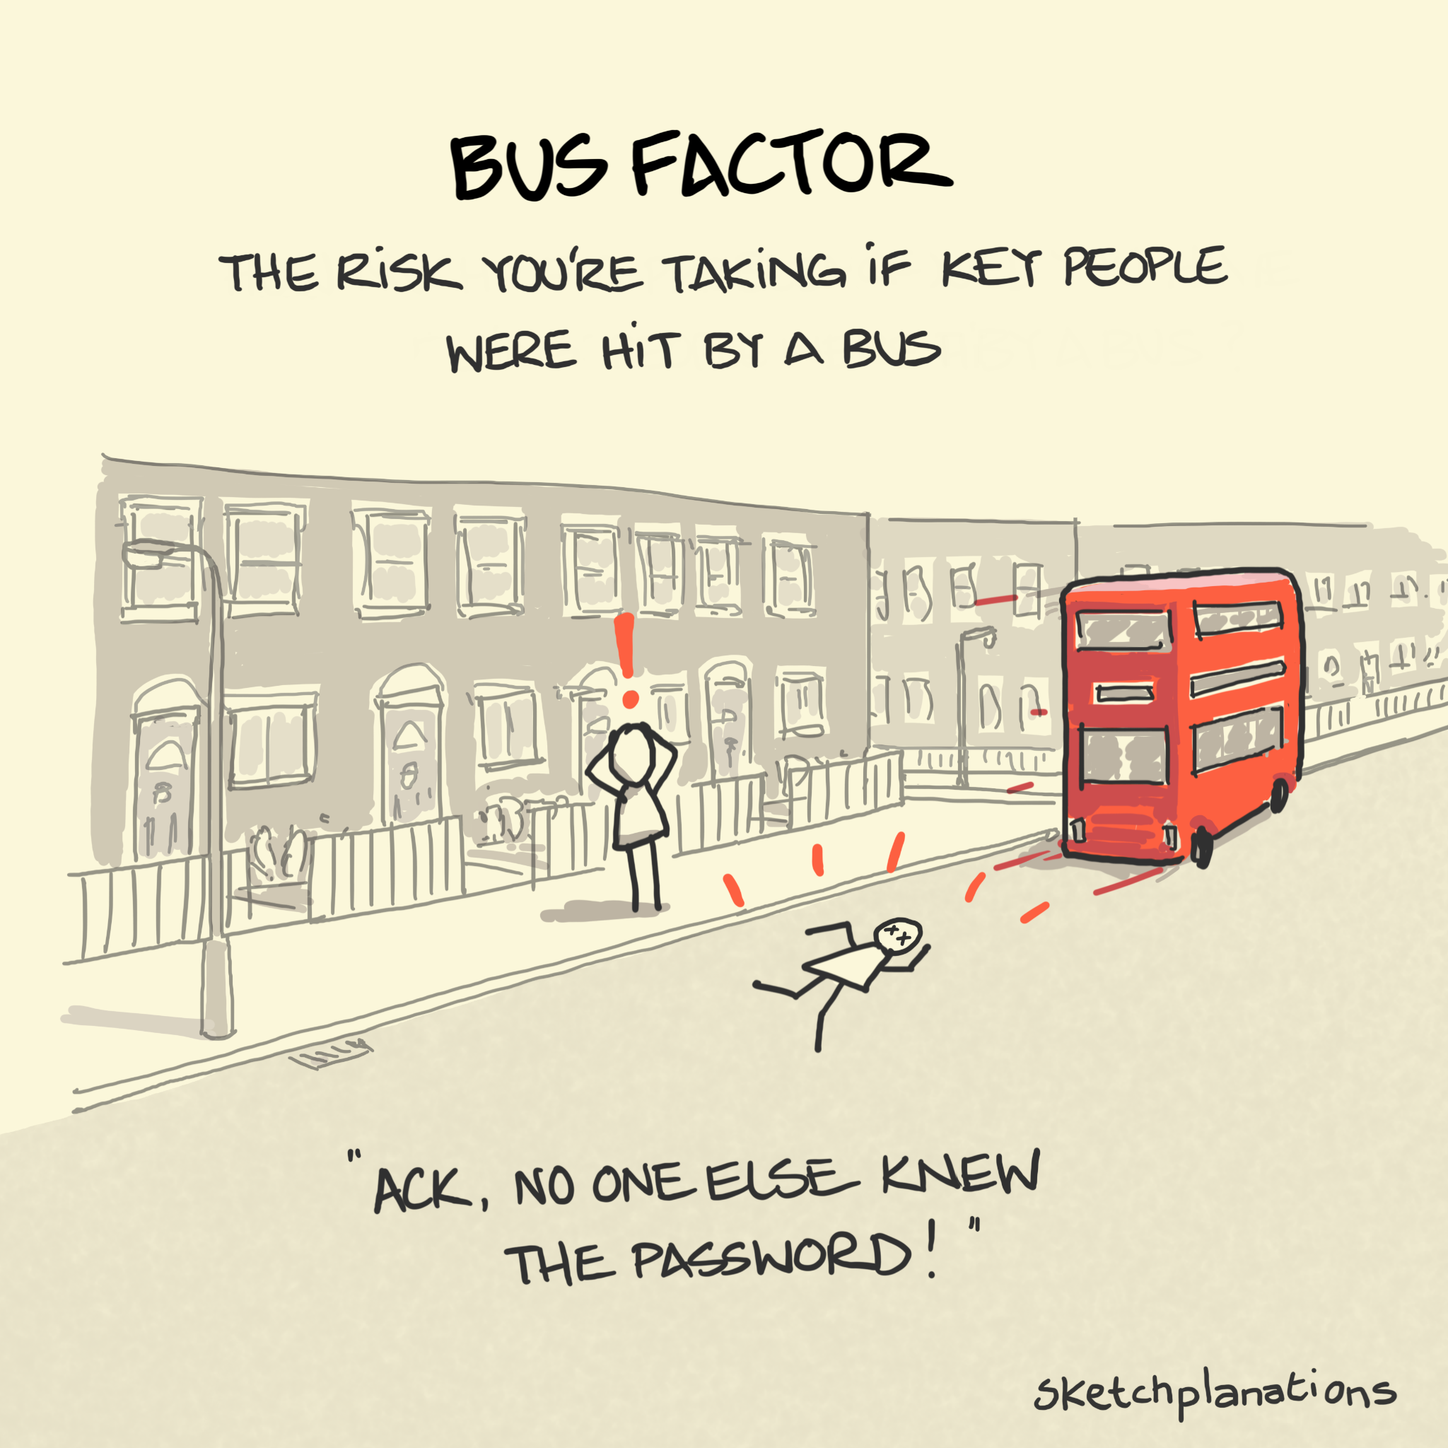
The "Works on My Machine" Trap
The Problem:
You send your code to a colleague...
"It crashes on line 1" 😩
"I can't install the dependencies"
"Which Python version did you use?"
The Bus Factor Problem:
Code works perfectly on ONE laptop. If it disappears, the research is gone.
Notes:
We see this often in consulting. A research staff member came to us asking for Python training because, in their words, “I’m the only one who knows how to write or run the script that powers our research.” That’s not a skill gap. It’s a single point of failure.
This is sometimes called the “bus factor” problem. If one person disappears, intentionally or not, the project can’t move forward.

Slide 5
The "Works on My Machine" Trap
$ python src/analysis.py
Traceback (most recent call last):
File "analysis.py", line 1, in <module>
import numpy as np
ModuleNotFoundError: No module named 'numpy'
This is where most research software lives. Fragile.
What's the fix? FAIR4RS Principles →

Slide 6
FAIR4RS Principles
What We’re Doing TODAY:
F - Findable: Software and metadata are easy to discover
→ DOI, CITATION.cff, metadata
A - Accessible: Retrievable via standard protocols
→ Public GitHub, git clone, Zenodo
I - Interoperable: Exchanges data with other tools
→ Standard formats, documented dependencies
R - Reusable: Can be executed AND modified
→ LICENSE, README, environment files

Slide 7
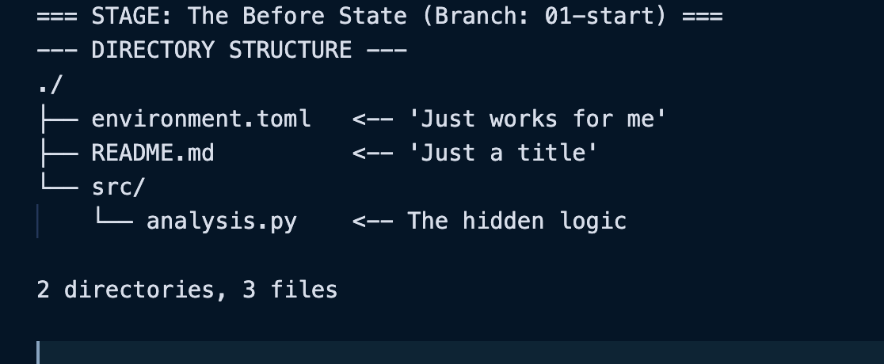
The "Works on My Machine" Trap
What's Missing?
❌ No LICENSE • ❌ No environment • ❌ No citation • ❌ No DOI
But before we fix it step-by-step, let's see what "done right" looks like in a real research project.

Slide 8
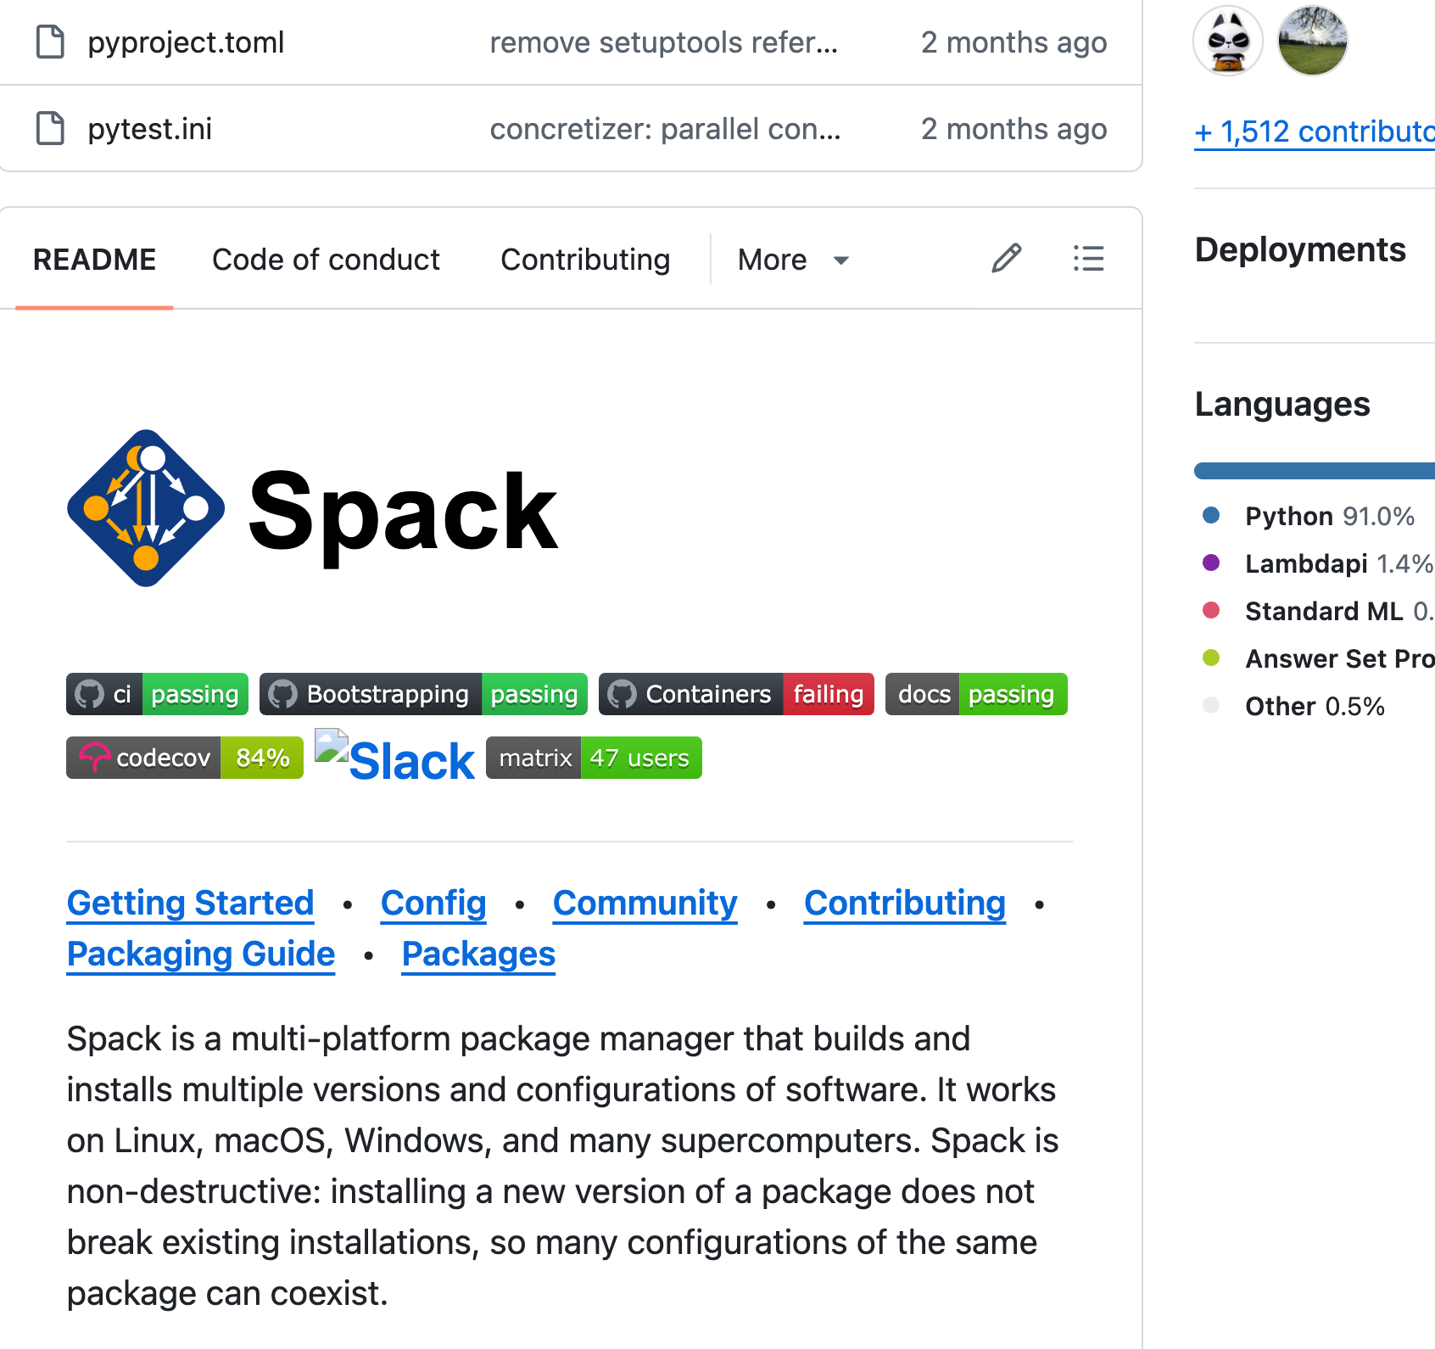
What Does "FAIR Research Software" Look Like?
Spack: A production research software project done right
Used by national labs, universities, supercomputing centers
Check the README, LICENSE, CITATION.cff, documentation
Notice what makes it discoverable and reusable
Great examples: https://github.com/matiassingers/awesome-readme
Notes:
https://github.com/spack/spack

Slide 9
From Fragile to FAIR
We've seen the problem: fragile, undocumented code.
We've seen the solution: Spack with all the pieces in place.
Now let's build it step-by-step:
✅ License - So others can legally use your work (Reid)
✅ Environment - So it runs on any machine
✅ Citation - So you get academic credit
✅ README - So people can find and use it
Let's start with the foundation: Licensing.

Slide 10
Why Licensing Matters?
Clear licensing communicates permission and expectations, reducing friction and supporting open, reproducible research.
But before choosing a license or making the decision to open source your software, it is important to determine who owns the code.
Licensing can be trickier than you would expect!

Slide 11
Why Licensing Matters?
When researchers publish code without a license, most people assume it is “public.”
Legally, it is not.
Copyright law applies automatically.
Without a license:
others cannot reuse, modify, or redistribute the code
collaboration becomes uncertain and risky
the sustainability of the project suffers

Slide 12
Understanding license categories
Open-source licenses fall into two broad categories.
Permissive licenses:
These are "no strings attached" licenses.
Idea: "Just take it and use it; we don't care what you do next."
Copyleft licenses
These are often called "reciprocal" or "viral" licenses.
Idea: "We give you this freedom, but you must ensure the next person has the same freedom."
Notes:
1. Permissive Licenses
These are "no strings attached" licenses. They allow you to do almost anything with the code, including using it in proprietary (closed-source) software, as long as you keep the original copyright notice and disclaimer.
2. Copyleft Licenses
These are often called "reciprocal" or "viral" licenses. They require that if you modify the code and distribute it, your new version must also be licensed under the same open-source license.

Slide 13

Permissive Licenses
Examples: BSD, MIT, Apache 2.0
Permissive licenses - have few requirements and are relatively easy to comply with. Typically, you are required to provide attribution.
These licenses allow users to distribute your software commercially
BSD and MIT are often preferred in UC environments due to their simplicity and lack of explicit patent grant provisions.
The Apache license requires licensors to grant a patent license to all licensees.

Slide 14

Copyleft Licenses
Examples: GNU General Public License 2.0 or GPL 2.0
Copyleft licenses - these licenses require that “derivative works/modifications” must be licensed under the same terms of the copyleft license.
This protects openness across the lifecycle of a project.

Slide 15
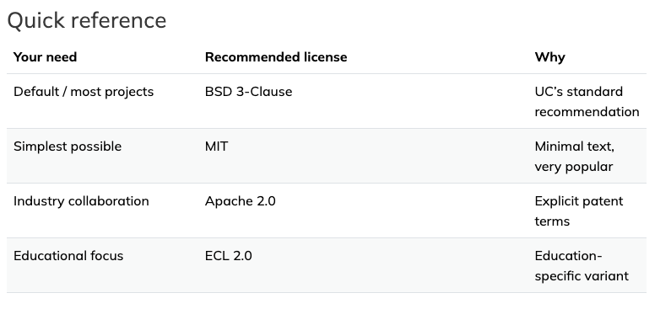
How to choose a license for your UC project
Before releasing code under an open-source license, you must check with your campus Tech Transfer office (sometimes called the Office of Intellectual Property or Technology Commercialization).
Selection of a license will depend on your goals, and the policies of the University of California. The Open Source Software chart and its companion can help you to navigate the UC policies and help guide your discussion with your TTO.
Always consult your campus Tech Transfer office before releasing UC-owned software.
Notes:
They will:
Verify ownership and funding requirements.
Ensure no third-party restrictions apply (e.g., from proprietary libraries).
Help you select the most appropriate license from the UC-recommended list.

Slide 16
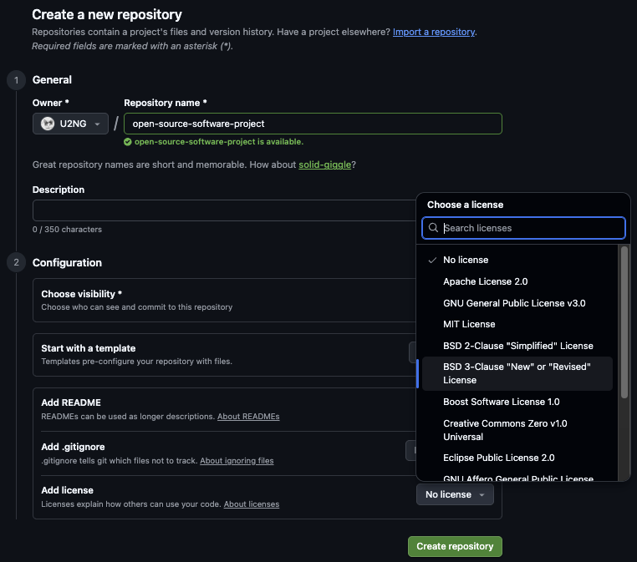
When creating a new GIthub repository - Choose your
License
The UC Standard Recommendation is:
BSD 3-Clause
Why this matters: Users reading your README on platforms other than GitHub (Zenodo, email, exported PDFs) will see your license terms even without GitHub's automatic detection.
Notes:
Change slide to:
When creating a github repo choose your license
Screenshot github repo license selection
Make sure your put a license , bsd3 for UC or contact TTO for confirmation and information

Slide 17
UC Licensing Resources
UC OSS Resources – Resources and guides for open source activities at UC.
UC OSS Chart and Companion Guide – The definitive list of UC-recommended "low-risk" licenses.
UC OSPO License Guide – Guidance on institutional requirements and templates.
ChooseALicense.com – A helpful tool created by GitHub for comparing license features. This tool does not supersede UC policies.

Slide 18
Why Environments Matter
Code rots. Python updates, packages break, and 6 months from now, your script won't run.
The Problem: Research software often "works on my machine" and nowhere else.
Different operating systems, outdated packages, and mismatched library versions frequently break code.
What Environment Management Captures:
- The exact language versions used
- Required packages
- The dependency set needed to run the software
- Instructions for reproducing the execution environment
The Payoff: We aren't just shipping code; we're shipping the computer state needed to run it.
Notes:
* Managing environments allows software to be run with specific settings ensuring that everyone using it is able to use the exact version - making the process reproducible.
Why Environments Matter
For researchers, this supports:
reproducibility
clearer documentation
better long term maintenance
a stronger foundation for citation and reuse
For example, while developing software in a team, clearly documented code makes it easier to test, run, and de-bug code if needed.

Slide 19

Pixi is a modern, fast environment manager that works with Python, R, and many other languages
Cross-platform: MacOS, Linux, Windows
Automatically creates a lock file - lock files contain the exact versions of all packages installed into an environment, ensuring all users run the exact same versions of every package.
Notes:
You may have used or heard of package managers (pip, venv; Posit from the developers of RStudio) and conda and mamba.
While there are many environment managers available, we’re highlighting Pixi as an example since it works across languages and platforms.

Slide 20
pixi: Reproducible Environments
❌ The Vague Way:
```toml
[dependencies]
python = "*"
numpy = "*"
```
`python = "*"` is like saying "I need some food."
Problems:
Works today, breaks tomorrow
Different versions on different machines
"Works on my machine" syndrome
✅ The Locked Way
```
pixi.lock contains:
python = "3.11.4"
numpy = "1.24.3"
+ 47 dependencies
```
`pixi.lock` is like saying "I need a pepperoni pizza from Mario's, baked at 5:00 PM."
Benefits:
✅ Exact versions locked
✅ Same environment everywhere
✅ Reproducible in 5 years
Notes:
A common standard for documenting project metadata is in a .toml file - Tom's Obvious, Minimal Language (TOML, originally Tom's Own Markup Language) https://en.wikipedia.org/wiki/TOML
https://peps.python.org/pep-0621/
TOML: e.g. is human-edited, includes version ranges, high-level dependencies.
Lock Files: auto-generated, include exact version ranges, lists the full dependency tree - dependencies and the dependencies they rely on.

Slide 21
Installing pixi
Full installation docs: https://pixi.sh
In MacOS or Linux
curl -fsSL https://pixi.sh/install.sh | bash
In Windows
Install via MSI Installer OR
winget install prefix-dev.pixi

Slide 22
Why pixi?
Fast, cross-platform, automatic lockfiles
Works on macOS, Linux, Windows
Creates pixi.lock automatically
Supports Python, R, and more
Simple workflow:
pixi init # Create project
pixi add python numpy pandas # Add dependencies
pixi run python analysis.py # Run code
FAIR Connection:
Standard formats + clear dependencies = Interoperable & Reusable software

Slide 23

Creating a New pixi Project
Create a directory and initialize a pixi project:
This creates a pixi.toml file, which documents your environment.

Slide 24
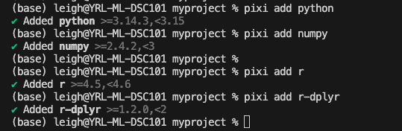
Example: creating a New pixi Project - pixi.toml
Notes:
Pixi is known for its speed! Each of these installations took about 1 second if not less.
Keeping Repositories Clean (.gitignore)
When you run pixi init, pixi automatically creates a .gitignore file. This file tells Git which files to ignore. Pixi creates a hidden .pixi/ folder containing thousands of environment files. You never want to commit this folder to GitHub - it is large, platform-specific, and can be regenerated by anyone using your pixi.lock file.

Slide 25
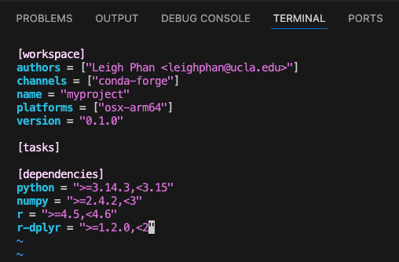
Checking pixi.toml
The pixi.toml file is now a reproducible record of all dependencies needed for the software.

Slide 26
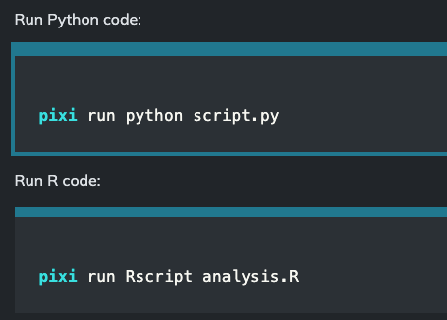
Running Code with pixi
Every command is executed inside the environment described by pixi.toml.
This makes it easier for others to test, cite, extend, build upon your work.

Slide 27
How Environments Support Citation and Reuse
A reusable research software project contains not only code, but:
Licensing
authorship and citation metadata (CITATION.cff)
version information
a documented environment

Slide 28
Publishing and Citation
When publishing your software, include:
the pixi.toml file
instructions such as:
pixi run python script.py
Reuse in practice:
Including pixi.toml in your repository or DOI deposit helps future readers:
  recreate the execution environment
  verify results
  adapt your code for new analyses
  evaluate whether the software is FAIR (Findable, Accessible, Interoperable, Reusable)
Notes:
FAIR: Findable, Accessible, Interoperable, Reusable
Reproducible environments reduce troubleshooting and support more reusable software.
pixi provides fast, cross platform environment management.
The pixi.toml file acts as documentation that supports citation and FAIR4RS principles.
Use pixi run to execute Python or R code inside a reproducible environment.
Promotes open science and open research.

Slide 29
The Citation Problem
Scenario: You publish a paper using someone's code.
❌ Bad Citation: > "We used the analysis script from https://github.com/jt14den/software-demo"
Problems:
URL breaks (link rot)
No version specified
No formal credit
Author's name not visible

Slide 30
The Citation Problem
✅ Good Citation:
Dennis, T. (2025). Biodiversity Analysis Toolkit (v0.1.0). Zenodo. https://doi.org/10.5281/zenodo.123456
Why This Works:
DOI is permanent
Version is explicit
Author gets formal credit
Appears in citation metrics
The Fix: CITATION.cff file

Slide 31
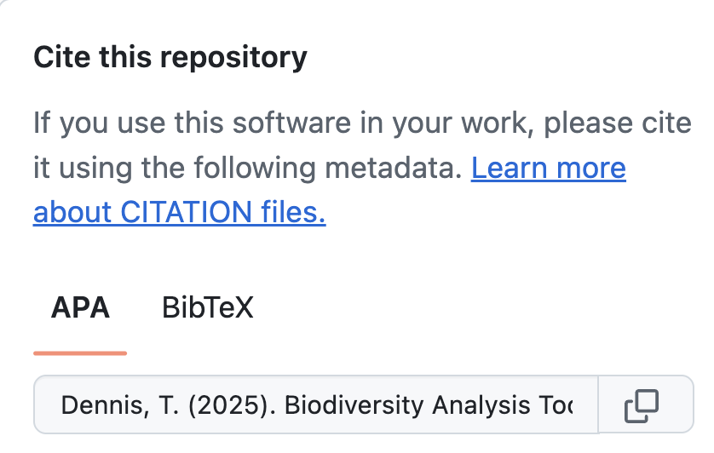
CITATION.cff: The "Cite Me" Button
cff-version: 1.2.0
message: "If you use this software, please cite it as below."
authors:
- family-names: "Dennis"
given-names: "Tim"
orcid: "https://orcid.org/0000-0002-1234-5678"
title: "Biodiversity Analysis Toolkit"
version: 0.1.0
date-released: 2025-01-15
url: "https://github.com/jt14den/software-demo"
GitHub creates a "Cite this repository" button automatically!

Slide 32
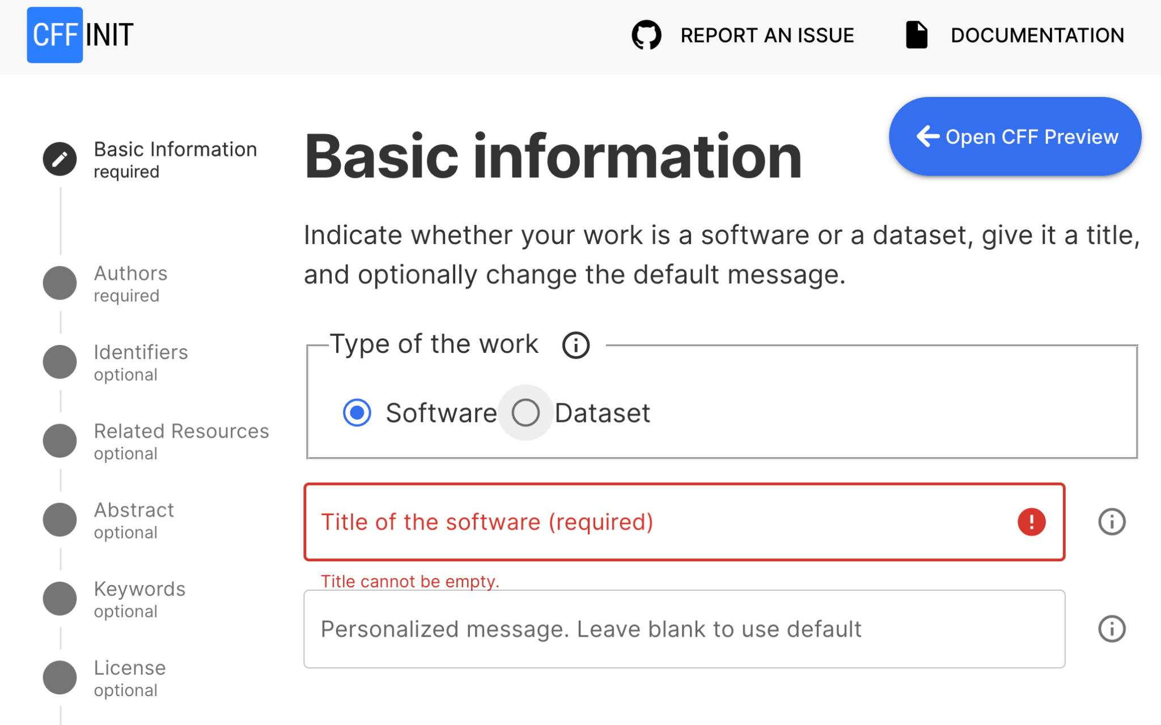
How to Create a CFF Doc
Use CFF INIT:
More information on CFF: https://citation-file-format.github.io/
A wizard for creating your own CFF file:
https://citation-file-format.github.io/cff-initializer-javascript/#/
Fill out, download and add to your repo
Notes:
You can hand edit a CFF file, but I use the CFF Init site to walk me thru the fields.

Slide 33
The Link Rot Problem
GitHub URLs are not citations. They break.
Timeline:
2020: Project starts → github.com/jt14den/software-demo
2022: Author changes username → github.com/timdennis/software-demo
2025: Repository archived → "404 Not Found"
Your citation is now dead. 💀

Slide 34
The Solution: Minting a DOI
DOI = Digital Object Identifier
Think of it as a QR Code for your software project.
✅ Never breaks (permanent redirect)
✅ Points to archived snapshot (Zenodo)
✅ Includes metadata (author, version, license)
✅ Citable in academic publications
Example: `https://doi.org/10.5281/zenodo.123456`
Even if GitHub disappears, your DOI still works.

Slide 35
Minting a DOI: The Workflow
Branch: 05-release
Step 1: Tag your release
git tag v0.1.0
git push --tags
Step 2: Create GitHub Release
Go to: Releases → Draft a new release
Select tag: v0.1.0
Add release notes
Step 3: Connect Zenodo
Link GitHub repo to Zenodo
Zenodo automatically mints DOI for each release
**Result:** Permanent, citable version of your software
Notes:
Add GithHub screenshot instead of git commands

Slide 36
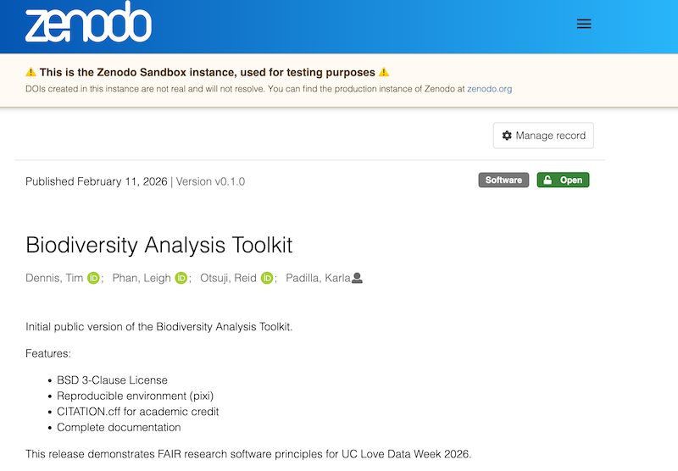
Steps to Mint DOI
Log in to Zenodo with GitHub
Enable your repository (toggle ON)
Create GitHub Release (tag v1.0.0)
Zenodo auto-archives and mints DOI
Add DOI badge to your README
Update your CFF file with your DOI
Now we have: LICENSE, environment, CITATION.cff, DOI.
But where do people look first? Your README.

Slide 37

Writing a README
Your README is your software's front door.
If users can't understand what it does, how to install it, or how to use it in
30 seconds → they leave.
The Fix:
A structured README makes your software:
Findable: Clear description aids discovery
Accessible: Easy installation removes barriers
Reusable: Usage examples enable adoption
UC OSPO Guide: https://ucospo.net/oss-resources/template-guides/readme-guide/
Notes:
First place end user people will look

Slide 38
README Structure (UC OSPO Template)
Essential sections to include:
About: What does this do? (2-3 sentences)
Features: Key capabilities (reproducible, citable, open source)
Getting Started: Prerequisites + installation
Usage: Minimal working example
Citation: Link to CITATION.cff or DOI
License: Explicitly state terms
Contact: How to get help
Don't reinvent the wheel: https://github.com/UC-OSPO-Network/templates/blob/main/README.md
Notes:
Create a repo , create a readme & add as much information you have at that point
Puta s much information as you can at each point during your project
Update Add information as you work on your project or make changes

Slide 39
README: Before vs. After
❌ Before (01-start)
✅ After (06-metadata)
# Biodiversity Analysis Toolkit
Analysis tools for biodiversity research.
## Features
- Reproducible (pixi) • Citable (DOI) • Open source (BSD-3)
## Getting Started
```bash
pixi install
pixi run python src/analysis.py
```
Citation
[zenodo.org/badge/DOI/10.5281/zenodo.123456.svg]
License
BDS - see LICENSE file
# Biodiversity Analysis Toolkit
A script.
No description. No instructions. No citation. Unusable.
Professional. Citable. Usable.

Slide 40
README Best Practices
5 Quick Tips:
1. Clear description → Answer "What problem does this solve?"
2. Show, don't tell → Include code examples
3. Link metadata → Add DOI badge, link CITATION.cff
4. Keep updated → Refresh when features change
5. Use the template* → https://github.com/UC-OSPO-Network/templates
Every tip maps to FAIR principles.

Slide 41
Beyond the README
GitHub looks for:
CONTRIBUTING.md → How to contribute
CODE_OF_CONDUCT.md → Behavioral standards
CHANGELOG.md → Version history
Why it matters:
Signals your project is professionally managed and welcoming.
Templates: https://github.com/UC-OSPO-Network/templates
Awesome README: https://github.com/matiassingers/awesome-readme/

Slide 42
Your FAIR4RS Checklist
What we covered today:
✅ F - Findable: Added DOI, CITATION.cff, rich metadata
✅ A - Accessible: Public GitHub, archived on Zenodo
✅ I - Interoperable: Standard formats (YAML, CFF), documented dependencies (pixi.toml)
✅ R - Reusable: LICENSE (BSD-3), README with setup, environment reproducibility

Slide 43
Resources
Lesson Materials:
🔗 https://github.com/carpentries-incubator/research-software-citable-discoverable
Tools:
CITATION.cff Helper: https://citation-file-format.github.io/cff-initializer-javascript/
Zenodo: https://zenodo.org
Pixi: https://pixi.sh
Choose a License: https://choosealicense.com
UC OSS-Chart: https://security.ucop.edu/files/documents/resources/oss-chart.pdf
UC OSPO License Guide: https://ucospo.net/oss-resources/template-guides/license-guide/
UC Open Source Program Office (OSPO) Network
🔗 https://ucospo.net/

Slide 44








Slide 45
Questions
Thank you!
Tim Dennis • tdennis@library.ucla.edu
Laura Langdon • lalangdon@ucdavis.edu
Karla Padilla • kpadilla@ucsd.edu
Leigh Phan • leighphan@library.ucla.edu
Reid Otsuji • rotsuji@ucsd.edu

