Slide 1

Facial Recognition with High Accuracy to create Attendance
Made by :Utkarsh Chauhan Bhoomica Gupta

Slide 2

WHAT IS FACE RECOGNITION ATTENDENCE SYSTEM??
A face recognition attendance system uses face recognition technology to identify and verify a person using the person's facial features and automatically mark attendance.

Slide 3

PROBLEMS DURING FACE RECOGNITION!!
Face recognition is really a series of several related problems:
First, look at a picture and find all the faces in it
Second, focus on each face and be able to understand that even if a face is turned in a weird direction or in bad lighting, it is still the same person.
Third, be able to pick out unique features of the face that you can use to tell it a part from other people— like how big the eyes are, how long the face is, etc.
Finally, compare the unique features of that face to all the people you already know to determine the person’s name.
As a human, our brain is wired to do all of this automatically and instantly. In fact, humans are too good at recognizing faces
Computers are not capable of this kind of high-level generalization, so we have to teach them how to do each step in this process separately.

Slide 4
Libraries Used
Python,
OpenFace and
dlib installed
Softwares Used
Pycharm
Visual Studio Code

Slide 5

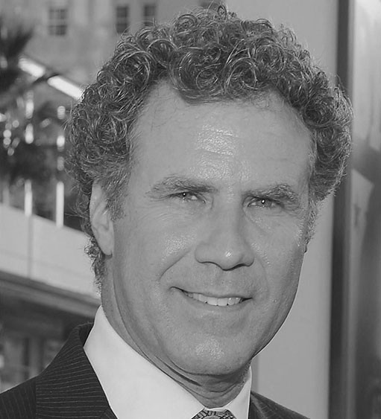
Face Recognition — Step by Step
Let’s tackle this problem one step at a time. For each step, we’ll learn about a different machine learning algorithm. I’m not going to explain every single algorithm completely to keep this from turning into a book, but you’ll learn the main ideas behind this project.
Step 1: Finding all the Faces :
The first step in our is face detection. We’re going to use a method called Histogram of Oriented Gradients HOG in short. To find faces in images we have to make it black and white because colors data are not required:
Then we’ll look at every single pixel in our image one at a time. Our goal is to figure out how dark the current pixel is compared to the pixels directly surrounding it. Then we want to draw an arrow showing in which direction the image is getting darker. By repeating this for every single pixel in the image, you end up with every pixel being replaced by an arrow.
To be continued…

Slide 6

To be continued…

Slide 7
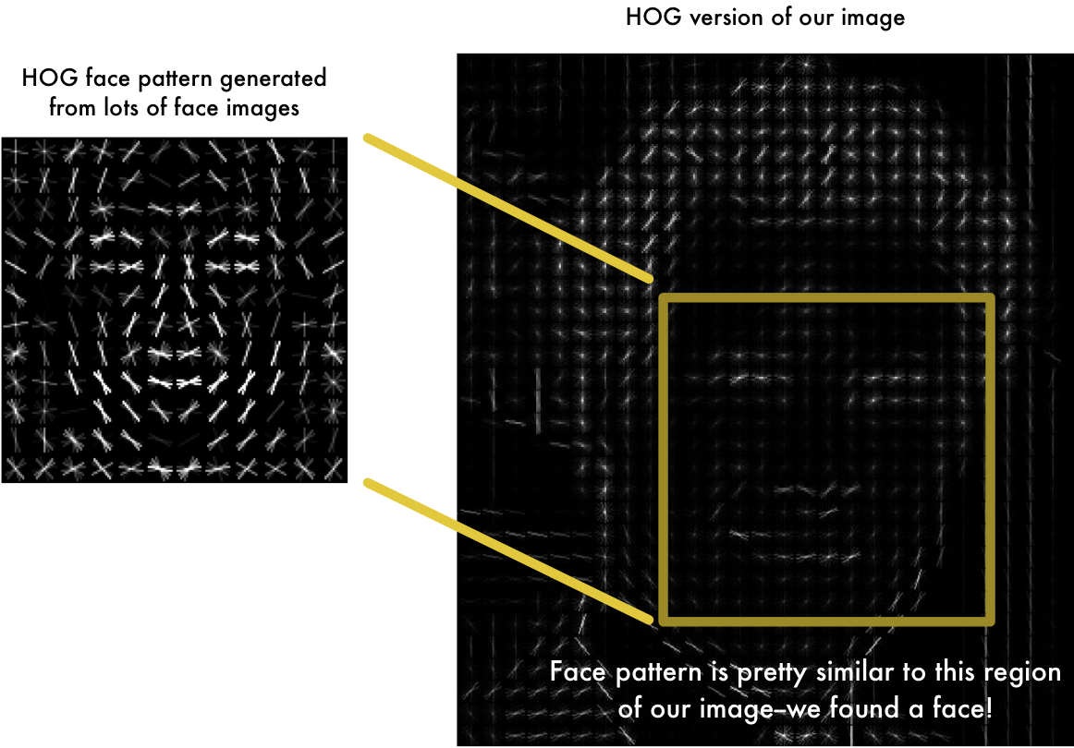
The end result is we turn the original image into a very simple representation that captures the basic structure of a face:

Slide 8
Step 2: Posing and Projecting Faces
We isolated the faces in our image. But now we have to deal with the problem that faces turned different directions look totally different to a computer.
To account for this, we will try to warp each picture so that the eyes and lips are always in the sample place in the image. This will make it a lot easier for us to compare faces in the next steps
To do this, we are going to use an algorithm called face landmark estimation.
The basic idea is we will come up with 68 specific points (called landmarks) that exist on every face — the top of the chin, the outside edge of each eye, the inner edge of each eyebrow, etc. Then we will train a machine learning algorithm to be able to find these 68 specific points on any face.
To be continued…

Slide 9
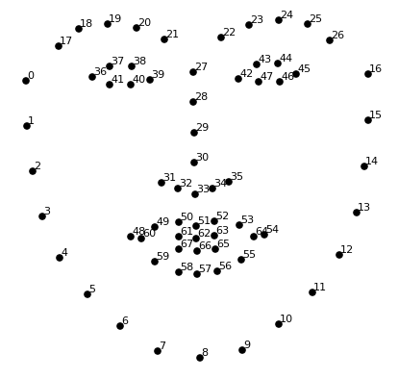
The 68 landmarks we will locate on every face.

Slide 10
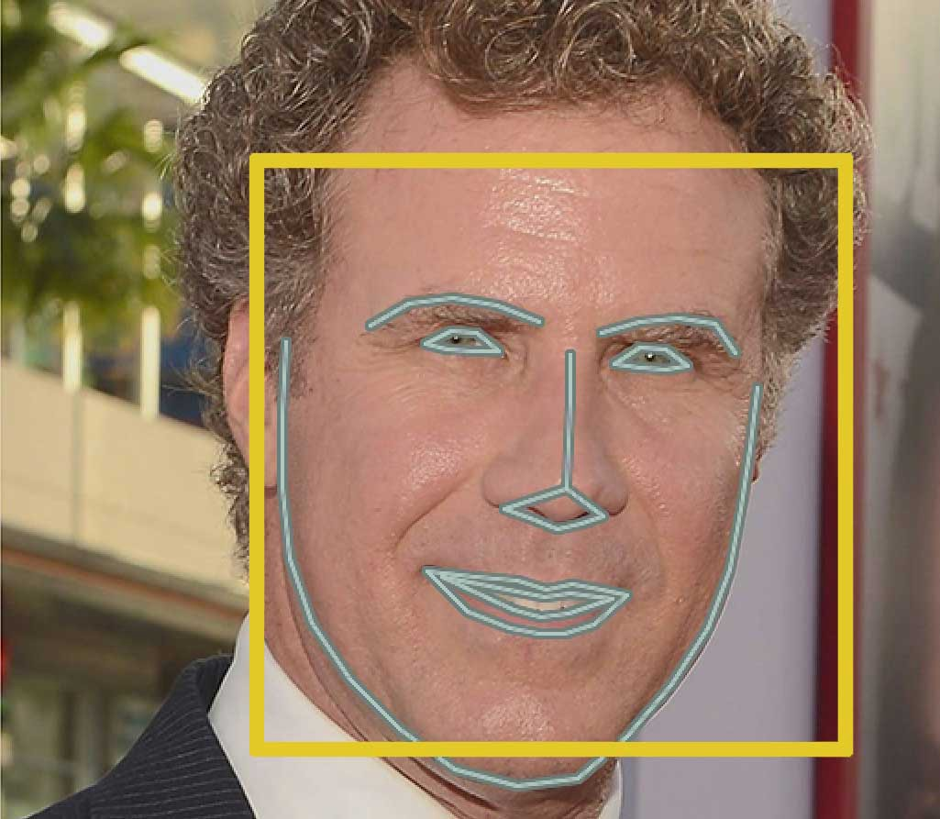
Here’s the result of locating 68 face landmarks on our test image.

Slide 11
Step 3: Encoding Faces
So the main problem arises here.
The simplest approach to face recognition is to directly compare the unknown face we found in Step 2 with all the pictures we have of people that have already been tagged. When we find a previously tagged face that looks very similar to our unknown face, it must be the same person.
There’s actually a huge problem with that approach. That would take way too long. They need to be able to recognize faces in milliseconds, not hours.
What we need is a way to extract a few basic measurements from each face. Then we could measure our unknown face the same way and find the known face with the closest measurements. For example, we might measure the size of each ear, the spacing between the eyes, the length of the nose, etc.
To be continued…

Slide 12
The solution is to train a Deep Convolutional Neural Network. But instead of training the network to recognize pictures objects like we did last time, we are going to train it to generate 128 measurements for each face.
The training process works by looking at 3 face images at a time:
Load a training face image of a known person
Load another picture of the same known person
Load a picture of a totally different person
After repeating this step millions of times for millions of images of thousands of different people, the neural network learns to reliably generate 128 measurements for each person. Any ten different pictures of the same person should give roughly the same measurements.
To be continued…

Slide 13
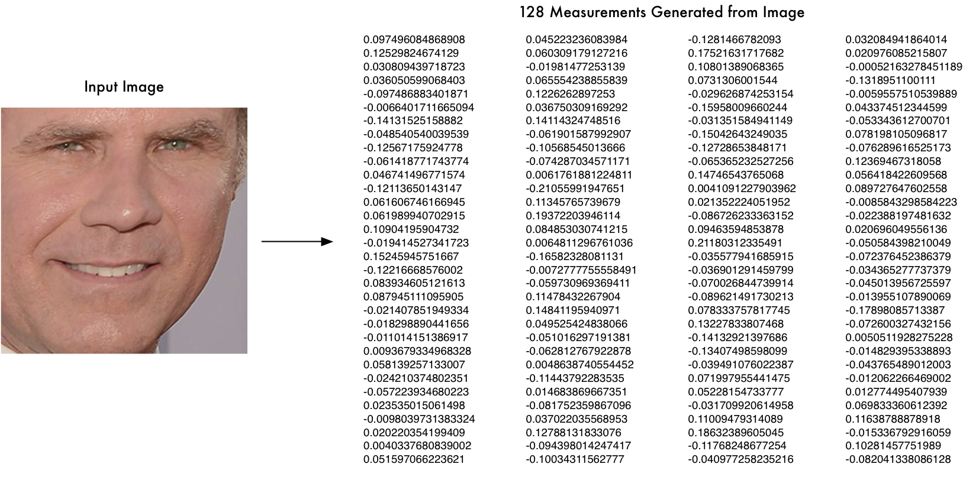
So all we need to do ourselves is run our face images through their pre-trained network to get the 128 measurements for each face. Here’s the measurements for our test image:

Slide 14
Step 4: Finding the person’s name from the encoding
This last step is actually the easiest step in the whole process. All we have to do is find the person in our database of known people who has the closest measurements to our test image.
You can do that by using any basic machine learning classification algorithm. We’ll use a simple linear SVM classifier.
All we need to do is train a classifier that can take in the measurements from a new test image and tells which known person is the closest match. Running this classifier takes milliseconds.

Slide 15
WHY WE NEED FACE RECOGNITION ATTENDENCE SYSTEM??
Automated time tracking system : A time and attendance system using facial recognition technology can accurately report attendance, absence, and overtime with an identification process that is fast as well as accurate.
Labor cost savings : Facial recognition software can accurately track time and attendance without human error. It keeps track of the exact number of hours an employee is working, which can help save the company money.
Tighter security : Facial biometric time tracking allows you to not only track employees but also add visitors to the system so they can be tracked throughout the worksite. Access can be denied to any person not in the system. If an incident should occur, facial recognition software can provide evidence for an investigation with a scanned image of a person or persons who have entered the area.
Time saving and reduced contagion : When contagious illnesses such as colds and viruses spread throughout the workforce, it can increase the incidence of employee absences and significantly reduce productivity. With facial recognition, employees can enter and leave the facility in considerably less time.
Ease of integration : Biometric facial recognition technology can be easily programmed into your time and attendance system.

