Slide 1

مشروع قاعدة بيانات الكلية الجامعية UCAS Database Project
إشراف المهندس / رامي رياض محمد لبد
إعداد الطلاب / وليد مرتجى – محمود الشيخ خليل – إياد العماوي

Slide 2

المحتويات
فكرة المشروع
DMBS
الوظائف
Relations
Entity Relationship Diagram (ERD)
Attachments
Schema (Logical Design)
Views
DDL Contents & DML & PL\SQL

Slide 3

فكرة المشروع
إنشاء قاعدة بيانات للكلية الجامعية، يتم من خلالها تخزين وارشفة بيانات و مكونات الكلية الجامعية وإدارة وتنظيم الشؤون الإدارية والدراسية وعمليات التسجيل وما يتعلق بها من إجراءات وبيانات .

Slide 4



DBMS
Oracle Database 11g Express Edition Release 11.2.0.2.0 - 64bit Production
PL/SQL Release 11.2.0.2.0 - Production
CORE 11.2.0.2.0 Production
TNS for 64-bit Windows: Version 11.2.0.2.0 - Production
NLSRTL Version 11.2.0.2.0 - Production

Slide 5

الوظائف
تسجيل وإضافة طلاب وموظفين وفرزهم حسب الأقسام والتخصصات وبياناتهم اللازمة.
إنشاء الأقسام الإدارية والدراسية والتخصصات.
إضافة القاعات الدراسية المتوفرة لدى الكلية بمختلف أنواعها ومكوناتها .
طرح الأقسام الدراسية لشعب مساقات دراسية.
لوحة تحكم خاصة بموظف قسم القبول التسجيل لتسجيل طالب جديد واضافة بياناته الاساسية وتسجيل مساقات للطالب او سحبها.

Slide 6

الوظائف
لوحة تحكم خاصة بالطالب يمكنه من خلالها تصفح المواد وتسجيلها او سحبها، واضافة وتحديث بياناته الثانوية وعرض البيانات الشخصية و الدراسية.
لوحة تحكم خاصة بالمدرس يمكنه من خلالها معرفة جدوله التدريسي والطلاب المسجلين في مساقاته وإدخال علامات الطلاب وعرض بياناته وتحديثها .

Slide 7

الوظائف
لوحة تحكم خاصة بمدير القسم يمكنه من خلالها إدارة قسمه والبيانات المتعلقة بالقسم.
لوحة تحكم خاصة بمدير قاعدة البيانات يمكنه من خلالها إدارة قاعدة البيانات ومتابعة العمليات التي تتم على قاعدة البيانات و منح الصلاحيات وعمل التعديلات والاضافات اللازمة.

Slide 8

Relations
Address
Nationality
Employee
Building
Floor
Room
Department
Majors_Department
Major
Course
Pre_Required_Courses
Teacher
Manager
Security
Secretary
Item
Room_Items
Study_Plan
Study_Plan_Courses
Student
Academic_Advice
Section
Enroll
Section_Rooms

Slide 9
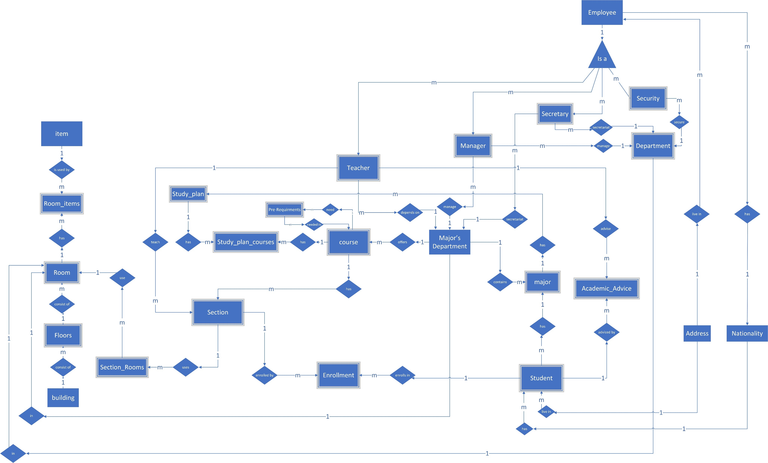

Slide 10

Attachments
Entity Relationship Diagram (ERD)
DDL.sql
All Thing about Project on Github :
Click here

Slide 11
Schema (logical design)
Address (Area name, City name, Block name, Street name)
Nationality (Nationality)
Employee (Employee id, Full Arabic name, Full English name, Nationality, National id, sex (M/F), Social status(S/M/D), Salary, Birth place, Date of birth, Religion, Health status, Number of family members, Phone, Telephone, Email, Area name, City name, Block name, Street name, Employment Date)
Building (Building code (one char), Building description)
Floor (Floor number (2Digits), Building code, Floor description)
Room (Room number, Floor number, Building code, Capacity (No. people))

Slide 12
Schema (logical design)
Department (Department id, Department name, Room number, Floor number, Building code)
Majors Department (Majors department id, Majors department name, Room number, Floor number, Building code)
Major (Major id, Major name, Majors department id)
Course (Course id, Course name, Credit (No of hours), Course level(semester), Description, Majors department id)
Pre-required courses (Course id, Pre-required course id (course id))
Teacher (teacher id (Employment id), Teaching start year, Teaching start semester (1/2/3), Teaching start date, Teaching end date, Majors department id, Salary)

Slide 13
Schema (logical design)
Manager (Manager id (Employment id), Managing start year, Managing start semester (1/2/3), Managing start date, Managing end date, Salary, Manager grade, Managed major's department id, Manager department id (accept one null))
Security (Security id (Employment id), Security start year, Security start semester (1/2/3), Security start date, Security end date, Salary, Department id)
Secretary (Secretary id (Employment id), Secretary start year, Secretary start semester (1/2/3), Secretary Start date, Secretary end date, Salary, Majors department id, Department id)
Item (Item id, Item name, Item description)
Room items (Item id, Room number, Floor number, Building code, Quantity)

Slide 14
Schema (logical design)
Study plan (Plan number, Major id)
Study plan courses (plan number, Major id, Course id, Year, Semester (1/2/3))
Student (Student id, Full Arabic name, Full English name, Nationality, National id, sex (M/F), Social status(S/M/D), Guardian name, Guardian national id, Guardian relation, Birth place, Date of birth, Religion, Health status, Mother name, Mother job, Mother job description, Father job, Father job description, Parents status(S/M/D), Number of family members family university students ,Social affairs , Phone , Telephone , Emergency phone , Email , Tawjihi GPA(%) , Tawjihi field(S/L) , Area name City name ,Block name ,Street name ,Major id ,Balance )

Slide 15
Schema (logical design)
Academic Advice (Teacher id, Year, Semester, Student id)
Section (Section number, Course id, Year, Semester(S/M/D), Teacher id)
Enroll (Student id, Course id, Section number, Year, Semester, Middle year grade (from 40), Final exam grade (from 60))
Section Rooms (Section number, Course id, Year, Semester, Day, Room number, Floor number, Building code, Start Time, End Time)

Slide 16
Views
قائمة المساقات المطروحة لفصل دراسي محدد
قائمة بالمساقات التي يستطيع الطالب تسجيلها في فصل محدد
الجدول التفصيلي الدراسي للطالب
جدول بقائمة المساقات المسجلة
الجدول التدريسي للمدرس
جدول محاضرات لكل قاعة

Slide 17
Views
جدول بأرقام وأسماء الطلاب في قسم او تخصص او مساق او شعبة
الخطة الدراسية لكل تخصص مقسمة حسب الفصول الدراسية
جدول محاضرات لكل تخصص
جدول بكشف درجات الطالب
جدول محاضرات لكل قسم

Slide 18
Sequences
رقم الطالب الجديد يقوم النظام بإنشائه عن طريق sequence تبدأ من 1 للطلاب أو 2 للطالبات ثم السنة الحالية ثم يبدأ بالزيادة بمقدار 1 رقم الطالب 9 ارقام : مثال : 120170001: 1 (الجنس ذكر 1 او انثى 2 ), 2017 (السنة الدراسية للتسجيل) ، 0001 (ارقام تزداد من 0001 بمقدار 1 لكل مرة).
رقم الموظف الجديد يقوم النظام بإنشائه عن طريق sequence يبدأ من 3 للموظفين أو للموظفات ثم يبدأ مقدار الزيادة بمقدار 1.
رقم المدرس 9 ارقام : مثال :320150001 : 1 (دائما 3 للتمييز انه مدرس) 2015 (سنة التسجيل اول مرة) 0001 (أرقام تزداد من 0001 بمقدار 1 لكل مرة).

Slide 19

DDL Contents
Tables
Log Tables
Triggers
Procedures
Sequences
Roles
Views

Slide 20
DDL Contents
Tables :
There are 24 tables (without the log ones) in this data base which contain all the data that we need to store as records (rows) those tables can describe the relation between the students , teachers , courses , and even more than another 15 object ..
Log Tables :
For each table from those 24 from there is a log table , which is used to save every manipulation(DML) happen in the table and who did that and what changes , so the log table keep a record about who did what in which record and when ..

Slide 21
DDL Contents
Triggers :
For each log table there is a three triggers so in simple calculation there are 72 trigger in our data base , the trigger goal is to auto save a record about the manipulations from the origin tables in the log tables , those three triggers are responsible for saving every insert , update , delete operation ,who (which user) & when in the log tables ..

Slide 22
DDL Contents
Procedures :
Because of there is a a lot of users in data base and for each student, employee there should be a user we made a procedure to insert into the (student , employee) tables that give every one a unique username that got the ability to see and edit his/her own information and its using the pl\sql also to run the sequences as their normal job , so there is no need to enter an id for every insertion operation in the student's or employees tables .

Slide 23
DDL Contents
Sequences :
There is a 3 sequences in this database our goal from them is to auto make the id's for every student (male of female) and every employee the male students sequence starts every year from 1(year)0001 to 1(year)9999 so in every year just around 10 thousand of male student's can register in the database of university but if you need more you just have to adding 0 after the year in that sequence to keep ability to regist more that that number , its autom increment number is 1 to make it easy for every one to know how many student reigisted in the university ..

Slide 24
DDL Contents
Roles :
Because we can't give the ability for each student to remove - drop - delete any thing in the data base we gave every one role that he can't overrun any thing except his normal abilities as selection from his table or from his courses table so we prevented him from editing a record in another tables as a security in the database .
Views :
There are some views we made for the most queries requested in the data base , and for makeing the proccess more easy and much security .

Slide 25

DML
there is already some ready records in the data base which is used to check that every thing is working well in the data base and its also in the same file , you can just delete them or don't copy them if you don't need them in your database or just keep them ..
#Ps.Those records based on a real-world examples in our university.

Slide 26

PL\SQL
In the triggers & the procedures there is pl\sql language we used it in our project.
As a last word we want to give all the thanks for our god then for our teachers for learning us like these skills in the first subject in our database.

Slide 27
Users

Slide 28
Jobs

