Slide 1
Warm-up
5:00-5:10
Make a new R script
Save it to your computer and name it “week2_warmup”
Add a comment with the title of the script, the date, and your name
Create three different vectors, each with 5 items
Vector called “pid” with 5 participant id numbers
Vector called “ages” with 5 ages of participants
Vector called “condition” with the condition of each participant, either cond1, cond2, or control.
Make the condition vector into a factor
Run length(pid). What does it tell you?
Extra time? Download this week’s materials from the course site!

Slide 2

Week 2: Directories and Data
Sierra & Maria
9/5/2023

Slide 3
Today’s agenda
Warm-up
Check-in + any questions about the program?
Go over warm-up + data frames (!)
Working directories & setting up your project folder
Reading in data
Viewing and summarizing data
Notes:
Willa

Slide 4
Week 2: Record!
Let’s review the warm-up

Slide 5
What is a “working directory”?
The current file path that R is using and where it will “look” for files
R will assume you want to read in or write out files using this folder
You can think of file paths as addresses
Each file has one!
Our files are in a nested structure
For more info see YaRR: A Pirate’s Guide to R chapter
Notes:
If a file is outside of your working directory, R won’t know how to handle this unless you specify how to
It’s easiest to keep all relevant files IN your working directory
There are other advantages to this structure

Slide 6
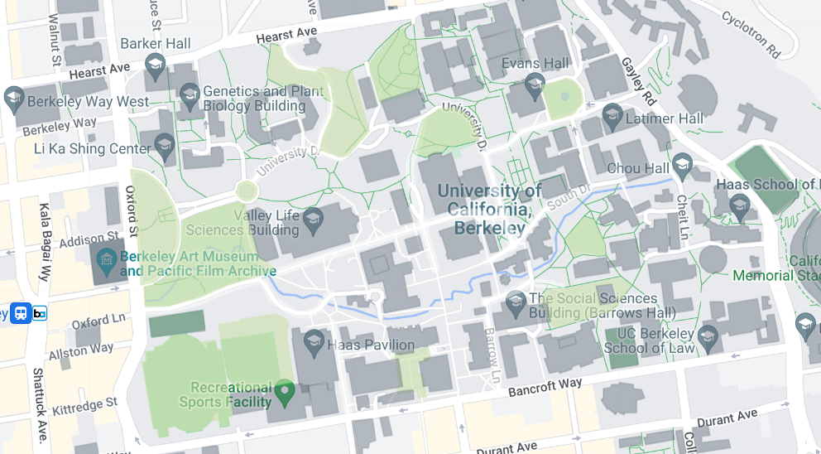
For instance….
Let’s say you have a class! But where are you going? Where is it being held?
File path: “Berkeley/…”
Thank you Emily Rosenthal for these slides!

Slide 7
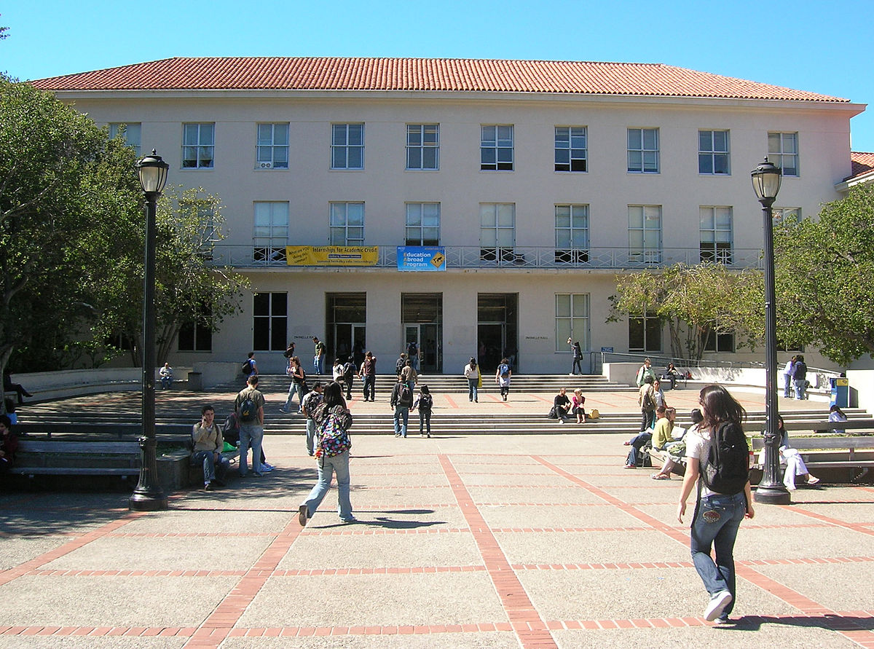
It’s in Dwinelle Hall
File path: “Berkeley/Dwinelle/…”

Slide 8
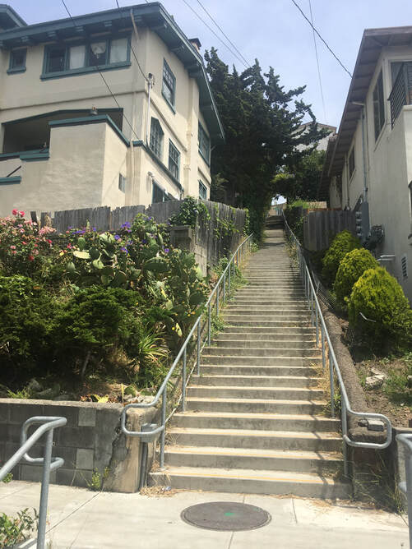
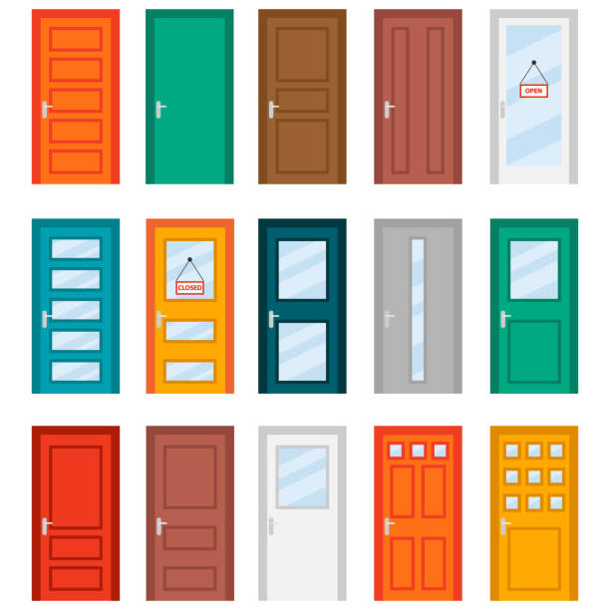
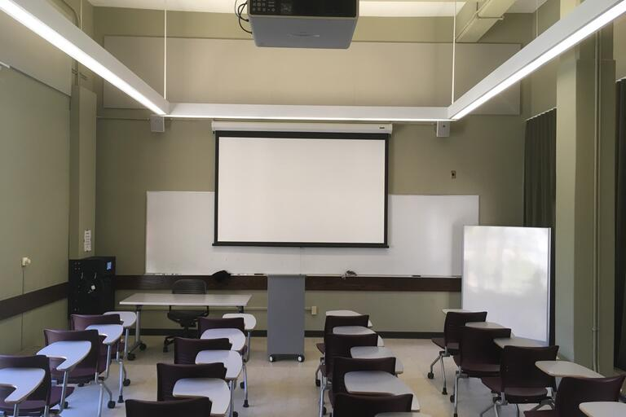
It’s in the basement!
In room 75!
71 72 73 74 75
76 77 78 79 80
File path: “Berkeley/Dwinelle/Basement/Room75”

Slide 9

These have a NESTED STRUCTURE
UC Berkeley
Campus
Building
Floor
Room
Building 1
(e.g., Dwinelle)
Building 2
(e.g., BWW)
Basement
Floor 1
Floor 2
Floor 1
Floor 2
Floor 3
71
72
73
….
1201
1202
….
Notes:
Can imagine trying to find key or hidden treasure, in room 71, cabinet, in this box etc. can keep making things more and more specific etc (when make mapping to folder structure, could make unlimited folders).
Not enough to give file name, room 73 meaningful in dwinelle, not at UC Berkeley level
Different people have different file structures, if someone is taking the same class and they are at UCLA, and you tell them it is in room 75 of Dwinelle hall, they won’t be able to find it, because it’s located somewhere else for them

Slide 10
These have a NESTED STRUCTURE
UC Berkeley
Campus
Building
Building 1
(e.g., Dwinelle)
Building 2
(e.g., BWW)
Basement
Floor 1
Floor 2
Floor 1
Floor 2
Floor 3
71
72
73
….
1201
1202
….
Notes:
Can imagine trying to find key or hidden treasure, in room 71, cabinet, in this box etc. can keep making things more and more specific etc (when make mapping to folder structure, could make unlimited folders).
Not enough to give file name, room 73 meaningful in dwinelle, not at UC Berkeley level
Different people have different file structures, if someone is taking the same class and they are at UCLA, and you tell them it is in room 75 of Dwinelle hall, they won’t be able to find it, because it’s located somewhere else for them

Slide 11
These have a NESTED STRUCTURE
UC Berkeley
Campus
Building
Floor
Room
Building 1
(e.g., Dwinelle)
Building 2
(e.g., BWW)
Basement
Floor 1
Floor 2
Floor 1
Floor 2
Floor 3
71
72
73
….
1201
1202
….
Notes:
Can imagine trying to find key or hidden treasure, in room 71, cabinet, in this box etc. can keep making things more and more specific etc (when make mapping to folder structure, could make unlimited folders).
Not enough to give file name, room 73 meaningful in dwinelle, not at UC Berkeley level
Different people have different file structures, if someone is taking the same class and they are at UCLA, and you tell them it is in room 75 of Dwinelle hall, they won’t be able to find it, because it’s located somewhere else for them

Slide 12
These have a NESTED STRUCTURE
UC Berkeley
Campus
Building
Floor
Room
Building 1
(e.g., Dwinelle)
Building 2
(e.g., BWW)
Floor 2
Floor 3
Basement
Floor 1
Floor 1
Floor 2
Floor 3
73
74
75
….
1201
1202
….
Notes:
Can imagine trying to find key or hidden treasure, in room 71, cabinet, in this box etc. can keep making things more and more specific etc (when make mapping to folder structure, could make unlimited folders).
Not enough to give file name, room 73 is only meaningful information when Dwinelle Hall is specified, not at UC Berkeley level
Different people have different file structures, if someone is taking the same class and they are at UCLA, and you tell them it is in room 75 of Dwinelle Hall, they won’t be able to find it, because it’s located somewhere else for them

Slide 13
Working directory and loading data
Organization is up to you -- ask around for how people organize their data and files
We have some suggestions, too!
Keep this structure in mind when loading your data!
R has to know specifically where to look for the data file (its address), or it won’t be able to read it in
Notes:
Important to know where you are loading data relative to where your script is, where R thinks where you are.
Need to tell R where to look. That’s what working directory is where R assumes you want to load your data, output any new files.
More specifically, R will tell you that the file doesn’t exist. You know that the file DOES exist, but since it isn’t in the exact place that R expected to find it, it basically doesn’t.

Slide 14
Most common errors when loading data
Wrong file path (i.e., wrong working directory so R is looking in the wrong place and cannot find the file)
Forgot to put quotes around the name of the file and/or file path! read.csv(“penguins.csv”)
Other tips:
Don’t use spaces in your file names or folder names!
Notes:
We mentioned not using spaces last week - this will save you from headaches in the future, so get into the practice now :)

Slide 15
Our file organization for QuACK
[folder] quack2023
[sub-folder] data
[sub-folder] week1
[sub-folder] week2
[sub-folder] week3
[sub-folder(s)] …

Slide 16
Our file organization for QuACK
Both of the data files that we are using for the semester will go in here!
quack2023
data
week1
week2
week3
…

Slide 17
Our file organization for QuACK
quack2023
data
week1
week2
week3
…
Each week has its own folder

Slide 18
Our file organization for QuACK
quack2023
data
week1
week2
week2_warmup.R
week2_starter.R
week2_practice.pdf
week2_key.R
week3
…

Slide 19
Our file organization for QuACK
quack2023
data
week1
week2
week2_warmup.R
week2_starter.R
week2_practice.pdf
week2_key.R
week3
…
Download the materials for this week from the course site and put all your files for QuACK in this structure!
Remember to unzip the folders each week
Be sure to store the penguins.csv and covid_attitudes.csv in the data folder
Notes:
Take a few minutes to organize your file structure like this and get more snacks

