Slide 1

Check in questions:
How have your first few weeks been?
Do you think ketchup is a smoothie?

Slide 2


Warm-up
5:00-5:10
1.
Make a new R script
a. b.
Save it to your computer and name it “week2_warmup” Add a comment with the title of the script, the date, and your name
2.
Create three diﬀerent vectors, each with 5 items
a. b. c.
Vector called “pid” with 5 participant id numbers Vector called “ages” with 5 ages of participants Vector called “condition” with the condition of each participant, either cond1, cond2, or control.
3. 4.
Make the condition vector into a factor Run length(pid). What does it tell you?
Extra time? Download this week’s materials from the course site!
1

Slide 3




Week 2: Directories and Data
Sophie & Lou 9/16/2024
2

Slide 4


Today’s agenda
1.Warm-up
2.Check-in + any questions about the program?
3.Go over warm-up + data frames (!)
4.Working directories & setting up your project folder
5.
Reading in data
6.Viewing and summarizing data
3

Slide 5

What is a “working directory”?
●
The current ﬁle path that R is using and where it will “look” for ﬁles
○R will assume you want to read in or write out ﬁles using this
folder
You can think of ﬁle paths as addresses
●
○
Each ﬁle has one!
Our ﬁles are in a nested structure
●
For more info see YaRR: A
Pirate’s Guide to R chapter
5

Slide 6

For instance….
●
Let’s say you have a class! But where are you going? Where is it being held? File path: “Berkeley/…”
●
Thank you Emily Rosenthal for these slides!
6

Slide 7



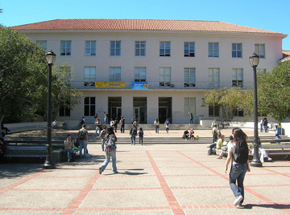

It’s in Dwinelle Hall
●
File path: “Berkeley/Dwinelle/…”
7

Slide 8


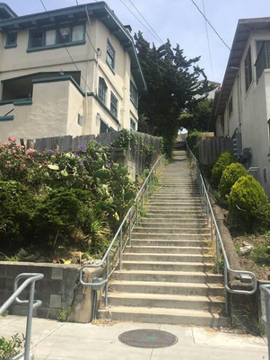





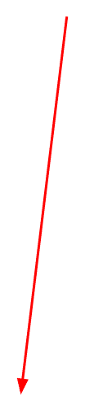
It’s in the basement!
In room 75!
71
72
73
74
75
76
77
78
79
80
●
File path: “Berkeley/Dwinelle/Basement/Room75”
8

Slide 9
Example: Users/SophieRegan/Documents/Experiments/BrillaintStudy/Data

Slide 10
Working directory and loading data
●
Organization is up to you -- ask around for how people organize their data and ﬁles
○We have some suggestions, too!
Keep this structure in mind when loading your data!
R has to know speciﬁcally where to look for the data ﬁle (its address), or it won’t be able to read it in
● ●
13

Slide 11
Most common errors when loading data
●
Wrong ﬁle path (i.e., wrong working directory so R is looking in the wrong place and cannot ﬁnd the ﬁle)
Forgot to put quotes around the name of the ﬁle and/or ﬁle path!
read.csv(“penguins.csv”)
●
Other tips:
●Don’t use spaces in your ﬁle names or folder names!
14

Slide 12
What now?

Slide 13
Commands to Inspect the Data
1. head() - Displays the first 6 rows of your data. - Example: head(data)
1
2. tail() - Shows the last 6 rows of your data. - Example: tail(data)
2
3. dim() - Returns the dimensions of the dataset. - Example: dim(data)
3

Slide 14
Summary and Structure of Data
1. str() - Displays the structure of your dataset. - Example: str(data)
2. summary() - Provides summary statistics for each column. - Example: summary(data)
3. names() - Lists all column names in the dataset. - Example: names(data)

Slide 15
Checking for Missing or NA Values
1. is.na() - Identifies missing values in the dataset. - Example: is.na(data)
2. sum(is.na()) - Summarizes the total number of missing values. - Example: sum(is.na(data))
3. complete.cases() - Finds rows without missing values. - Example: complete.cases(data)

Slide 16

Initial Visualization
1. plot() - Basic plots of data. - Example: plot(data$variable1, data$variable2)
2. hist() - Histogram of a specific variable. - Example: hist(data$variable)
3. boxplot() - Boxplot to visualize the distribution of data. - Example: boxplot(data$variable)

Slide 17
Common Data Types in R
1. Numeric - Example: x <- 10.5 - Double precision numbers.
2. Integer - Example: y <- as.integer(5) - Whole numbers.
3. Character - Example: name <- "John" - Strings of text.
4. Logical - Example: flag <- TRUE - Boolean values (TRUE/FALSE).
5. Factor - Example: factor_var <- factor(c("Male", "Female")) - Categorical data.

Slide 18
Complex Data Types in R
1. Vectors - Example: c(1, 2, 3, 4) - Homogeneous data.
2. Lists - Example: list(name = "John", age = 25) - Heterogeneous data.
3. Data Frames - Example: data.frame() - Similar to tables (rows and columns).
4. Matrices - Example: matrix(1:9, nrow = 3) - 2D homogeneous arrays.

Slide 19
Comparison of Data Types
Data Type | R | Python | JavaScript
Numeric | Numeric (double) | int, float | Numbers (double)
Character | Character | String | String
Logical/Boolean | Logical | Boolean | Boolean
Factor | Factor | N/A | N/A
Data Frame/Array | Data Frame | Pandas DataFrame | Arrays/Objects

