Slide 1

Welcome to QuACK!
Week 5
10/06/2025
Nina, Sophie, Alyson, and Victoria

Slide 2
Today’s Agenda: Plotting (cont.)
Warm-up activity
Themes
Color/Fill Brewer
Demo: data visualization + bootstrapping

Slide 3
Week 3 Warm-up – 10 minutes
Download this week’s materials from this link: https://tinyurl.com/quack-fall2025
Open the practice PDF from last week (session 4)
If you did the practice exercises during last week’s session, refresh your memory on what you did and what the answers were
If you didn’t get a chance last week, try the practice exercises now!

Slide 4
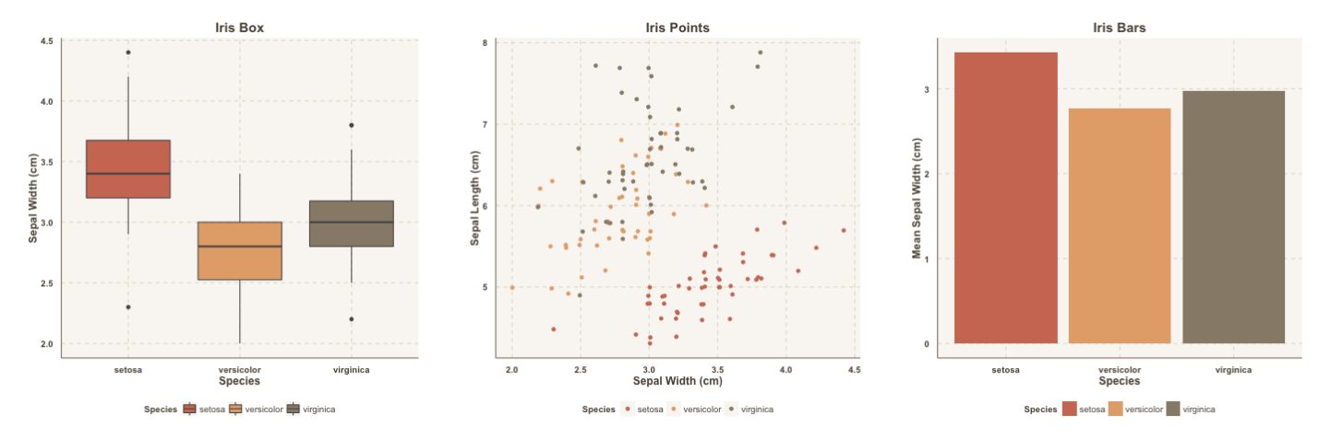
Exploring Themes
Many built-in ggplot themes (see here: https://r-graph-gallery.com/192-ggplot-themes.html)
Additional themes here: https://github.com/Mikata-Project/ggthemr#palettes

Slide 5
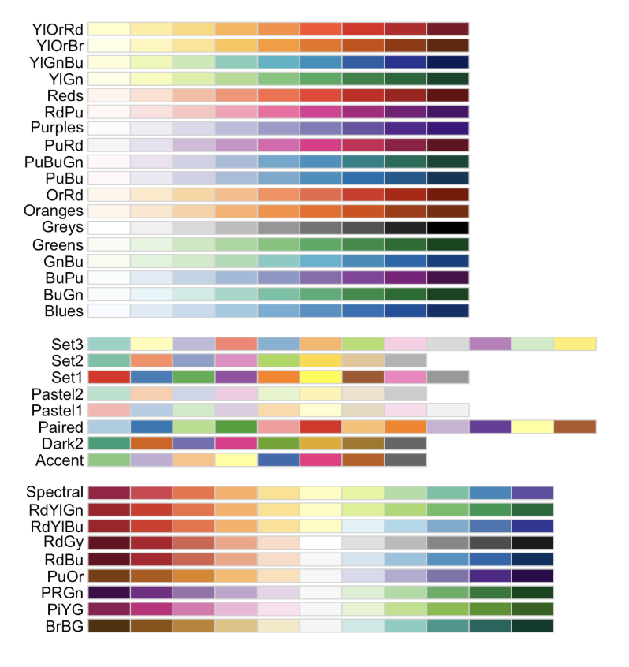
Exploring Color Palettes
Some options:
Scale color/fill brewer
Scale Color Brewer
Palletteer
Color Palette Finder

Slide 6
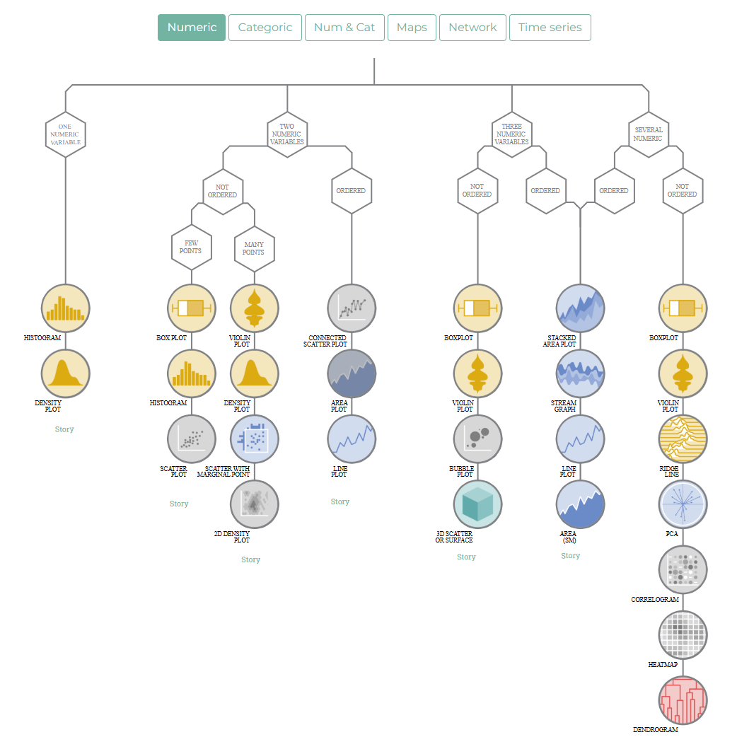
A helpful dataviz resource: https://www.data-to-viz.com/

Slide 7
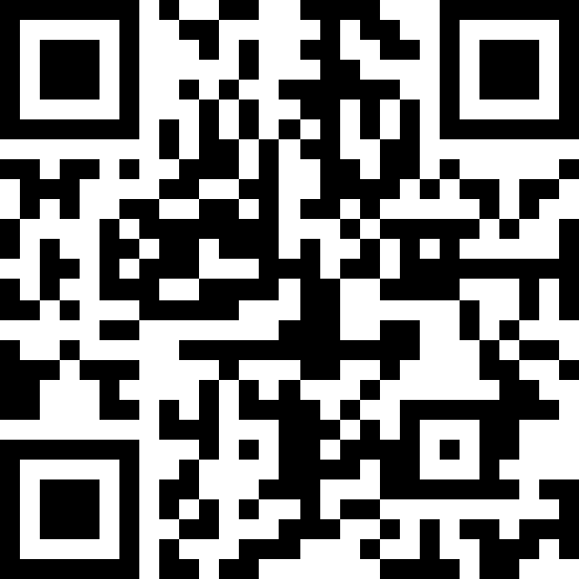
Time to get started in R!
Go to https://tinyurl.com/quack-fall2025
Download and unzip the course materials
You will see many files:
Two R Markdown (.rmd) files
A .csv file
Two PDF files – slides and a practice doc
Some other folders – ignore these for now
Open the R Markdown file marked “starter_code” – this is where we will code together for the first part of the session
The .csv file contains the data we will be working with
The practice PDF contains practice exercises for you to do during the second part of the session

Slide 8
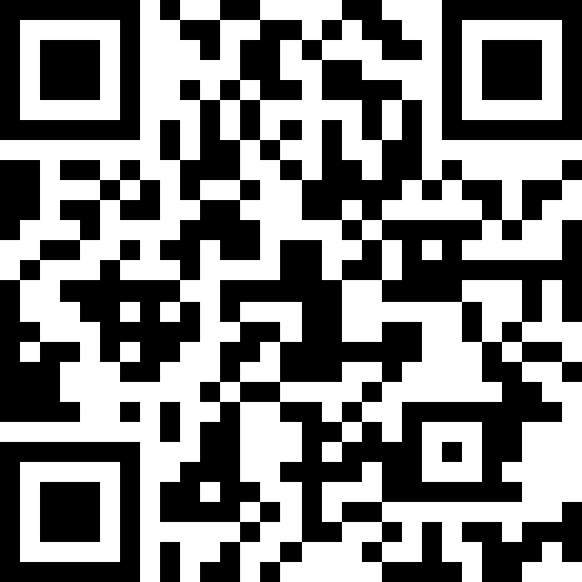
Exit Ticket
Link: https://tinyurl.com/quack-fall2025-exit-survey

