Slide 1

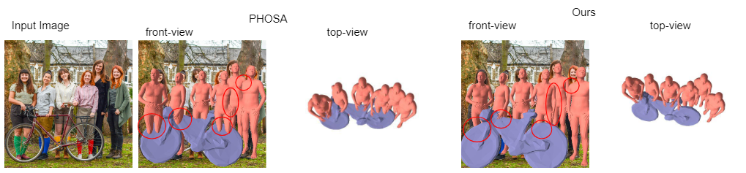
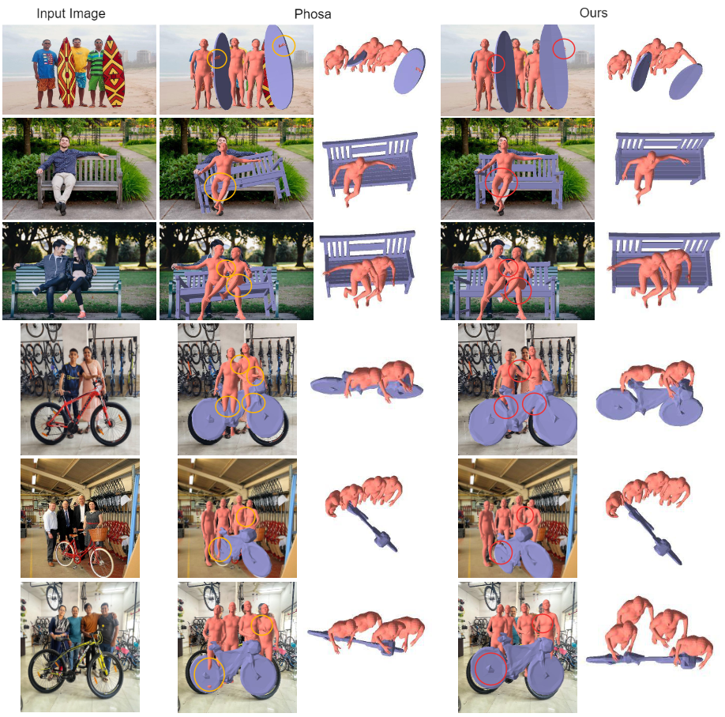
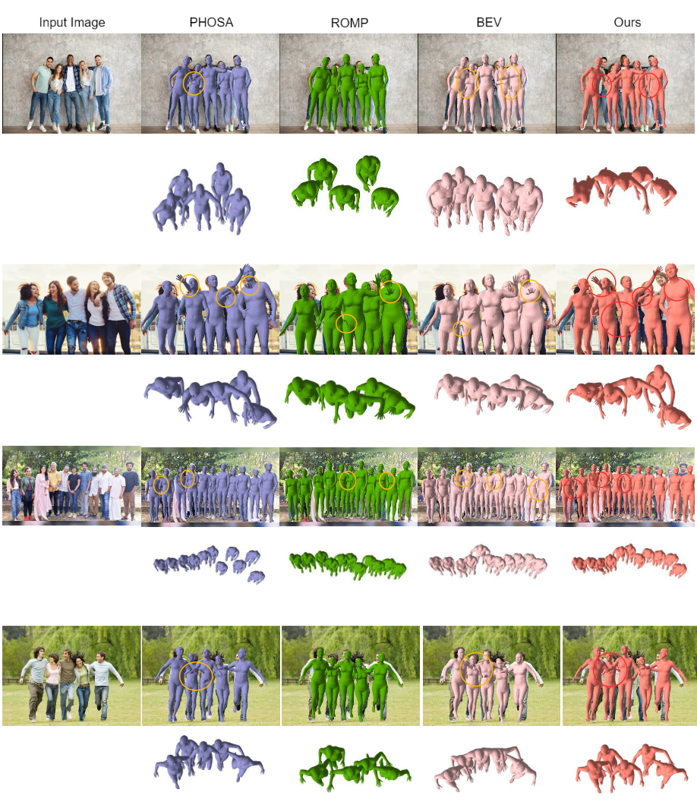
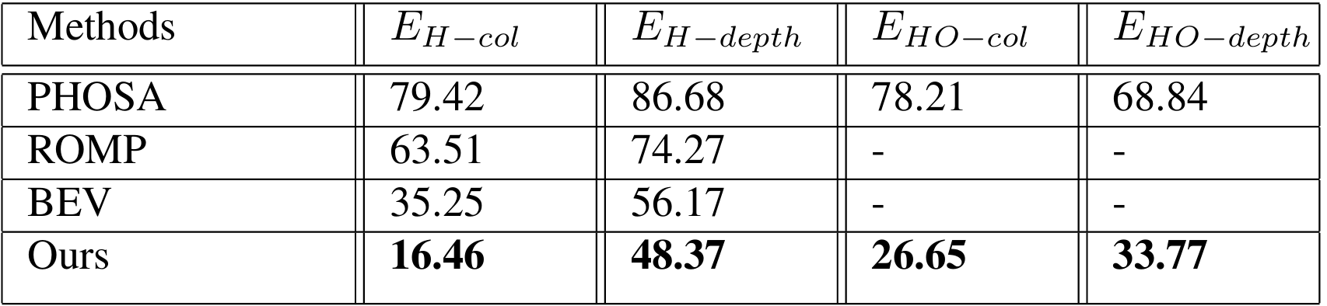
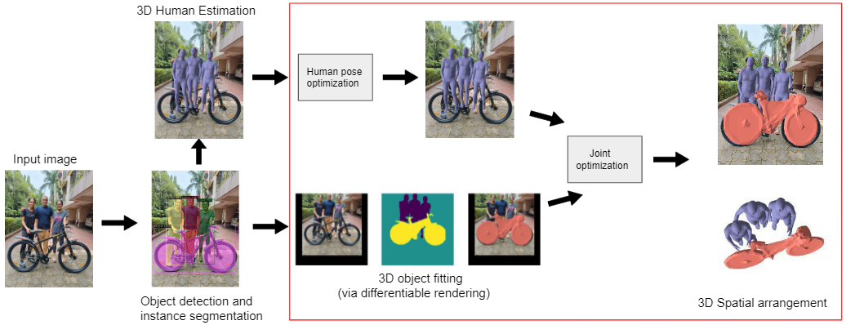
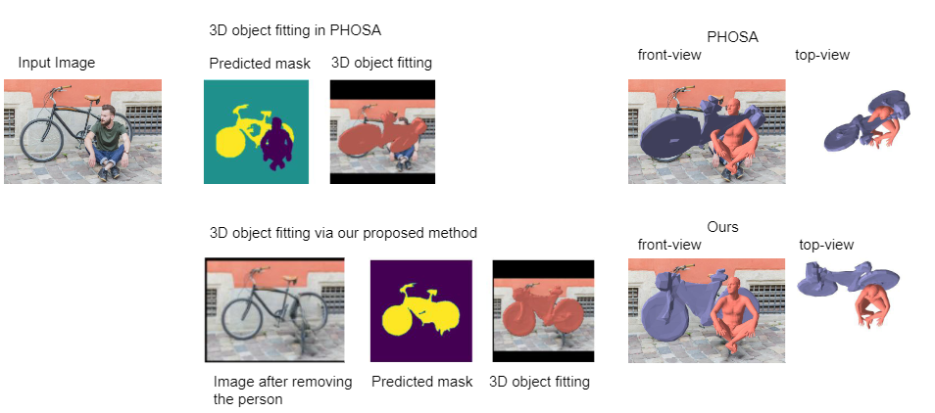
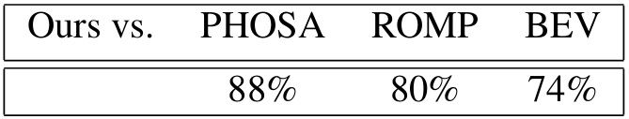
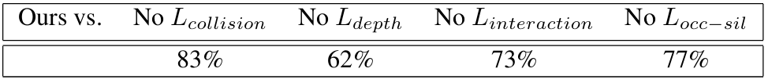
Single Image Coherent Reconstruction of Objects and Humans
Sarthak Batra¹, Simon Hadfield¹, Partha P. Chakrabarti², Armin Mustafa¹
¹University of Surrey, ²Indian Institute of Technology Kharagpur
Introduction
Qualitative Results
Comparison of the proposed method (right) reconstruction with PHOSA(middle). The proposed method gives a more coherent reconstruction with correct spatial arrangement by reasoning about human-human and human-object interaction
This paper presents a method for achieving globally consistent 3D reconstruction of interacting objects and humans from a single image. The main contributions are:
Optimization Framework: Includes a collision loss to handle interactions between humans and objects, and between multiple humans, ensuring spatially coherent scene reconstruction.
Robust Pose Estimation: Introduces a technique to estimate 6 degrees of freedom (DOF) poses for heavily occluded objects using image inpainting.
The method effectively processes images from real-world scenarios without needing scene or object-level 3D supervision. Extensive evaluations show that the proposed approach significantly reduces collisions and improves the coherence of reconstructed scenes compared to existing methods.
Quantitative Results
Method
Overview of Methodology
Inpainting based 3D Object Pose Estimation
User study that gives the average percentage of images for which our method performs better on COCO-2017. 50% implies equal performance.
In the ablation study we drop loss terms from our proposed method. The higher the percentage, the more the effect of the loss term.
Discussion
The proposed method takes a single RGB image as input and gives a spatially coherent reconstruction of interacting humans and objects in the scene
Current approaches for reconstructing humans/ objects from a single image often produce reconstructions that contain various ambiguities, especially in situations involving multiple interactions between humans and between humans and objects. In this paper, we perform holistic 3D scene perception by exploiting the information from both human-human and human-object interactions in an optimization framework. The optimization makes use of several constraints to provide a full scene that is globally consistent, and reduces collisions, and improves spatial arrangement over other methods. The proposed human optimization framework resolves ambiguities between reconstructed people, and the proposed human-object optimization framework addresses ambiguities between humans and objects. We further introduce a method that significantly improves the pose estimation of heavily occluded objects.
First, objects and humans are detected followed by SMPL-based per-person reconstruction which gives incorrect spatial reconstructions with collisions between meshes
The human 3D locations/poses are translated into world coordinates and refined through a human-human spatial arrangement optimization using a collision loss, Depth-ordering loss and an Interaction loss.
To correctly estimate the 3D object pose (6-DoF translation and orientation) a differentiable renderer is used that fits 3D mesh object models to the predicted 2D segmentation masks
Limitations and Future Work
We correct the occluded object mask using image inpainting unlike PHOSA which uses an occluded object mask.
Lastly, we perform joint optimization that takes into account both human-human and human-object interactions for a globally consistent output
When compared to learning-based techniques, our method demands increased processing time for reconstruction generation and may occasionally yield a slightly inaccurate spatial configuration to mitigate collisions. In terms of future directions, our current implementation only considers coarse interactions among humans. However, in subsequent iterations, we aim to incorporate fine-grained interactions, leveraging this information to refine our estimation of human pose.
Our framework produces plausible reconstructions that capture realistic human-human and human-object interactions

