Slide 1
What is data visualization?

Slide 2
What is data visualization?
The visual representation of data.
Abstracted into a visual form – numbers made into a thing to represent those numbers.
Wait, “Abstraction”?
Computer science term meaning representing the concept while hiding away the implementation details.

Slide 3
What is data visualization?
Data visualization can be a simple representation, or a complex one.
Can represent scale, space, time, amount. It’s comparative, relies on context.
It’s meant to create a deeper understanding of a subject.
It can be silly, or deadly serious, and anywhere between.

Slide 4
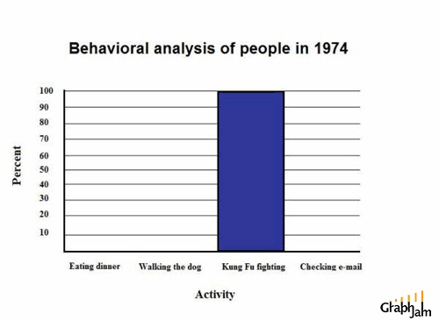
Those cats were fast as lightning.
This is funny, but in reality a terrible data visualization.

Slide 5
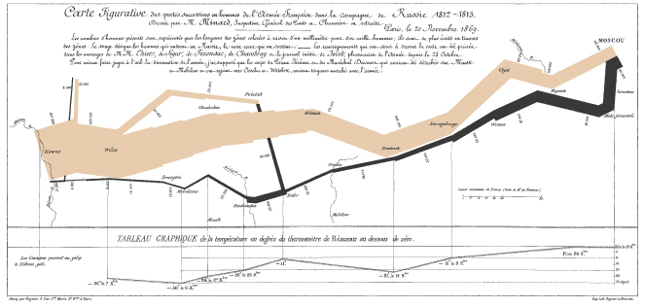
The greatest graphic ever made.
It’s rare you can describe a chart as eloquent. Aspire to it.

Slide 6
What is data visualization?
From Tufte, data visualization …
Shows the data
Induces the viewer to think about the substance rather than methodology.
Avoids distorting the data and what it says.
Presents lots of data in small space.
Makes large datasets coherent.
Encourages comparison.
Reveals several levels of detail.
Serves a clear purpose: Description, exploration, tabulation.

Slide 7
What is data visualization?
Data visualization is journalism. It’s storytelling.
It has the same structure as a story.
It has the same rules as journalism.
It just uses visual cues and the mechanics of your brain to tell that story.
Don’t believe me?

Slide 8
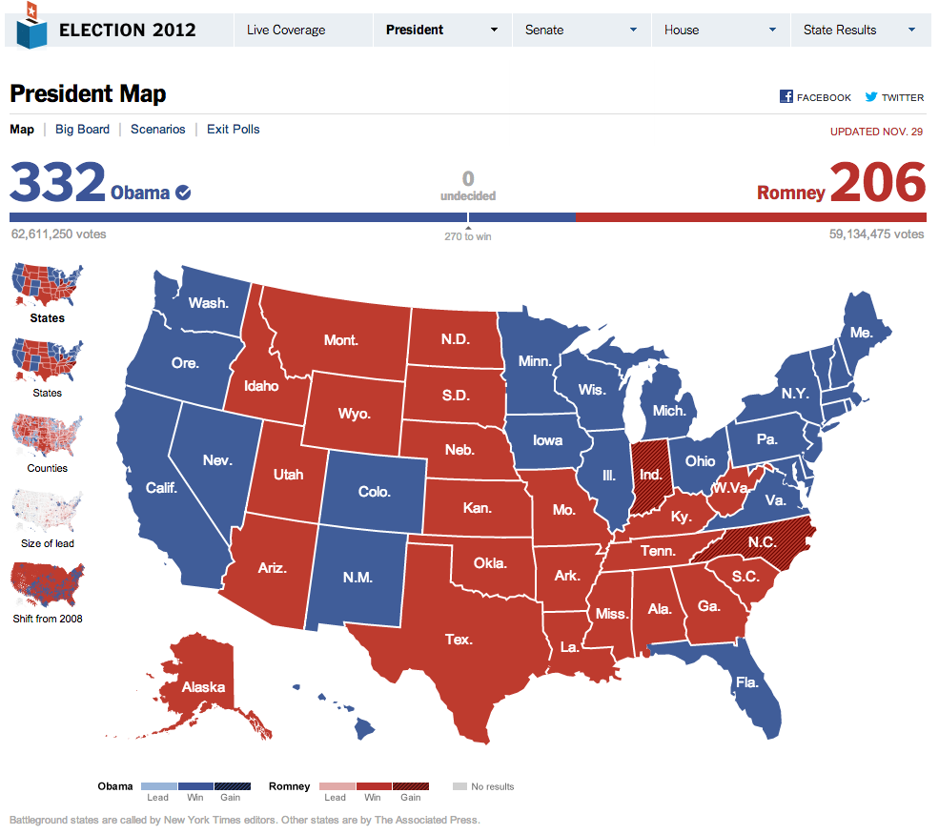

Slide 9
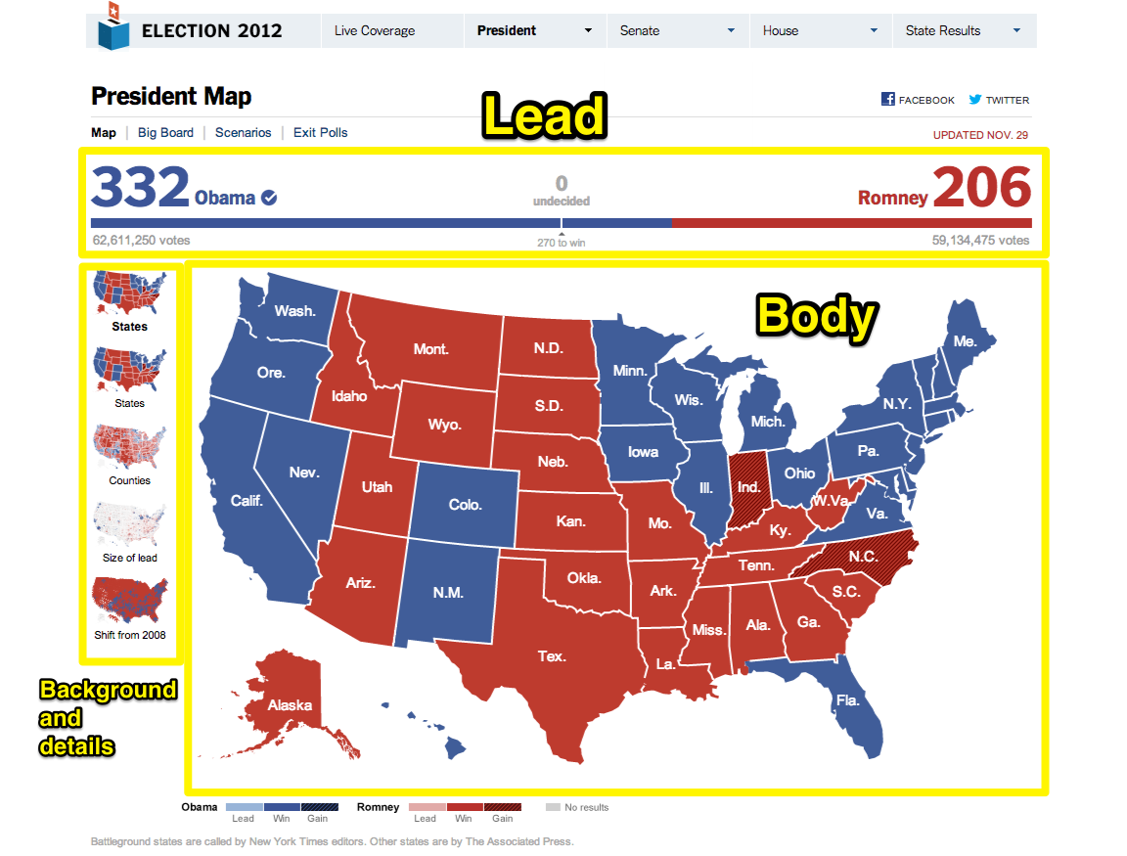

Slide 10
Graphical excellence explained

Slide 11
Graphical Excellence explained
Show the data
Induce the viewer to think about substance over method
Avoid Distortion
Present many number in a small space – information density
Make large datasets coherent
Encourage the eye to compare things
Reveal data at multiple levels
Serve a clear purpose

Slide 12
Graphical excellence explained
Graphics reveal data.
Graphics efficiently communicate complex quantitative ideas.
Tufte lists these graphical designs
Data maps
Time-series
Space-time narrative
Relational graphics

Slide 13
Data maps
“Maps repay careful study,” Tufte writes.
But they do have flaws – they equate importance with geographic area instead of some kind of weight.
This.
Vs. This.
John Snow and a map vs. cholera.

Slide 14
Time series
The most frequent form of graphical visualization.
The trend line.
Time vs. quantity
Best for large data with real variability – a simple linear chart is boring.

Slide 15
Space-time narratives
Take time series, add geography.
The data moves over space and time.
This.

Slide 16
Relational graphics
A silly example.
Two or more variables, inviting comparison between them.
The Scatterplot.
Invites visual analysis toward a causal relationship.
Like this.

Slide 17
Graphical excellence
From Tufte:
A matter of substance, statistics and design.
Complex ideas communicated with clarity, precision and efficiency.
Give the viewer the greatest number of ideas in the shortest time with the least ink the smallest space.
Nearly always multivariate.

Slide 18
From information to wisdom
Cairo describes a process of information that goes from unstructured information to wisdom.
Unstructured information > Data > Structured Information > Knowledge > Wisdom
We achieve wisdom when we achieve a deep understanding of the subject – meaning we not only understand it, but it blends into our previous understanding and makes us smarter

Slide 19
From information to wisdom
We will be dealing with structured information, for the most part, and attempting to create knowledge at worst and wisdom at best.
Joan Costa: “to make certain phenomena and portions of reality visible and understandable.”

Slide 20
Homework
Do assignment 1 -- installing Jupyter Notebook.
Download your first Jupyter Notebook, open it in Jupyter Notebook and walk through it.

