Slide 1

(UCCPS discord)

Slide 2
UCCPS Workshop 1
An Introduction to Competitive Programming

Slide 3
Today’s workshop
Brief intro to competitive programming
Introduction to Complexity Analysis (very important in CP)
Some example problems
Introduction to Dynamic Programming (a key technique in a lot of CP problems)
More example problems
Team competition

Slide 4
What is competitive programming?
Timed programming competitions with several tasks
Problem solving and algorithm design are the key skills
Task time limit: a few seconds. This is how long your code has to produce an output.
Your score is (usually) determined first by how many questions you solve, then by how quickly you solve them
There is generally one (or a few) correct solutions
It’s all about finding the correct algorithm - one that is fast enough, and always correct
Some call it a sport (it’s obviously not a sport)

Slide 5
What’s the point?
Fun, if you’re into problem solving
Improves your ability to design algorithms and write code
Valued by employers blah blah
Makes coding interviews a breeze
Free pizza sometimes

Slide 6
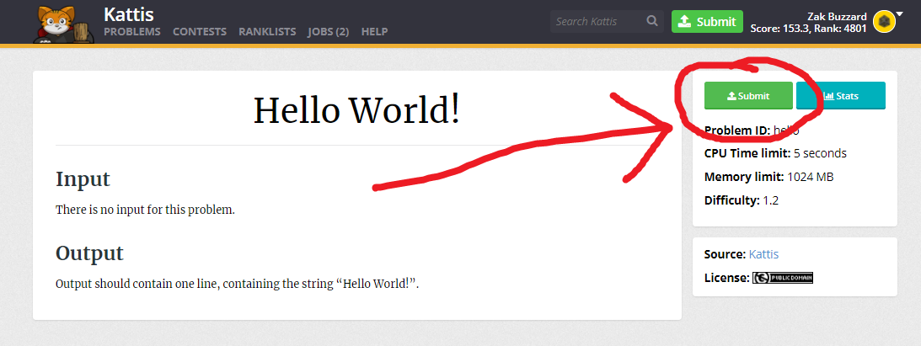
How to submit code
Generally, problems require you to read input, do some problem solving, then produce an output.
On Kattis, this is done by stdout/stdin
That means you just do normal input/output e.g. “input()” and “print()” on Python
Python, Java, C++, whatever
It depends on the platform, these ones are almost always supported
You then submit the source code to Kattis
We will be using Kattis: https://open.kattis.com/
https://open.kattis.com/problems/hello to test

Slide 7
Introduction to Complexity Analysis
Computers have finite resources to finish a given task
The most important of such resources are time and memory
Need some way to analyse how long a program will take to run for very large inputs
We use big O notation to compute an upper bound on the amount of time/memory required

Slide 8
Big-O basics
Formally: say a function f(n) is O(g(n)) as n→∞ if |f(n)| <= Mg(n) for all n>N, for some N, M > 0
Practically: use big O notation to estimate how long our programs will take for large inputs (i.e. N = 10^6)
We only care about the term which will be most significant as N grows. For example, O(N^3 + N^2) = O(N^3)
Important: Big-O notation is an upper-bound, so you always consider the worst-case scenario

Slide 9
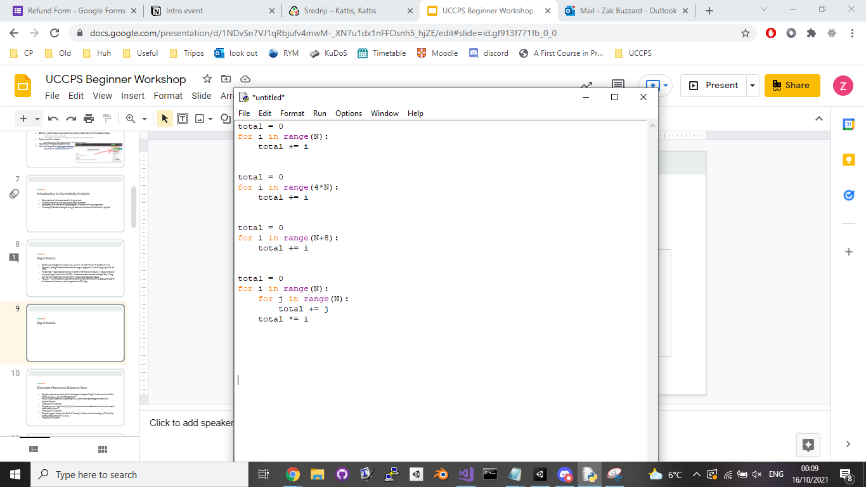
Big-O basics
Sorting: O(N log(N))
Binary search: O(log(N))
O(N)
O(N) (= O(4N))
O(3N³+2N²+100N) = O(N³)
O(2^{N}+N¹⁰⁰) = O(2^{N})
O(500) = O(1) (“constant time”)
O(N) (= O(N+8))
O(N²)

Slide 10
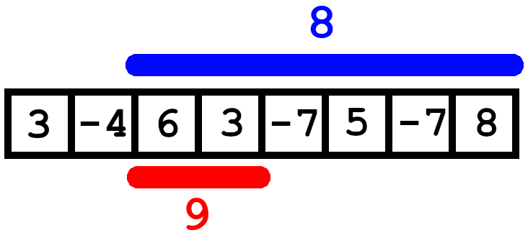
Example: Maximum Subarray Sum
N integers in an array (+ve or -ve)
Find interval with largest sum
IDEA 1: The engineer’s solution.
1) Loop through every possible interval - there are O(N^2) of these
2) Calculate the sum for each interval by looping through it - the interval has size up to N, so this takes O(N) time
Overall runtime is therefore O(N^3) - can handle N=500 at most (rubbish!)

Slide 11
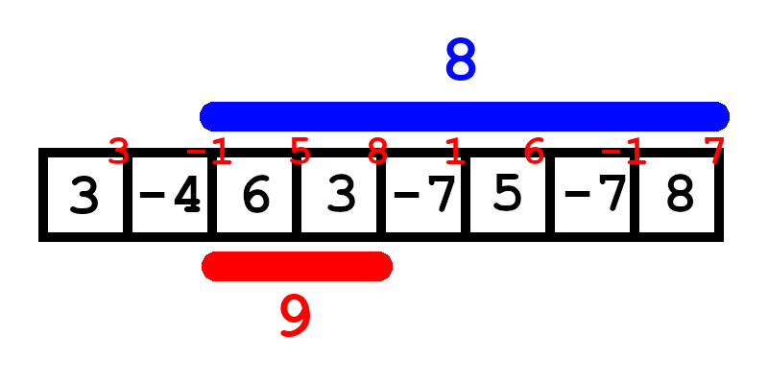
Example: Maximum Subarray Sum
IDEA 2: An optimisation
Precompute the cumulative sum of numbers in array - this only takes O(N) time
Sum of an interval = Cumulative at end - Cumulative before start
1) Loop through every possible interval - there are O(N^2) of these
2) Calculate the sum for each interval using precomputed cumulative numbers - O(1) time
Overall runtime is therefore O(N^2) - can handle N=10,000 at most

Slide 12
Example: Maximum Subarray Sum
IDEA 3: An observation
We want to find max(Cumulative(j) - Cumulative(i)), for i < j
For a given endpoint, we always choose the minimum Cumulative(i)
1) Loop through all endpoints, pick i with minimum cumulative(i) - O(N) if you update the minimum i as you go
Overall runtime is therefore O(N) - can handle N=100,000,000 at most
(Huge improvement from the original 500)

Slide 13
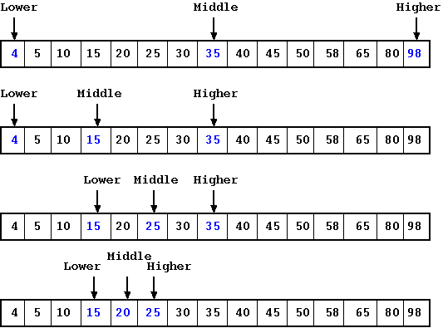
Example: Binary Search
How do we check if a value is in a big list?
What if the list has 1,000,000 things in it?
What if the list is sorted?
“Linear search”: Check them all! O(N)
“Binary search”: Sorted lists only. Check the middle, halve the area we’re searching. O(log N)
Hard to grasp how fast this is! for 1,000,000,000 items, it takes only 30 checks.
Like the “Guess a number” “Higher/Lower” game

Slide 14
General advice
For large N, the only thing that matters is the asymptotic complexity, i.e. whether it is O(N), O(N^2), O(2^N), O(N!), etc.
Rule of thumb: assume you can do about 10^8 “operations” per second
N = 10^7, then you probably need an O(N) algorithm.
N = 10^5, then you probably need an O(Nlog(N) algorithm)
N = 10^3 then O(N^2), if 100 then O(N^3),...
Roughly speaking, you can only use O(2^N) algorithms if N <= 20 and O(N!) if N <= 11
Don’t worry too much about optimising small parts - time limits are (usually) set in such a way that your code will pass iff your algorithm has the correct complexity

Slide 15
Introduction to Dynamic Programming
Task 1: Let F(n) be the Fibonacci sequence (F(0) = 0, F(1) = 1 and for each n >= 0, F(n+2) = F(n+1) = F(n)). Given a positive integer n, determine the value of F(n).
Input: The first and only line of the input consists of the number n (1 <= n <= 100).
Output: The first and only line should contain the number F(n).
Constraints Time limit 1 second, Memory Limit 256MB

Slide 16
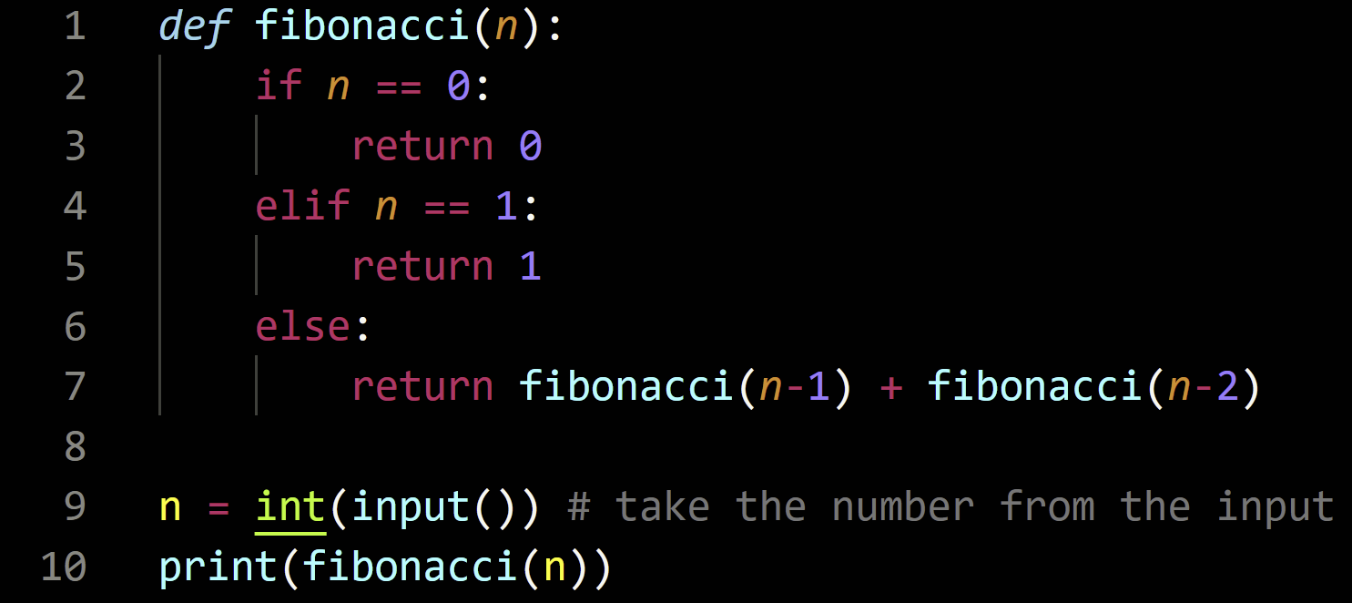
Introduction to Dynamic Programming (2)
Naive approach: Write a recursive function, which computes the nth Fibonacci number by adding the two previous numbers.

Slide 17
Introduction to Dynamic Programming (3)
This solution works, but is very slow - even for n = 35, the computer takes several seconds to compute the answer, and it is totally impractical for n > 50
Why is this program so slow?
For n = 35, the fibonacci function is called 9,227,465 times!
This is because every time “Fibonacci(n-1)” or “Fibonacci(n-2)” is called, the computer recomputes their values, even if they have already been computed before - leading to exponential amounts of repeated work!
How can we make this program faster?
Perhaps, we could try finding a way to store these previous values, so that they don’t need to be re-computed

Slide 18
Introduction to Dynamic Programming (4)
Using this idea:
Construct an array of numbers “Fibonacci”
Set Fibonacci[0] = 0 and Fibonacci[1] = 1 (initial conditions)
For 2 <= i <= n, compute Fibonacci[i] as Fibonacci[i-1] + Fibonacci[i-2]
The answer for N is then Fibonacci[N]

Slide 19
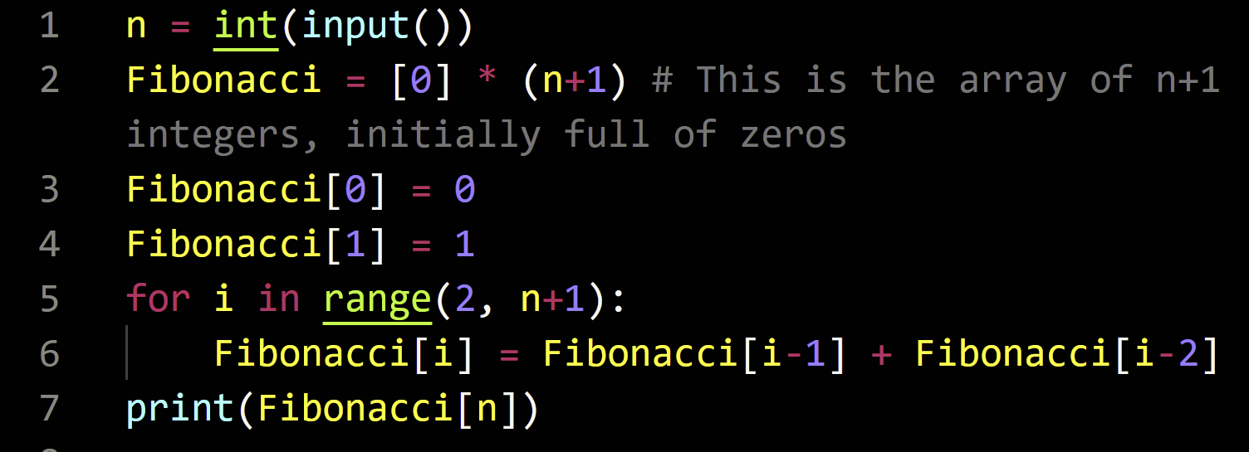
Introduction to Dynamic Programming (5)

Slide 20
Introduction to Dynamic Programming (6)
Observe that the code now runs much faster, and produces correct answers for n <= 100 instantly.
Note that the program runs in O(n)* time, because we only perform n addition operations. We also only use O(n)* memory to store the states.
This idea of storing pre-processed numbers in memory and updating values through a recurrence is known as Dynamic Programming
While this example is rather simple, we can solve much harder problems with a similar technique
Notes:
*the integers grow in size exponentially (as we are using Python’s arbitrary precision ints), so their addition is no longer O(1)

Slide 21
Introduction to Dynamic Programming (7)
Task 2: Cambridge only has coins of value £13, £17 and £19. Zak needs to pay his College accommodation charge, which is £N. He has an unlimited supply of each of these coins, but as they are all equally heavy, he would like to use the least number of coins possible. Note that the total value of the coins he spends must equal exactly N.
Input: The first and only line consists of the number N (1 <= N <= 1,000,000), the cost of Zak’s term charge.
Output: Print the least number of coins Zak needs, or -1 if no such set of coins exist.
Constraints Time limit 1 second, Memory Limit 256MB

Slide 22
Introduction to Dynamic Programming (8)
Let f(n) denote the number of coins required when Zak’s term charge is £n. Hence, we seek the answer f(N).
Instead of trying to compute f(n) only for n = N, we could try computing f(n) for smaller values n < N, and see if we can find a recurrence relation.
Suppose we have a set of coins whose sum is £n, and consider the last coin. There are a few cases:

Slide 23
Introduction to Dynamic Programming (8.5)
For 1 <= n <= 19, we have f(n) = ∞ unless n = 13, 17 or 19, because obviously you need at least one coin to pay fees, but a coin only has said values
For n > 19, we have 3 cases:
Use a £13 coin: this requires 1 + f(n-13) coins
Because you used 1 coin already, and have £(n - 13) left to pay
Use a £17 coin: this requires 1+f(n-17) coins
Use a £19 coin: this requires 1+f(n-19) coins
We must have one of these cases since we can only use £13, £17, and £19 coins
If all cases give an answer of ∞, then we cannot make n from these coins

Slide 24
Introduction to Dynamic Programming (9)
Conclusion:
f(n) = 1 + min(f(n - 13), f(n - 17), f(n - 19))
If this leaves us with f(N)=∞, then we cannot produce N, so output -1
The final algorithm takes O(N) time, because for each i <= N we only perform 3 comparisons and at most 3 assignments. It’s also O(N) space since the array we use to store the numbers has size N.

Slide 25
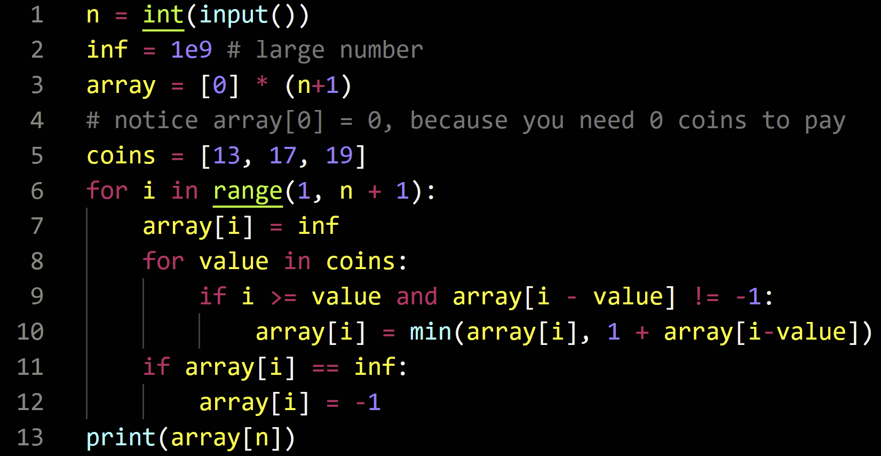
Introduction to Dynamic Programming (10)

Slide 26
Introduction to Dynamic Programming (11)
Task 3: You are given an array a = {a[0], a[1], …, a[n-1]}. You can choose any subset of elements in this array as long as no two numbers you choose are adjacent in the array.
What is the maximum sum you can obtain by selecting such a subset? The empty selection (choosing no elements at all) is assumed to have sum zero.
Input: The first line consists of the number n (n <= 100,000), the number of elements in the array. The i’th element of the second line consists of a[i] (-1000 <= a[i] <= 1000).
Output: Print the highest sum attainable.
Constraints Time limit 1 second, Memory Limit 256MB

Slide 27
Introduction to Dynamic Programming (12)
Naively, choosing all such subsequences and testing each one will take O(n 2^n) time, because for each of the 2^n subsets of a, you will need to first test whether you’ve chosen two adjacent elements (which takes O(n) time), and also find the value by summing (also takes O(n) time).
For n ~ 100,000, this is very much impractical, so this solution will TLE
Does there exist a faster algorithm to do this?

Slide 28
Introduction to Dynamic Programming (13)
Let’s construct an array dp of size n, such that dp[i] denotes the highest sum that is achievable for just the sub-array {a[0], a[1], …, a[i]}. That is, we are using Dynamic Programming on the length of a. Then, the answer would equal dp[n-1].
Then to compute dp[i+1], we have the following:
dp[i+1] >= dp[i], because the best construction for the first i elements of the array would also give a valid construction for the first i+1 elements
dp[i+1] >= a[i+1] + dp[i-1], by taking a[i+1] and the best construction for the first i-1 elements. This gives a valid construction for i+1, as no 2 elements adjacent
At least one of these inequalities must be equalities

Slide 29
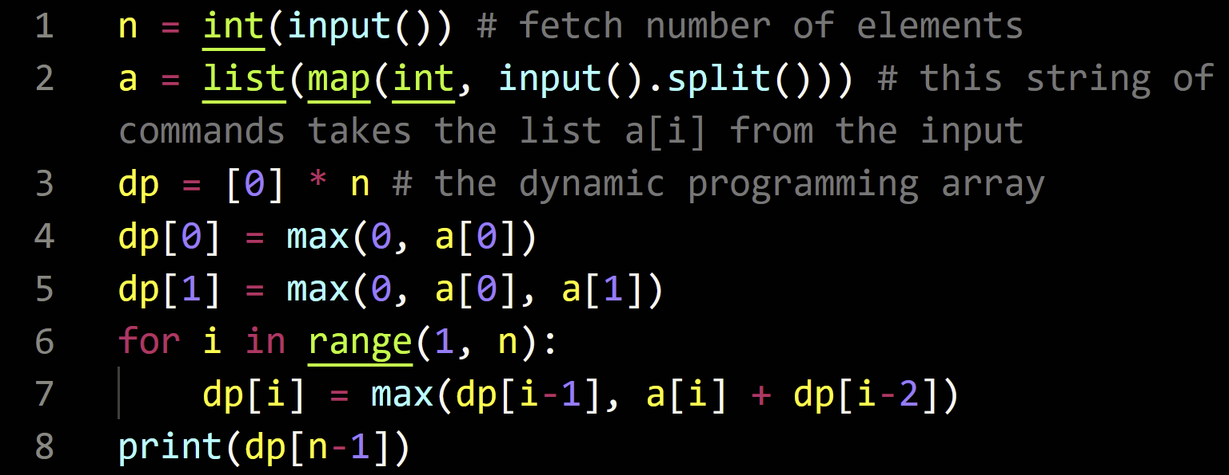
Introduction to Dynamic Programming (14)
Hence, we get the recurrence, dp[i+1] = min(dp[i], a[i+1] + dp[i-1]) for each i > 0.
dp[0] = max(a[0], 0), because we can either choose a[0], or not pick anything
dp[1] = max(0, a[0], a[1]) because you can pick zero or one elements
Both time and memory complexity are O(n), so this suffices to pass constraints

Slide 30
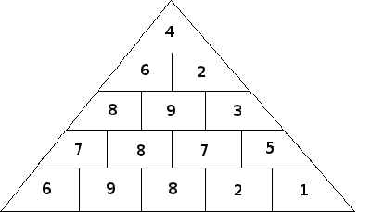
Introduction to Dynamic Programming (15)
Task 4: Consider the game Hopscotch, played on a pyramid with N rows, with the first row having one number, the second with two numbers, and so forth. The goal is to obtain the highest sum possible, by following a path from the apex to the base of the pyramid while only moving to one of the two squares directly beneath it. Notice said path must cover exactly N numbers.
Find the highest score that can be attained.
Input: The first line consists of a number N (1 <= N <= 1000). The i’th of the next N lines contains i numbers, which are the numbers in the i’th row. Each number is an integer between -1000 and 1000 inclusive.
Output: Print the highest sum attainable.
Constraints Time limit 1 second, Memory Limit 256MB

Slide 31
Introduction to Dynamic Programming (16)
So far, all DP’s used have been 1 dimensional, i.e. the recursion had a single variable (the index) and depended only on the previous few values. We can try extending this idea to a multidimensional DP, in this problem.
This time, we let dp be a n x n (2D) array, such that dp[i][j] (read, the element in the i’th row, and j’th column) denotes the highest value that can be achieved, when starting from the apex and ending at the cell (i, j).
Then, the answer would be MAX(dp[n-1][0], dp[n-1][1], …, dp[n-1][n-1])
Let a[i][j] (n >= i >= j >= 0) be the array that contains the value in the cell with row i, column j (assume that the apex has coordinates (0, 0) by convention)
Thus: dp[0][0] = a[0][0]

Slide 32
Introduction to Dynamic Programming (17)
To reach a cell (i, j) not the apex, you must have come from either the cell (i-1, j) or (i-1, j-1)
Hence: the best value you can get, when you end up at (i, j), is the highest of the best value achievable by those two paths, plus a[i][j] (for the current value)
Get the recurrence dp[i][j] = max(dp[i-1][j], dp[i-1][j-1]) + a[i][j]
Be careful with bounds: notice that when j == i or j == 0, the array actually goes out of bounds on the RHS, and will cause errors when compiling or during runtime
In these cases, notice that j == 0 or i corresponds to the cell being at the leftmost or rightmost position of its row, so only the cell inside the triangle should be counted

Slide 33
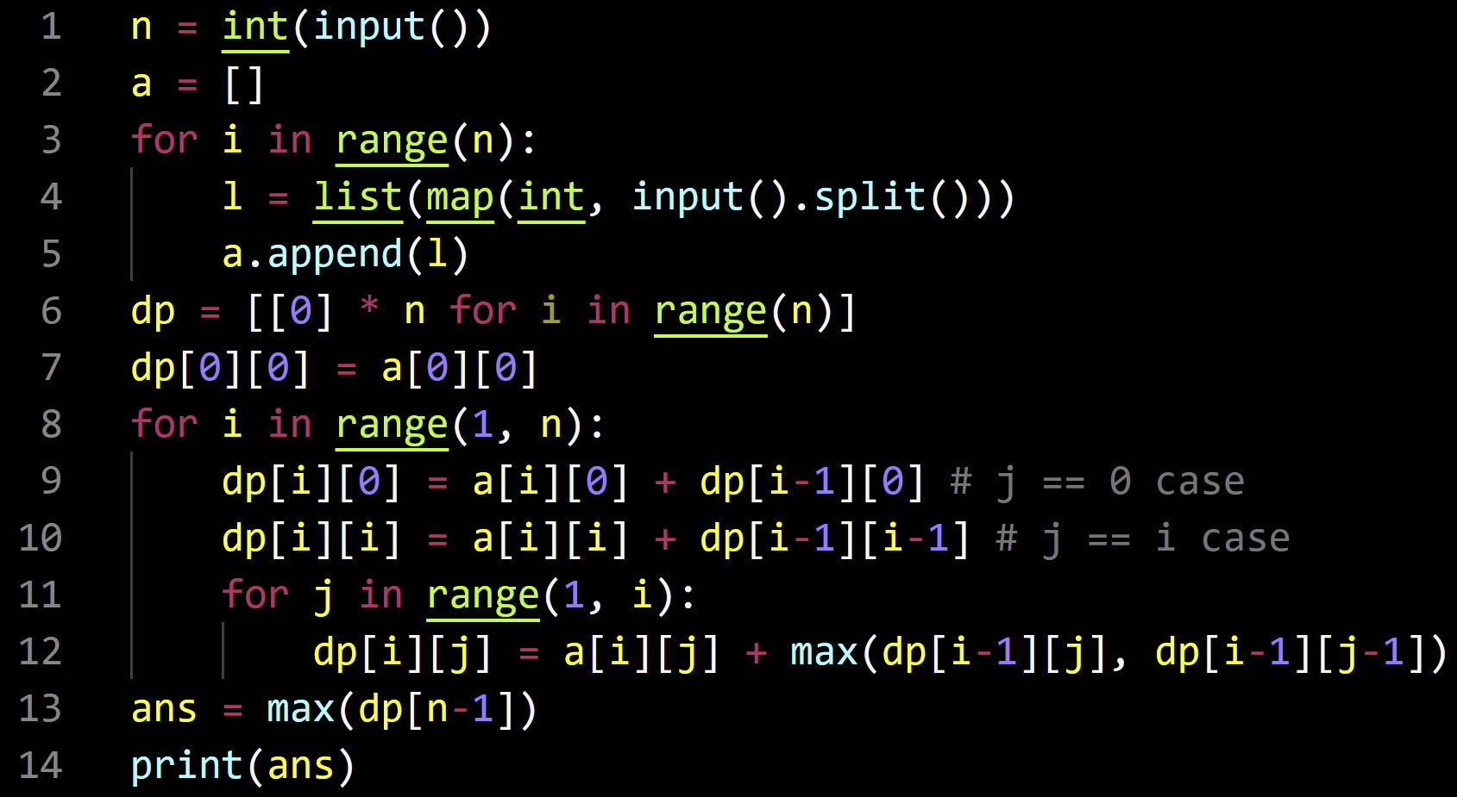
Introduction to Dynamic Programming (18)
Time complexity for this algorithm is O(N^2), because we perform approx i operations per i <= N, which means the total number of operations is about (N^2) / 2 = O(N^2). Space complexity is also O(N^2)
Code:

Slide 34
Contest link on discord
Get in teams or do it individually
Snacks outside
Pizza 4:15
Feel free to ask us if you get stuck!

