Slide 2
The Creaking Grounds

Slide 3
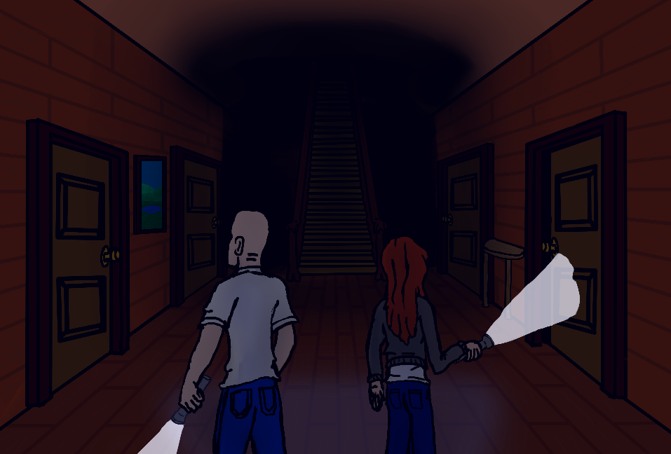
Razor Statement
Explore the old mansion collecting items to survive. But beware the cursed spirits of this house for they have surprises of their own waiting.

Slide 4
User Stories

Slide 5
Game Features

Slide 6
Demo

