Slide 2
The Creaking Grounds

Slide 3
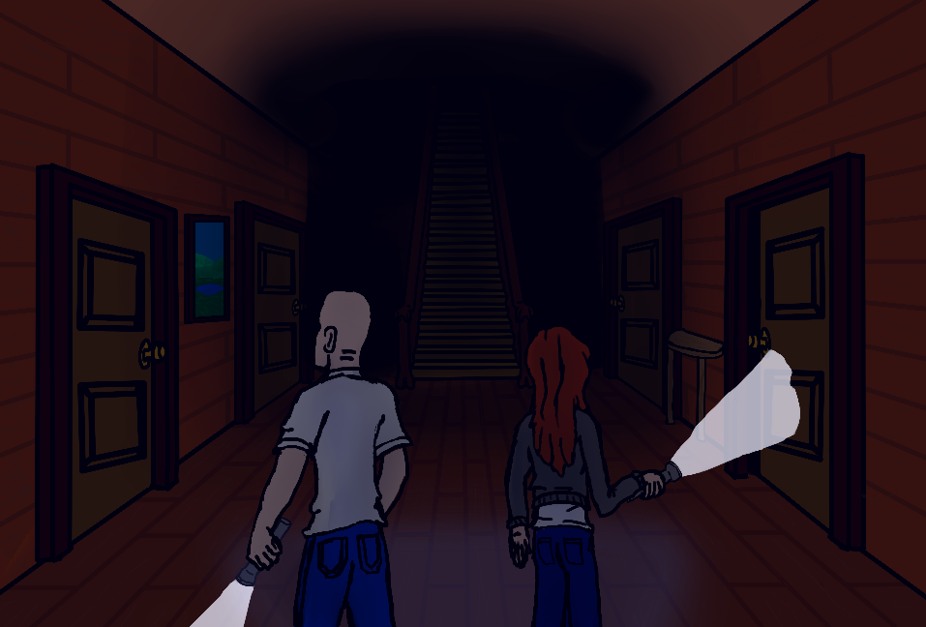
Razor Statement
Explore the old mansion collecting items to survive. But beware the cursed spirits of this house for they have surprises of their own waiting.

Slide 4
User Stories
As a player I want to search rooms in order to find items to help me survive
As a player I want to explore the mansion in order to find more equipment
As a player I want to customize my character and select abilities that suit my play style.
As a Betrayer I want to be able to attack the players in different ways in order to win the game.
As a Player, I want to be able to complete various objectives in order to defeat the betrayer and win the game.

Slide 5
Game Features
Explore a randomly generated labyrinth of a mansion
Create a character with stats to suit your play style
Search the rooms and containers for items and artifacts
Find hidden passages and secrets to help you win
Collect special powers from artifacts
Survive the Curse’s Awakening OR Destroy the trespassers as a Betrayer.

Slide 6
Why Are We Different?
Most horror games are linear and repetitive. Ours is not.
Multiplayer
We are an ambitious group that focuses on quality
Much accomplished in short time already = PROFIT SOONER FOR YOU

Slide 7
Demo

Slide 8
The Creaking Grounds

