Slide 1
Social Interactivity Mentor for Youth with Autism using the NAO Robot (SIMYAN)
Andrew Nguyen, Bryce George, Colton Homuth, William Ross
Sponsor: Dr. Adham Atyabi
Faculty Sponsor: Mr. Bill Michael
January 29, 2021

Slide 2
Project Recap
Objective:
Create a framework for the NAO robot to support future implementation of ASD treatment/intervention activities designed by medical professionals and researchers.
Social Interactivity for Youth with Autism using the NAO robot
Core SDK
Supports advanced social interactivity behaviors
Framework for building Activity Modules
Orchestrates Activity Module execution
Social Interactive Drawing Module
PoC Activity Module
Guides human subject through a drawing exercise
Incorporates social interaction

Slide 3
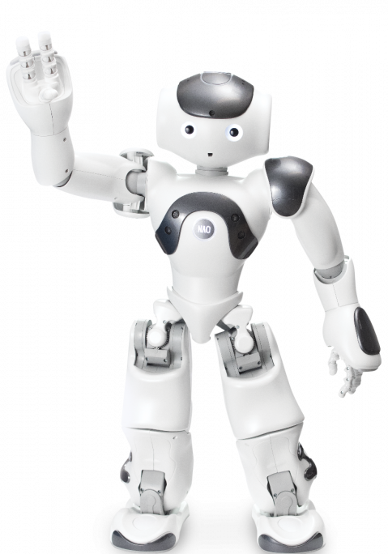
Presentation Overview
System Design Analysis
Hardware System Designs 1 & 2
Hardware System Design Selection
Software System Designs 1 & 2
Software System Design Selection
Updates to Specifications & Requirements
System Diagrams
Block Diagrams
Software Diagrams
Test Plan
Overview
Integration Tests
Demonstration Plan
Development Strategy
Project Schedule
Sprint Breakdown
Epics Breakdown
Board & Gantt Chart
Budget
Knowledge Integration
https://www.eduporium.com/media/catalog/product/cache/c687aa7517cf01e65c009f6943c2b1e9/n/a/nao-print_06_4.png

Slide 4
Hardware System Design 1
Use of NAO CPU solely for processing
CPU vs. GPU for graphics processing
Single core leaves no room for parallel processing*
No need for external hardware
* Without an external GPU, the NAO robot will not be capable of handling any additional peripheral video/camera inputs.
NAO Specs
Camera captures 960p 30fps
Single core ATOM CPU
1GB RAM**
2GB internal Flash memory + 8GB micro SDHC (Secure Digital High Capacity)
** 1GB of RAM is widely considered bare-minimum for image processing and would be insufficient for any of our planned extensions

Slide 5
Hardware System Design 2
Use of Nvidia Jetson Nano to do all real-time image processing
GPU does processing in parallel, so much more efficient than normal CPU when it comes to image processing
Use of LiDAR depth sensor or Xbox Kinect
Most of the stretch scenarios we had in mind will require better vision hardware
Jetson Nano Specs
128 core Maxwell GPU
4GB LPDDR4
Quad core ARM CPU
Encoding:
4K @ 30fps
4x 1080p @ 30fps
Decoding
2x 4K @ 30fps
8x 1080p @ 30fps
NAO Specs
Camera captures 960p 30fps
Single core ATOM CPU
1GB RAM
10GB total storage
2GB internal Flash memory
8GB micro SDHC

Slide 6
Hardware System Design Selection
Selected Design 2, with GPU supplementing NAO hardware:
Jetson Nano is capable of decoding images as fast as NAO camera captures
Doing image processing with the external GPU frees up NAO CPU to focus on other tasks
Quad core CPU will allow more parallel processing to take place
Increase in RAM will also aide in image processing
External hardware is very small and able to be connected to the NAO seamlessly
Depth sensor gives freedom to explore more advanced visual systems (environment mapping, proximity detection, etc.)
GPU will be able to handle increased resolution from depth sensor
Jetson Nano along with a depth sensor provides major improvements with very few drawbacks.

Slide 7
Software System Design 1
Using wrapper functions to include all functionality needed within our Core SDK
Will increase the size of our Core SDK drastically with many modules that may not be useful outside of our project
Will allow all code used in project to be in one place
Ability to adjust NAOqi capabilities to fit our need
Could condense and improve readability of code inside the drawing modules
More modular design, may improve readability and condense the code inside the drawing module.

Slide 8
Software System Design 2
Using a mix of new functionality from our core SDK and existing functionality from NAOqi framework
Less modular design, could lead to longer blocks of code within the drawing modules
Utilizing NAOqi framework directly will decrease the workload
Keeping Core SDK simple could lead to less confusion when being utilized in the future
Overall, less modular design and may hurt readability, but this will give more time to focus on essential functionalities.

Slide 9
Software System Design Selection
Selecting the second software system design including accessing both the Python SDK and our Core SDK in the drawing modules
Gives us freedom to leverage existing Python SDK when needed without adding an extra layer of abstraction
Allows Core SDK to fully supplement Python SDK focusing on our specific contributions
Allows more time focusing on core development rather than just wrapping existing modules
This strategy will allow us to more heavily focus on developing unique innovations for our Core SDK.

Slide 10
Specification & Requirement Updates
Requirements | Specifications
The robot shall be able to recognize and handle a dry erase marker of radius 0.5-0.75” and weighing no more than 3oz. The robot shall be able to recognize a drawing surface on a dry erase whiteboard. The robot shall have a mechanism for attaching the Jetson Nano GPU to it without impeding its movements. | Jetson Nano GPU Attachment Capacity Dimensions: 100mm x 80mm x 29mm

Slide 11
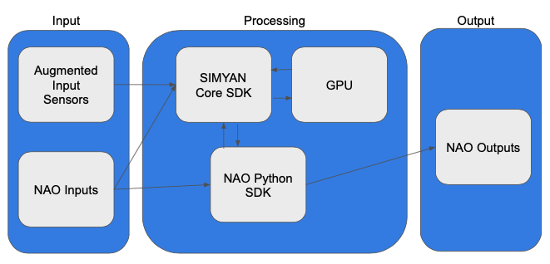
System Diagram

Slide 12
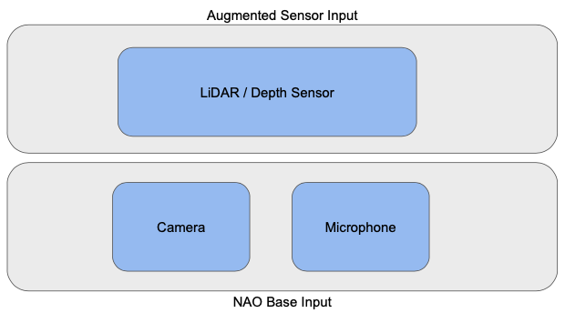
Input Subsystem
Processing Subsystem

Slide 13
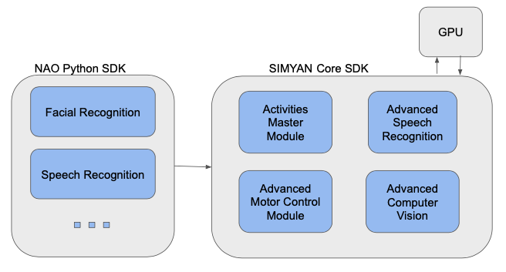
Processing Subsystem
Input Subsystem
Output
Subsystem

Slide 14
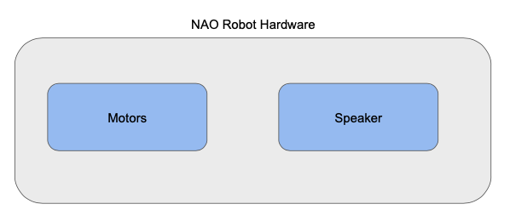
Output Subsystem
Processing
Subsystem

Slide 15
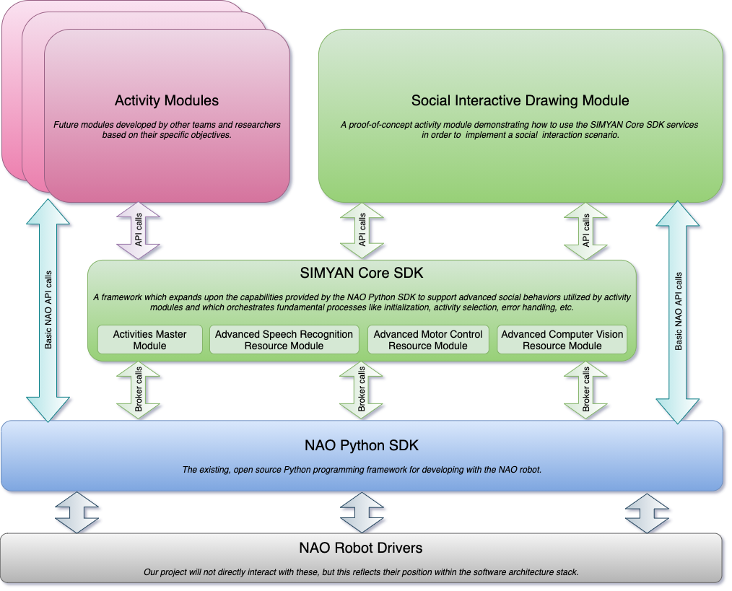
Software Architecture Stack

Slide 16
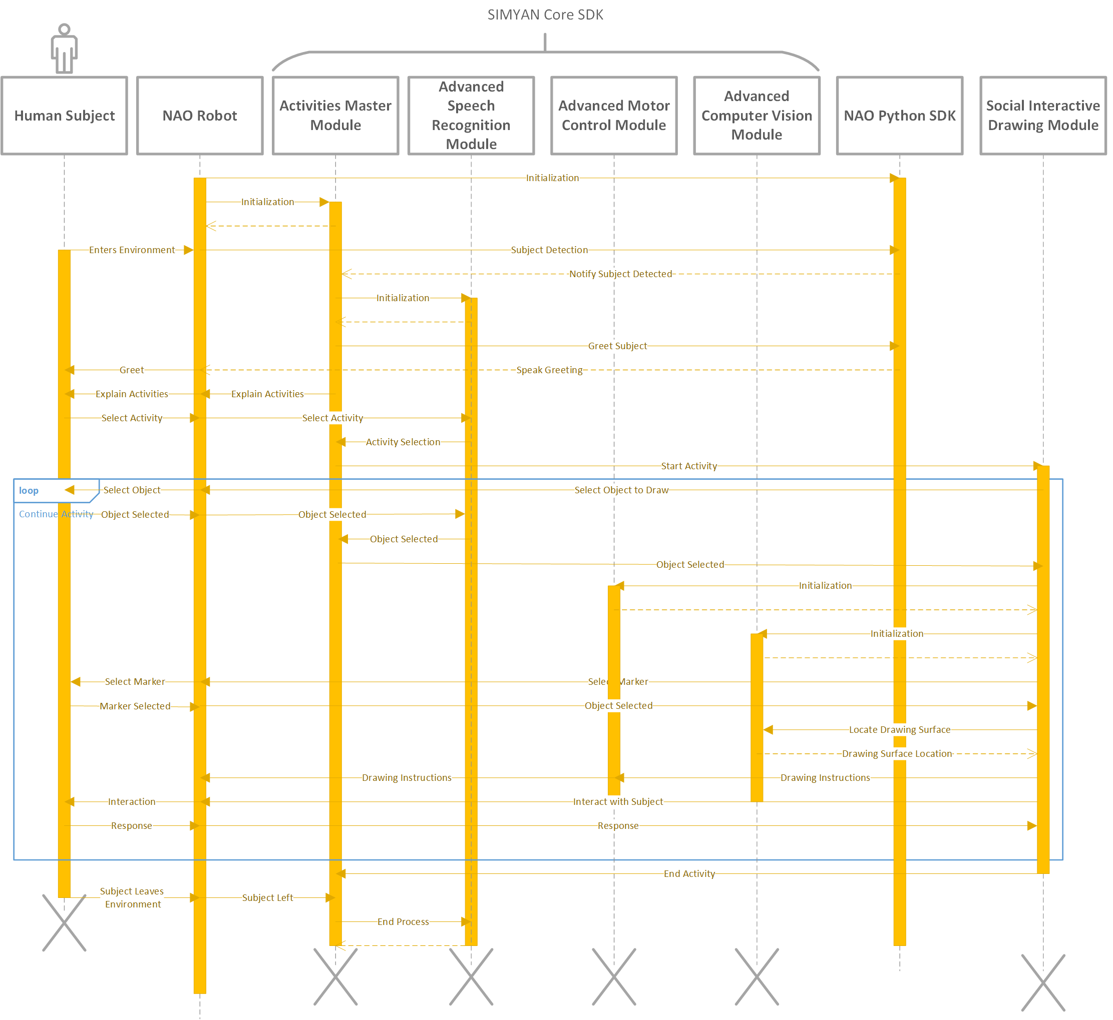
Sequence Diagram

Slide 17
Test Plan: Overview
1.Unit Testing
Ensuring that unit tests are:
thorough (70-100% coverage)
passing (100% passing)
complete (pass and fail test cases for sufficient range of inputs)
2.Integration Testing
3.Demonstration Plan

Slide 18
Integration Tests
Test inter-module connections in the code:
Speech Recognition to Drawing Module Integration
Object Selection
Color Selection
Social Interactions
Motor Control Module to Drawing Module Integration
Collect Marker
Draw on Drawing Surface
Vision Module to Drawing Module Integration
Recognize Subject
Recognize Drawing Surface
Recognize Drawing Implements
Integration Test definitions include:
Preconditions
Scenario
Testing Steps
Passing Results / Criteria

Slide 19
Demonstration Plan
Flow of events:
Default Scenario
Robot draws a picture with the human subject and engages in expected social behaviors
Highlights the fulfillment of the MVP and any completed extensions
Exceptional Cases
Subject gives invalid command to the robot
Subject selects invalid object to draw
Marker has a cap on
Delivery
Pre-recorded video
Brief code overview
Diagrams
Pseudocode
Demonstrate all use cases:
Load Master Module
Initialize Activities Master Module
Start Activity
Select Object to Draw
Obtain Writing Implement
Draw Object
Subject Interaction

Slide 20
Development Strategy
Agile Development | Test Driven Development | Paired-Programming
Iterative development cycle Plan Develop Test Deploy Retrospective Focus on delivering working code each sprint | Unit testing Define tests before writing code Integration test cases Write just enough code to pass the tests | Task owner paired with assisting partner Develop together whenever possible Partner stays updated on development progress Partner assists with code Review/QA

Slide 21
Sprint Breakdown
Sprint 1 | Sprint 2 | Sprint 3 | Sprint 4 | Sprint 5 | Sprint 6
Feb 1 - Feb 16 | Feb 22 - Mar 5 | Mar 8 - Mar 19 | Mar 24 - Apr 9 | Apr 12 - Apr 23 | Apr 26 - May 7
Design Review
Final Presentation
Core SDK Development
Core SDK Extensions
Final Report
Social Interactive Drawing Module Development
Social Interactive Drawing Module Extensions
Integration Testing
End-to-end Testing

Slide 22
Epics Breakdown
Core SDK Development | Core SDK Extensions | Social Interactive Drawing Module Development | Social Interactive Drawing Module Extensions
Activities Master Module ^{B} Activity Module Loader Activity Module Manager Command Recognition Manager Speech Recognition Resource Module ^{A} Advanced Motor Control Resource Module ^{AB} Advanced Computer Vision Resource Module ^{CW} Jetson Nano GPU Integration ^{C} | Advanced Computer Vision Resource Module Extensions ^{CW} Advanced Motor Control Resource Module Extensions ^{AB} | Drawing Activity Command Recognition ^{A} Marker Detection ^{C} Marker Collection ^{W} Marker Handling ^{B} Drawing Surface Detection ^{C} Drawable Object Loader ^{B} Object Drawing Manager ^{CW} Social Interaction Manager ^{AB} | Self-Directed Marker Collection ^{AW} Self-Directed Marker Selection ^{AW} Advanced Drawing Selection ^{AB} Automated Object Drawing Specification Generator ^{BC}
Integration Testing | End-to-end Testing | Design Review | Final Presentation | Final Report | LEGEND
Run Integration Test Cases * Fix Failures * Re-Test Failed Cases * | Run End-to-end Test Cases * Fix Failures * Re-Test Failed Cases * | Develop System Design * Prepare Design Review Presentation * Deliver Design Review Presentation * | Prepare Final Presentation * Prepare Demonstration * Deliver Final Presentation * | Prepare Final Report * Deliver Final Report * | * – All A – Andrew B – Bryce C – Colton W – Will Superscript = Primary Owner(s)

Slide 23
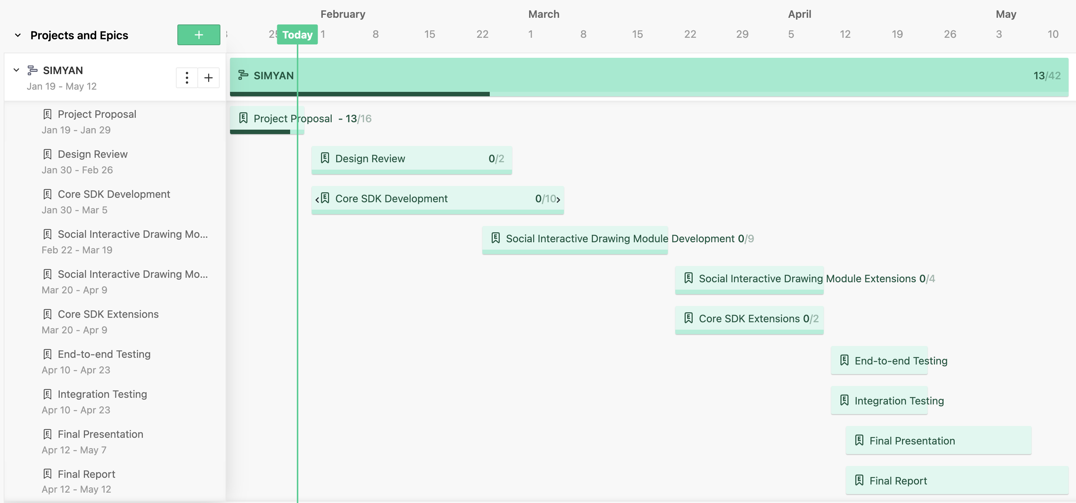
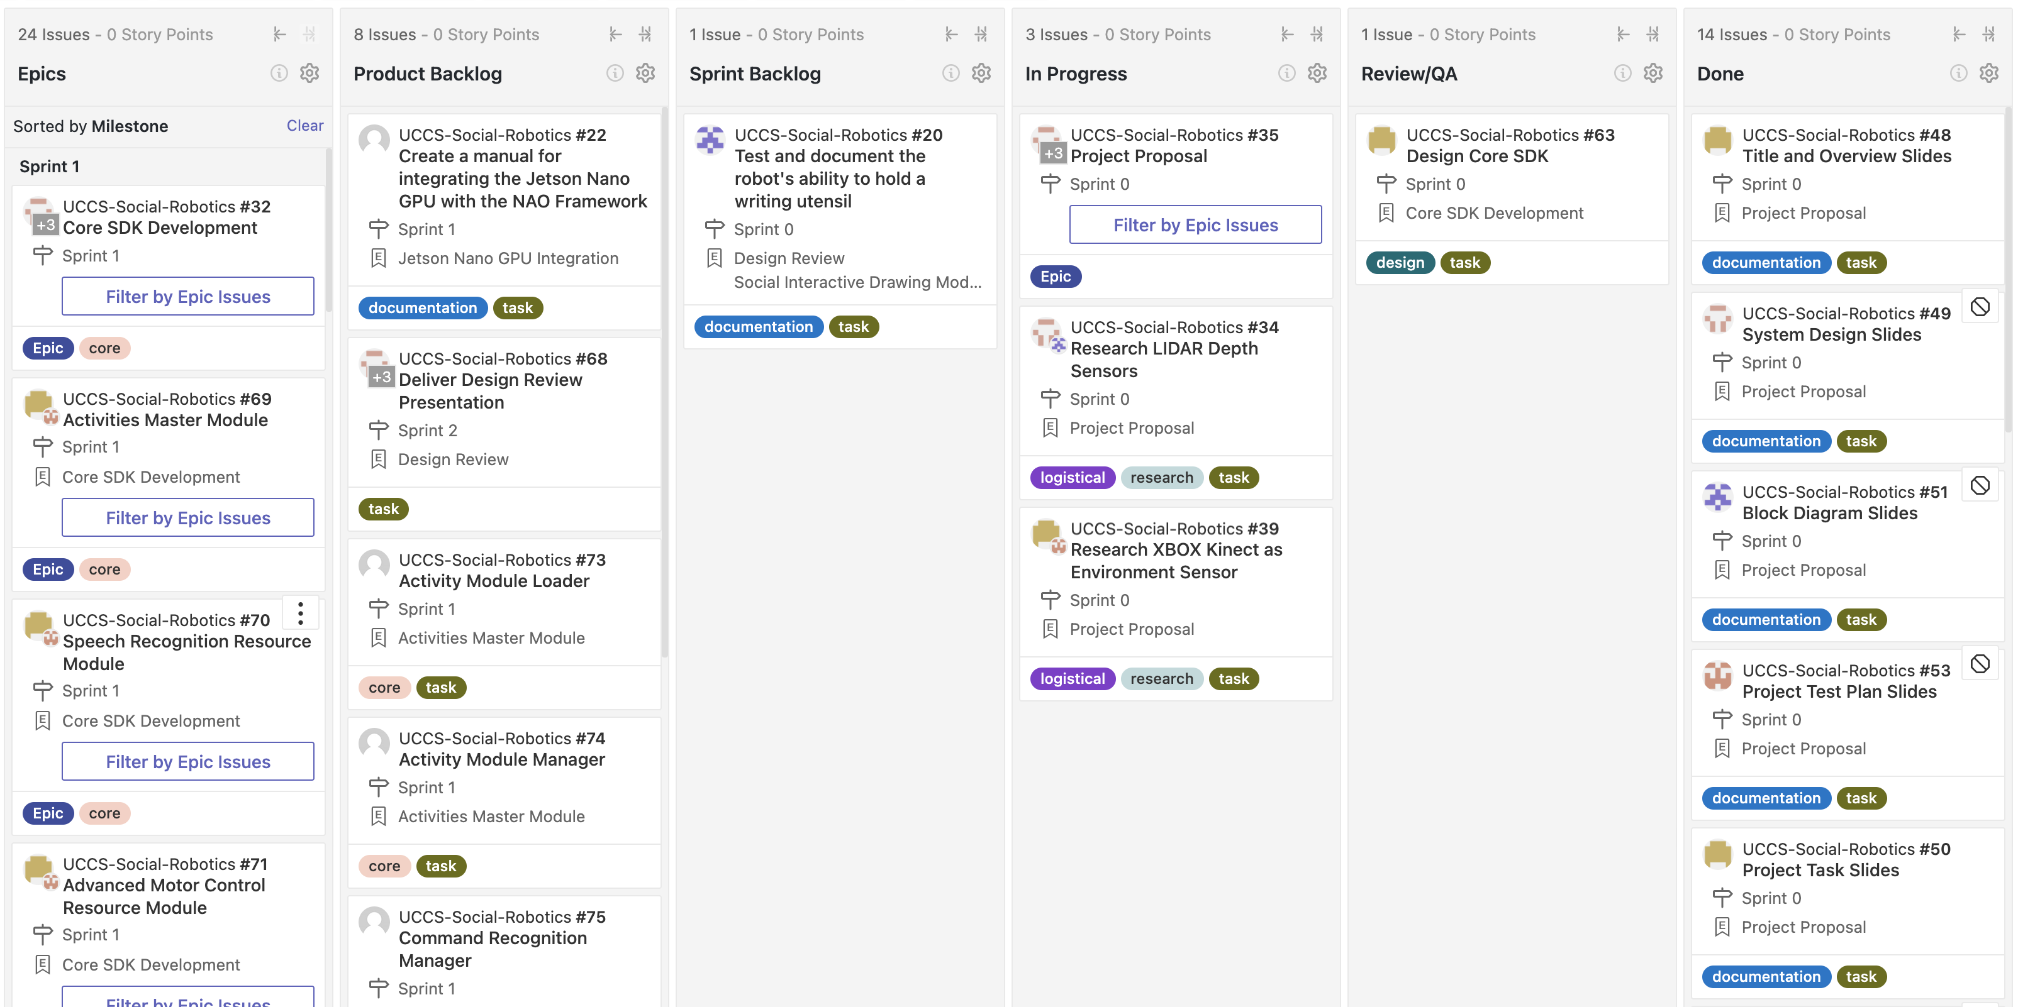
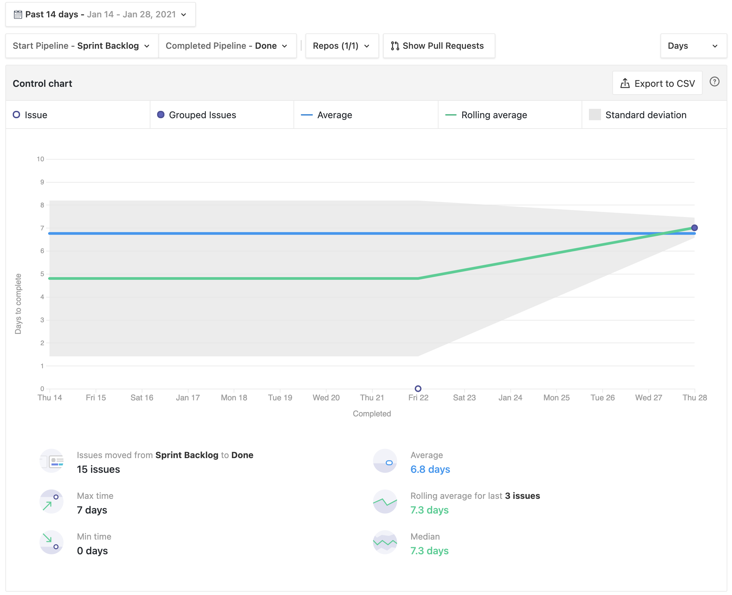
Board & Gantt Chart

Slide 24
Budget
Items:
Jetson Nano GPU
3D printed materials: utensil holder, backpack (for GPU)
Depth Sensor (LiDAR/Infrared)
Cost allocation:
Jetson Nano GPU - free, borrowed from advisor Bill Michael
Depth Sensor ($300 maximum)
Rest of materials ($100 maximum)
*Funds will be acquired from department allowance of $100 per person

Slide 25
Knowledge Integration
Agile Development
Test Driven Development
System Design and Analysis
Problem Decomposition
Requirement Identification
Architecture
Systems Engineering
Machine Learning
Computer Vision
Natural Language Processing

Slide 26
Conclusion
Goals:
To develop our own SDK for the NAO robot that will include support for advanced social behaviors and complex motor skills.
Secondarily, is to create a robot guided scenario to promote social interaction with ASD children.
Produce a quality product that can be built upon with further research.

Slide 27
Any Questions?

