Slide 1

SOCIAL ROBOTICS II
Social Interactivity Mentor for Youth with Autism using the NAO Robot (SIMYAN)
Andrew Nguyen, Bryce George, Colton Homuth, William Ross
Sponsor: Dr. Adham Atyabi
Faculty Sponsor: Mr. Bill Michael
December 4, 2020
Notes:
Will

Slide 2







TEAM ORGANIZATION
Project Manager:
Bryce George
Communication & Logistics Managers:
Colton Homuth & William Ross
Standards & Test Manager:
Andrew Nguyen
Notes:
Will

Slide 3

PROBLEM OVERVIEW
ASD impairs social interactions
Even more important to learn these skills while young
Social interactions are critical for future success
Robotics may be a key solution to developing these social skills
Notes:
Will

Slide 4
PROBLEM BACKGROUND
We are developing the functionality for the robot to have social interactions with humans
Limited in our knowledge of literature on best approaches for social development in children with ASD - specific therapeutics are out of scope
Our work is more general in scope and guided by our sponsor’s prior research and guidance
Notes:
Will
Scenario Description slide

Slide 5

PROJECT SCENARIO
Notes:
Andrew

Slide 6

CONSTRAINTS
Social
Testing will not be able to be done with ASD individuals
Ethical
When dealing with ASD children, they must always be treated with respect
Must make sure to focus on social development
Health and Safety
Must make sure NAO programming doesn’t prompt it to do anything dangerous
COVID-19
Notes:
Colton

Slide 7
CONSTRAINTS
Economics
Constraint would be budget in this case
Don’t need many outside supplies, won’t be a huge factor
Manufacturability
Since project is adding software to existing hardware, we are only limited by the hardware provided and the software we write
Sustainability
Project will be sustainable as long as no changes are made to the NAO robot that we are running it on, and we stay consistent with Python version
Notes:
Colton

Slide 8

LITERATURE SEARCH
Using social robots to work with ASD individuals is an emerging research field...
Commercial Robots for ASD Research and Therapy
Robot | Made By | Height (cm) | Ambulatory | Programmable | Degrees of Freedom | Features
Milo | Robokind | ~58 | Yes | Yes | 21 | Humanoid High degrees of freedom allows body language expression Emotive verbal expression
NAO | SoftBank Robotics | 58 | Yes | Yes | 25
Pepper | SoftBank Robotics | 120 | No (wheels) | Yes | 20
QTrobot | LuxAI | 63 | No (stationary) | Yes | 17
Notes:
Bryce
Add prices
Pepper from SoftBanks

Slide 9
LITERATURE SEARCH
Used for teaching social skills
Body Language Cognition
Emotional Intelligence
Social Customs/Standards
Language Development
Self Expression
Used in:
Classrooms
Treatment Facilities
Research Facilities
Facilitate researchers, educators, and therapists
ASD children more likely to interact with adult, asking questions to learn how to operate a robot
ASD individuals are calmer when interacting with robot than with person
Consistency of robot speech, movement, and interaction is comforting
Fewer distracting body language cues than a human
Notes:
Bryce

Slide 10

PROJECT SCOPE
Outside Scope
Not aiming to produce diagnostic test
Not aiming to create therapeutic experience
Not aiming to design or conduct a particular research experiment
* No testing will be performed with individuals who have ASD during this project
Within Scope
Create a framework to aid the development and implementation of advanced behaviors to support diagnostic and therapeutic applications
Develop behavior components for a specific scenario as a POC
Interactive drawing exercise with a human subject
Notes:
Will
Vision is for kids with Autism, the current plan is to deliver for TD individuals
Testing and feasibility for kids with ASD beyond current scope

Slide 11

STANDARDS DISCUSSION
Coding Standards | Python PEP 8 formatting style Use 4 spaces instead of tabs Comments Describe all functions and their parameters References/links to supporting documentation (Optional) Custom utilities should provide a command line or GUI interface
Documentation Standards (GitHub) | Committed to UCCS-Social-Robotics/docs Must include a Wiki page or markdown for each module Include author(s) GitHub username and date information at the top of documentation files and wiki pages
Safety Standards | Subscribe to IEC 60601 technical standards
Notes:
Andrew

Slide 12
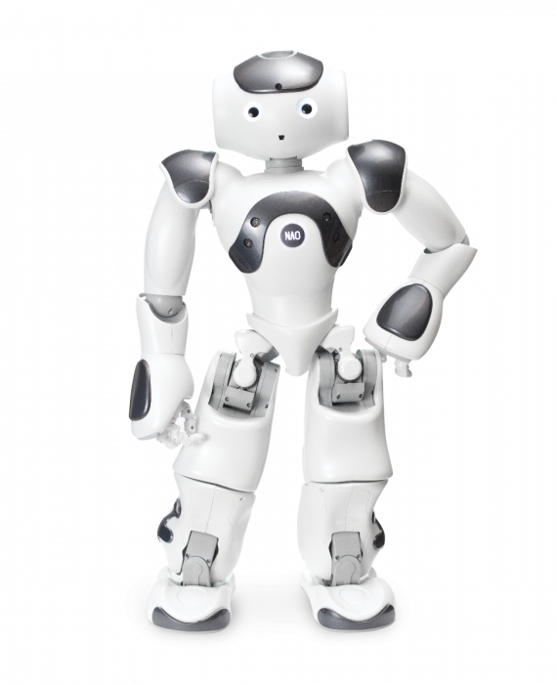
REQUIREMENTS ANALYSIS: ENVIRONMENT SURVEY
Frontier customer in emerging field
Limited existing research to draw upon
Using NAO robots provided by UCCS
Existing NAO Framework base
Basic robot operation
Support for some advanced behaviors
Extensible via custom modules
Relatively small community using NAO
Limited community contributions
Less likely to find useful utilities already implemented
Image 1
Notes:
Colton

Slide 13

REQUIREMENTS ANALYSIS:
CUSTOMER
NEEDS & WANTS
Needs
Extension of existing NAO framework
Advanced behaviors
Cognition
Speech
Vision
Mobility & Motor Control
Provide “play” experience
Opportunity to learn social cues and concepts
Human mannerisms and social characteristics
Wants
Relative autonomy
Intelligence
Adaptability
Natural interaction experience
Intuitive
Instructive
Comfortable
Solution extensibility
Solution reusability
Notes:
Andrew

Slide 14
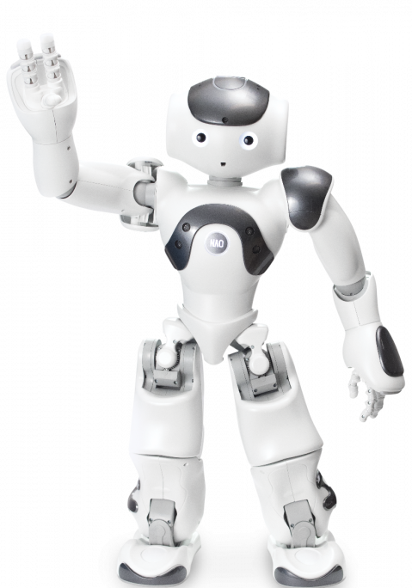
REQUIREMENTS ANALYSIS: CONSIDERATIONS
Complexity of human social environments
Natural language processing
Contextual reference
Unexpected disruptions/interruptions
Multiple human interactors
Environmental awareness
Measuring 3D distance and depth in environment
Recognizing obstacles and resources
Mapping environment and moving to different locations
Understanding of object properties
Scale
Orientation
Color
Image 2
Notes:
Bryce

Slide 15

REQUIREMENTS ANALYSIS: CONSIDERATIONS
Deep Learning & AI
Model development and training
Accuracy
Training Time
Computational resources
Model application
Collecting necessary data
Collecting sufficient data
Processing data within acceptable timeframe
Reasoning and Situational Analysis
Situational Prediction
Situational Responsiveness
Data integration and interpretation
Notes:
Bryce

Slide 16
REQUIREMENTS SPECIFICATIONS
# | Use Case | Functional Requirements | Quality of Service Requirements
1 | Load Master Module | Allocate all necessary resources and load the Activities Master Module Detect subject within 5m of starting position | Performed on robot startup Verbal notification of completion
2 | Initialize Activities Master Module | Verbally greet subject Orient face to look at subject (+/- 5°) Allocate/initialize all master level subroutines | Greet subject < 1s after detection
Notes:
Bryce

Slide 17
REQUIREMENTS SPECIFICATIONS
# | Use Case | Functional Requirements | Quality of Service Requirements
3 | Start Activity | Verbally explain operation instructions Verify valid verbal activity selections Notify of invalid activity selections and re-prompt Discover all available activity modules Load and initialize selected activity module | Verify and acknowledge selections <= 1s after heard
Notes:
Bryce

Slide 18
REQUIREMENTS SPECIFICATIONS
# | Use Case | Functional Requirements | Quality of Service Requirements
4 | Select Object to Draw | Verbally explain drawing activity Verbally list drawable objects Prompt for object selection Verify object selection Notify of invalid object selections and re-prompt | Verify and acknowledge selections <= 1s after heard
Notes:
Andrew

Slide 19
REQUIREMENTS SPECIFICATIONS
# | Use Case | Functional Requirements | Quality of Service Requirements
5 | Obtain Writing Implement | Determine if already holding writing implement Ask whether to continue using current writing implement Drop writing implement Verify and acknowledge choice to use current writing implement Verbally instruct subject to provide new writing implement | Verify and acknowledge selections <=1s after heard
Notes:
Colton

Slide 20
REQUIREMENTS SPECIFICATIONS
# | Use Case | Functional Requirements | Quality of Service Requirements
5 | Obtain Writing Implement (continued) | Detect when to close hand to grip writing implement Close hand to grip writing implement Evaluate writing implement orientation Notify invalid orientation and instruct how to fix Evaluate if cap still on Notify cap still on and instruct subject to remove it | Detect writing implement in hand in <=1s after it is placed there Identify marker orientation <2s after closing grip Identify if cap is still on in <2s
Notes:
Colton

Slide 21
REQUIREMENTS SPECIFICATIONS
# | Use Case | Functional Requirements | Quality of Service Requirements
5 | Obtain Writing Implement (continued) | Notify cap still on and instruct subject to remove it Determine writing implement color (black, blue, red, green, brown, purple, or yellow)
Notes:
Colton

Slide 22
REQUIREMENTS SPECIFICATIONS
# | Use Case | Functional Requirements | Quality of Service Requirements
6 | Draw Object | Locate/detect drawing surface within 5m of position Notify of no drawing surface found and prompt for next action Detect drawing surface boundaries Notify inaccessible drawing surface conditions and instruct how to position correctly | Detect drawing surface in <= 3s Identify drawing surface boundaries in <= 1s
Notes:
Will

Slide 23
REQUIREMENTS SPECIFICATIONS
# | Use Case | Functional Requirements | Quality of Service Requirements
6 | Draw Object (continued) | Load necessary hand/arm motor control module(s) Locate object drawing instructions Execute drawing instructions to draw the object on the drawing surface Able to draw square Four angles within +/- 1° of 90° Four sides same length to within +/- 5mm
Notes:
Will

Slide 24
REQUIREMENTS SPECIFICATIONS
# | Use Case | Functional Requirements | Quality of Service Requirements
6 | Draw Object (continued) | Able to draw rectangle Four angles within +/- 1° of 90° Two sets of sides same length to within +/- 5mm Able to draw circle No segment of circumference varies by more than +/- 5% of radius length in distance from the center
Notes:
Will

Slide 25
REQUIREMENTS SPECIFICATIONS
# | Use Case | Functional Requirements | Quality of Service Requirements
6 | Draw Object (continued) | Able to draw right triangle One angle +/-1° of 90° Two angles +/-1° of 45° Length of sides adjacent to 90° angle are same length within +/- 5mm
Notes:
Will

Slide 26
REQUIREMENTS SPECIFICATIONS
# | Use Case | Functional Requirements | Quality of Service Requirements
7 | Interact with Subject | Select an appropriate user interaction statement Speak interaction statement to subject Listen for verbal response to an interrogative statement Evaluate response statement | Select or generate an interaction statement in <= 3s Evaluate a response statement in <= 3s
Notes:
Andrew

Slide 27
REQUIREMENTS SPECIFICATIONS
# | Use Case | Functional Requirements | Quality of Service Requirements
8 | Complete Activity | Evaluate whether activity can be repeated Ask whether to repeat activity or exit activity Verify and verbally acknowledge choice to repeat or exit the activity Re-initialize activity module Exit an unload activity module | Verify and acknowledge selections <= 1s after heard
Notes:
Bryce

Slide 28
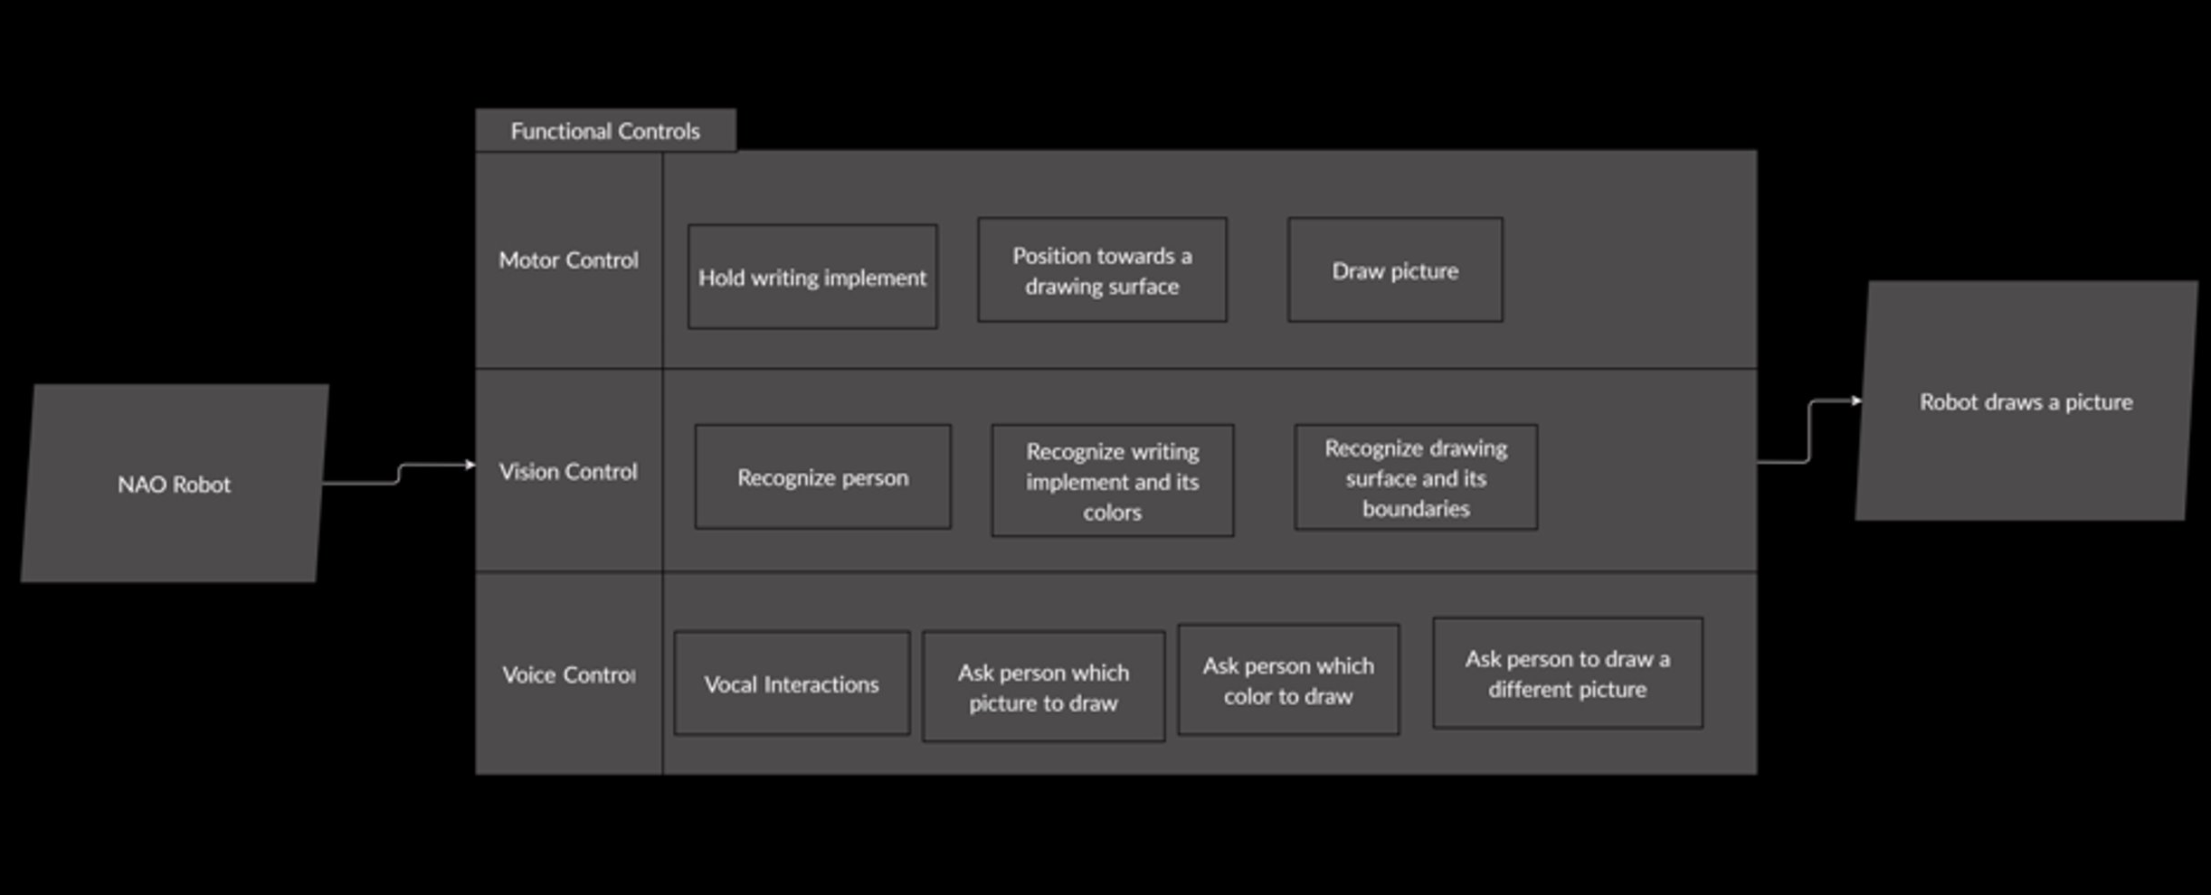
BLOCK DIAGRAM
Notes:
Andrew

Slide 29
SYSTEM DESIGN EXPECTATIONS
Design will entail programing the NAO robot to draw with another person
Must supplement existing NAOqi API to perform more detailed tasks
Handling a writing implement
Recognizing a writing surface
Intricate joint movement
Social interaction
Since project is going to be implemented using NAO…
Majority of time will be spent developing/testing various algorithms
Most anticipated problems are standard problems with software development
System integration
Lots of tasks working simultaneously
Notes:
Colton

Slide 30

ISSUES
Minimal robotics experience
Minimal Python experience
Limited knowledge of Neural Networks and Machine Learning
Proprietary NAO Framework
Limited knowledge of ASD social behavior and therapies
COVID-19 closures and limitations
Notes:
Andrew

Slide 31
TIMELINE
Development
2020
Requirements Analysis Report
SDK Design
Project Proposal Presentation
Design Review Presentation
Final Presentation
Begin Development
Finish Development
Start Integration Testing
2021
Design
4
4 || 19
29
1
26
9
12
7
Testing
DEC
JAN
FEB
MAR
APR
MAY
Notes:
Bryce
Sprints:
2/8 - 2/19
2/22 - 3/5
3/8 - 3/19
3/29 - 4/9
4/12 - 4/23
4.26 - 5/7

Slide 32
TIMELINE: UPCOMING TASKS
Task | Assigned To | Start | Complete By
Setup Robot Remote Access | Setup – Bryce, Andrew Materials – Will, Colton | Begun | Before end of semester
Requirements Analysis Report | Full Team | Begun | 12/4/2020
Test NAO’s ability to hold marker | Will | ASAP | First week of Spring semester
Research Depth Sensors | Xbox Kinect – Bryce, Andrew LIDAR - Will, Colton | 12/4/2020 | 1/29/2021
SDK Design | High Level – Bryce Focus Areas – To Be Assigned | 1/19/2021 | 2/26/2021
Prepare Proposal Presentation | Full Team | 1/22/2021 | 1/29/2021
Deliver Proposal Presentation | Full Team | 1/29/2021 | 1/29/2021
Notes:
Bryce

Slide 33

DRAFT BUDGET
Items:
Jetson Nano GPU
Remote access equipment: Camera, “play pen” fence, padding
3D printed materials: utensil holder, backpack (for GPU)
Depth Sensor (Lidar/Infrared)
Cost allocation:
Jetson Nano GPU - free, borrowed from advisor Bill Michael
Depth Sensor ($300 maximum)
Remaining materials ($100 maximum)
Funds will be acquired from department allowance of $100 per person (total $400)
Notes:
Will

Slide 34

CONCLUSION
Extend the existing NAO Framework to support advanced social behaviors
Cognition
Speech
Vision
Mobility & Motor Control
Provide advanced social behaviors in order to promote interaction and social learning for ASD youth
Fulfill specific Social Interactive Drawing scenario
Create documented SDK for future application development
Notes:
Colton

Slide 35

REFERENCES
Images:
https://www.eduporium.com/media/catalog/product/cache/c687aa7517cf01e65c009f6943c2b1e9/n/a/nao-print_03_4.png
https://www.eduporium.com/media/catalog/product/cache/c687aa7517cf01e65c009f6943c2b1e9/n/a/nao-print_06_4.png
Diehl, J., Schmitt, L., Villano, M., & Crowell, C. (2012, January). The Clinical Use of Robots for Individuals with Autism Spectrum Disorders: A Critical Review. Retrieved November 28, 2020, from https://www.ncbi.nlm.nih.gov/pmc/articles/PMC3223958/
NAO⁶. (n.d.). Retrieved Fall, 2020, from https://developer.softbankrobotics.com/nao6
Waltz, E. (n.d.). Therapy Robot Teaches Social Skills to Children With Autism. Retrieved November 28, 2020, from https://spectrum.ieee.org/the-human-os/biomedical/devices/robot-therapy-for-autism
Zhang, Y., Song, W., Tan, Z., Zhu, H., Wang, Y., Lam, C., . . . Yi, L. (2019, April 09). Could social robots facilitate children with autism spectrum disorders in learning distrust and deception? Retrieved November 28, 2020, from https://www.sciencedirect.com/science/article/pii/S0747563219301487

Slide 36




























ANY QUESTIONS?
Index:
Title
Team Organization
Problem Overview
Problem Background
Constraints
Literature Search
Project Scope
Standards Discussion
Requirements Analysis:
Environment Survey
Customer Needs & Wants
Considerations
Requirements Specifications:
Use Case 1: Load Master Module
Use Case 2: Initialize Activities Master Module
Use Case 3: Start Activity
Use Case 4: Select Object to Draw
Use Case 5: Obtain Writing Implement
Use Case 6: Draw Object
Use Case 7: Interact with Subject
Use Case 8: Complete Activity
Block Diagram
System Design Expectations
Issues
Timeline
Upcoming Tasks
Draft Budget
Conclusion
References
Notes:
ADOS Severity score – Autism Diagnostic Observation Schedule
Diagnostic and Statistical Manual of Mental Disorders (DSM-5) governs the criteria for making an autism spectrum diagnosis
Autism spectrum disorder (ASD) is a complex developmental condition that involves persistent challenges in social interaction, speech and nonverbal communication, and restricted/repetitive behaviors. The effects of ASD and the severity of symptoms are different in each person.
Not responding to his/her name by 12 months of age
Not pointing at objects to show interest by 14 months
Not playing "pretend" games by 18 months
Avoiding eye contact or preferring to be alone
Getting upset by minor changes
Flapping their hands, rocking their body or spinning in circles
Having unusual and sometimes intense reations to the way things smell, taste, feel and/or look
Levels:
1 – Requires Support
2 – Requiring Substantial Support
3 – Requiring Very Substantial Support

