Slide 1
Purpose & Scope (JC)
Monitor Racks & Servers
Interactive GUI
Utilise Papillon system

Slide 2
Design Methodology: Agile
Project Management
  Trello
Software Development
  GitHub

Slide 3
Front End (RF)
Demo
  Index.jsp
  Hosts.jsp

Slide 4
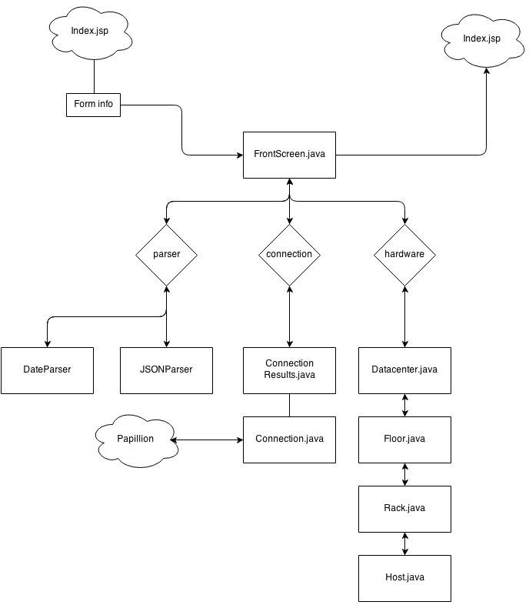
Architecture (AD & CG)

Slide 5
Testing
Unit Testing
Integration Testing
Regression Testing

Slide 6
Issues (JdP)
Risky Estimates?
Max & Doomsday figure
Date before server existed

Slide 7
Future Works
Disclosure to state estimates run a risk
Use JSON info with timestamp to check new max.
Weighted Average

