Slide 1
Representations of Ignorance Statements: Known Unknowns in Prenatal Nutrition
Acknowledgements:
Mike Bada
Tiffany Callahan
Kevin Cohen
William Baumgartner
Mayla Rachel Boguslav
University of Colorado Anschutz Medical Campus
Advisors: Larry Hunter and Sonia Leach
AMIA NLP Working Group
Emerging NLP Opportunities
11/3/18
Funding: NLM Training Grant (3T15LM009451-12S1)
Notes:
10-12 minute talk!!
New NLP task – finding new relevant information that we are missing
Scientists think about more than facts – they think about questions but all of our NLP to date has been about information retrieval and extraction
I want to capture what are the open questions in the literature – previous work related but new task!!!
As we get better we can maybe find answers to the open questions

Slide 2

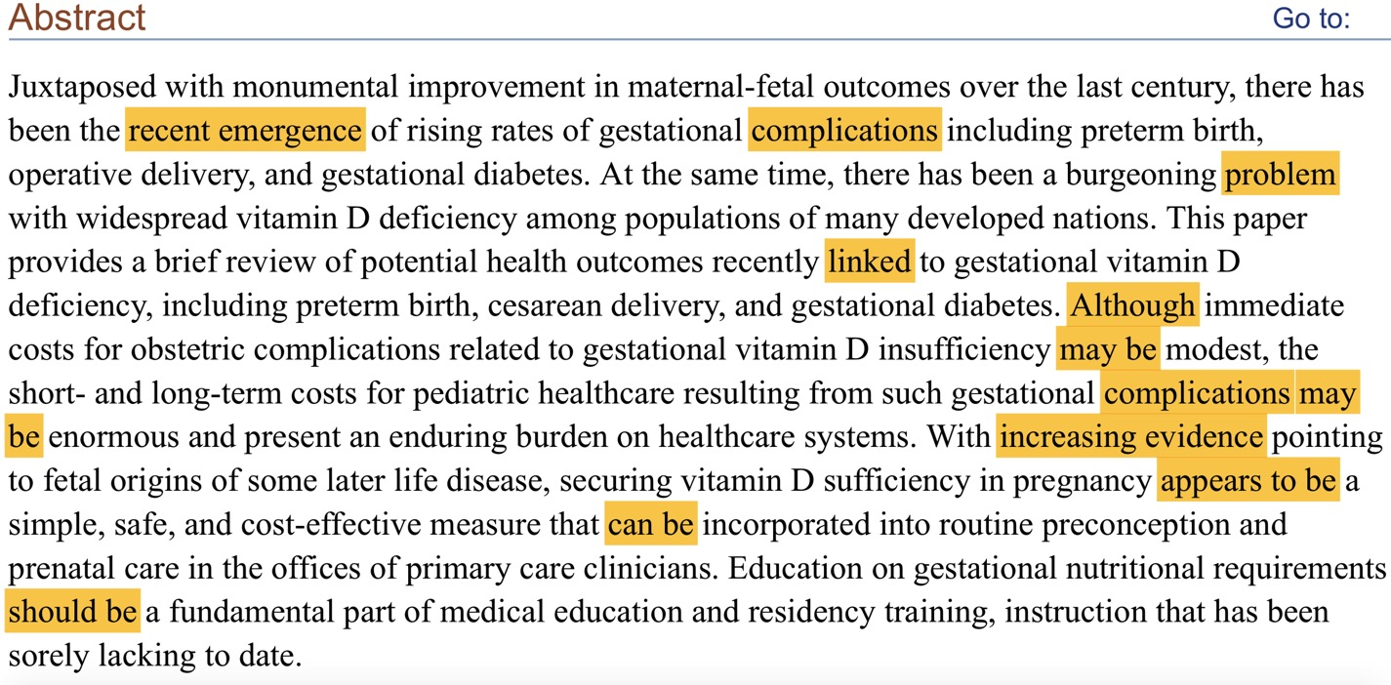
Classical NLP ignores hedged sentences
Lexical Cues:
Recent emergence
Complications
Problem
Linked
Although
May be
Increasing evidence
Appears to be
Can be
Should be
Notes:
Lots of epistemic cues – not facts so classical NLP would discard all of these sentences
Epistemics – how we know what we know
Given that, there has been previous work in epistemics but:
1. Many different names with no standard definition
2. Lexical cues given to help identify epistemics but no formal categorizations
3. Serving knowledge mainly to ensure that information extraction is factual not uncertain/unknown/speculated/hedged
Novel: I will serve the epistemics and not the knowledge in order to

Slide 3
Goals
1a: Create a taxonomy of ignorance statements to identify and classify ignorance statements (known unknowns) in the scientific literature.
1b: Create a formal representation of knowledge goals (next steps or future work) by combining elements of the taxonomy with characterizations of the specifics taken from Open Biomedical Ontologies.
Notes:
Not only create a formal taxonomy but also think about next steps or goals for knowledge from them

Slide 4
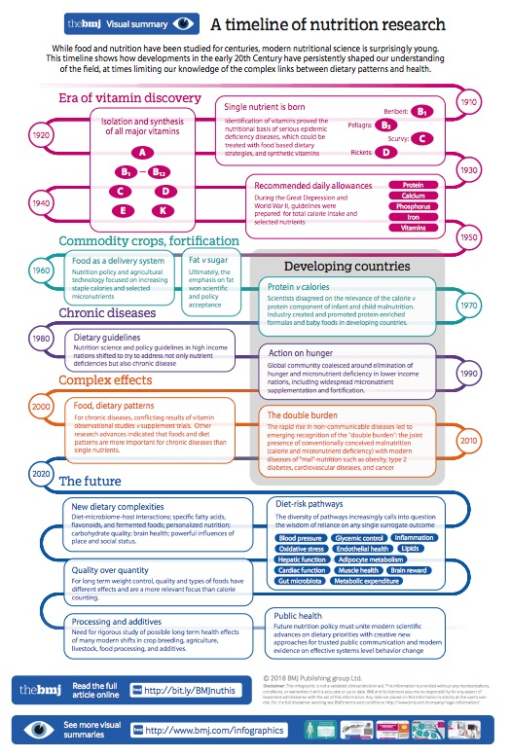
Characterize the important open questions in the literature
Notes:
What we could do if we had these:
Survey the literature – timeline based on questions not just answers and what we did – more true to the scientific endeavor
Use all the NLP information extraction outputs to see if we can find new knowledge (a new form of literature-based discovery)
Linguistically interesting – formalize and understand epistemics

Slide 5
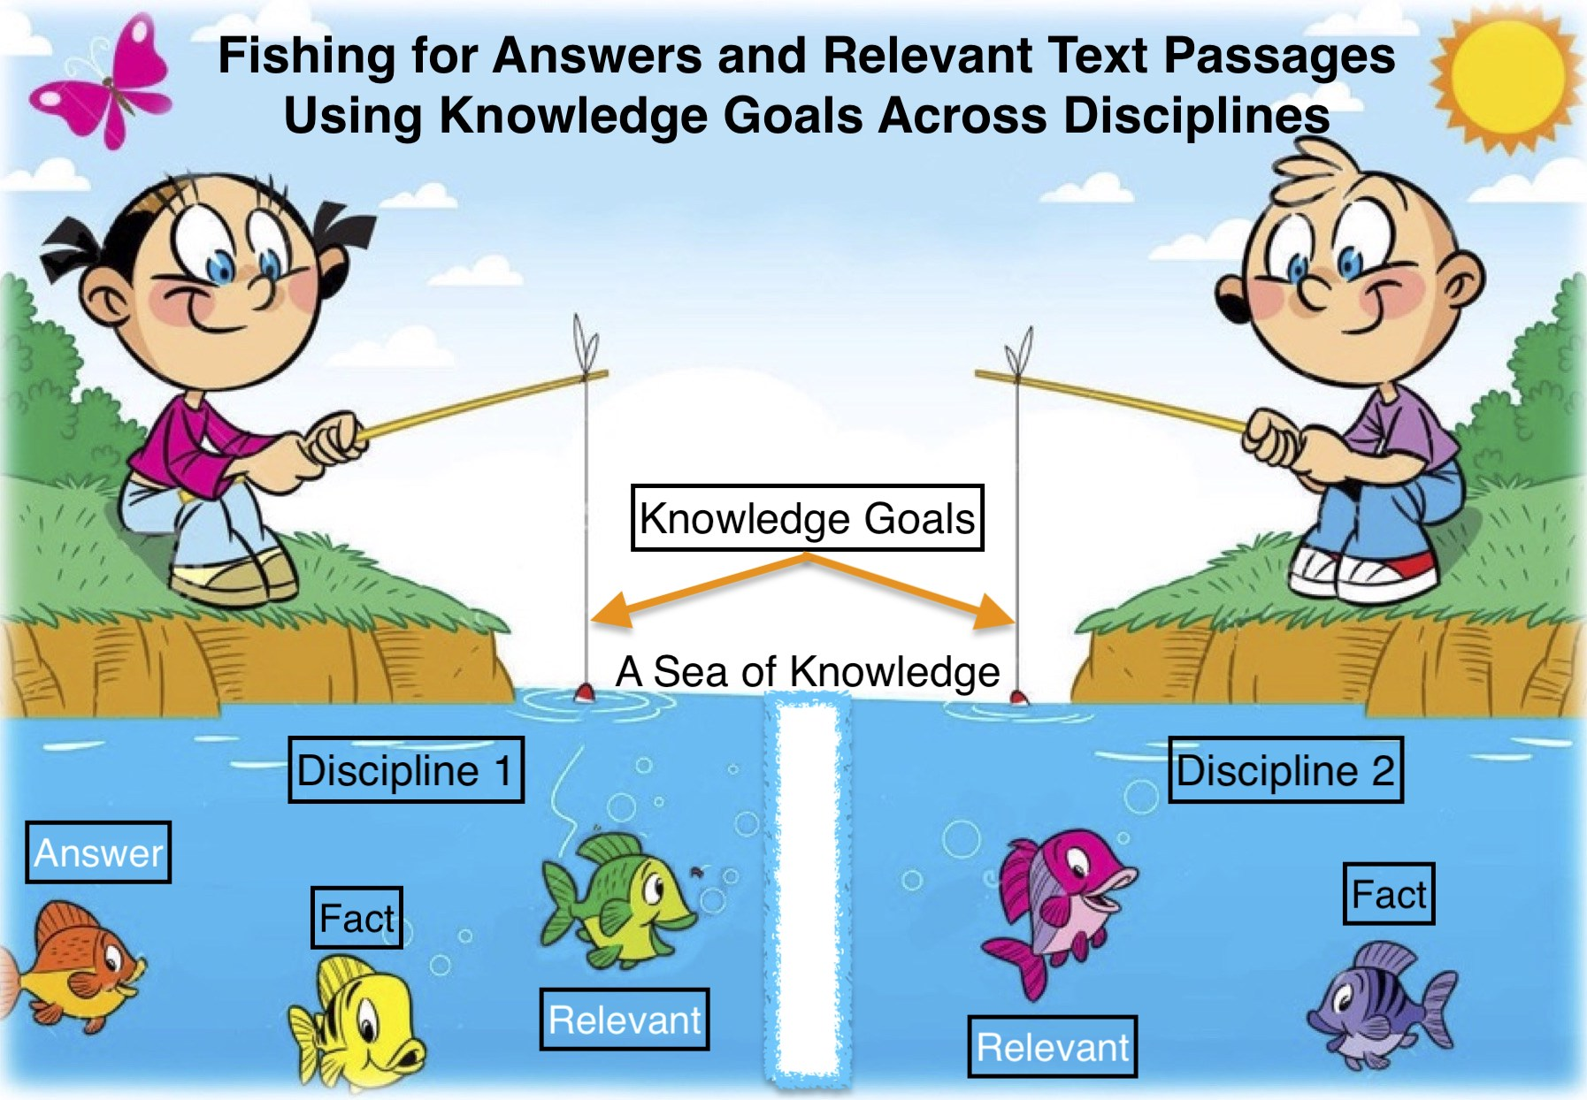
A new form of Literature-Based Discovery
https://playmotionmusic.com/pmm-basic-module-3/pmm-song-card-fishing-at-the-pond-front-mod3-trk6/
Notes:
What we could do if we had these:
Survey the literature
Use all the NLP information extraction outputs to see if we can find new knowledge (a new form of literature-based discovery)
Linguistically interesting – formalize and understand epistemics

Slide 6
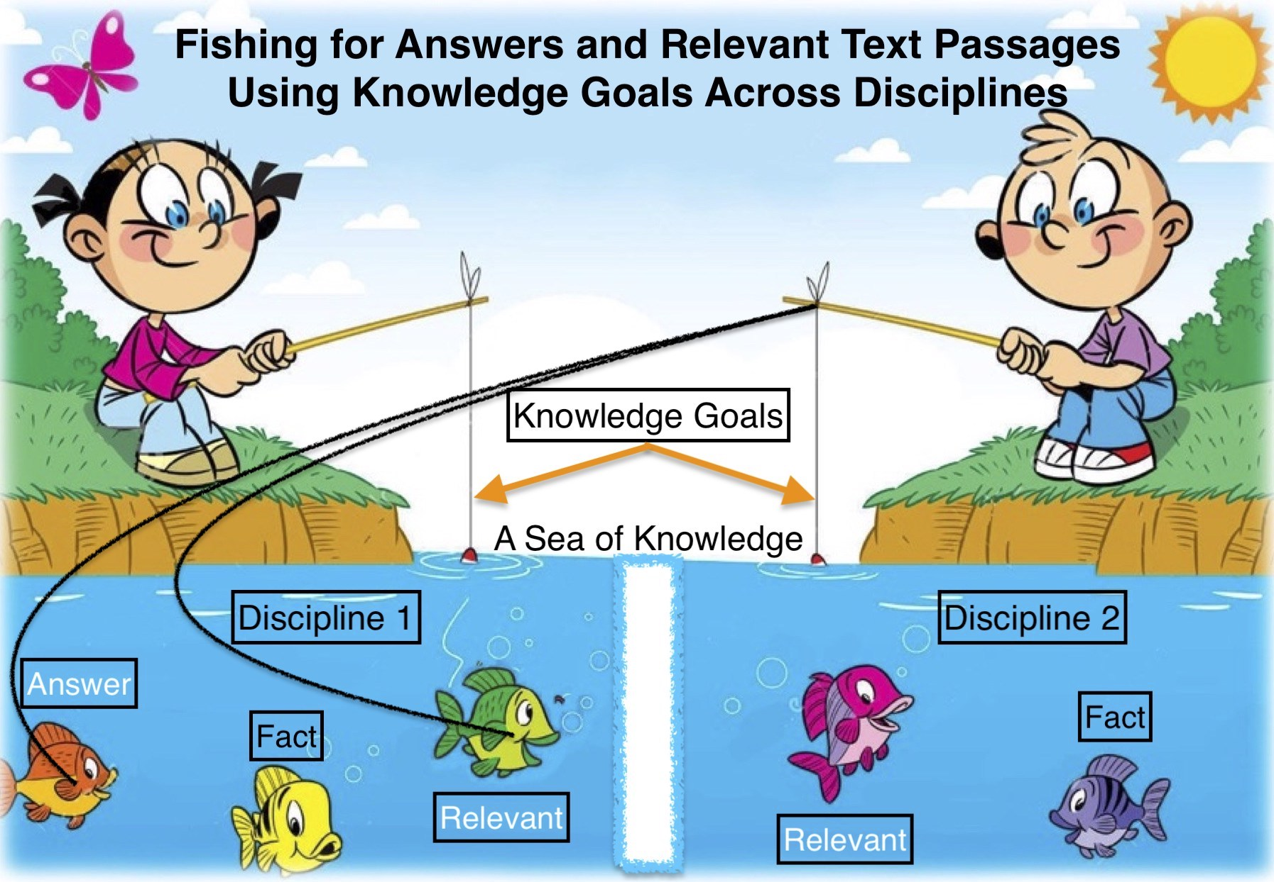
A new form of Literature-Based Discovery
https://playmotionmusic.com/pmm-basic-module-3/pmm-song-card-fishing-at-the-pond-front-mod3-trk6/
Notes:
What we could do if we had these:
Survey the literature
Use all the NLP information extraction outputs to see if we can find new knowledge (a new form of literature-based discovery)
Linguistically interesting – formalize and understand epistemics

Slide 7
Researchers | Definition | Product
Ken Hyland 1998 | Hedging = an unwillingness to make an explicit and complete commitment to the truth of propositions | Linguistic analysis in scientific discourse
Marc Light et al. 2004 | Hedge = an assertion relating to a result that does not necessarily follow from work presented, but could be extrapolated from it Affect = expressions of levels of belief | First annotation experiment in bioscience
Ben Medlock and Ted Briscoe 2007 | Hedge = hedge made in previous work, statement of knowledge paucity, speculative question or hypothesis, anaphoric hedge reference | Weakly supervised machine learning to aid curators to populate databases
Halil Kilicoglu and Sabine Bergler 2008 | Hedges = sentences can be true or false to some extent Levels of speculation | Linguistically oriented approach following Hyland 1998
Viola Ganter and Michael Strube 2009 | Weasel words = offer an opinion without really backing it up, and… are really used to express a non-neutral point of view | Hedge detection system based on Wikipedia
Veronika Vincze et al. 2008 | Speculation = the possible existence of a thing Negation = non-existence of something | BioScope Corpus = keywords and their scope
Richárd Farkas et al. 2010 | Hedges = indicating authors do not or cannot back up their opinions/statements with facts | CoNLL-2010 Shared Task = Uncertainty cues and their linguistic scope in Bioscope and Wikipedia
Chrysoula Zerva et al. 2017 | Uncertainty = Hypotheses, speculated outcome of an experiment, a case under investigation, a result attributed to an unclear external source | Contextualize evidence for models and assess confidence
Notes:
Effort in NLP is mainly in information extraction – so statements of ignorance have been discarded because not good for information extraction
New task – trying to categorize the unknowns – not the same thing as hedging but we can leverage the previous work but we need to come up with the types and content of the statements of ignorance
We never worried about the content before we would just
1. Definitions are all different – not standardized
2. Lexical cues given to help identify epistemics
3. Serving knowledge mainly to ensure that information extraction is factual not uncertain/unknown/speculated/hedged
- about caveating things
Novel: I will serve the epistemics and not knowledge and the scientific method!
Weasel words from Wikipedia: https://en.wikipedia.org/wiki/Wikipedia:Manual_of_Style/Words_to_watch#Unsupported_attributions

Slide 8
CLASSICAL NLP: OPEN BIOMEDICAL ONTOLOGIES
UBERON:0000922
(UBERON:“embryo”)
DOID:4
(DOID:“disease”)
With increasing evidence pointing to fetal origins of some later life disease,
ChEBI:27300
(ChEBI:“vitamin D”)
securing vitamin D sufficiency in pregnancy appears to be a
simple, safe, and cost-effective measure that can be incorporated into
HL7:C0033131
(HL7:“primary care physician”)
routine preconception and prenatal care in the offices of primary care clinicians.
Notes:
Specific sentence from the abstract as an example – first we add open biomedical ontologies (classic NLP)
- From CRAFT: chebi, go, so, pato, uberon, cl, pro,
These slides get busy so just bare with me
Add colors!!!!

Slide 9
Ignorance Taxonomy (My work)
Methodology: Manually annotated 736 prenatal nutrition abstracts
Claims/Questions/Evidence
Full unknown, Explicit questions, Alternative options, Incomplete evidence
Links/Understanding
Possible understanding, Probable Understanding, Superficial Relationship, Etiology
Future opportunities
Future work, Non-urgent recommendation, Future prediction, Urgent call to action
Surprises/Interesting
Curious finding, Unexpected Observation
Issues/Concerns
Difficult task, Problems or complications, Controversy
Questions answered by this work
Michael Smithson, Carl Craver and Lindley Darden, Stuart Firestein
Notes:
Yellow = focus on from the sentence example
We will focus in on the ones highlighted to follow through with an example

Slide 10
ADDING EPISTEMICS
Epistemic
(EC:‘’incomplete evidence”)
UBERON:0000922
(UBERON:“embryo”)
DOID:4
(DOID:“disease”)
With increasing evidence pointing to fetal origins of some later life disease,
ChEBI:27300
(ChEBI:“vitamin D”)
Epistemic
(EC:‘’unexpected observation”)
securing vitamin D sufficiency in pregnancy appears to be a
Epistemic
(EC:‘’possible understanding”)
simple, safe, and cost-effective measure that can be incorporated into
HL7:C0033131
(HL7:“primary care physician”)
routine preconception and prenatal care in the offices of primary care clinicians.
Notes:
Specific sentence from the abstract as an example – first we add open biomedical ontologies (classic NLP), second we add epistemics in yellow

Slide 11

ADDING GENERAL SUBJECT
Epistemic
(EC:‘’incomplete evidence”)
UBERON:0000922
(UBERON:“embryo”)
Subject
(S:“establishes”)
DOID:4
(DOID:“disease”)
With increasing evidence pointing to fetal origins of some later life disease,
ChEBI:27300
(ChEBI:“vitamin D”)
Subject
(S:“sustains”)
Epistemic
(EC:‘’unexpected observation”)
securing vitamin D sufficiency in pregnancy appears to be a
Subject
(S:“methodology”)
Epistemic
(EC:‘’possible understanding”)
simple, safe, and cost-effective measure that can be incorporated into
Subject
(S:“environment”)
HL7:C0033131
(HL7:“primary care physician”)
routine preconception and prenatal care in the offices of primary care clinicians.
Notes:
Specific sentence from the abstract as an example – first we add open biomedical ontologies (classic NLP), second we add epistemics in yellow, third we add the general subject of the epistemics
I know this is a busy slide but bare with me and pay attention to what is added = the subject
Add a color for subject to stand out

Slide 12
Dependency parse of example sentence – knowledge goals
APPEARS
with
.
evidence
be
increasing
pointing
securing
to
measure
to
origins
fetal
of
disease
some
later
life
sufficiency
vitamin
D
in
pregnancy
a
simple
incorporated
,
safe
,
and
cost-effective
that
can
be
into
in
preconception
routine
and
care
prenatal
offices
the
of
clinicians
primary
care
KEY:
Epistemics
Subjects
OBOs
https://github.com/tensorflow/models/tree/master/research/syntaxnet
Notes:
Origins = establishes/etiology
Sufficiency = sustains/ adequate nutrition
Measure = methodology
Incorporated = environment

Slide 13
Dependency parse of example sentence – knowledge goals
APPEARS
with
.
evidence
be
increasing
pointing
securing
to
measure
to
origins
fetal
of
disease
some
later
life
sufficiency
vitamin
D
in
pregnancy
a
simple
incorporated
,
safe
,
and
cost-effective
that
can
be
into
in
preconception
routine
and
care
prenatal
offices
the
of
clinicians
primary
care
KEY:
Epistemics
Subjects
OBOs
https://github.com/tensorflow/models/tree/master/research/syntaxnet
Notes:
Origins = establishes/etiology
Sufficiency = sustains/ adequate nutrition
Measure = methodology
Incorporated = environment

Slide 14
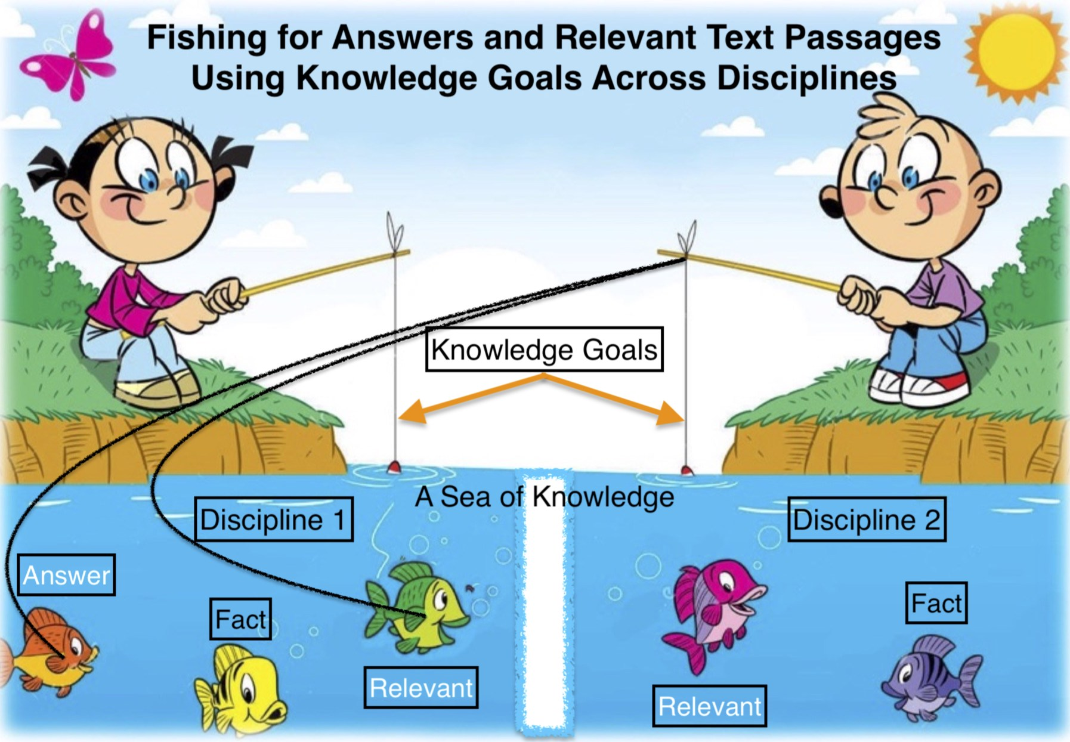
Goals
1a: Create a taxonomy of ignorance to identify and classify ignorance statements in the scientific literature.
1b: Create a formal representation of knowledge goals by combining elements of the taxonomy with characterizations of the specifics taken from Open Biomedical Ontologies.
2: Create a relevance metric between an ignorance representation and text span to define an information retrieval system that returns the most relevant text passages from a large collection of biomedical journal articles.
Notes:
I will focus on the first 2 where we will follow through with the example abstract for everything specifically one sentence

Slide 15
Proof of concept to fish across disciplines
Methodology
Evaluation
Bag of words from knowledge goal concepts
Search Google Scholar for relevant articles
Cited articles near the knowledge goal within an article
Not-cited articles
Not relevant
Redundant information
New relevant knowledge
Notes:
Start with 2nd query first because it will show a true positive

Slide 16
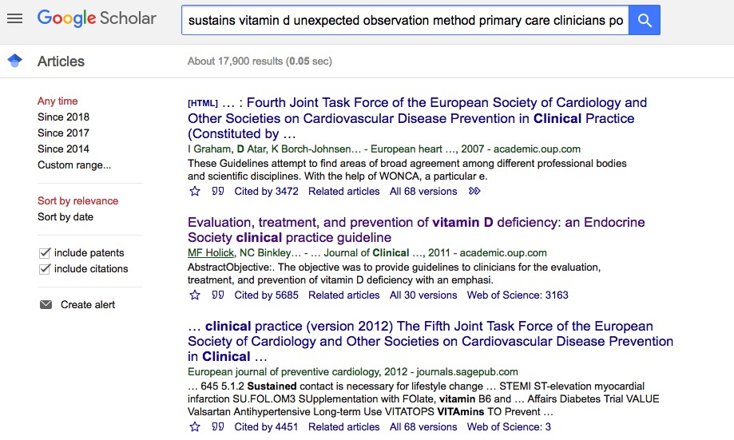
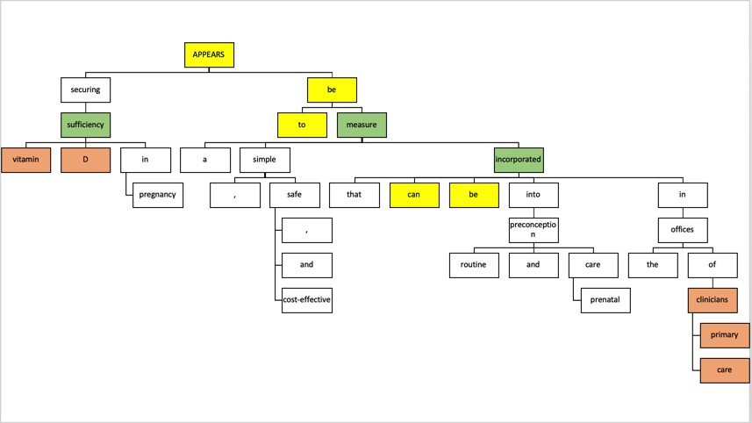
Proof of concept: Cited article
Notes:
Google searches with query results
Also mention we need to figure out how articles are not relevant

Slide 17
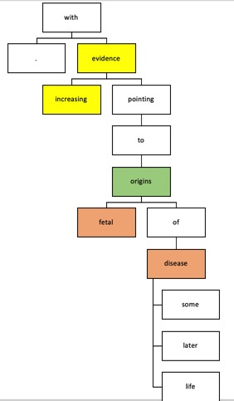
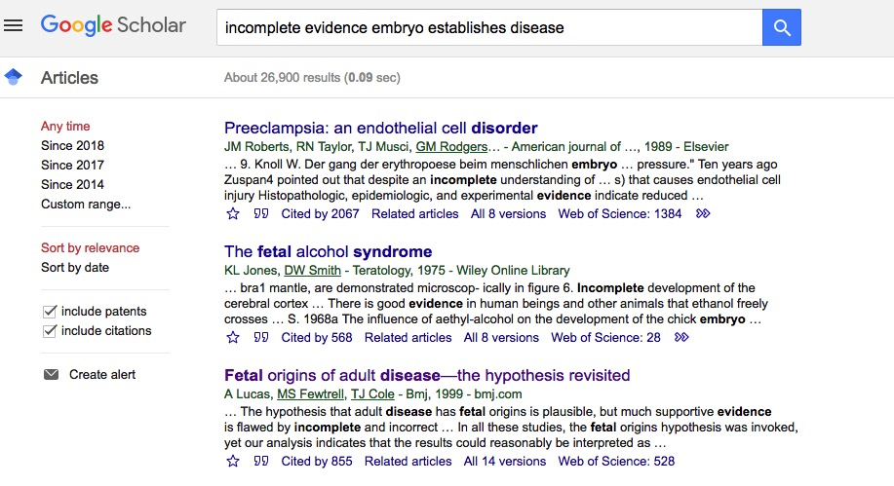
Proof of concept: Not-cited article
Notes:
Google searches with query results
Also mention we need to figure out how articles are not relevant

Slide 18
Ignorance Taxonomy
QUESTIONS?
Claims/Questions/Evidence
Full unknown, Explicit questions, Alternative options, Incomplete evidence
Links/Understanding
Possible understanding, Probable Understanding, Superficial Relationship, Etiology
Future opportunities
Future work, Non-urgent recommendation, Future prediction, Urgent call to action
Surprises/Interesting
Curious finding, Unexpected Observation
Issues/Concerns
Difficult task, Problems or complications, Controversy
Questions answered by this work
Contact: Mayla.Boguslav@ucdenver.edu
Notes:
Yellow = focus on from the sentence example
We will focus in on the ones highlighted to follow through with an example

Slide 20
Epistemics Subject
Function
Abilities, Activities, Roles
Global Organization
Communication, Comparison, Disruption, Independent, Pathway, Regulation, Reproducibility, Risk, Safety, Model, Methodology
Location/Context
Body location, Environment, Model/Animal system, Sex
Production
Establishes, Mobilization, Sustains
Structures/Entities
Characteristics, Magnitude/Amount/Size, Molecular nature, Morphology, Structure/Consistency/Uniformity
Timing
Age, Duration, End time, Start time, Time points
Notes:
Yellow = focus on from the sentence example
We will focus in on the ones highlighted to follow through with an example

Slide 21
Epistemic Concept | Definition | Knowledge Goal
Incomplete Evidence | a statement of one proposed explanation for a phenomenon (SIO_000284) on the basis of limited evidence as a starting point for further investigation;; OR; a statement that information is needed to support an assertion or claim (ECO_0000000) including both positive and negative statements. Either some evidence already exists, explaining how current findings support previous work, adding confidence to the claim OR a statement that information is limited, more research is needed or is ongoing, including limitations - biases or short comings related to the study design and execution (IAO_0000631) | gather more evidence to support the claim or conduct more research to determine the validity of the claim; complete the partial picture; Consider the short comings and biases for the next experiment and how it can be addressed
Possible Understanding | a statement of a feasible explanation, relationship, or phenomenon; ; no claim to the correct explanation, relationship, or phenomenon | determine the most feasible or correct explanation, relationship or phenomenon either mentioned or not
Unexpected Observation | a statement of a judgement or inference from an observable phenomenon that the researchers did not expect; an element of surprise | repeat the experiment or simulation to make sure observation is repeatable; ; think about next steps with the results
Notes:
The ones used in our example – too long = shorten it

Slide 22
Epistemic Concept | Definition | Knowledge Goal
Establishes | information about establishment including formation and signaling | What establishes it? How is it established? What forms it? What signals it?
Sustains | information about its maintenance including reduction, loss, and retention | What sustains it? Is it sustained?
Methodology | instrumentation or methodologic information | Is the instrumentation appropriate? Does it fulfill all its needs?
Environment | the outside surroundings of the system | What are the surroundings? What role do the surroundings play?
Notes:
The ones used in our example

Slide 23
Ignorance Statements Create Knowledge Goals
Ignorance statement = a statement of alternative options, questions answered by this work, problems complications, controversy, curious finding, difficult task, etiology, explicit question, future work, incomplete evidence, possible understanding, future prediction, probable understanding, non-urgent recommendation, superficial relationship, unexpected observation, full unknown, urgent call to action
Knowledge goal = next steps or future work
What we could do if we had these:
Survey the literature
Use all the NLP information extraction outputs to see if we can find new knowledge (a new form of literature-based discovery)
Linguistically interesting – formalize and understand epistemics
Notes:
Need a better definition of ignorance statement!
Think about fields in terms of its questions/goals for knowledge over time
Helpful for grad students, researchers if find something beyond their field
New form of summarization
Relevance metric
Lots of definitions around it – not formally categorized yet

Slide 24
Goals
1a: Create a taxonomy of ignorance to identify and classify ignorance statements in the scientific literature.
1b: Create a formal representation of knowledge goals by combining elements of the taxonomy with characterizations of the specifics taken from Open Biomedical Ontologies.
2: Create a relevance metric between an ignorance representation and text span to define an information retrieval system that returns the most relevant articles from a large collection of biomedical journal articles.
Notes:
I will focus on the first 2 where we will follow through with the example abstract for everything specifically one sentence

Slide 25
How are concepts linked – knowledge goals?
is about (IAO:0000136 ) =
1 .
INCOMPLETE EVIDENCE
EMBRYO
ESTABLISHES
DISEASE
2 .
SUSTAINS
VITAMIN D
UNEXPECTED OBSERVATION
METHODOLOGY
PRIMARY CARE CLINICIAN
POSSIBLE UNDERSTANDING
ENVIRONMENT
Notes:
Is about is the fundamental relationship from the relations ontology – ask mike where is_about came from?
GOOGLE SEARCHES:
incomplete evidence embryo establishes disease
sustains vitamin d unexpected observation method primary care clinicians possible understanding environment

Slide 26
How are concepts linked – knowledge goals?
is about (IAO:0000136 ) =
1 .
INCREASING EVIDENCE
FETAL ORIGINS
DISEASE
2 .
SECURING VITAMIN D SUFFICIENCY
APPEARS TO BE
SIMPLE, SAFE, AND COST-EFFECTIVE MEASURE
CAN BE
ROUTINE PRECONCEPTION AND PRENATAL CARE IN THE OFFICES OF PRIMARY CARE CLINICIANS
Notes:
Is about is the fundamental relationship from the relations ontology – ask mike where is_about came from? – Add in the IAO numbers

Slide 27
Knowledge Goals
incomplete evidence
establishes
embryo
disease
unexpected observation
sustains
vitamin D
methodology
primary care clinicians
environment
possible understanding

Slide 28
APPEARS
be
securing
to
measure
sufficiency
vitamin
D
in
pregnancy
a
simple
incorporated
,
safe
,
and
cost-effective
that
can
be
into
in
preconception
routine
and
care
prenatal
offices
the
of
clinicians
primary
care

Slide 29
with
.
evidence
increasing
pointing
to
origins
fetal
of
disease
some
later
life

