Slide 1

How to work with
BRaIN GitHub
Seyed Yahya Shirazi
Biomechanics, Rehabilitation, and Interdisciplinary Neuroscience (BRaIN) Lab
University of Central Florida
Dec 2019

Slide 2
Git & GitHub
Git is a version management tool for single or multiple collaborators.
Using Git, all the changes made on a “supported” file are documented.
In case of collaboration, changes of different people can be brought together and conflicts can be resolved.
Git repositories can be on disks or on cloud.
GitHub (now a Microsoft service), is a cloud Git host. Academic use of GitHub is free.

Slide 3
BRaIN GitHub
BRaIN GitHub is the place to back up and share your code with lab members.
To join, send your GitHub handle to Dr. Huang and wait for the invitation email.
Visit github.com/UCF-BRaIN-Lab to see current repositories.

Slide 4
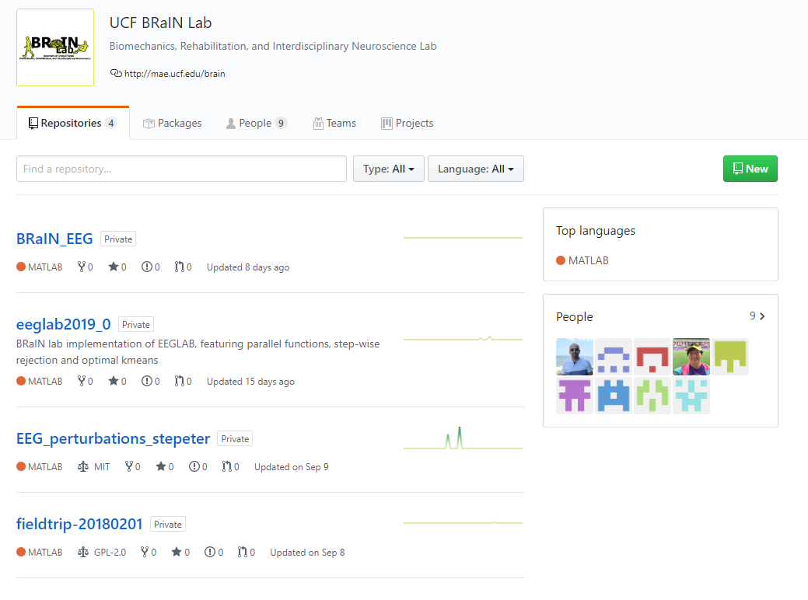
BRaIN GitHub
Private repositories
What if you can’t see a repository?
How to create a repository?
How can you access a repository?

Slide 5
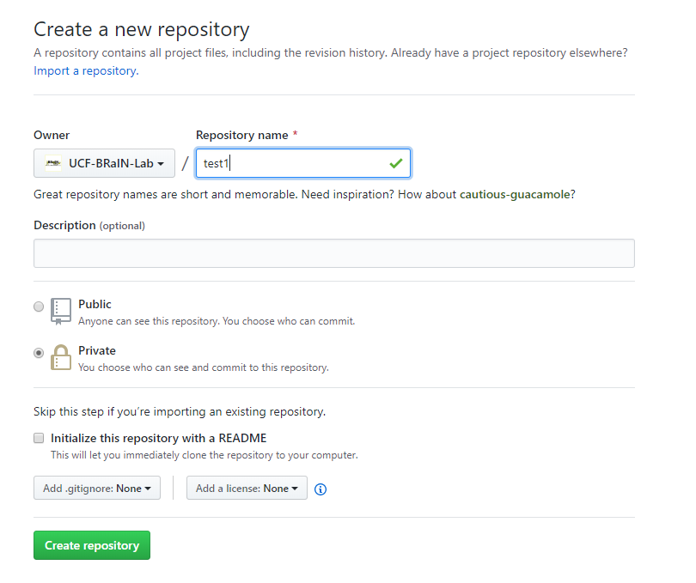
How to create a repository
Should you import a repository?
Public or Private?
What is README?
License and gitignore

Slide 6
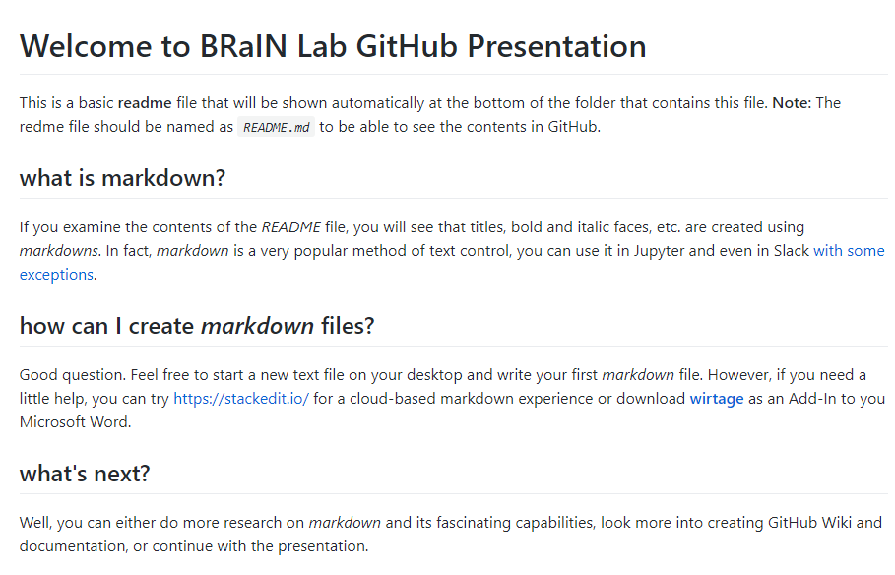
Markdown files for README
Please read the readme on UCF-BRaIN-Lab/GitHub_presentation

Slide 7
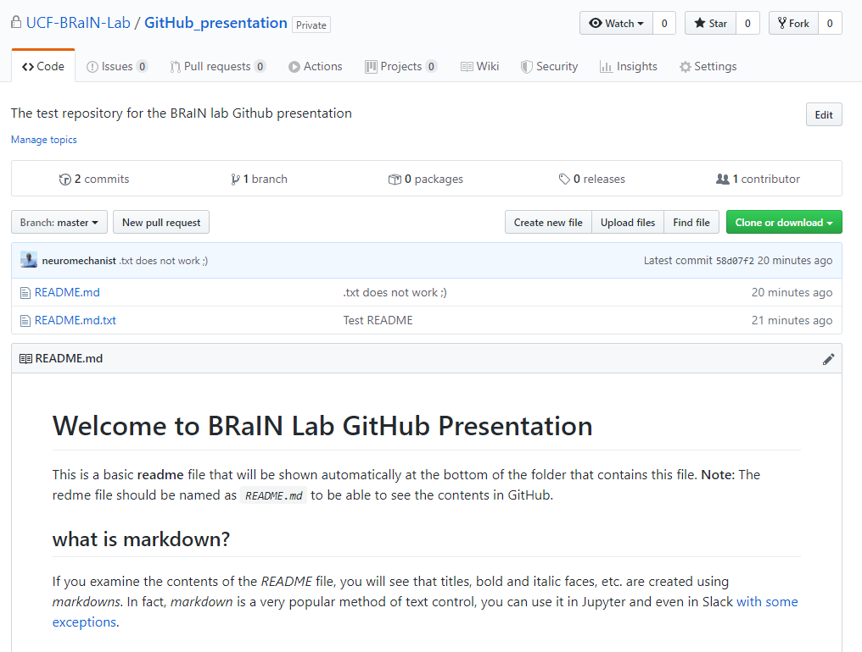
Can I make a change in a repository
Yes, but only on your own branch & after you contact an Admin.
Once you are set, you can create a branch that includes your name from any other branch.
Contact an admin if your edits are good and you want to merge your branch to an upper branch.

Slide 8

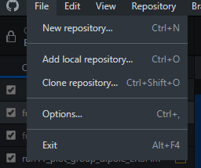
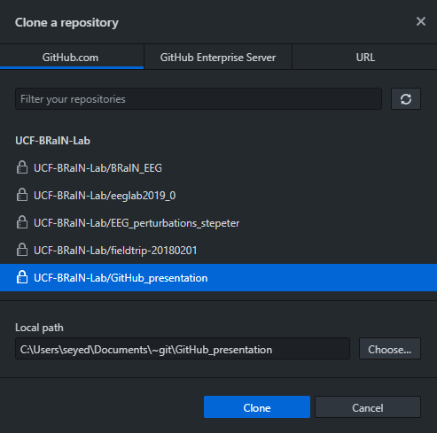
let’s continue on desktop

Slide 9
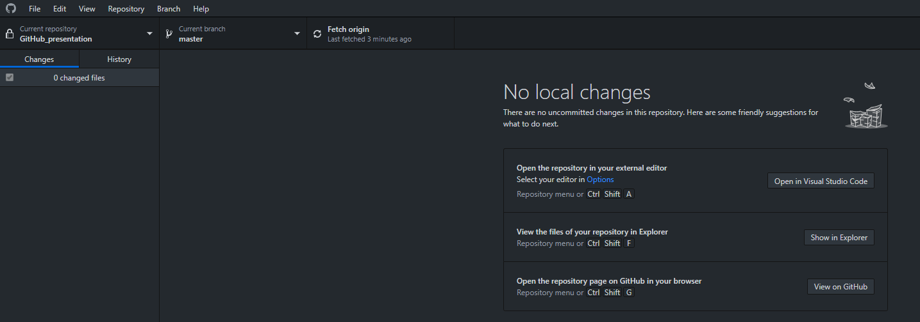

your screen should look like this

Slide 10
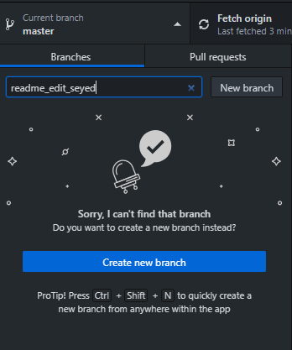
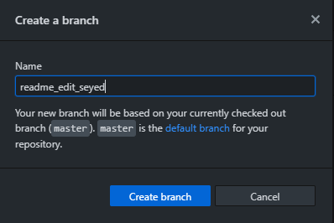
create a branch
You need to include your name to the branch to be able to create one.
Pay attention to the upper branch you want to base you branch on.

Slide 11
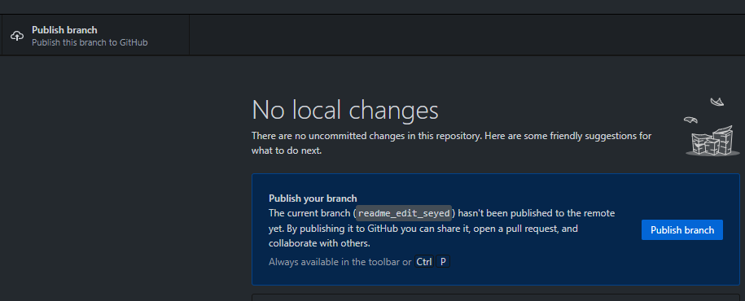
publish you branch

Slide 12
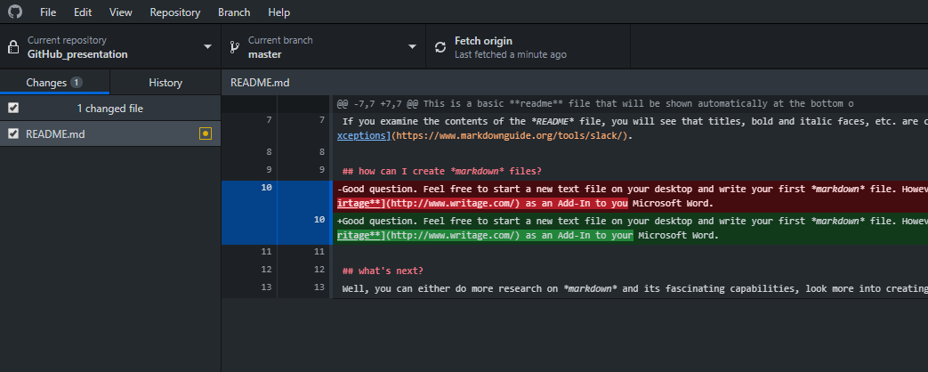
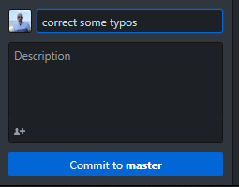
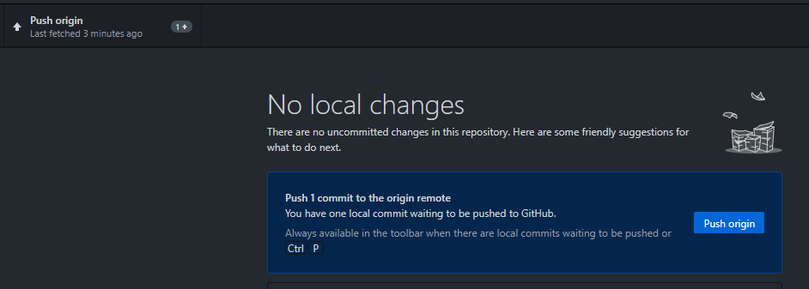
Make a change, commit, and push

Slide 13

Have fun using GitHub 😎

