Slide 1
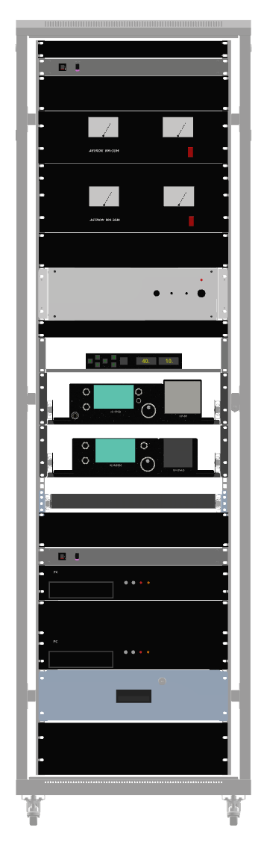
1U
PDU
2U
Astron 1
1U
Astron 2
2U
Linear behind panel
Q-Pace CGS
1U
Big RAZ Ctlr
IC-9700
Sliding shelves with brackets/clamps
IC-R8600
Slide out Table
2U
PDU
PC1-RF
2U
If tipover is a concern, swap location
of the Astron supplies and the PCs.
Blank panels indicated in “U”s.
Once installed, 3U panels can be
machined to fit the IC-R8600 and
IC-9700
PC2-Pointing
Equipment should be placed on
rails or shelves except for the
Communications Rx and the UHF
TRx; the latter are on sliding shelves.
3U

Slide 2
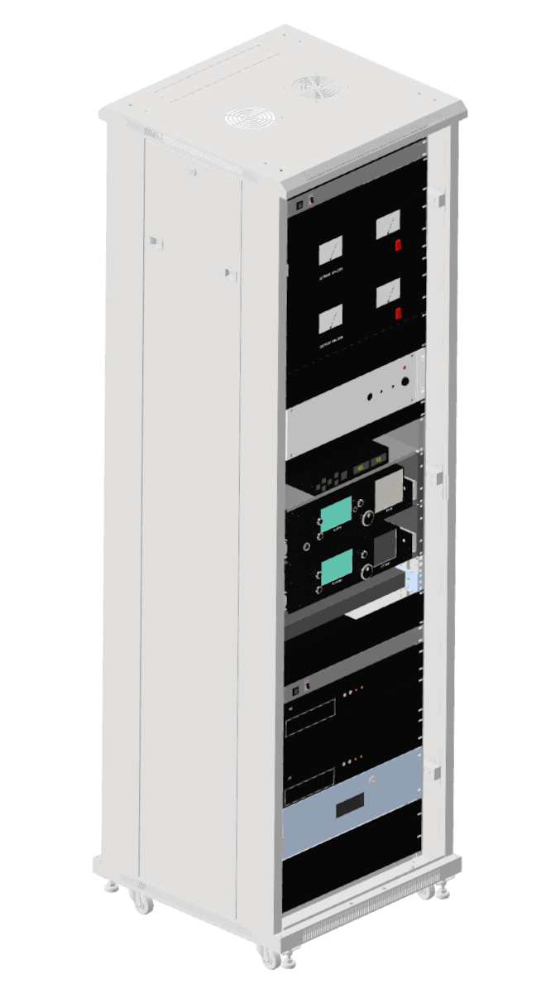
Cool air should enter from
rear. Observe airflow exiting
equipment; locate hot
equipment at the upper
part of the rack.
Except for equipment
with front vents
(venting inward)
the front should be
airflow restrained.
This panel should be
replaced with vents/
filter if plenum space
heat is excessive

