Slide 1
SHE: A Fast and Accurate Deep Neural Network for Encrypted Data
Qian Lou, Lei Jiang
Indiana University Bloomington

Slide 2
Outline
1. MLaaS and Data Privacy
2. Secure MLaaS
3. Our work
4. Conclusion

Slide 3
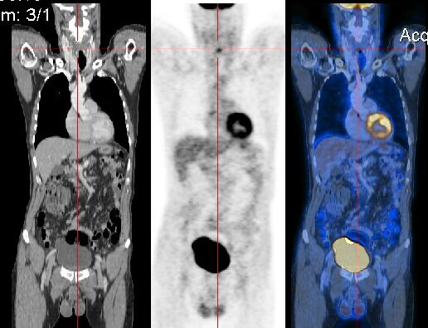
Machine Learning as a Service(MLaaS)
Client’s image is exposed to server
MLaaS
Private data
MLaaS needs to protect client’s data privacy
Notes:
Let’s see Machine learning as a Service. Assume there is a client and a server where this server helps client recognize image. This client sends one handwritten image to server and receives the result which is number 2. So far so good. However, there is a big issue for this model. This issue is that the client’s image is exposed to this server so that server knows user’s private data. If the input data is medical data, this problem is more important. So, MLaaS needs to protect client’s data privacy. But how?

Slide 4
Homomorphic Encryption
Homomorphism
Addictive homomorphism: F(a+b)=F(a)+F(b)
Multiplicative homomorphism: F(a*b)=F(a)*F(b)
Homomorphic Encryption: let F() is an encryption Enc()
Addition on ciphertext: Enc(a+b)=Enc(a)+Enc(b)
Multiplication on ciphertext:
Enc(a*b)=Enc(a)*Enc(b)
Notes:
Homomorphic Encryption enables secure machine learning as a service.
Firstly, let’s take look at Homomorphism. Addition homomorphism means that Function of (a+b) = Function of a + function of b.
Multiplication homomorphism means that Function of (a*b) = Function of a * function of b.
Homomorphic Encryption is nothing but let above function is and encryption function, denoted as Enc().

Slide 5
Secure addition example
Task : Server helps client compute (15=5+10) but server dose not know the number 5 and 10.
Solution: addition on ciphertext:
Let encryption function Enc(x)=2*x; decryption function Dec(x)=x/2;
1. Encryption: Enc(5)=10; Enc(10)=20.
5+10
2. Addition:
Enc(5+10)=Enc(5)+Enc(10) =30;
{5,10}
{10,20}
*2
3. Decryption:
+
Dec(Enc(5+10))=30/2=15
{15}
{30}
/2
Notes:
Let’s see an example how to do a secure addition on a server. Task : server helps client compute the sum between 5 and 10 but server dose not know the 5 and 10 from clients. The solution is that server performs addition on ciphertext, encrypted data.

Slide 6
HE enables secure MLaaS
Secure MLaaS
1. Encrypts input
2. Uploads encrypted input
3. Performs inference on encrypted data
4. Downloads encrypted prediction
5. Decrypts encrypted prediction

Slide 7
Problems
HE only supports linear operations
Addictive homomorphism ( F(a+b)=F(a)+F(b) )
Multiplicative homomorphism ( F(a*b)=F(a)*F(b) )
Deep Neural Network (DNN)
Linear operations ( Convolution Layer, Dense Layer)
Non-linear Operations (Activation functions, Max Pooling)
How to process non-linear operations?
Previous works: Polynomial approximation
ReLU: Y = max(x,0) ͌ X^2 ͌ 0.125x^2+0.25X+0.5

Slide 8
Outline
1. MLaaS and Data Privacy
2. Secure MLaaS
3. Our work
4. Conclusion

Slide 9
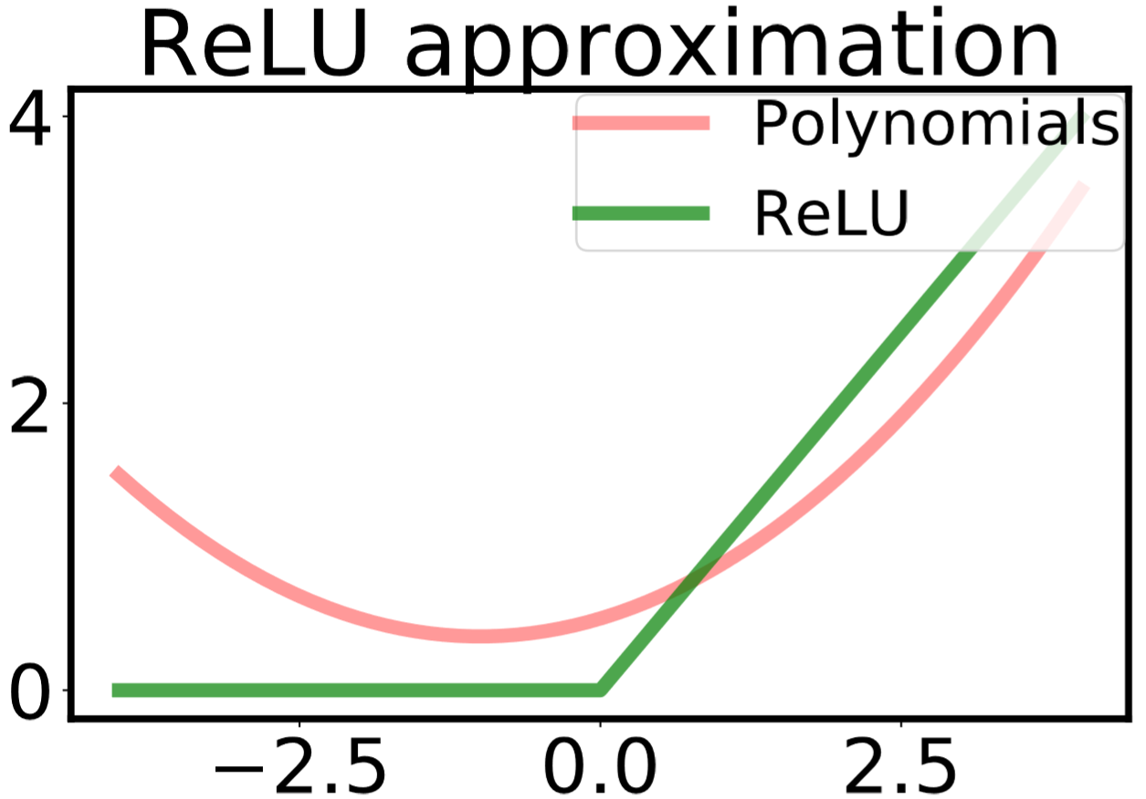
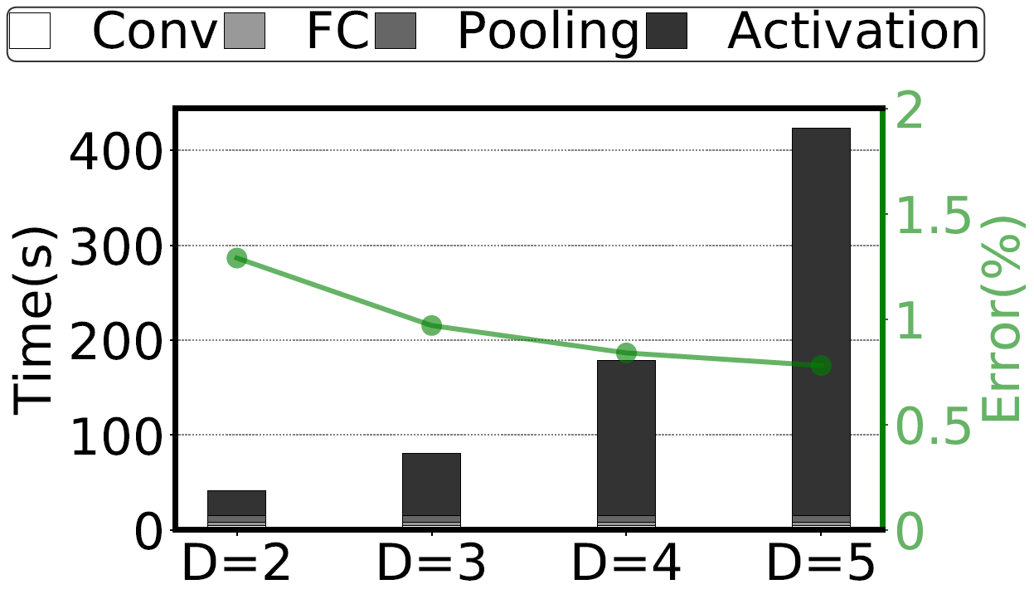
Motivation
1. Inaccurate approximation
2. Various-degrees approximation

Slide 10
Executive summary
Need: Fast and accurate deep Learning over encrypted data
Opportunities to improve privacy-preserving deep learning by the co-design of Homomorphic Encryption scheme and neural network optimization:
Binary bits-operations-friendly TFHE encryption scheme
Shift-Accumulation based quantization for neural network
Problem: Previous works stacked multiple & inaccurate ReLU activation and max pooling layers (Polynomials approximation):
Accuracy ↓ & overhead ↑ & shallow networks topology
Key Idea: Directly implementing ReLU and max using TFHE [1]; Using cheap Shift-Accumulation to support deeper neural networks other than acceleration.
SHE: Accuracy-lossless CNN, performance ↑76.12%, the first to support modern deep learning like AlexNet on ImageNet.
Notes:
First, I’ll give you a high level executive summary.
Our motivation is that CNN is accurate in mobile system.
Applications on mobile systems include critical tasks which focus more on accuracy and non-critical tasks which focus more on real-time.
QoS is essential.
And Process In Memory is a good method to get energy-efficiency computation.
The problem is CNN is slow and costs too much power.
Our goal is to get a QoS capable mobile device to run deep CNN applications.
The solution is 3DICT. Firstly, Lookup-based CNN can reduce MAC operations number; If we use 2d ReRAM MLC array to speedup LCNN, the endurance is a problem;
2D ReRAM SLC can improve endurance, but it suffers from throughput problem. At last 3D ReRAM SLC solves both throughput and endurance problems.
Our evaluation shows that 3DICT improves CNN test performance per Watt by 13%~61x over prior architectures

Slide 11
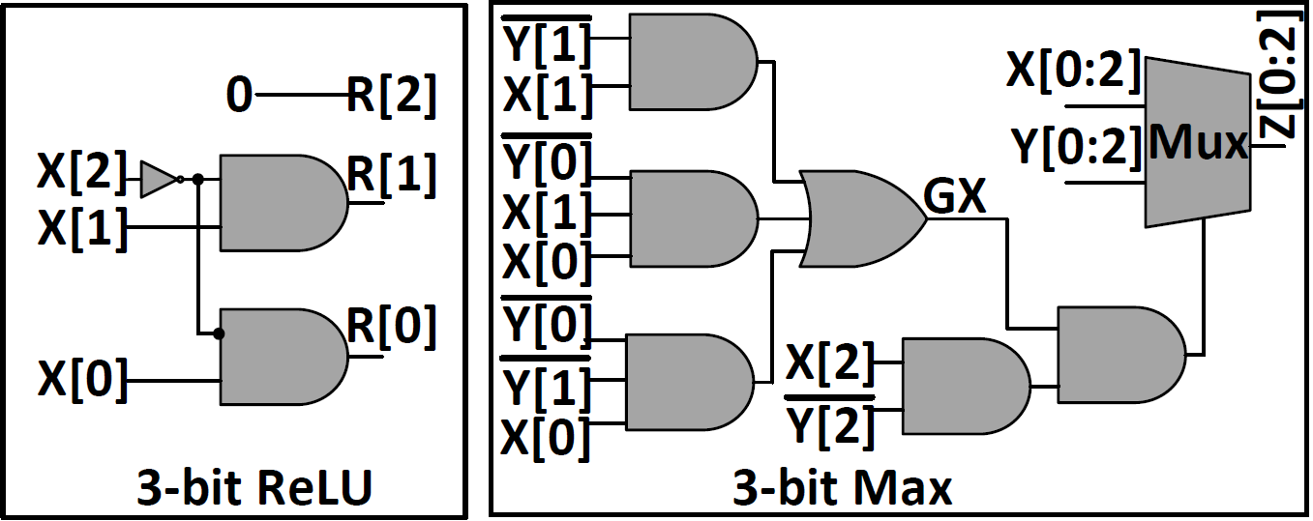
Our work SHE
SHE
Supports accuracy-lossless ReLU and Max → Accurate
TFHE scheme

Slide 12
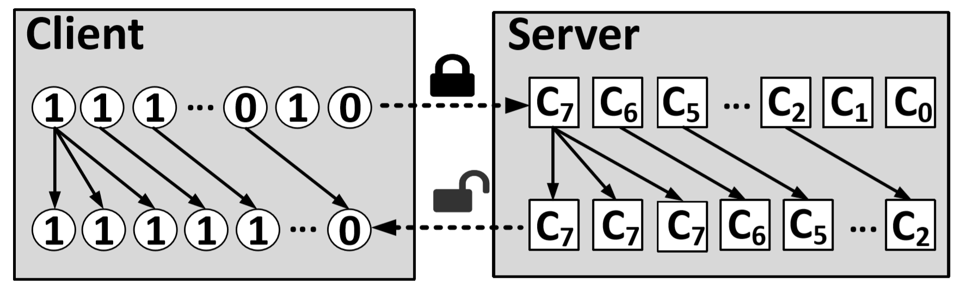
Our work SHE
SHE
Logarithmic Quantization: Convolution to Shift-Accumulation → Fast
Very Cheap shift operations

Slide 13
Thank you!
Notes:
We propose 3DICT to improve CNN test performance, provide QoS support and enlarge endurance of system.

