Slide 1



How to use Code Composer Studio to program CLOSED LOOP CONTROL on the TI Microprocessor CODING The Stack
EGN 1007

Slide 2

Download CCS
You can download CCS from the TI website
https://www.ti.com/tool/CCSTUDIO#downloads
Next, select the "CCSSTUDIO" option by clicking on the RED 'Download options' button. Do NOT select the 'THEIA' version.
You should now see the page shown on the next slide.

Slide 3
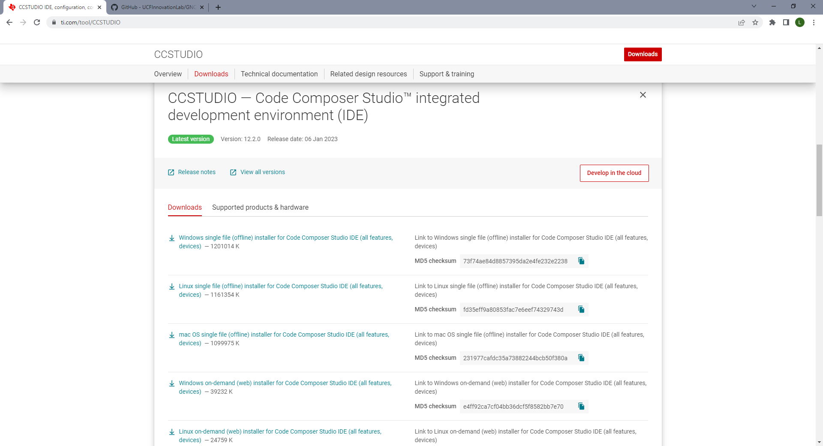
CONTENTS OF THIS TEMPLATE
This is a slide structure based on an educational presentation
You can delete this slide when you’re done editing the presentation
FONTS | To view this template correctly in PowerPoint, download and install the fonts we used
USED AND ALTERNATIVE RESOURCES | An assortment of graphic resources that are suitable for use in this presentation
THANKS SLIDE | You must keep it so that proper credits for our design are given
COLORS | All the colors used in this presentation
INFOGRAPHIC RESOURCES | These can be used in the template, and their size and color can be edited
CUSTOMIZABLE ICONS | They are sorted by theme so you can use them in all kinds of presentations
For more info: SLIDESGO | SLIDESGO SCHOOL | FAQS
You can visit our sister projects: FREEPIK | FLATICON | STORYSET | WEPIK | VIDFY

Slide 4
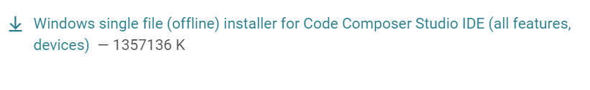
Select this option (below) on the TI page
Download this file – it may take 4 to 5 minutes for this file to download. Next, right click on the folder/file (that appears in your Downloads),
and hit "Extract all"
then click 'ccs_setup'

Slide 5
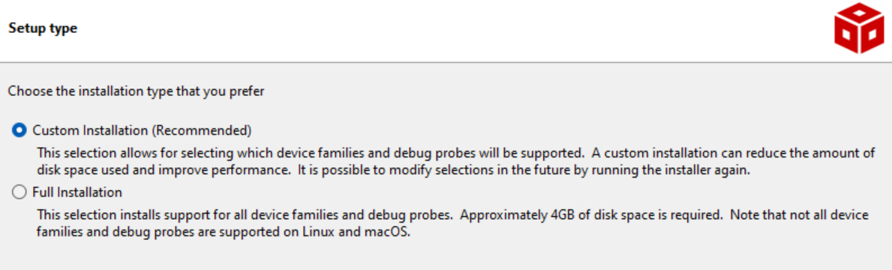
Move through prompts w/ 'Next' and ACCEPT "Default installation directory"
Also select the option shown below:

Slide 6
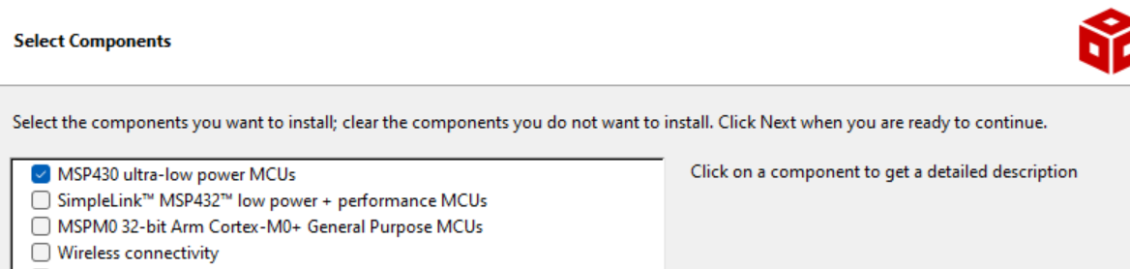
Now select the MSP430 component (as shown below)
Depending on your laptop, this could take a LONG TIME to load (30 minutes?)

Slide 7
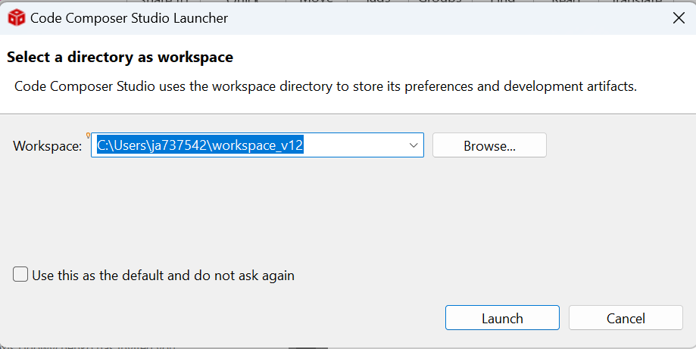
Select Default Workspace Directory and click 'Launch'

Slide 8
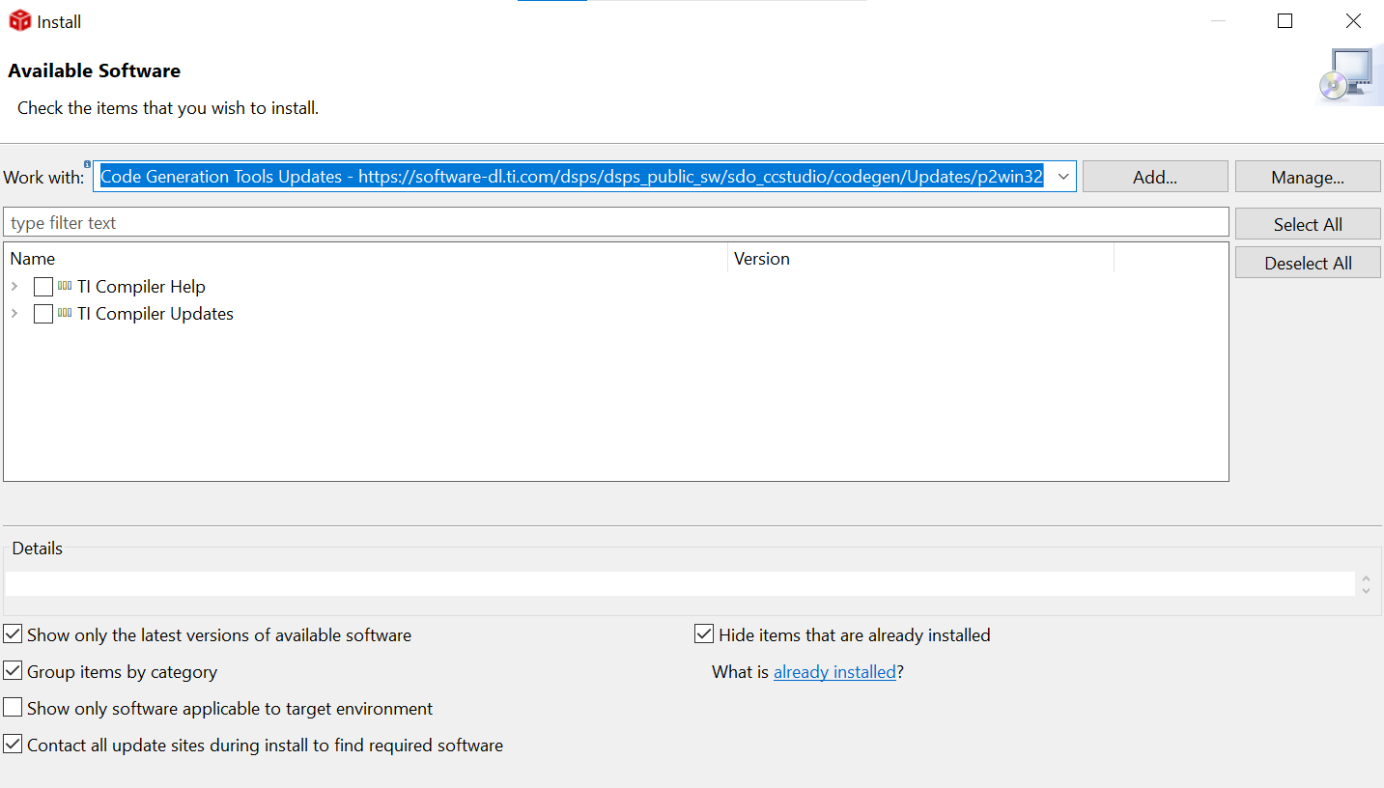
Update the libraries
The GNOR library code was made on version 4.4.5 of Code Composer Studio. As a result, we need to update our software to the 4.4.5 version:
In CCS, go to "Help", then select "Install New Software..."
You should then see the following screen and select
"Code Generation Tools Update" as shown in blue:

Slide 9
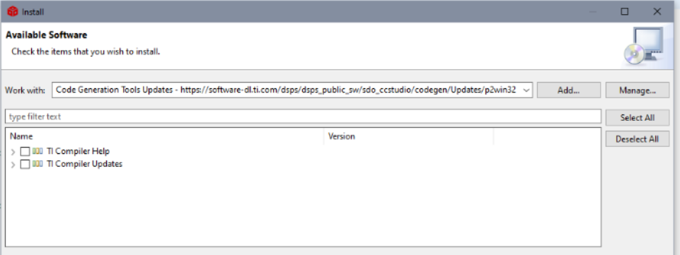
Update the libraries – cont.
Next, OPEN the "TI Compiler Updates" drop down

Slide 10
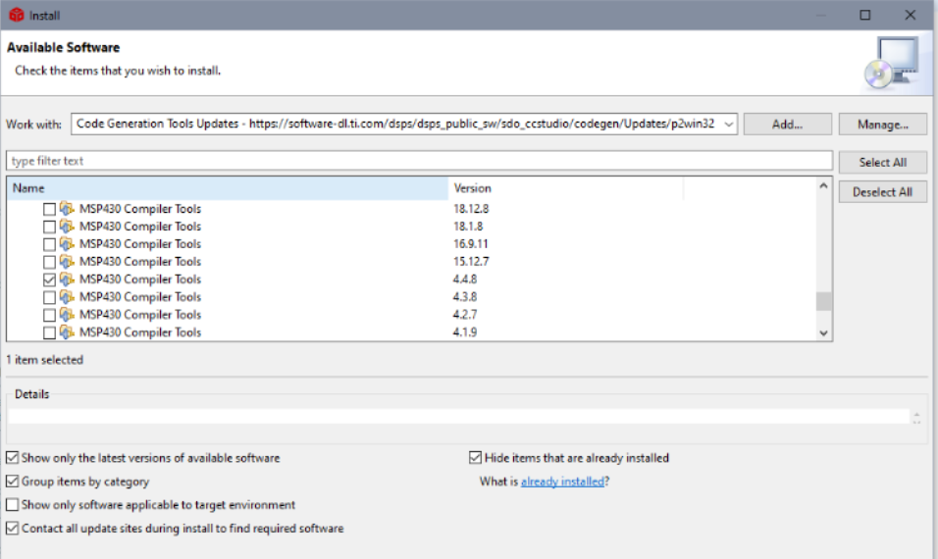
Update the libraries – cont.
Now, select the "MSP430 compiler tool for 4.4.8"
(This operation may take a little time for the download to complete)

Slide 11
Download the code from github
Go to: https://github.com/UCFInnovationLab/GNOR
As shown on next slide -
Click on "< > Code" (green button),
Then when the next option appears,
Select "Download zip"

Slide 12
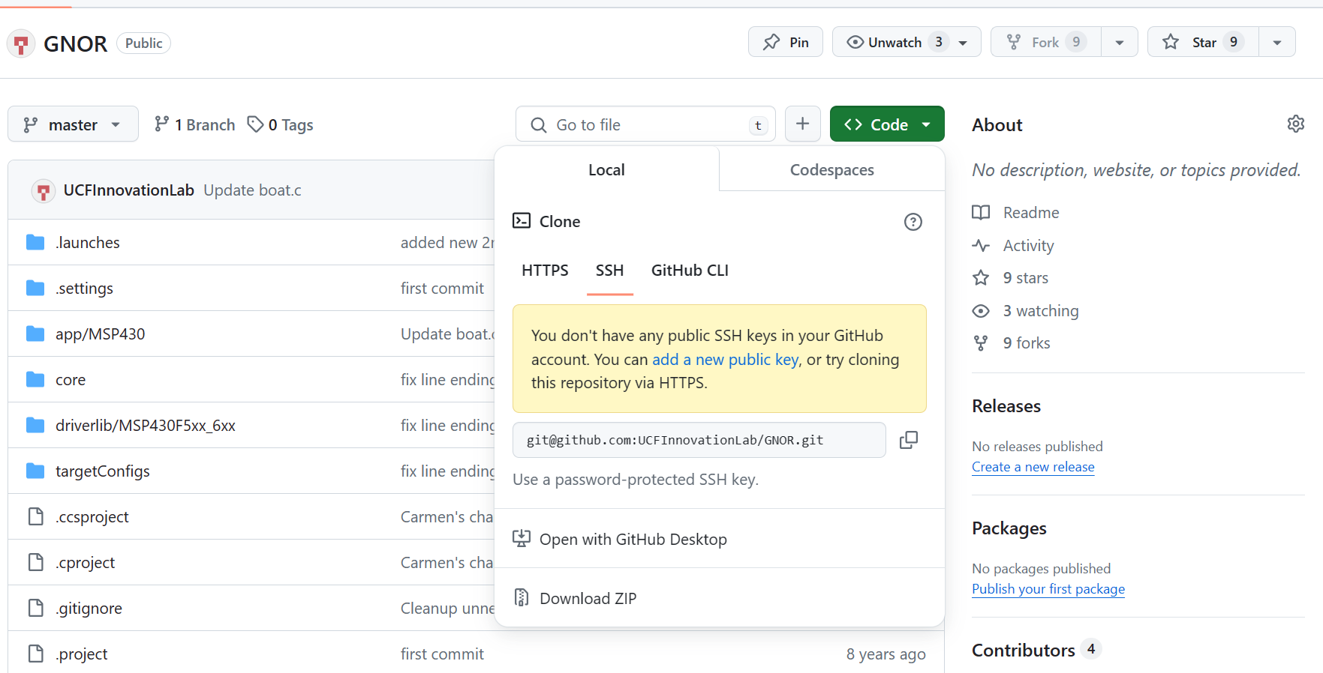

Slide 13
Upload the GNOR code to CCS
Once you have downloaded the GNOR zip file, you need to extract the zip file
and import it into the CCS.
Go to CCS, select 'File', 'Import'.
Next, click 'Select an import wizard',
Then in the Code Composer Studio file tab,
Select 'CCS Projects' (see next slide)

Slide 14
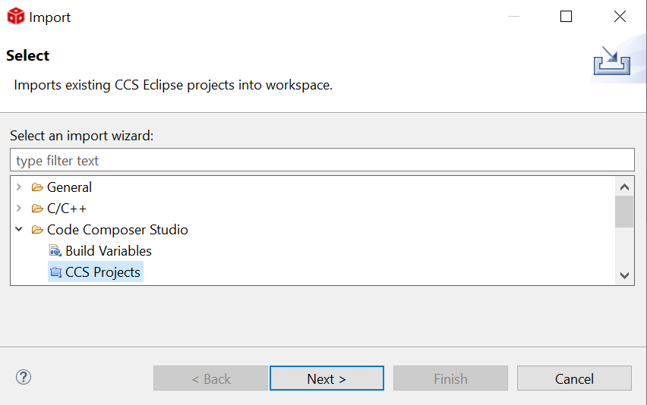

Slide 15
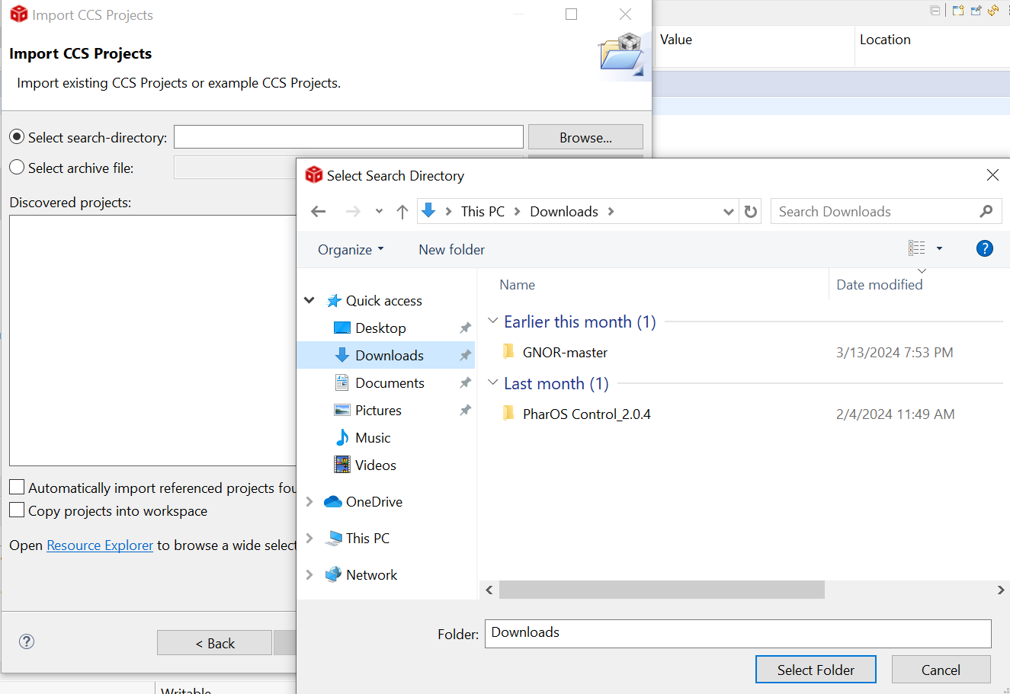
On Import CCS Projects page, see 'Select search-directory' and click 'Browse'.
On the Select Search Directory page, click 'Downloads' then click on the "GNOR-master" file, then hit the 'Select Folder' button. (see below)

Slide 16
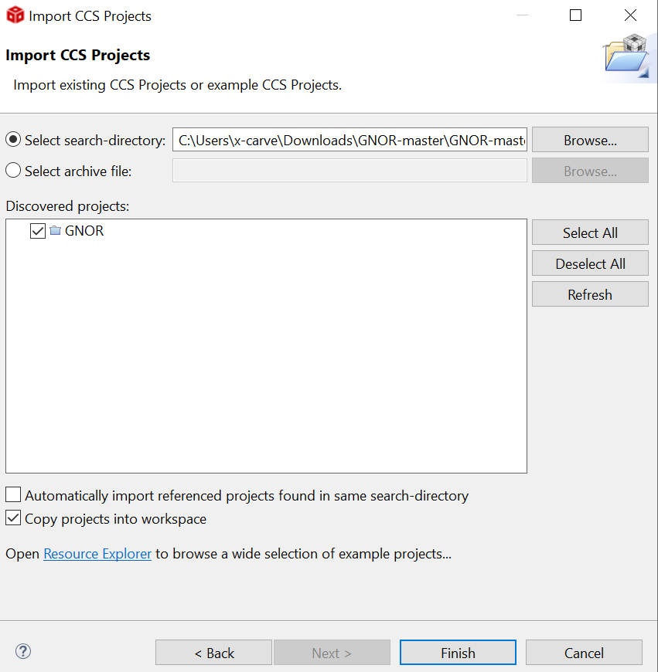
Click (add a check mark) to the "Copy projects into a workspace" option at the bottom of the page.
The GNOR folder should also have a check mark.
Now click on the 'Finish ' button

Slide 17
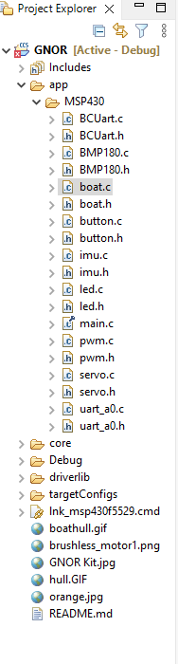
Edit the Code
Once the updates are done, you are ready to edit the code.
In the feature tree on the left,
open GNOR,
then app,
then MSP430.
then boat.c At line 148 you will find where the code lines begin that require editing - per the righthand comments (in green). Edit this code (see next slide) based on the guidance course your team planned for your vessel's race.

Slide 18
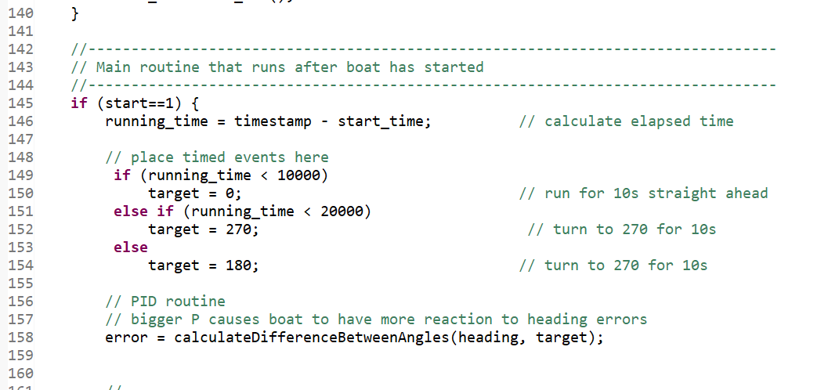

Slide 19
Upload the code into the PCBs stack
FIRST, verify that the stack is DISCONNECTED from the boat battery BEFORE uploading the code.
Then, plug the stack to the PCB and
upload the code.

